Slide 1
Unsupervised Machine Learning in Python using Scikit-learn
Data Science Skills Series
Márcio Mourão
https://marcio-mourao.github.io

Slide 2
Outline
Brief introduction to Machine Learning
Unsupervised and supervised learning
Principal Component Analysis (PCA)
Review the methodology
How to use Python & Scikit-learn to apply the methodology
K-Means
Review the methodology
How to use Python & Scikit-learn to apply the methodology

Slide 3
What is Machine Learning (ML)?
A branch of artificial intelligence, concerned with the design and development of algorithms that allow computers to evolve behaviors based on empirical data.
As intelligence requires knowledge, it is necessary for the computers to acquire knowledge.

Slide 4
What is Machine Learning (ML)?
Traditional Programming
Machine Learning
Data
Computer
Output
Program
Data
Computer
Program
Output

Slide 5


Some algorithms
Unsupervised learning ( )
Dimensionality reduction
Clustering
Supervised learning ( )
Decision tree induction
Rule induction
Instance-based learning
Bayesian learning
Neural networks
Support vector machines
Model ensembles
Learning theory

Slide 6
Principal Component Analysis (PCA)

Slide 7
Summarization of data with many (p) variables by a smaller set of (k) derived (synthetic, composite) variables.
p
k
A
X
n
n

Slide 8
Geometric Rationale of PCA
The goal of PCA is to rigidly rotate the axes of this p-dimensional space to new positions (principal axes) that have the following properties:
The axis are ordered such that principal axis 1 has the highest variance, axis 2 has the next highest variance, .... , and axis p has the lowest variance
The covariance among each pair of the principal axes is zero (the principal axes are uncorrelated).

Slide 9
PCA Example (in 2D)
Variables X₁ and X₂ have positive covariance
Each variable has a similar variance

Slide 10
PCA Example (in 2D)
PC 1
Variables X₁ and X₂ have positive covariance
Each variable has a similar variance
PC 2

Slide 11
PCA Example (in 2D)
PC 1 has the highest possible variance (9.88)
PC 2 has a variance of (3.03)
PC 1 and PC 2 have zero covariance.

Slide 12
A summary of the PCA approach
Standardize the data
Obtain eigenvectors and eigenvalues from the covariance matrix or correlation matrix, or perform Singular Vector Decomposition
Sort eigenvalues in descending order and choose the k eigenvectors that correspond to the k largest eigenvalues where k is the number of dimensions of the new feature subspace (k ≤ p)
Construct the projection matrix W from the selected k eigenvectors
Transform the original dataset X via W to obtain a k-dimensional feature subspace Y.

Slide 13
Some features
Assumes relationships among variables are linear
cloud of points in p-dimensional space has linear dimensions that can be effectively summarized by the principal axes
if the structure in the data is nonlinear, the principal axes will not be an efficient and informative summary of the data.

Slide 14
PCA in Python
Sklearn.decomposition.PCA is the class that implements PCA in Scikit-learn.
Documentation is available at http://scikit-learn.org/stable/modules/generated/sklearn.decomposition.PCA.html
Key options:
n_components (default is the min(n_samples, n_features))
svd_solver (default ‘auto’): The default solver
Outputs:
components_: Principal axes in feature space, representing the directions of maximum variance in the data
explained_variance_ratio_: Percentage of variance explained by each of the selected components.

Slide 15
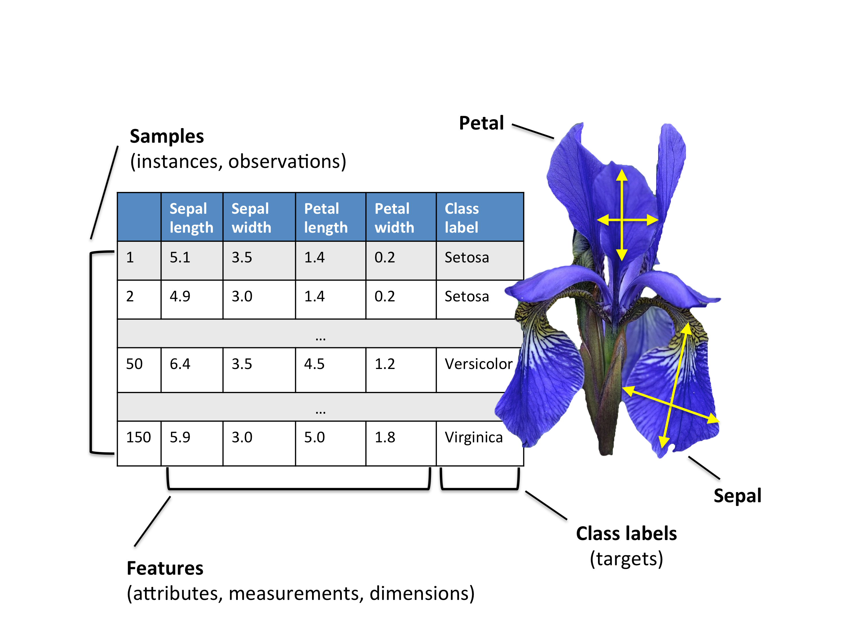
The Iris dataset
This data sets consists of 3 different types of irises’ (Setosa, Versicolour, and Virginica) based on four attributes
The data is stored in a 150x4 numpy.ndarray, the rows being the samples and the columns being: Sepal Length, Sepal Width, Petal Length and Petal Width

Slide 16
K-Means

Slide 17
K-Means problem
Partitioning Clustering Approach
Learn a partition on a data set to produce several non-empty clusters
Optimal partition achieved via minimizing the sum of squared distance to its “representative object” in each cluster
e.g., Euclidean distance

Slide 18
Lloyd’s algorithm
Given a set of data points as input
Randomly assign each point to one of the k clusters
Repeat until convergence
2.1 Calculate model (center) of each of the k clusters
2.2 Assign each point to the cluster with the closest model (center)

Slide 19
K-Means example (in 2D)

Slide 20
K-Means example (in 2D)
1. Randomly assign each point to one of the k clusters (assume k=3)

Slide 21
K-Means example (in 2D)
2.1 Calculate center of each cluster

Slide 22
K-Means example (in 2D)
2.1 Calculate center of each cluster

Slide 23
K-Means example (in 2D)
2.1 Calculate center of each cluster

Slide 24
K-Means example (in 2D)
2.2 Assign each point to closest cluster center

Slide 25
K-Means example (in 2D)
2.1 Calculate center of each cluster

Slide 26
K-Means example (in 2D)
2.1 Calculate center of each cluster

Slide 27
K-Means example (in 2D)
2.1 Calculate center of each cluster

Slide 28
K-Means example (in 2D)
2.2 Assign each point to closest cluster center

Slide 29
K-Means example (in 2D)
2.1 Calculate center of each cluster

Slide 30
K-Means example (in 2D)
2.1 Calculate center of each cluster

Slide 31
K-Means example (in 2D)
2.1 Calculate center of each cluster

Slide 32
K-Means example (in 2D)
2.2 Assign each point to closest cluster center (no changes)
We have reached convergence

Slide 33
Some features
Relatively efficient: O(tkn), where n is # objects, k is # clusters, and t is # iterations. Normally, k, t << n
Often terminates at a local optimum. It is good to restart it several times
Applicable only when mean is defined
Need to specify k, the number of clusters, in advance

Slide 34
K-Means in Python
Sklearn.cluster.Kmeans is the class that implements Kmeans clustering in Scikit-learn.
Documentation is available at http://scikit-learn.org/stable/modules/generated/sklearn.cluster.KMeans.html
Key options:
n_clusters (default 8)
n_init (default 10): The number of times to run the algorithm with different centroid seeds
init (default “k-means++”, other possible values “random” or an ndarray): Methods of initialization for cluster centers
Outputs:
cluster_centers_: Coordinates of the cluster centers
labels_: Cluster classification for the observations
inertia_: The sum of the squares of distances from the samples to their closest cluster center

Slide 35
Measuring Clustering Effectiveness
If we don’t know the true labels, then we will evaluate the clustering in terms of distances:
Inertia
Silhouette coefficient: the mean value of (b-a) / max (a , b) where:
a is the mean distance between a sample and all other points in the same class
b is the mean distance between a sample and all other points in the next nearest cluster
Calinsky-Harabasz index: the ratio of the overall between-clusters variance to the overall within-cluster variance.
Documentation is available at http://scikit-learn.org/stable/modules/clustering.html#clustering-evaluation

Slide 36

Handwritten Digits Dataset
The dataset contains images of handwritten digits: 10 classes where each class is one digit from 0 to 9.
The attributes consist of an 8x8 image of integer pixels in the range 0..16.
The data is stored in a 1797x64 numpy.ndarray, the rows being the samples and the columns being the 64 attributes.

Slide 37
References
http://scikit-learn.org/
http://sebastianraschka.com/Articles/2015_pca_in_3_steps.html
http://cs.wellesley.edu/~cs315/315_PPTs/...L17-Clustering/k-Means-Clustering-Example.ppt
https://cs.brown.edu/courses/cs143/lectures/17.ppt

