Slide 1



Thesis - planning
Behind schedule
was sick during Christmas break unfortunately…
…and Nvidia doesn’t like me…
… but I just fixed Isaac ROS yesterday evening
Next step: get MAVROS working ☺
Side thing: when Erik is back I might want to setup IsaacROS again with him, not exactly sure why my current setup is working…
Notes:
Line spacing + Page numbers

Slide 2
Thesis – focus/novelty
Branch detection – sensors to detect them close at hand/cheaply
Branch detection – ML based (needs dataset and training)
Vertical perching against a tree trunk
Ideally, get perching fully autonomous outdoors, but maybe too much → VIO, obstacle avoidance + perching needed
Getting closer to real perching, leaves etc.
Notes:
Line spacing + Page numbers

Slide 3
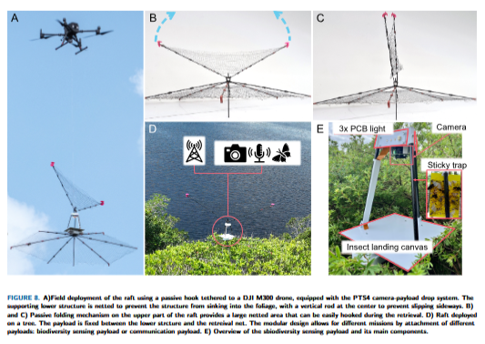
Others
xPrize – figure → someone (I think Stefano) changed it to this one, ok?
xPrize – reimbursement
xPrize PTS4 in Zurich
Literature Study – should I do anything (send to Xavier)?

