Slide 1
Agenda
1 – LiteratureStudy → Thesis kickoff decisions
2 – xPrize (quick)

Slide 2
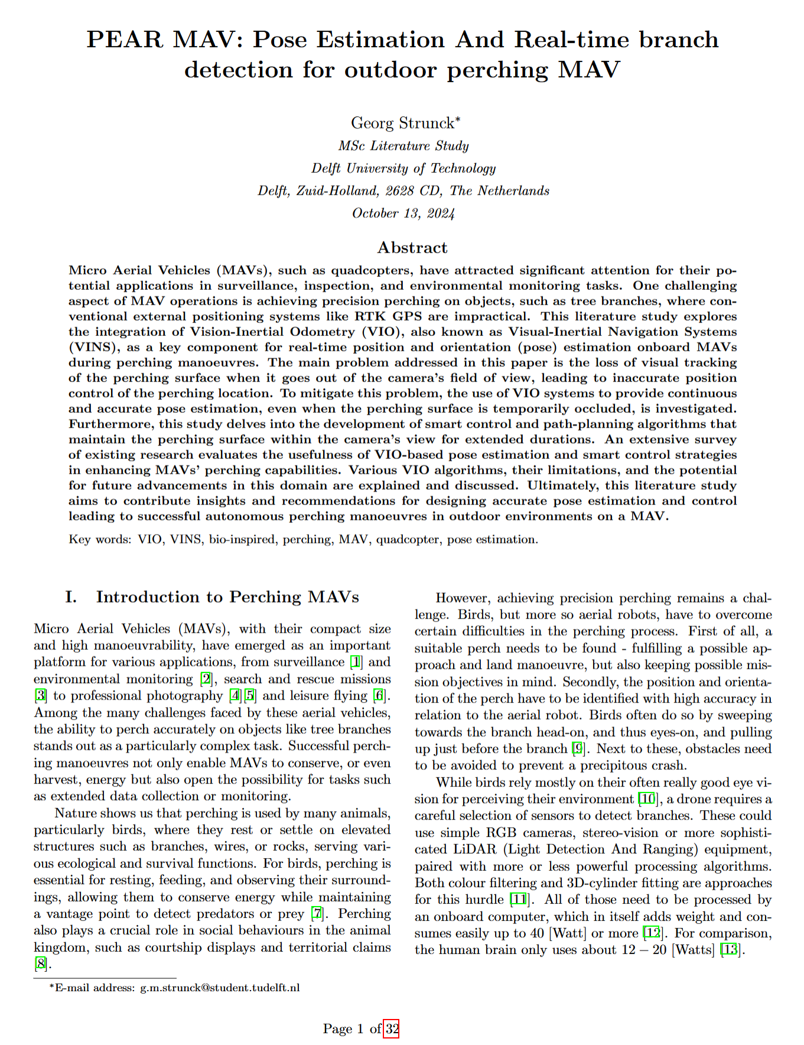
Literature Study --> Thesis PEAR – MAV Pose Estimation And Real-time branch detection for outdoor perching MAV
Need to write pipeline (ROS2, attitude (no position) control) --> requires own control (MINCO vs PID)
Based on that a few decisions/tasks (see next slide):
Adding VIO/accurate onboard pose estimation
Improving branch detection (higher versatility + accuracy + speed)
Notes:
Line spacing + Page numbers

Slide 3
Thesis - Discussion
Adding VIO/accurate onboard pose estimation
Implement existing VIO (Orbslam or VSLAM, foundationpose)
Completely new, optimized for forest environments
ZED stereo camera (includes different options for lightning, VIO)
Branch detection:
Reimplement Seamus work
Create new PERCH (vs. BRANCH) detection… own ML? Stefanos branch prediction? Additional sensors!
Notes:
Line spacing + Page numbers

Slide 4
Thesis - Discussion
Controller: MINCO vs PID --> would make that dependent on how much Liming can help with MINCO
Simulation: I strongly prefer “real” simulation (walk in the forest, compare to optitrack, record rosbags), most can be tested without props I spent 2 weeks trying to get AvoidBench simulation working without success, similar experience from others
New Hardware (buy or existing?): - ZED stereo cam (570€) (outputs pose + improved lighting over realsense) - Orin NX onboard computer (640€ + ca 200€ carrier board) → allows newer sped up pose estimation libraries - rangefinders or small rgb/infrared cameras ( not sure, assume around 200€ maybe less)
Notes:
Line spacing + Page numbers

Slide 5
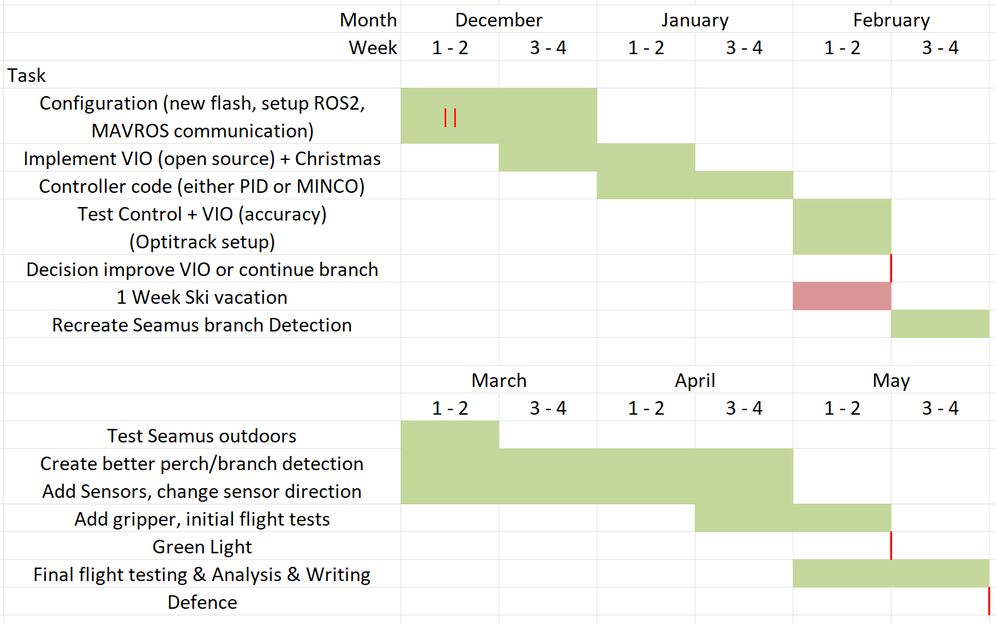
Thesis - Planning
Notes:
Line spacing + Page numbers

Slide 6
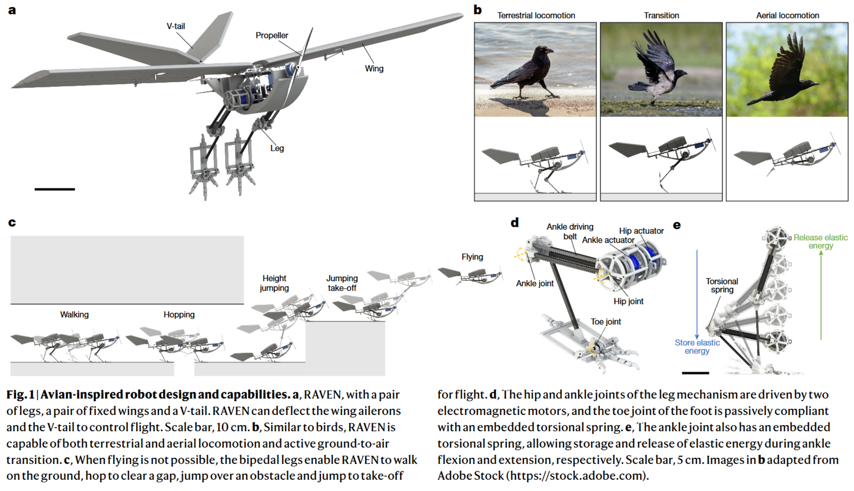
Article – side note
Fast ground-to-air transition with avian-inspired multifunctional legs https://doi.org/10.1038/s41586-024-08228-9
Notes:
Line spacing + Page numbers

Slide 7
xPrize
0.0
Reimbursement for materials 691.91€ still open
Hardware what to do with it? PTS4 in Zurich, take it back?
Paper, in touch with Christian, wait for Frederik to add part then shorten more

Slide 8
Takeaways
0.0
Thesis: - know what is novel about my research… - greenlight 6 weeks/2 months in advance, afterwards no serious testing anymore
xPrize: - reimbursement get Saluas laptop - paper, make figure better, in power point, share with Salua

