Slide 1
Delivering customer insights for online food orders
Dimitra Georgakaki

Slide 2
OUTLINE
Data exploration
Data model selection
Running the solution as a web-app
Further Improvements

Slide 3
Data exploration using BigQuery
The data exploration part of the use case can be easily implemented directly in the BigQuery application using SQL queries, so that the data processing steps can then be programmed in the codebase using pandas dataframe manipulations.
Summary of Important insights
There exist 122919 unique customers in our dataset and only 114251 out of them have a previous order history, tagged as returning visitors. We are going to perform our analysis only on returning customers.
The payment method that customers use is almost equally divided among cash and not cash.
The fraction of the customers that use coupons to order is much smaller than those who do not use coupons.
Over 50% of the customers are located in Athens.
97% of the revenues come from restaurant orders.
Coffees and souvlaki orders represent more than 50% of the total orders.
Coffees, souvlaki and pizza are associated with more earnings so customers that tend to like/order these cuisines are associated with more value for efood.
There is a direct correlation between the total_order_value and the num_items_ordered.
Plotting the total number of unique customers per day, the total number of orders per day and the total earnings per day, we can see the same trend in the data (qualitatively), which means that the aforementioned features are correlated. Moreover, there is a weekly trend which is apparent in all the aforementioned timeseries.
The lowest peak regarding orders/sales happened on 16 February 2019.
The weekly trend in the data is a good indication that we can use the LSTM method for the demand forecasting of the last two weeks in March.

Slide 4
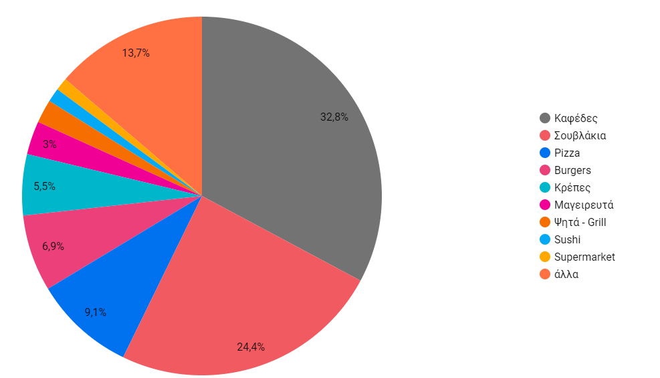
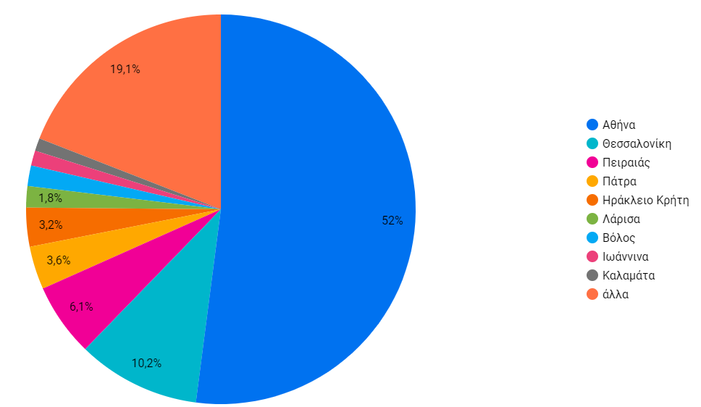
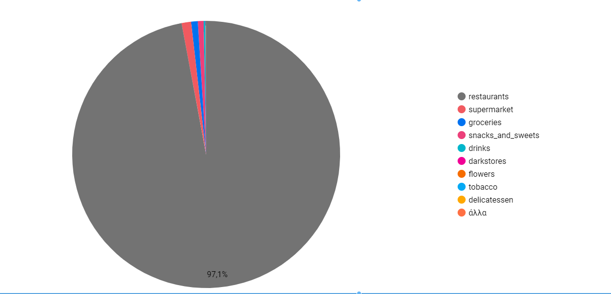
Grouping of orders
cuisine
Location
vertical

Slide 5
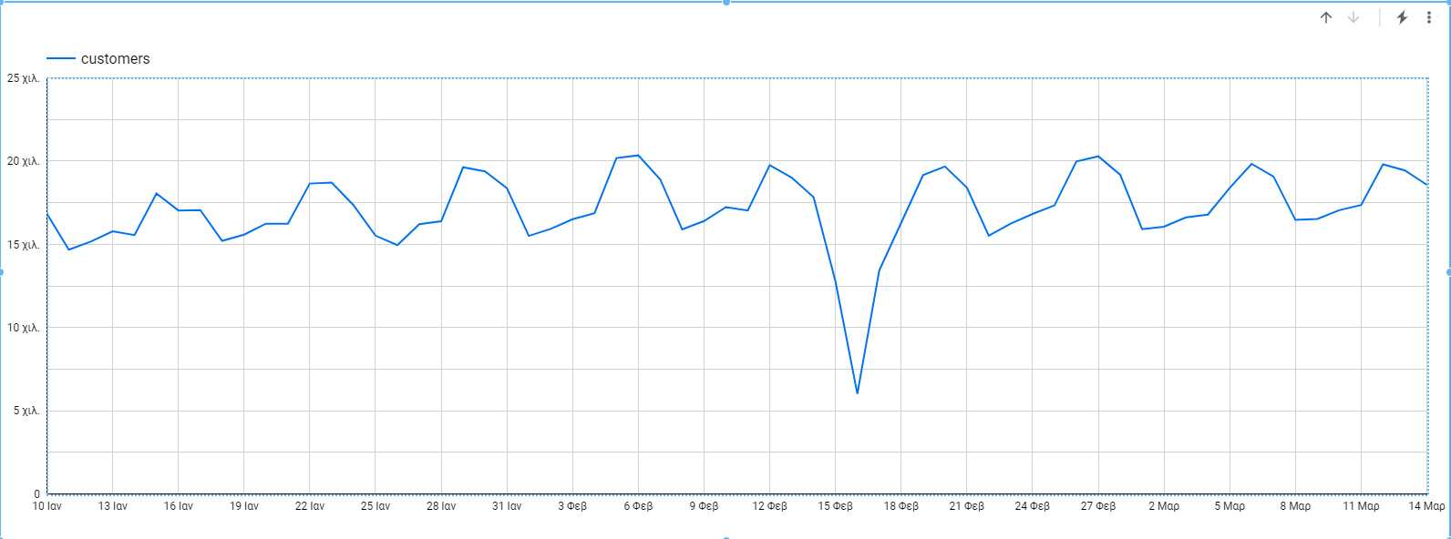
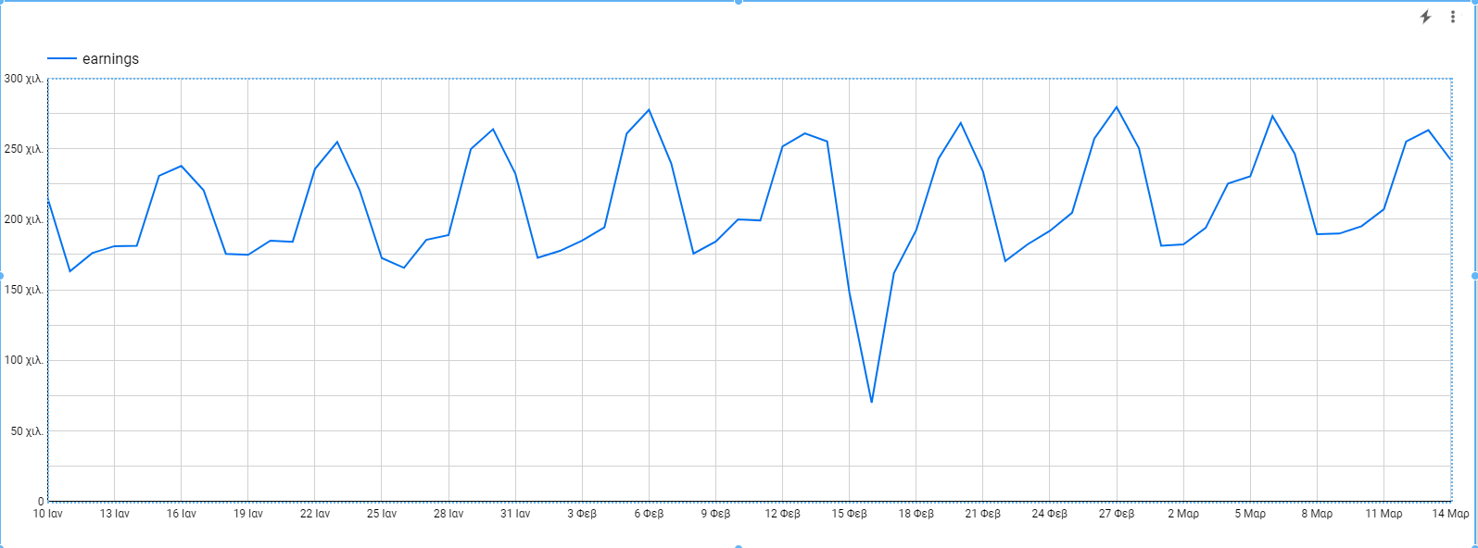
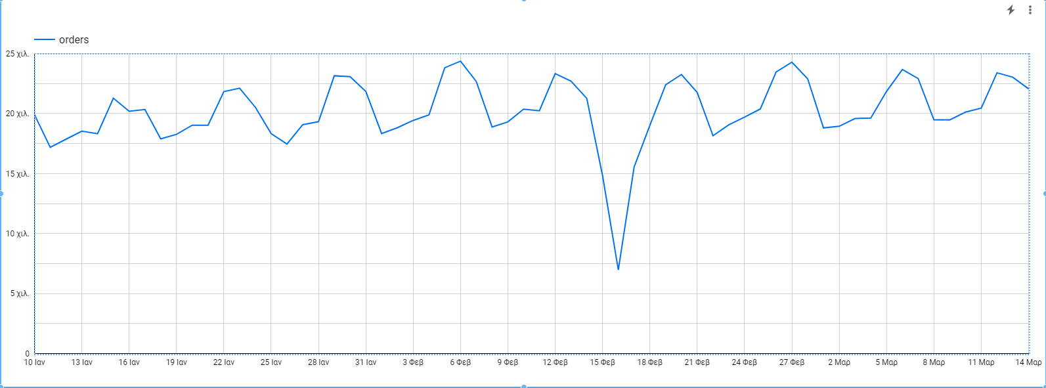
Similar Trends between total customers per day, total earnings per day, total orders per day

Slide 6
Data model selection
From the data insights presented we decided to use LSTM.
Preprocessing steps:
Check for duplicate entries and if any remove duplicates.
Keep the customers that are of type returning which means that they do have an order history.
Drop the columns that are not candidates for important features in the model.
Transform the x-column to date format (lose the hours, minutes, seconds)
Add one more feature regarding if it is a weekday or weekend.
Produce a dataset for the LSTM model with 4 columns: date, grouped total orders per day, grouped sum of earnings per day, weekday/weekend.
Initially we have trained a generalized model based on the total amount of orders per day, and another one on the total earnings per day. These models look back at 7 days and predict the next 7 days. This was chosen after we have observed in the data exploration phase the 7-day periodicity in the data.
Due to the stochastic nature of the model the MAPE results ranged from:
Orders: 0.104 - 0.138
Order_values: 0.149 - 0.178

Slide 7
Data model details
The LSTM layer expects input to be in a matrix with the dimensions: [samples, time steps, features].
We have used -> [length of the training set, 7 steps in the past, 7 features (1 for each day)]
The basic model parameters are batch_size, epochs and number of neurons.
We have used batch_size = 1 as we are interested in making one-step forecasts on the test data. This imitates the real test case where the sum / count each day is available at the end of the day to be used for the next day.
The number of epochs improved the MAPE score . We experimented with 1000, 2000, 3000 but it can further improve at the cost of computational speed.
Increasing the number of neurons actually had a negative impact on the MAPE score so we kept it as 50.
We have tested 2 different optimizers Adam and Relu, Adam performed better so we proceeded with that.
Data were scaled between [0,1].

Slide 8
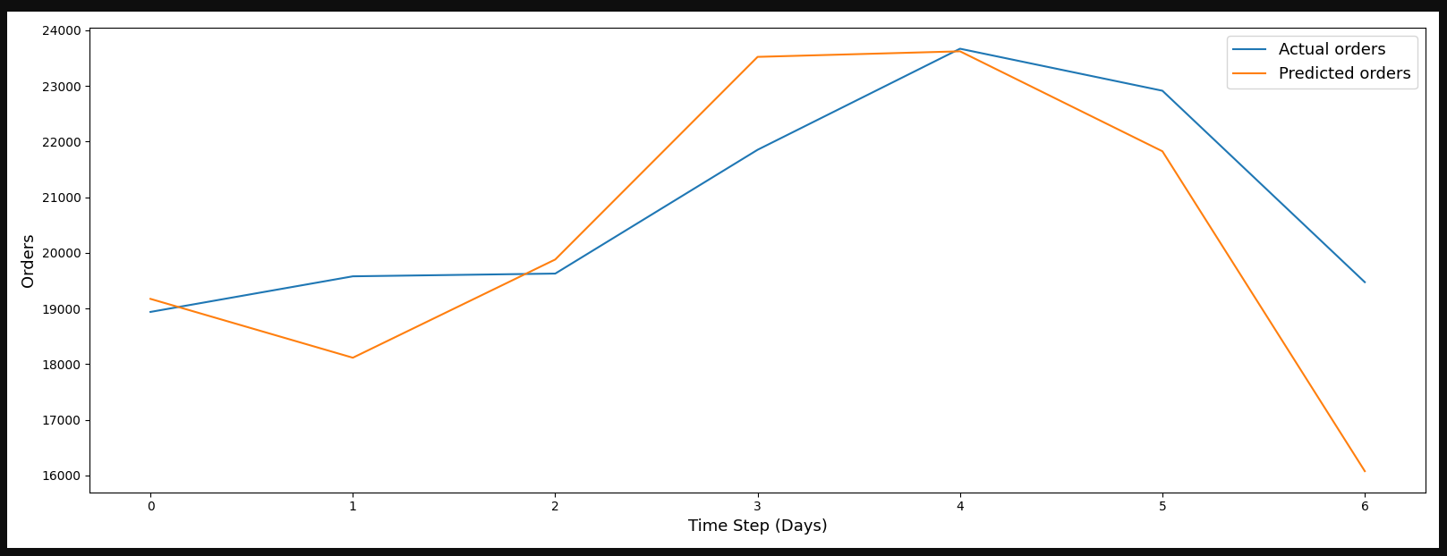
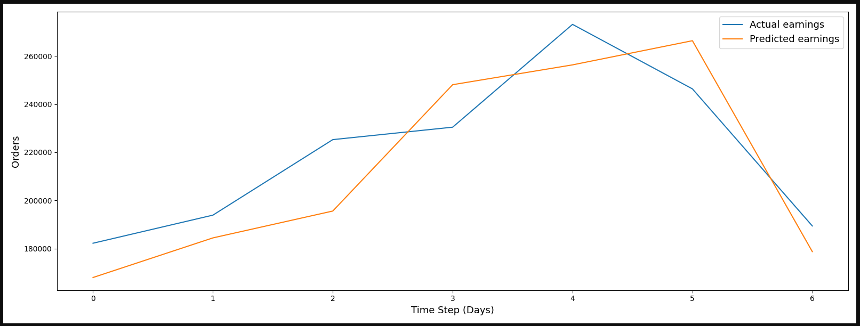
Test Results on actual data after training

Slide 9
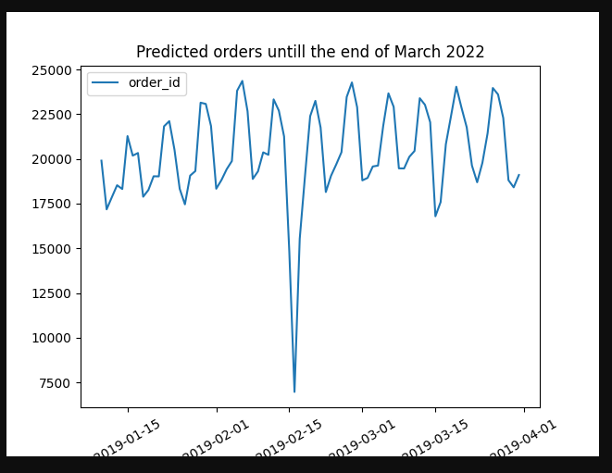
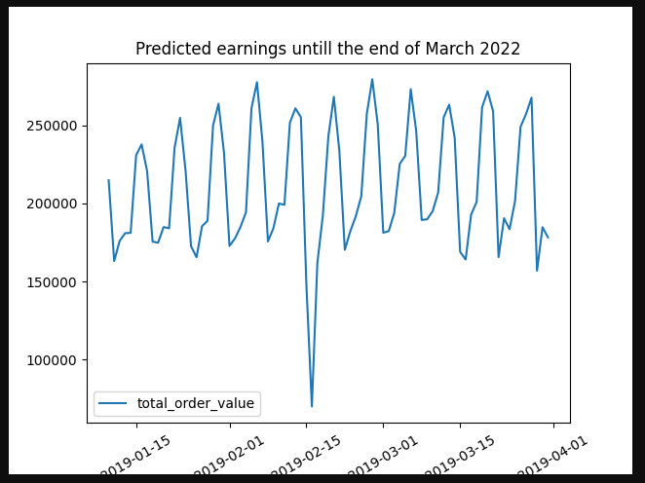
Predictions of grouped values untill end of March 2019

Slide 10
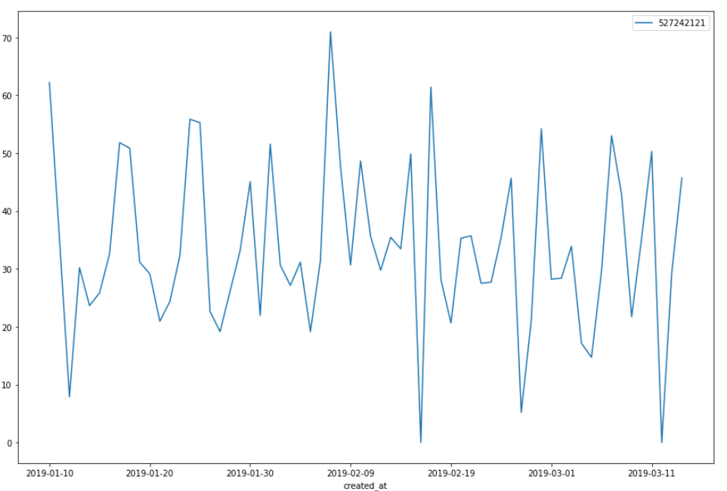
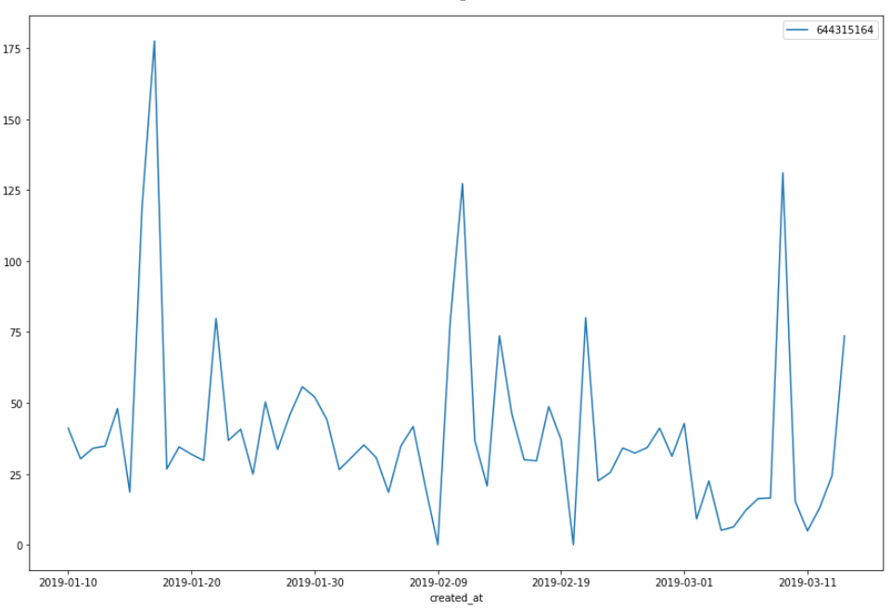
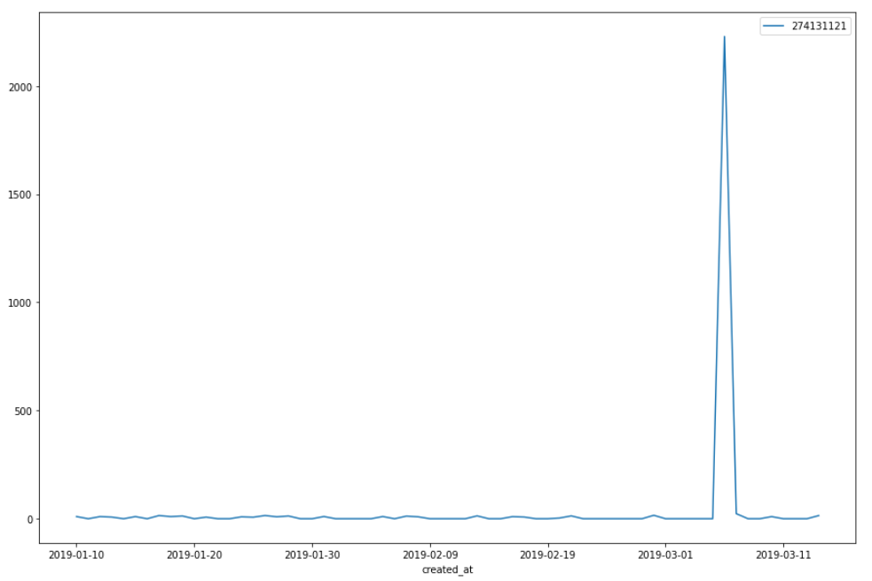
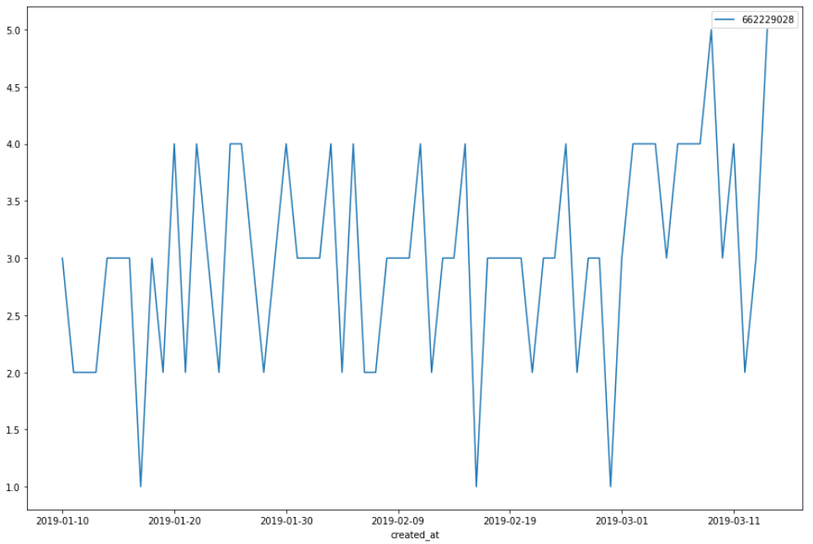
Selected customers (top 10 spenders / top 10 orderers)
Some results:
{"customer_id_orders":"662229028", "total_predicted_orders": 73, "customer_id_values": "993537497", "total_predicted_values": 2198.388}
The customer profiles can show different behavior!! We can even have the extreme case of one major order at one single day!

Slide 11
Running the solution as a web-app
The environment used was Python 3.8.10. The same code can be built and run with docker (the image uses python 3.8 version).
We have chosen to implement the solution as a Django web-app to demonstrate the extensibility of the solution. A frontend application can easily be added to our Django backend, to provide a customized dashboard to the end-user.
Results can easily be seen on a browser.
The training can be run as a background task (using cron, celery or huey) at regular intervals (e.g. once per night).
Databases can be easily added to our solution.
Performance optimizations can be done using dask or spark.
Code refactoring is always an ongoing task, so our codebase is a work in progress. We can easily avoid code duplications and also re-write our code using class-based views. We can add more error handling.

Slide 12
Further Improvements
For the generalized model, try more features in the LSTM models like weekday/weekend.
Try more hyperparameter tuning.
Instead of treating the problem as a generalized model over all the customer portfolio, try an approach similar to seq2seq prediction using e.g. top N customers or customer profiles created from an automated clustering method.
Try clustering methods for better customer segmentation according to city, cuisine and vertical, as these features were not accounted for in our analysis. These methods could classify a new customer as a high/mid/low spender or a high/mid/low orderer (or more complex categories) and different models could explain different customer behavior.

