Slide 1

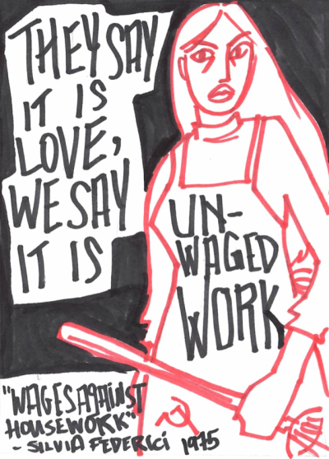

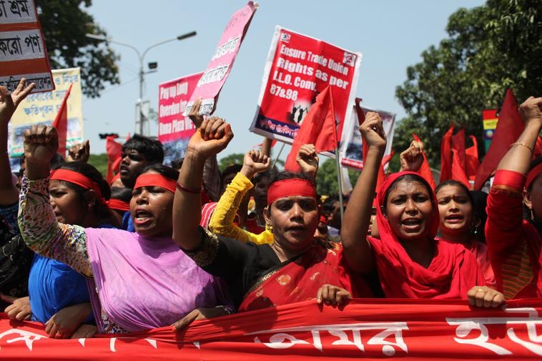
Feminist Philosophy of Work
Prof. Dr. Mirjam Müller
Summer Term 2022

Slide 2
Teacher
Prof. Dr. Mirjam Müller (she/her), Junior-Professor for Feminist Philosophy, mirjam.mueller@hu-berlin.de
Office Hours
Thursday 2-3.30 pm. Please make an appointment here: https://app.acuityscheduling.com/schedule.php?owner=20934359

Slide 3
Today
Overview over class format and credits
Brief introduction to the topic: group work
Seminar outline

Slide 4
Important!!
To participate in this class you will have to register on AGNES: https://agnes.hu-berlin.de/lupo/rds?state=verpublish&status=init&vmfile=no&publishid=193553&moduleCall=webInfo&publishConfFile=webInfo&publishSubDir=veranstaltung
Registration will be open from Thursday 21.04 until Thursday 28.04
You can only participate in this seminar if you are registered and accepted (Status ‘ZU’) on Agnes

Slide 5
Credits (Leistungspunkte)
Active participation:
Hand in one response paper:
Write one short response papers (1-2 pages) that responds to one seminar reading
The response paper should focus on one aspect/argument of the reading, briefly summarize it, and critically engage with it.
Deadline for submission: Thursday, 2. June via Moodle
Group work on one case study:
Each group of about 5 members picks one of the case studies in the syllabus (or suggests their own) and discusses the philosophical issues raised by it
The outcome of your discussion should be documented in some audio-visual form (poster, video, podcast, Zine…)

Slide 6
Credits (Leistungspunkte)
Modulabschlussprüfung (MAP):
Graded paper (Hausarbeit):
If you want to write a graded paper (Hausarbeit), you need to hand in a short exposé (1/2 - 1 page) detailing your research question and outline of the paper by Thursday, 14.07.22
Deadline: Friday 30.09.2022. Submission via Moodle
Oral exam (note, this option is limited to some modules)
Date: Mid October (please email me to confirm the date)
20 min exam that involves: (1) Handing in a 1-2 p outline of a research question + theses, (2) 5 min presentation, (3) questions on the outline and presentation

Slide 7
2.
Introduction to the topic

Slide 8
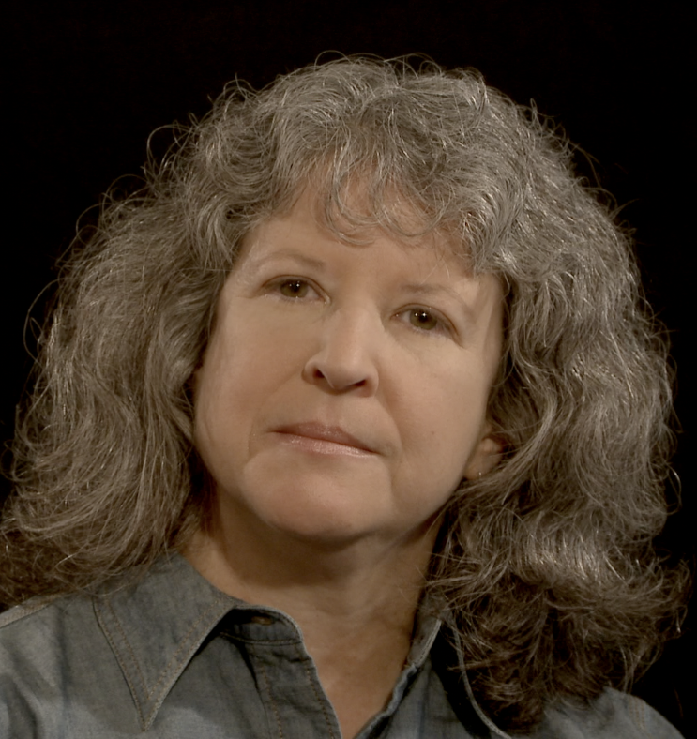
The Centrality of Work
In contemporary capitalist societies wage labour plays a central role in organizing access to economic resources like income, health insurance, pensions. It also provides access to a number of social goods, including recognition, community, or self-realization.
“Work is the primary means by which individuals are integrated not only into the economic system, but also into social, political and familial modes of cooperation.”
Kathi Weeks

Slide 9
Philosophical perspectives on work
What is work? What isn’t?
Why is that distinction useful (if it is)?
How is work embedded in social, political and economic structures?
Which norms govern access to work?
Who is excluded from work?
Is work good?
What are the problems with work?
Can work be transformed?
→ All of these questions raise distinct feminist concerns

Slide 10
Work from a feminist perspective?
Why is work a feminist issue?
Can you think of examples that illustrate the gendered nature of work?
What are you hoping to learn/discuss in this class?

Slide 11
3.
Seminar Outline

Slide 12
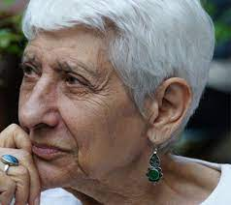
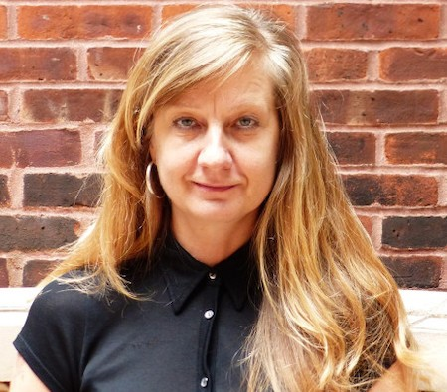
Part One. Work and the Worker
28. April: What is work?
Sabine Gürtler “The Ethical Dimension of Work: A Feminist Perspective"
Development of a feminist definition of work
Justification of a feminist definition of work
5. May: Who is a worker?
Selma James “Sex, Race and Class”
How do gender and race affect what counts as work and who gets to be a worker?
12. May: Affective labour
Johanna Oksala “Affective Labor and Feminist Politics”
What is affective labour and what is its significance in post-industrial capitalism?
In which sense is affective labour a gendered category?

Slide 13

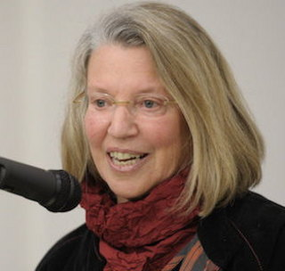
Part Two. The Problems With Work
19. May: Gendered Labour and Global Exploitation
Maeve McKeown “Sweatshop Labour as Global Structural Exploitation“
Intersectional approach to gendered and racialized labour in the global textile industry
What’s wrong with (global) exploitation?
2. June: Exploitation and Expropriation
Nancy Fraser “Expropriation and Exploitation in Racialized Capitalism”
What is the relation of exploitation, expropriation and freedom?
How does expropriation relate to processes of racial differentiation?

Slide 14
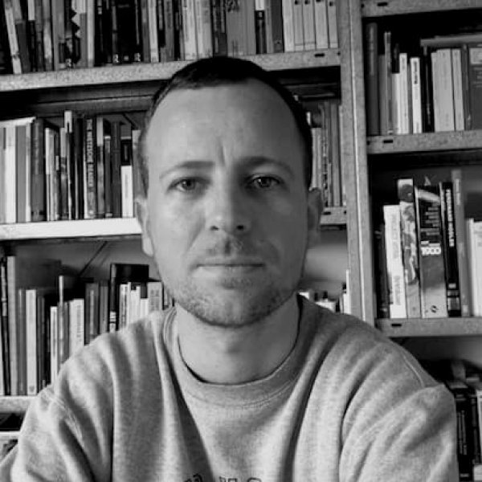
9. June: Precarity, Platform Labour and the Gig Economy
Niels van Doorn “Platform Labor: On the Gendered and Racialized Exploitation of Low-Income Service Work in the ‘on-Demand’ Economy”

Slide 15

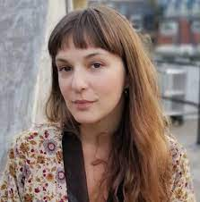
Part Three. Transformations
16. June: Automation and Technology
Helen Hester/Nick Srnicek “Love’s Labours Lost: Post-Work and Social Reproduction“
What is the relation between feminized labour and technology?
In which sense do technology and automation create new forms of gendered labour?
23. June: Socialization of Carework
Katrina Forrester “Feminist Demands and the Problem of Housework”
Socialization of carework as a demand that has transformative potential
Link between socialization debate and the politics of demand making

Slide 16
30. June: Post Work
Kathi Weeks „The Problem With Work: Feminism, Marxism, Antiwork Politics and Postwork Imaginaries“
Transformation of work vs. refusal of work
What should work‘s dominance be challenged?
7. July: No Class, alternative date
Possibility: Discussion with Amelia Horgan on her new book „Lost in Work“
Date TBC

Slide 17
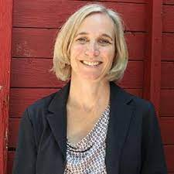

14. July: The feminist strike and collective bargaining
Susan Ferguson “The Social Reproduction Strike”
Verónica Gago “#WeStrike: Towards a Political Theory of the Feminist Strike”
What is the feminist strike?
In which sense is the feminist strike a strike of social reproduction?
How is it linked to other struggles?
21. July: Final Discussion
Presentations of group work
Information on MAPs

