Slide 1
Optimizing Java – High-Level Benchmarking
this slide intentionally left blank
Notes:
@hide slide, title;
@author Ben Evans
@thanks John Hunt;
@copyright Mallon Associates International Limited;
@tag title;
Benchmarking Java applications, as approached from the high-level, top-down viewpoint.
@tag intro;

Slide 2
Simple System Model
Incoming traffic
External
system
App
JVM
Operating system
Notes:
This represents a very simple model of the possible causes of slowness in a modern JVM-based application. The purpose of the system model is to guide the performance analyst in determining which subsystem is to blame for the dominant contribution to the observed performance problem, and suggest an approach to a more detailed analysis.
@tag simplemodel;

Slide 3
Top-Down Analysis
Consider 5 different top-level aspects of system
all can consume scarce system resources
Possible major contributor to performance issue
the “dominating consumer” of resources
Use simple heuristics to identify which is responsible
fix, then re-analyze performance
Provide examples of each system being responsible
and how to identify and fix
Notes:
@tag simplemodel;

Slide 4
External Systems
Incoming traffic
External
system
App
JVM
Operating system
Notes:
In this diagram, we will highlight each top-level component in turn, and discuss what circumstances can cause the component to have problems, as well as approaches to remedying the issue.
@tag simplemodel;

Slide 5
External Systems
Use a thread profiler to identify waiting threads
identify what these threads are waiting on
Some Common Problems
database query not performing well
poor network latency
slow SOAP / REST call not performing well
poor throughput from an RMI service
Authentication / Authorization System overwhelmed
Notes:
@tag simplemodel;

Slide 6
Fix – Code or Architecture Change
Improve the throughput of the external resource
spin up more database servers
Communicate with the external system less often
cache the results of previous calls
Interact with external system more efficiently
batch updates
coarse-grained service calls
Notes:
@tag simplemodel;

Slide 7
Operating System
Incoming traffic
External
system
App
JVM
Operating system
Notes:
@tag simplemodel;

Slide 8
Operating System
The OS can manifest a number of performance problems
Disk Read / Write Problems
slow hardware
inefficient Usage
Context Switching
OS spending too much time switching between tasks
threads contending for software lock
contention for hardware resources
Notes:
@tag simplemodel;

Slide 9
Disk Read / Write Problems
Get SSDs (if you haven’t already)
Use an in-memory cache (for read data)
Batch writes
Investigate overall usage profile
are there large spikes at particular times?
other cyclical patterns in data
outsized consumers
segregate read traffic from write
Notes:
@tag simplemodel;

Slide 10
Context Switching
Move contending processes
don’t have I/O intensive processes sharing machines
Investigate locking
intrinsic locks different from java.util.concurrent
determine which your app is using
ensure consistent locking strategy
Notes:
The difference between intrinsic locks (aka “synchronized locks”) and the Lock mechanism from java.util.concurrent is critical to understanding the context switching behavior of applications. The interested reader should consult the documentation for that package, and in particular the source code of the class AbstractQueuedSynchronizer in java.util.concurrent.locks.
@tag simplemodel;

Slide 11
JVM / GC
Incoming traffic
External
system
App
JVM
Operating system
Notes:
@tag simplemodel;

Slide 12
JVM / GC
If JVM is the source of perf problem then usually GC
occasionally other subsystems can cause bottlenecks
Solving these issues & tuning GC is non-trivial
tooling is usually essential
Use an up to date JVM
Oracle JDK 6 & 7 are EOL (& 6 is a critical PROD risk)
JDK 7 is 20-30% faster than 6 (& JDK 8 is 20% faster again)
JDK 8 has features with major performance increases
All performance-sensitive apps should be on JDK 8
Notes:
Upgrading between minor versions of the JDK may also provide significant performance upticks. E.g. the new lambda forms representation and invokedynamic improvements in 8u40 were a very significant upgrade.
@tag simplemodel;

Slide 13
Application Code
Incoming traffic
External
system
App
JVM
Operating system
Notes:
@tag simplemodel;

Slide 14
Application Code
How often is application code the cause of perf problems?
Notes:
@tag simplemodel;

Slide 15
Application Code
Usually the rarest of performance problems
regardless of what developers think
App code is true cause of slowness <10% of the time
from anecdotal experience
Don’t rush to jump in with a profiler
Measure first
using a simple top-down approach
then apply the profiler if indicated
Modern code profilers
VisualVM, JProfiler, Honest Profiler, YourKit
hprof and friends are now deprecated, will be removed
Notes:
Application developers are most familiar with their code, so it is natural that they will think the part they understand and control is the likely source of any problems. The top-down approach is discussed in the following section.
@tag simplemodel;

Slide 16
Too Much Traffic
Incoming traffic
External
system
App
JVM
Operating system
Notes:
@tag simplemodel;

Slide 17
Too Much Traffic
In some circumstances, there’s just too much traffic
scale outwards...
Remember your performance definitions
if resource utilization is good
if other metrics look healthy
then there may just be too much traffic
Hardware is often cheap by comparison…
Notes:
@tag simplemodel;

Slide 18
Basic Analysis with Simple Tools
“In God We Trust. Everybody else, bring data.”
– Mike Bloomberg
Notes:
@tag simplediagnosis;

Slide 19
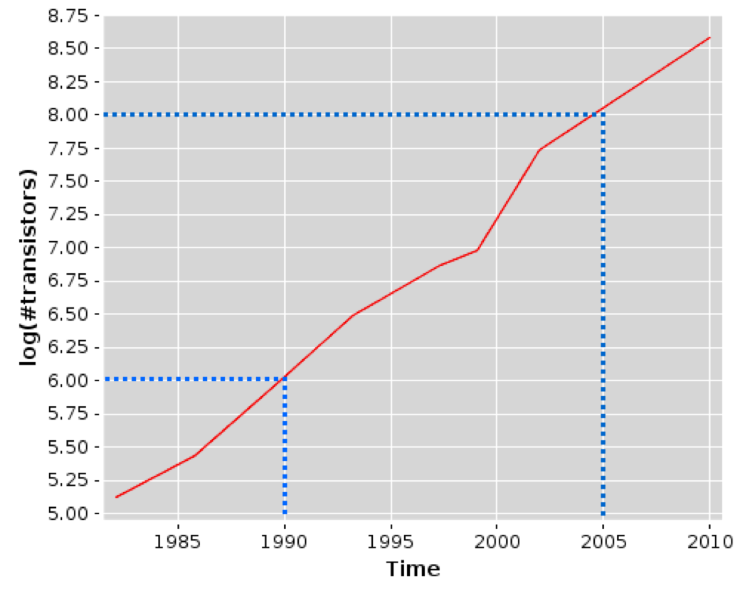
An Interesting Graph
Notes:
This is, of course, a representation of Moore’s Law: “The number of transistors on an economic-to-produce chip roughly doubles every 18 months”. However, as we will see, the increase in transistor count does not directly correlate to an increase in clock speed, and another factor, speed of access to memory has become a dominant effect in application performance over the last 15 years.
@tag simplediagnosis;

Slide 20
Basic Analysis Principles
CPU is expensive, scarce resource
aim to keep busy as much as possible
measure CPU in instructions executed (retired) per s
Keep data as close to the CPU as possible (caches)
operating system (& VM) tuning can help
app memory layout can improve hardware cache effectiveness
difficult to do in Java (no low-level control)
contrast with (e.g.) C++
Notes:
The Firm’s Velocity trading architecture provides an interesting counterpoint to the Java point of view. In that sphere, memory layout, locality and techniques like pinning are used to gain a performance edge – but this is only possible due to C++’s low-level mechanisms.
@tag simplediagnosis;

Slide 21
Basic Analysis Principles
Memory should be cheap, plentiful on modern servers
need to keep an eye on this & confirm
Efficient use of memory key to much application tuning
allocation rates
Garbage Collection cycles
context switching thrash
Notes:
Memory used to be one of the most precious and scarcest resources on any machine.
@tag simplediagnosis;

Slide 22
The Speed of Memory
Main memory
L3 cache full random access
L3 cache in page random access
L3 cache sequential access
L2 cache full random access
L2 cache in page random access
L2 cache sequential access
L1 cache full random access
L1 cache in page random access
L1 cache sequential access
167
38
18
14
11
11
11
4
4
4
0
50
100
150
200
Notes:
Measured in clock cycles to access, shorter is better. Obviously, registers are the best of all…

Slide 23
CPU Architecture
Core
L1
L2
L3
Northbridge
Main memory

Slide 24
Basic Analysis Principles
Operating Systems control access to resources
CPUs
Memory
I/O
Primary mechanisms to control access
Queues
Locks
Indirection
Examples
Run queues (CPU)
Intrinsic locks
Virtual memory
Notes:
@tag simplediagnosis;

Slide 25
Initial Heuristic
Check machine isn’t pushed into swap - vmstat 1
Watch mem and CPU utilisation with machine under load
is memory utilisation healthy?
is CPU utilisation close to 100%?
If no, how much system CPU is in use?
is it ~10% or more?
Notes:
@tag simplediagnosis;

Slide 26
High-level Heuristic
Start vmstat 1
Is machine swapping?
Move process to another machine
Y
N
Healthy memory utilisation?
Investigate memory
N
Y
High system CPU (>10%)?
CPU ~100% user utilised?
Lots of GC activity?
N
Y
Y
N
N
Y
Investigate I/O
Investigate context switching
Examine app code
Tune GC
Notes:
@tag simplediagnosis;

Slide 27
Common Performance Antipatterns
UAT is my Desktop
PROD-like Data is Hard
Fiddle With Switches
Tuning By Folklore
Blame Donkey
Reductionist Bias
Notes:
@tag antipatterns;

Slide 28

UAT is my Desktop
Notes:
This antipattern is all too common in enterprise environments. Constrained budgets lead to managers trying to cut costs, by using a UAT environment that is not of the same spec as the PROD environment. In extreme cases, the UAT environment may even not be composed of server-class machines, but simply a group of repurposed desktop machines.
@tag antipatterns;

Slide 29
UAT is my Desktop
UAT environment differs significantly from PROD
"A full-size UAT environment would be too expensive”
Reality
track cost of outages & lost customers
outages caused by differences in env almost always more expensive than a few more boxes
Java has complex adaptive runtime behaviour
“Some unrepresentative UAT is better than nothing” is a dangerous half-truth
Notes:
@tag antipatterns;

Slide 30
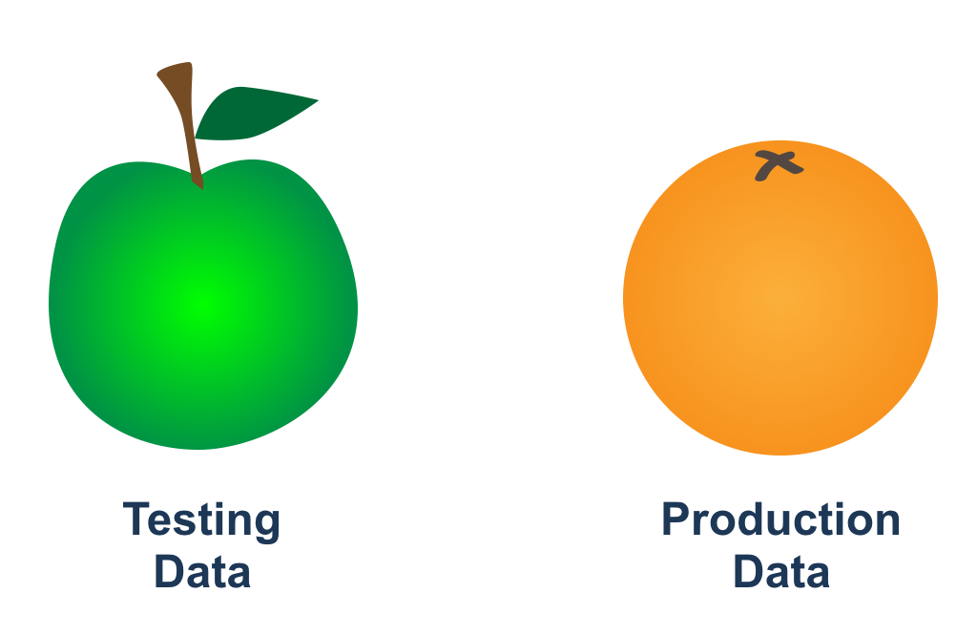
PROD-like Data is Hard
Notes:
@tag antipatterns;

Slide 31
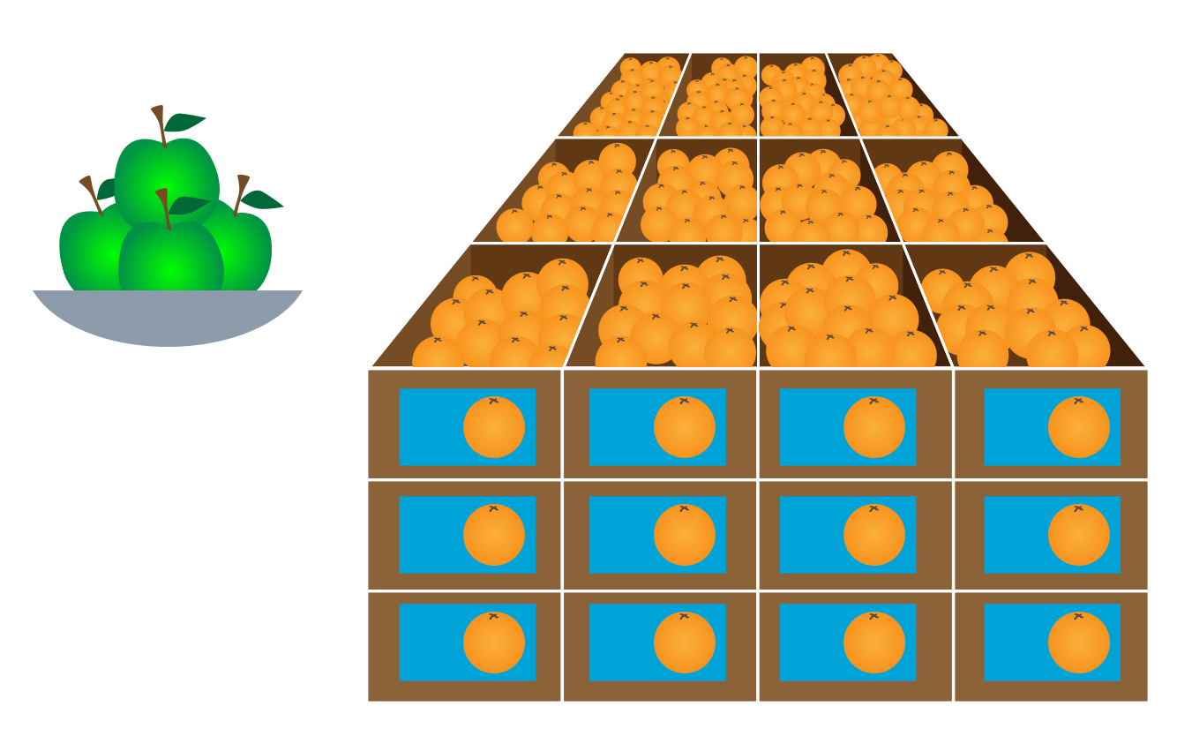
PROD-like Data is Hard
Notes:
@tag antipatterns;

Slide 32
PROD-like Data is Hard
Data in UAT looks nothing like PROD
"It's too hard to keep PROD and UAT in synch”
Reality
data in UAT must be PROD-like for accurate results
Another example: “something is better than nothing”
even less true with data than environment setup
can promote a false sense of security
Invest in formal data refresh process PROD -> UAT
Over-prepare for at-scale launches
Notes:
When the system goes live, and the usage patterns fail to conform to the expected norms that have been anchored by UAT data, the development and ops teams may well find that they have become complacent due to the warm glow that UAT has provided, and are unprepared for the sheer terror that can quickly follow an at-scale production release.
@tag antipatterns;

Slide 33

Fiddle With Switches
Notes:
@tag antipatterns;

Slide 34
Fiddle With Switches
Team becomes obsessed with JVM switches
“If I just change these settings, we’ll get better results”
Reality
team does not understand impact of changes
Root causes
Lack of Understanding
Misunderstood Problem
Notes:
The JVM has a large number of very low-level switches, which can be a tempting source of distraction to many Java developers. We will see several good examples in the GC section.
@tag antipatterns;

Slide 35
Fiddle With Switches
JVM has hundreds of switches
highly configurable runtime
great temptation to fiddle – RESIST
Defaults & self-management often sufficient
Before putting any change to switches live
measure in PROD
confirm in UAT
change 1 switch at a time in UAT
test & retest change in UAT
have someone recheck your reasoning
implement in PROD
measure again in PROD
Notes:
The tendency for developers to adjust switches to achieve a certain performance goal is a direct route where developers Confirmation Bias and other cognitive hazards come in to plat.
One of the problems associated with the 'Fiddle with Switches' antipattern is that there are so many interrelated switches which provides for a highly configurable runtime but where the interdependencies may not be understood. The result can be self defeating as there is a great temptation to keep tweaking different switches and then to see if the results improve the situation. Once the result appears to be better, developers tend to attribute causality to the switch changes rather than any other factor.
@tag antipatterns;

Slide 36
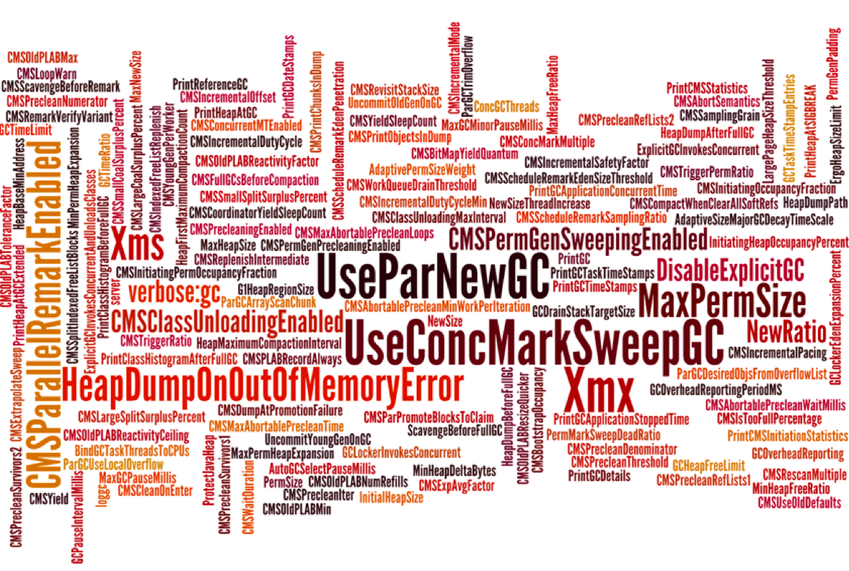
Fiddle With Switches
Notes:
Image Copyright Frank Pavageau, used with permission. This image represents (a subset of) the available switches for configuring just one aspect of the JVM – in this case, the CMS garbage collector. It is very difficult, if not impossible, for the performance engineer to understand the impact of each of these switches singly, never mind in combination. However, in most cases, most of them will have a negligible impact on overall application performance, unless the value is set to an extreme.
@tag antipatterns;

Slide 37

Tuning By Folklore
Notes:
@tag antipatterns;

Slide 38
Tuning By Folklore
Code and switches changes are being applied blind
“I found these great tips on Stack Overflow / Google”
Reality
dev does not understand context / basis of tip & true impact is unknown
Root cause
Lack of Understanding
Peer Pressure
Resolutions
only apply well-tested & well-understood techniques
which directly affect the most important aspects of system
Notes:
Another common anti-pattern is 'Tuning by Folklore'. This occurs because folklore says that certain options or switches are great. In the current world Google is a great source of such folklore. However, in reality the developer needs to understand their application as much as what the effect of different options / flags are in order to actually improve the performance for their situation.
@tag antipatterns;

Slide 39
Performance Tips
A tip is a workaround for a known problem
leads to “Tuning By Folklore”
solution looking for a problem
Tips have a shelf life & date badly
someone will come up with a solution rendering the tip useless
E.g. setting -Xmx == -Xms turns off adaptive sizing
common setting when adaptive sizing was immature
adaptive sizing now mature and this setting can be harmful
Admin manuals contain general advice devoid of context
performance happens in a specific context
Notes:
For example, in the early days of the platform, Java had a reputation for having slow virtual method dispatch times. As a result, developers wrote large methods to avoid virtual calls. Obviously, on a modern JVM this is terrible advice, as it interacts extremely badly with modern HotSpot optimizing technologies, such as inlining. In the worst cases, this advice might even result in methods that cannot be JIT-compiled at all.
@tag antipatterns;

Slide 40
Performance Tuning is NOT
A collection of tips and tricks
Secret sauce
Magic dust that you sprinkle on at the end of a project
The province of “heroes”
Particularly intellectually demanding
Usually very interesting
Notes:
@tag antipatterns;

Slide 41

Blame Donkey
Notes:
Its easy to find something to blame which means that it was that component, system, environments fault. Also known as the “Scapegoat” antipattern.
@tag antipatterns;

Slide 42
Blame Donkey
Certain components are always identified as the issue
“It’s always JMS / Hibernate / ANOTHERTECH”
AntiPattern often displayed by management / biz
Reality
insufficient analysis has been done to reach this conclusion
Root causes
Peer Pressure
Misunderstood Problem
Resolutions
resist pressure to rush to conclusions
perform analysis as normal
communicate the results of analysis to all stakeholders
Notes:
Of course a particular system may well be the route cause but without evidence it can at best just be a suspicion.
@tag antipatterns;

Slide 43

Reductionist Bias
Notes:
@tag antipatterns;

Slide 44
Reductionist Bias
Effort focused on very low-level aspects of the system
“If we can just speed up method dispatch time...”
Reality
Overall impact of micro-changes is utterly unknown
Root causes
Lack of Understanding
Misunderstood Problem
Peer Pressure
Solutions
Do not microbench unless you know you are a known use case for it
Notes:
Developers love to try to break things down into the smallest components - and the Reductionist Bias AntiPattern plays to that cognitive bias. Modern software systems are highly emergent, and so the reduction into small pieces misses the essential behavior of the system.
@tag antipatterns;

