Slide 1
Optimizing Java - Tuning GC
this slide intentionally left blank
Notes:
@hide slide, title;
@author Ben Evans
@thanks John Hunt;
@copyright Mallon Associates International Limited;
@tag title;
This chapter looks at how to tune Java / JVM GC and provides an introduction to tools and heuristics.
@tag intro;

Slide 2
GC Logging
GC log is a great source of information
especially useful for "cold case" analysis of performance
why a crash occurred
can be analyzed after the application process has crashed
Every serious application should always
generate a GC log
keep it in a separate file from application output
Especially production applications
GC logging has no real observable overhead
always turn it on for any important JVM process
Notes:
The GC provides information on its activities. This information can be logged to a file (the GC log). This is particularly useful for investigating cold cases, i.e. those where the investigation happens after the event (for example to identify why a particular issue occurred).
As there is no real observable overhead to turning on GC logging a good rule of thumb is to always turn it on for production applications (although the GC Log should be kept in a separate file from any application output for easy of analysis).

Slide 3
What about JMX for memory?
GC log data
driven by actual GC events
is extremely low impact to capture
contains over 50 aspects of memory perf data
is appended to a local file
JMX data
is obtained by sampling
has implicit proxying and RMI costs
has less than 10 performance aspects related to memory
provides streaming out of the box
Notes:
A full discussion of JMX is outside the scope of this course. For a rough trend analysis of basic heap usage, then JMX is a fairly quick and easy solution, however for deeper diagnosis of problems it quickly becomes underpowered.

Slide 4
Mandatory GC Logging Flags
-Xloggc:gc.log
which file to log GC events to.
-XX:+PrintGCDetails
replaces the older verbose:gc
-XX:+PrintGCTimeStamps
print the seconds since VM start that GC events occurred at
-XX:+PrintGCDateStamps
print the wallclock time that GC events occurred at
-XX:+PrintTenuringDistribution
tenuring information is vital for accurate tooling
Notes:
With the PrintGCTimeStamps then the default output will timestamp events with “seconds since VM start”. Practical experience shows that this value is difficult to correlate with application events which are timestamped in a human-readable way, and PrintGCDateStamps should also be turned on.

Slide 5
Potentially Useful GC Logging Flags
-XX:+UseGCLogFileRotation
switch on log file rotation
-XX:+NumberOfGCLogFiles=<n>
set the maximum number of log files to keep
-XX:+GCLogFileSize=<size>
set the maximum size of each file before rotation
Notes:
Production applications will often produce a large amount of GC log data. Operations teams may want a log rotation regime to prevent logs becoming too large, and to fit in with Splunk or other log management products and practices.

Slide 6
Basic Heap Sizing Flags
-Xms<size>
set the minimum size reserved for the heap
-Xmx<size>
set the maximum size reserved for the heap
-XX:MaxPermSize=<size>
set the size of the class metadata area (Java 7)
-XX:MaxMetaspaceSize=<size>
set the size of the class metadata area (Java 8)
Notes:
In Java 8 and up, the PermGen has been removed, and replaced by Metaspace, which serves the same purpose but is located outside the main Java heap and is not garbage collected in the same way.

Slide 7
Introduction to tools
VisualVM / Visual GC
DIY Parsing
GCViewer
Censum
Notes:
There are a range of tools available for working with GC, some of the tools available within the firm are listed here.

Slide 8
VisualVM / VisualGC
JMX / RMI-based tool
replacement for (obsolete) jconsole tool
has compatibility plugin (so jconsole plugins still work)
Out of the box VisualVM has 5 tabs
Overview
Monitor
Threads
Sampler
Profiler
GUI equivalents of the JRE command-line tools
Will auto-calibrate on first run of the binary
Notes:
VisualVM provides equivalents of tools such as jstack, jmap and other CLI. Note that MSJava provide a special version of VisualVM which has a number of preinstalled plugins, and supports MS Kerberos for connection to services. You should use the version of VisualVM provided under msjava/management and NOT the one that comes with your JDK.

Slide 9
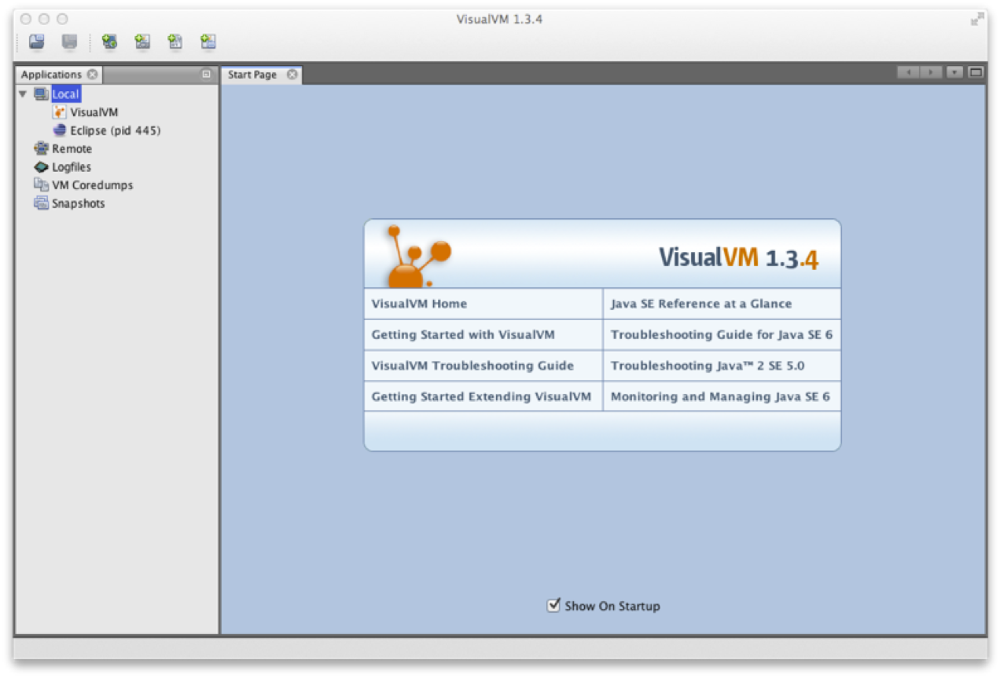
VisualVM Startup
Notes:
After calibration, VisualVM will open to a screen similar to this.

Slide 10
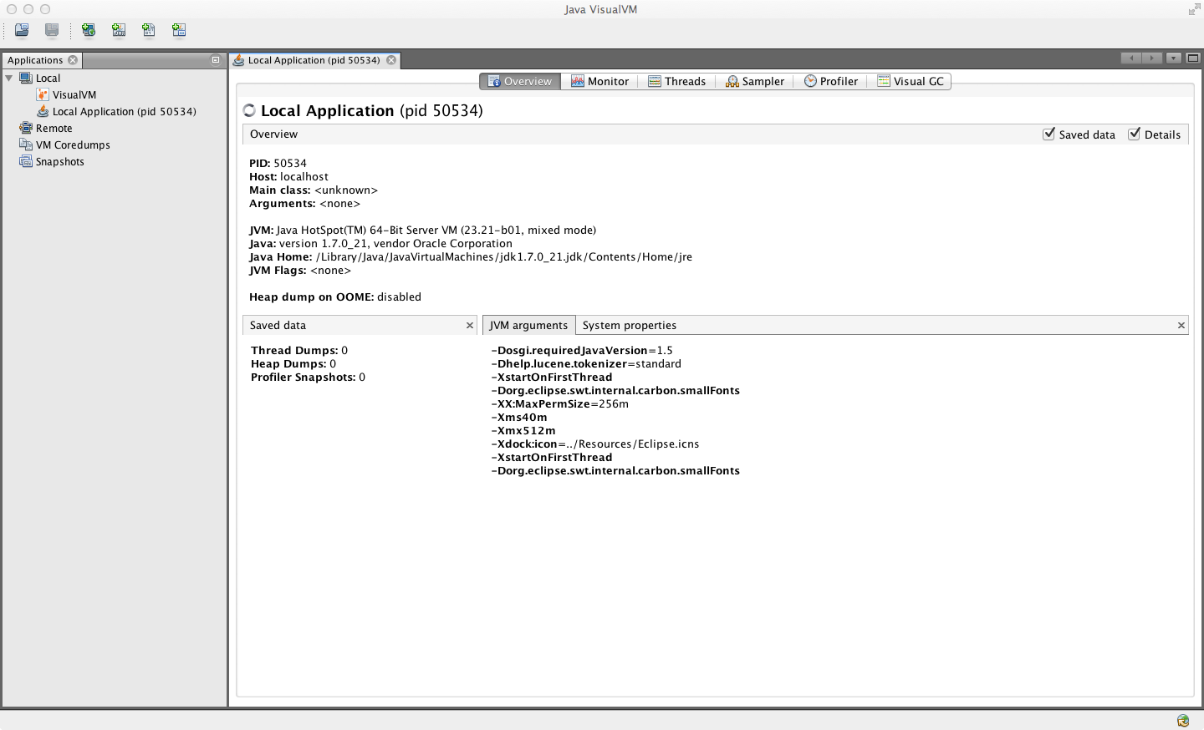
VisualVM Overview
Notes:
The Overview tab provides a summary of information about a Java process. This includes the flags and system properties that were passed in, and the exact Java version being executed. This is equivalent to jinfo.

Slide 11
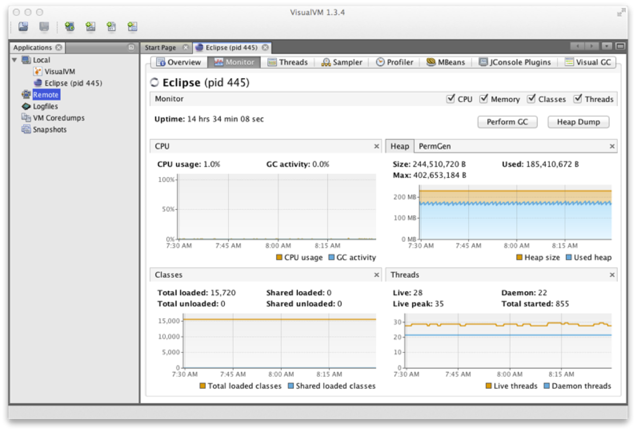
VisualVM Monitor
Notes:
In the Monitor tab graphs and data about the active parts of the JVM system are displayed. This is essentially high-level telemetry data for the JVM - including CPU usage and how much CPU is being used for GC.
Other information displayed includes the number of classes loaded and unloaded, basic heap memory information and an overview of the numbers of threads running. From this tab, it is also possible to ask the JVM to produce a heap dump, or to perform a Full GC - although in normal production operation, neither are recommended, as they will cause the JVM to pause for a potentially significant amount of time.

Slide 12
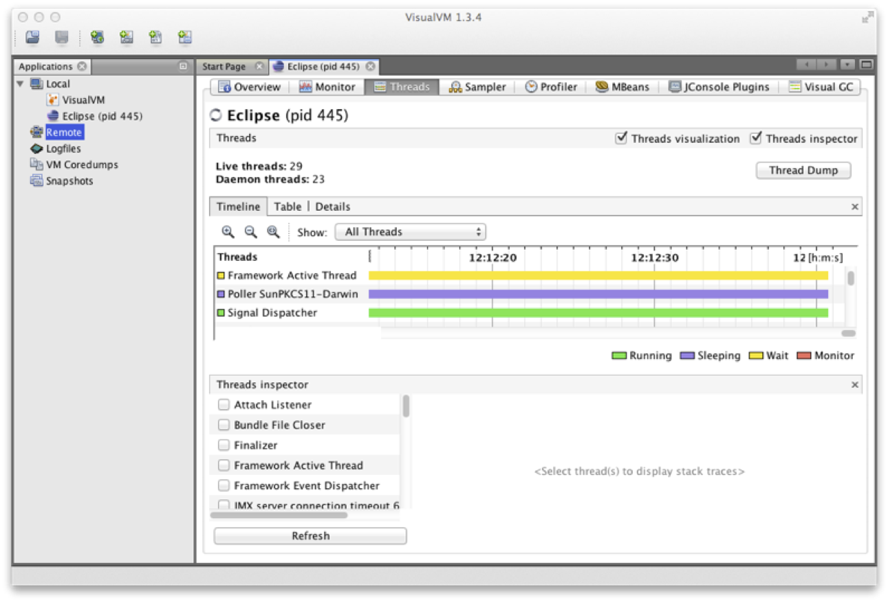
VisualVM Threads
Notes:
The Threads tab displays data on actively running threads in the JVM. This is displayed as a continuous timeline, with the ability to inspect individual thread details and perform thread dumps for deeper analysis. This presents a similar view to jstack, but with better abilities to diagnose deadlocks and thread starvation. Note that the difference between synchronized locks (i.e. operating system monitors wrapped in the cooperative multithreading provided by the JVM safepointing mechanism) and the user-space lock objects of java.util.concurrent can be clearly seen here.
@fold;
Threads which are contending on locks backed by operating system monitors (i.e. synchronized blocks) will be placed into the BLOCKED state. This shows up as red in VisualVM. Locked java.util.concurrent lock objects place their threads into WAITING (yellow in VisualVM). This is because the implementation provided by java.util.concurrent is purely user space and does not involve the operating system in the same way.

Slide 13
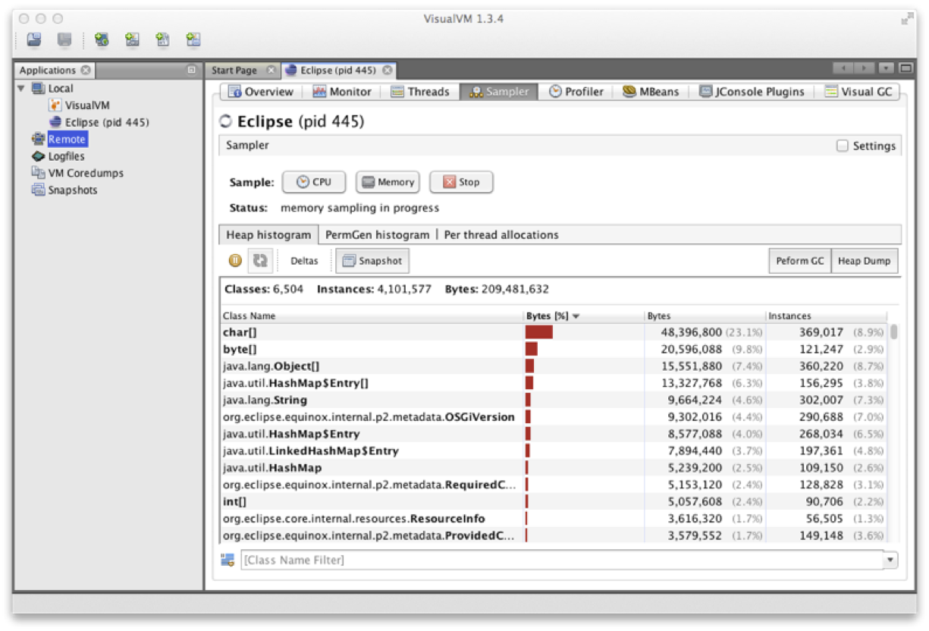
VisualVM Sampler
Notes:
The Sampler tab, samples either memory or CPU. In the memory mode, it samples object creation - either overall, or JVM only or even on a per-thread basis. This enables the developer to see what the most common objects are - in terms of bytes and instances (in a manner similar to jmap –histo).
The objects displayed on the Metaspace submode are typically core Java/JVM constructs. Normally, we need to look deeper into other parts of the system, such as classloading to see the code responsible for creating these objects.

Slide 14
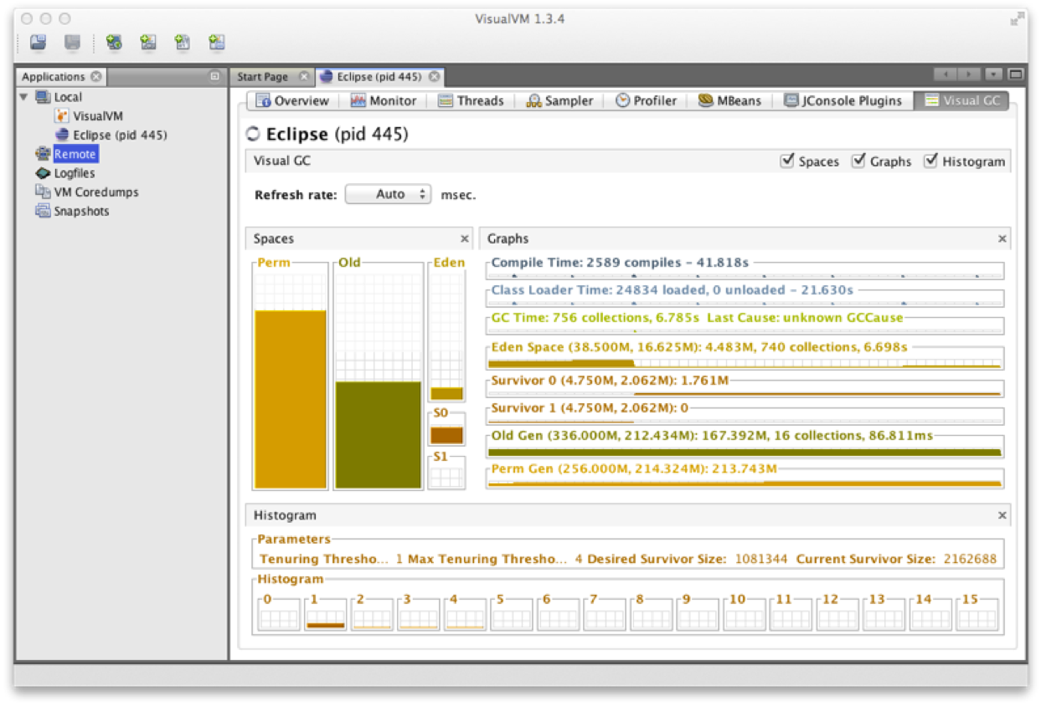
VisualGC
Notes:
VisualVM has a plugin system, which can be used to extend the functionality of the framework by downloading and installing extra plugins. VisualGC is provided as a plugin, as is the MBeans plugin, which can be used to read and control MBeans from the GUI. If JConsole compatibility is required, that too can be installed as a plugin. VisualGC is one of the simplest initial GC debugging tools available. As mentioned earlier - for serious analysis, GC logs are to be preferred to the JMX-based view that VisualGC provides. Having said that, VisualGC can be a good way to start to understand the GC behavior of an application, and to inform deeper investigations. It provides a near real-time view of the memory pools inside Hotspot, and allows the developer to see how GC causes objects to flow from space to space over the course of GC cycles.

Slide 15
DIY Parsing
No spec (language or VM spec) for GC log format
formats can and do change at minor releases
The simplest format is easy to parse
each added log flag can change the format
fully general parsing is a massive task
Logs from concurrent collectors
non-deterministic
Inaccurate log parsing leads to wrong conclusions
Homebrew parsers have a habit of breaking when needed
Notes:
It is worth noting that there is no specification (language or VM) for the format of the GC Log information. This means that the from can (and has) changed between even minor releases of the JVM.
However, the simplest format (with no additional flags turned on) used with GC log is typically easy to parse. However, each additional log flag can change the format as additional information is incorporated. This makes parsing the fully generated log information a much harder task.
This is important because parsing the log file incorrectly can lead at best to a waste of tine and at worse to an incorrect diagnosis resulting in further issues potentially in a production system.
Many organisations have developed their own homebrew GC log parsers over the years but these can be unreliable and may break when they are needed in production. One particular area of caution is the concurrent collectors (G1 and especially CMS). The lack of a formal standard for the logging subsystem leads to non-deterministic production of log entries and simple regex-based parsing fails to handle all the possible cases.

Slide 16
GCViewer
Free, open source
Desktop GUI tool
can also be used as a parsing library
Simple graphing
no analytics
Can parse some common log formats
not all possible formats
Not under very active development
Notes:
GCViewer is an open-source project adopted by volunteers after the original sponsors EOL’d it. It can be found on Github at https://github.com/chewiebug/GCViewer (although MS developers should use the version made available internally).

Slide 17
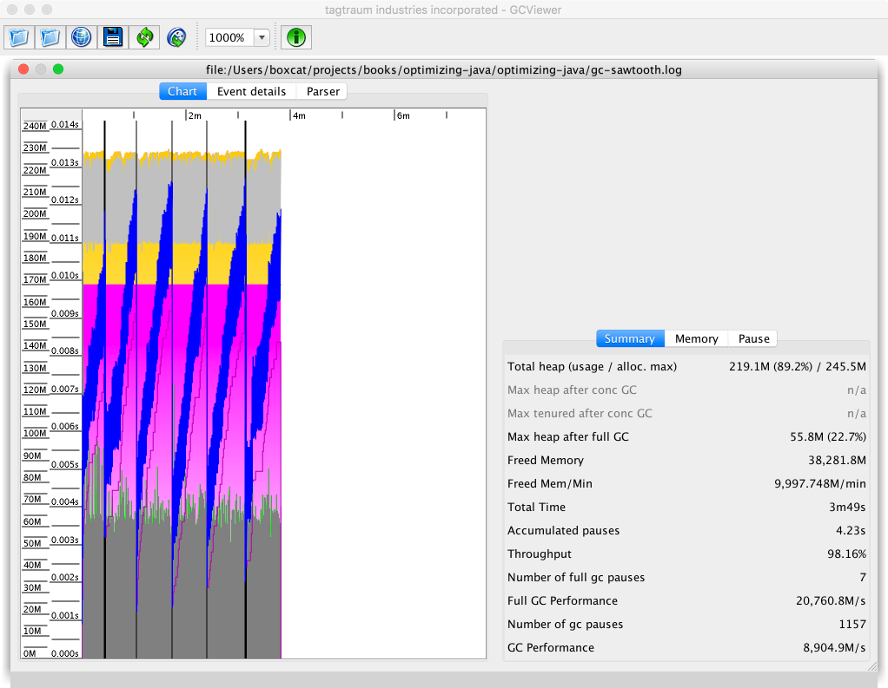
GCViewer
Notes:
This image illustrates GCViewer being used to monitor a Java application.

Slide 18
Censum
Commercial tool
created by jClarity
check license availablility
Parses all log formats
including all collectors
Analytics engine
allocation rates (inc aggressive or "spiky" allocation)
Premature Promotion
Idle Churn
memory leak detection
heap sizing & capacity planning (& memory pool sizing)
OS interference with the VM
Notes:
Censum is a commercial tool created by jClarity.

Slide 19
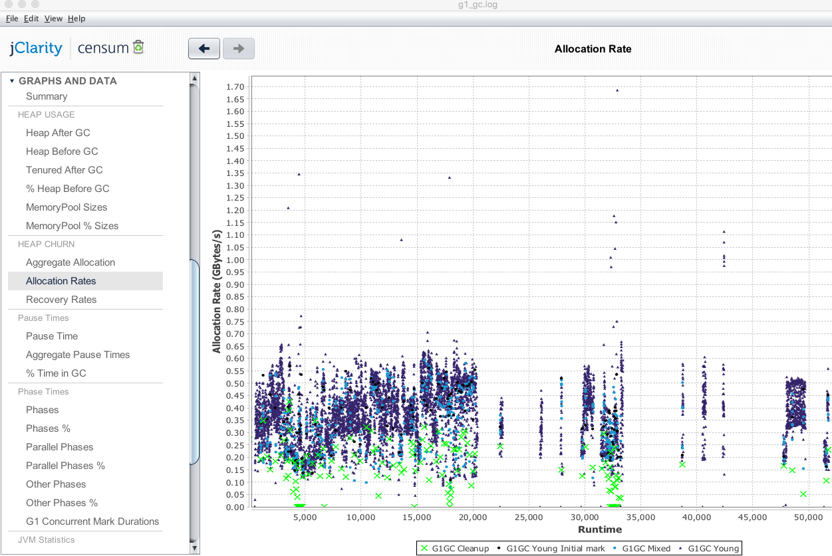
Censum
Notes:
This image shown here illustrates an example screen from desktop Censum – display the memory allocation rates of an application running with the G1 collector. This app is allocating almost 1G of memory per second during busy periods and the hardware is likely to be under some strain because of this allocation rate.

Slide 20
Application NFRs for tuning
Allocation
usually the most important
Pause sensitivity
not all applications are sensitive to pause times
Throughput behavior
concurrent collectors take up cores
Object Lifetime
hard to reason about directly
All factors should be studied and measured
Notes:
Not only is allocation behavior usually the most important tuning factor, it is most often the factor that developers can control easily (by modifying or rewriting code).

Slide 21
Choosing a Collector
 |  | How much pause can your requests actually tolerate?
 |  | >1s | 1s – 200ms | < 200ms
How big is your heap? | < 2G | Parallel | Parallel | CMS
 | < 4G | Parallel | Parallel / G1 | CMS
 | < 10G | Parallel | Parallel / G1 | CMS
 | < 20G | Parallel / G1 | G1 | CMS
 | > 20G | G1 | G1 | CMS / G1
Notes:
Developers frequently suffer from cognitive bias about pause time. Most applications can easily tolerate 200+ms pause times. The human eye can only process 5 updates per second, so a 200-400ms pause is below the threshold of visibility for applications (such as web apps) that are human-facing.
Three broad bands that response time can be divided into are: > 1s: Can tolerate over 1s of pause ; 1s-200ms: Can tolerate more that 200ms but less than 1s of pause & < 200ms: Cannot tolerate more than 200ms of pause. These are guidelines and rules of thumb intended for a starting point for tuning, not 100% unambiguous rules.

Slide 22
Choosing a Collector
Parallel is the most efficient
but is STW with marking O(heap size)
Concurrent Marking Collectors
reduce available cores by 50% during concurrent phases (marking)
Try collectors in this order:
Parallel
G1 (assuming 8u40 or later)
CMS
Trade offs
changing the collector
reworking allocation behavior
Notes:
Parallel is the easiest collector to reason about, but it has STW behavior that scales with the heap, meaning that applications with a big enough heap will always eventually have an unacceptable pause time. Note that Fiddle With Switches is not one of the recommended approaches to tuning GC.

Slide 23
Heap Layout & Sizing (CMS & Parallel)
Controlled by flags
-XX:NewRatio=N
-XX:NewSize=N
-XX:MaxNewSize=N
-XX:MaxHeapFreeRatio
-XX:MinHeapFreeRatio
-XX:SurvivorRatio=N
Turns off adaptive sizing in most cases
not usually what is needed on modern JVMs
Notes:
Another important example of an old piece of advice not being as useful to modern applications is -Xms = -Xmx which is now actively harmful to most Java apps.

Slide 24
Heap Layout & Sizing
Survivor spaces
Eden
Virtual
Virtual
Young
Tenured

Slide 25
Heap Sizing Flags
Eden
Survivor spaces
Tenured
Survivor ratio
New ratio

Slide 26
NewRatio & SurvivorRatio
Flags to
-XX:NewRatio=N
-XX:SurvivorRatio=K
YoungGen = 1 / (N+1) of heap
OldGen = N / (N+1) of heap
Eden = (K – 2) / K of YoungGen
Survivor 1 = 1 /K of YoungGen
Survivor 2 = 1 /K of YoungGen
Notes:
A great example of how not to design a command-line interface.

Slide 27
Tuning Parallel
Is Pause Time for Full GCs acceptable?
Consider allocation behavior
use jmap or VisualVM
Censum can show detailed allocation
understand your domain model
Tenuring Threshold is important
number of collections object must survive to move to Tenured
default 4, can be changed with flag
-XX:MaxTenuringThreshold=N
Notes:
Parallel is the simplest of the collectors to tune. If the pause times (driven by heap size) are acceptable, then the next thing to understand is allocation. This, combined with tenuring behavior, should be enough information to tune most Parallel installations.

Slide 28
Tuning G1
Don’t use G1 on any Java version below 8u40
Beware of information on the Internet
older docs can refer to older implementations
example of “Tuning by Folklore”
Test carefully
G1 has potential impact on application threads
including a “double write barrier”
still a long way from “Just set MaxGCPauseMillis”
Notes:
The implementation of G1 has changed a great deal since the early versions (in Java 6 & 7) and it was only with the advent of 8u40 that the base implementation fully stabilized.

Slide 29
Tuning G1
Is Pause Time ~200-500ms acceptable?
below 200ms may require significant tuning effort
G1 has many configuration options
some are very experimental
not all have supporting metrics
Beware Confirmation Bias
hard to justify switch settings
how do we make decisions on how to tune?

Slide 30
Tuning CMS
Do you need genuine low-pause?
will your application tolerate reduced throughput?
CMS uses half cores to perform GC
collecting Tenured will take at least 2x (wallclock)
as STW time of a Full Parallel collection, and
usually much, much longer (most of this is concurrent time)
Young GCs will take 2x as long when CMS is running
half the cores are doing CMS
Before tuning CMS
reduce your allocation

