Slide 1
Open Science
PCHN63101
George Farmer

Slide 2
Office hour:
Tuesdays (term time) 10 – 11
Dover Street 2.001
My personal Zoom meeting room:
https://zoom.us/j/9466562428

Slide 3
Recap

Slide 4
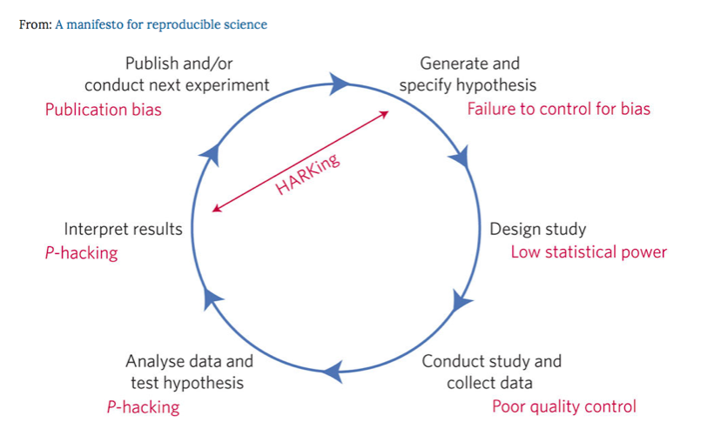
Intro to open science

Slide 5
Adopting Open Practices Summary
Open data and open code are the future - remember to make your data FAIR and add a license to both your data and code.
Pre-registration allows you to capture your predictions - time-stamped at a point in time so when you come to write up your work you can use the pre-reg as evidence that you really did make your predictions before data collection commenced.
In many cases conducting research in a reproducible manner is easy - it requires a bit of planning and organisation up-front, but the pay-off is huge.
Not only will others be able to reproduce your results, but so will you at some future point in time.
Working in an open and reproducible manner also makes large-scale collaborations easier - with the extra computational skills that you acquire, you’ll be a more effective researcher.

Slide 6
Power Summary
Power is important - underpowered experiments are a waste of time (often yours!), money, and resources such as lab space etc.
Underpowered experiments combined with questionable research practices (QRPs) and publication bias results in a literature that is full of research articles that are wrong.
The scientific theories/models you’re testing need to allow you to determine what the minimal effect size of interest is - and it is this minimal effect size that you need to power your experiment to find.
Even in a high powered study (e.g., 80%) sometimes you will fail to find an effect even though it is present - and with NHST just because you might have an absence of evidence for an effect, this is not the same as having evidence of the effect not being there. When our test is non-significant, we cannot conclude an effect is not there - just that we don’t have the support to conclude that it is there.

Slide 7
In Groups:
Come up with a name for your group. Think about and discuss the following 4 questions. After discussion, write down your thoughts/answers. The questions are:
How much did you know about the replication crisis and the importance of reproducibility in research before going through the Workshop 1 material
What do you think is the most important ‘take home’ message from the replication crisis?
How does R help tackle the issue of reproducibility and replication?
What questions did you have going through the content - what does your group think the answer is?

Slide 8

Data Replicada
https://datacolada.org/82

