Slide 1
R and RStudio
PCHN63101
George Farmer
07 October 2024

Slide 2
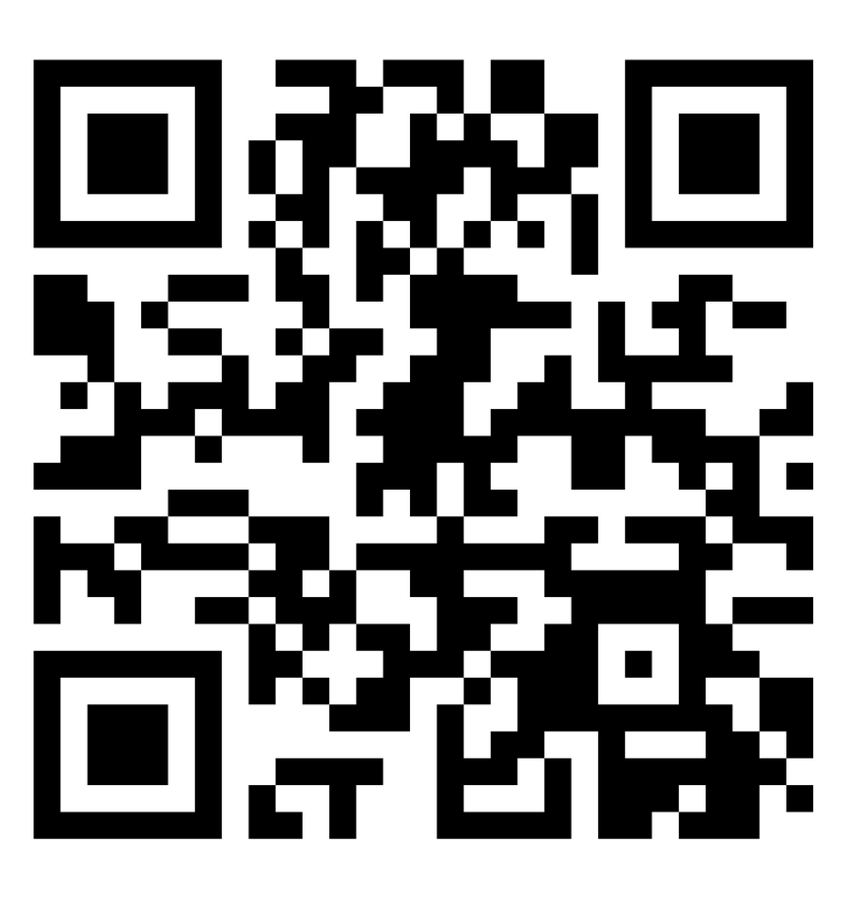
SEAtS
7 4 2 9 7 2
Notes:
Code better

Slide 3
Housekeeping (all on Blackboard)
Office hour: Tuesdays (term time) 10 – 11, Dover Street 2.001
My personal Zoom meeting room: https://zoom.us/j/9466562428
Alternative URL: https://pchn-63101-2024.netlify.app
Please subscribe to the discussion board on Blackboard (PCHN63101 Questions)
Assignment Deadlines: 14th Nov 2pm and 12th Dec 2pm
Notes:
URL
Don’t worry about assignments
We’ll talk about first one next week

Slide 4
Recap
Notes:
This is content you will need for you assignments

Slide 5
Getting Started with R
Download & Install R
Download & Install RStudio
Customise RStudio
Notes:
Any problems

Slide 6
Keeping things tidy
R Projects
Convenience
Reproducible
Folder structures
Notes:
Keeps related files together, file paths >
Shareable
Good practice – get in the habit
Questions

Slide 7
Good coding style
Comments
Whitespace
Naming
Headers

Slide 8
Do as I say not as I do!
norm.data
%>%

Slide 9
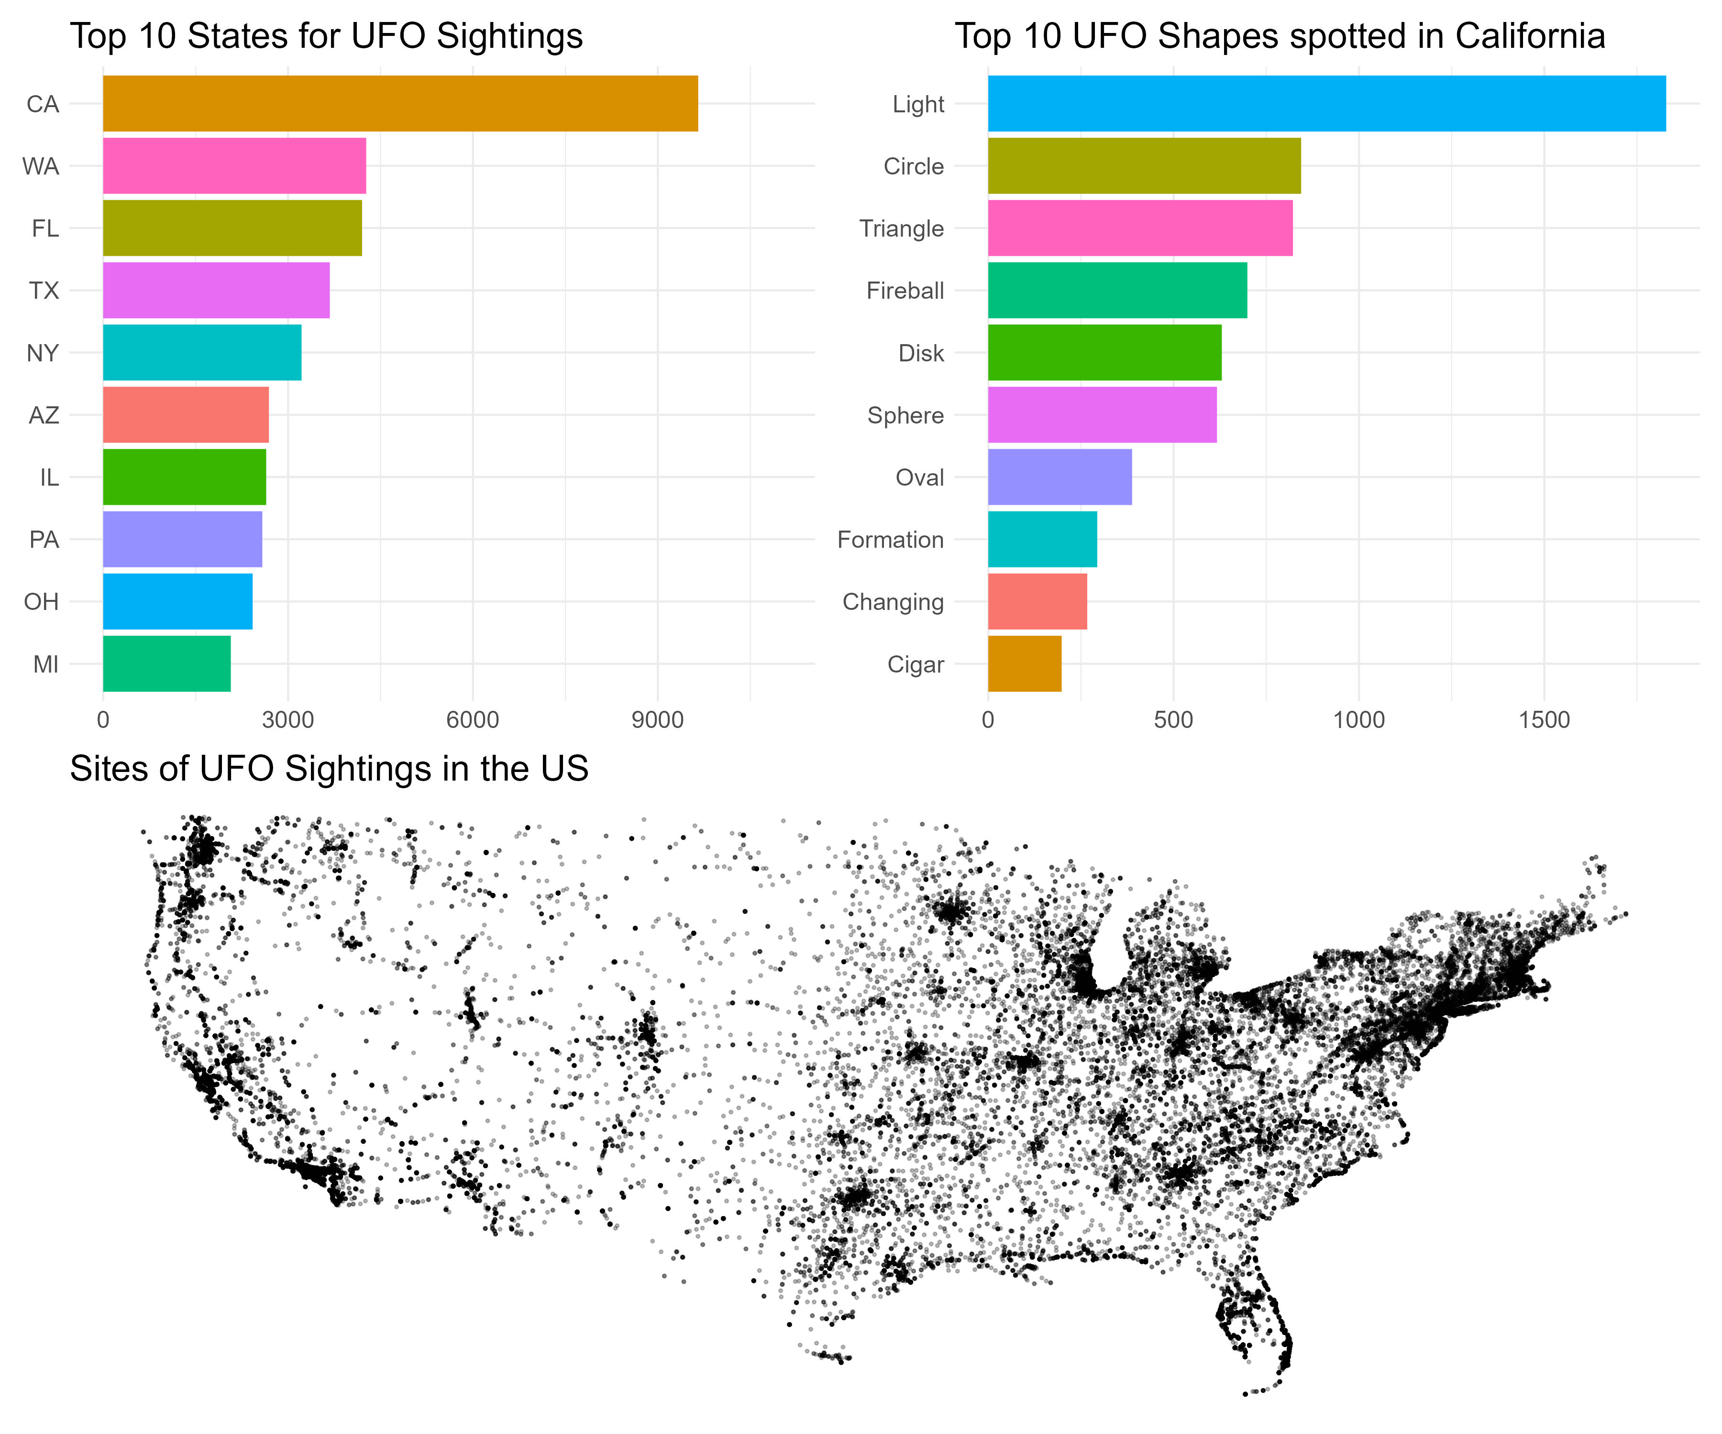
Your first R script
Notes:
Success?

Slide 10
In Groups:
After discussion, write down your answers.
Come up with a definition of the following from RStudio:
the environment
a script
the console
What were members of your group confused about from this week’s content? What answers did you / can you come up with?

Slide 11
In pairs: After each change, run the code and see what changes.
https://pchn-63101-2024.netlify.app/r-and-rstudio#your-first-r-script
In the plot1 code, put a hash symbol # at the start of the line ‘coord_flip()’ - this will turn the line into a comment and it won’t be executed. Run the code again - what changes?
In the plot1 code, put a hash symbol # at the start of the line `theme_minimal()`- this will turn the line into a comment and it won’t be executed. Run the code again - what changes?
In the plot2 code, change the size and alpha values for the line `geom_point(size = .5, alpha = .25)`. Run the code again - what changes? Change to some other values and see what happens.
In the plot3 code, change the size value in the line `theme(text = element_text(size = 15))`. Run the code again - what changes? Change to some other values and see what happens.
In the plot3 code, change geom_col() to geom_point() - what changes?
Notes:
Get the code from the course site

Slide 12
SEAtS
7 4 2 9 7 2
Notes:
Code better

Slide 13
Demo
Notes:
%>%
<-
library
packages

