Slide 1

Data Visualisation
PCHN63101
21 Oct 2024
5 7 0 0 4 4
Notes:
Site problems?

Slide 2
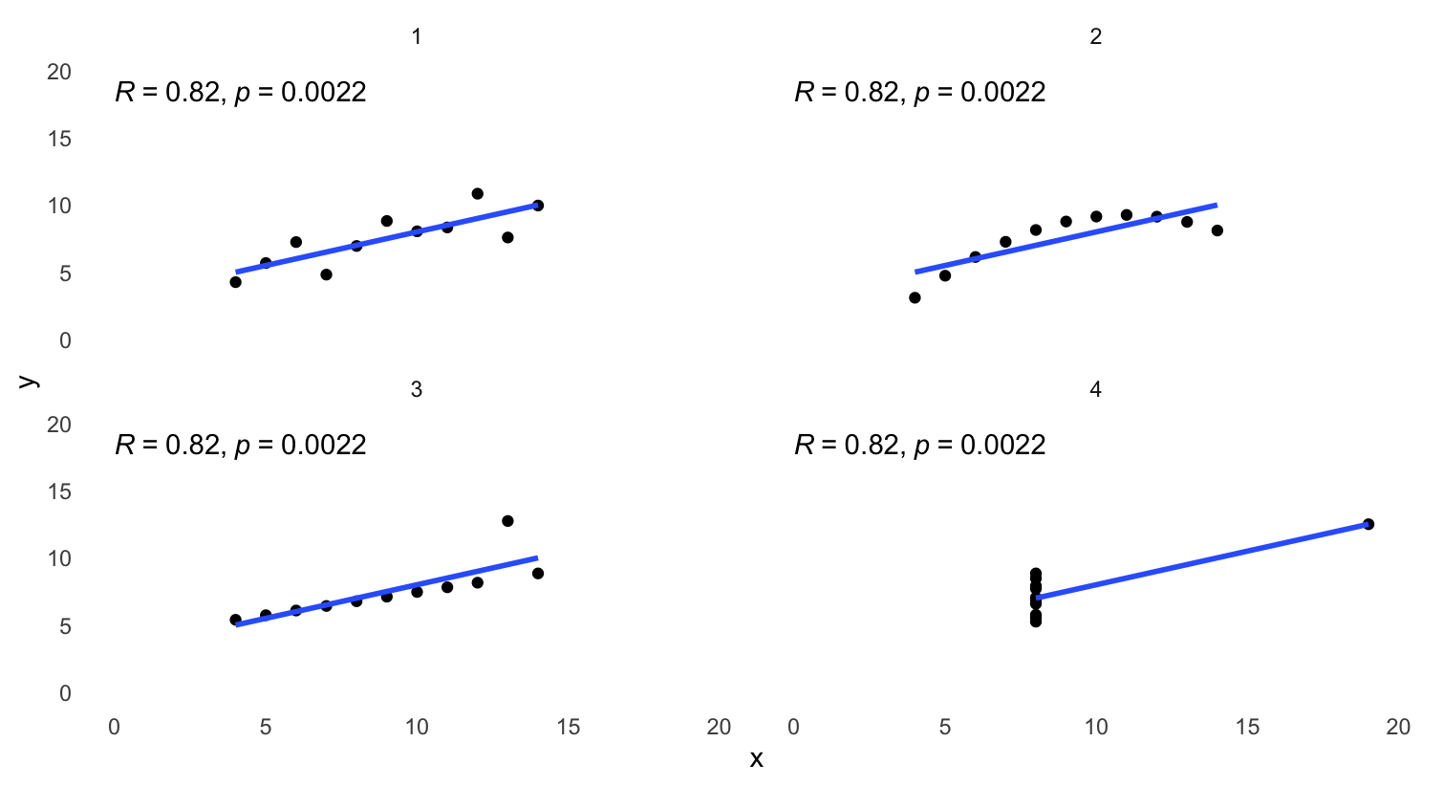
Recap / Questions
SEAtS Code: 5 7 0 0 4 4

Slide 3
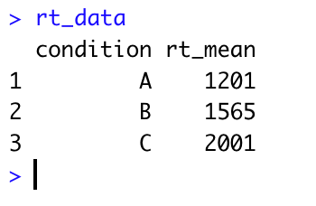
Recap / Questions
rt_plot <- ggplot(rt_data,aes(condition,rt_mean))+geom_point()
rt_data %>% ggplot(aes(condition,rt_mean))+geom_point()
SEAtS Code: 5 7 0 0 4 4

Slide 4
In pairs or threes
Let us know any problems you had working through this week’s content
Create some new visualisations using the mpg, storms and NHANES datasets.
Use the ggplot2 cheat sheet for inspiration: https://rstudio.github.io/cheatsheets/html/data-visualization.html
I would like each group to share their best visualisation - and their worst! Copy your plots and paste them into this google doc with your name(s): https://bit.ly/4dRfDmf
SEAtS Code: 5 7 0 0 4 4

Slide 5
Assignment 1
Next week is reading week, and there is less content than usual in the next workshop. Use the time to work on Assignment 1.
There is no page or word limit, but you may only include 2 plots. Please do not use interactive plots (or other interactive elements) as these will not display in Turnitin.
Imagine you are writing for another scientist who knows nothing about your experiment, your data, or the packages you are using.
Your narrative and comments should show that you understand what your code is doing
SEAtS Code: 5 7 0 0 4 4
Notes:
With markdown, all info needed for Assignment 1
Assignment 1 = 50%
Comments / narrative split.
Merit / distinction – necessary but not sufficient.

Slide 6

Assignment 1
Plagiarism and code:
Your code will inevitably be similar to the code on the course site – this is OK!
Do not collude on code!
Try to use APA guidelines for numbers, statistics, and figures. https://apastyle.apa.org/
SEAtS Code: 5 7 0 0 4 4
Notes:
With markdown, all info needed for Assignment 1
Assignment 1 = 50%
Comments / narrative split.
Code from websites

Slide 7
Catch-up session?
Purpose: Strictly for content that you have not understood or are struggling with:
Using R and Rstudio (projects, environment, console, scripts, basic functions and operators)
Data wrangling
Data summarising
Data visualisation
(Rmarkdown)
SEAtS Code: 5 7 0 0 4 4
Notes:
When?
Remit: up to and including Markdown
Purpose – that you can do the basics. Wrangling, Projects, summarizing, Markdown
Not: beyond markdown or assignment help
Send poll?

