Slide 1

SNA Applications George Kikuchi (george.kikuchi@phila.gov)

Slide 2
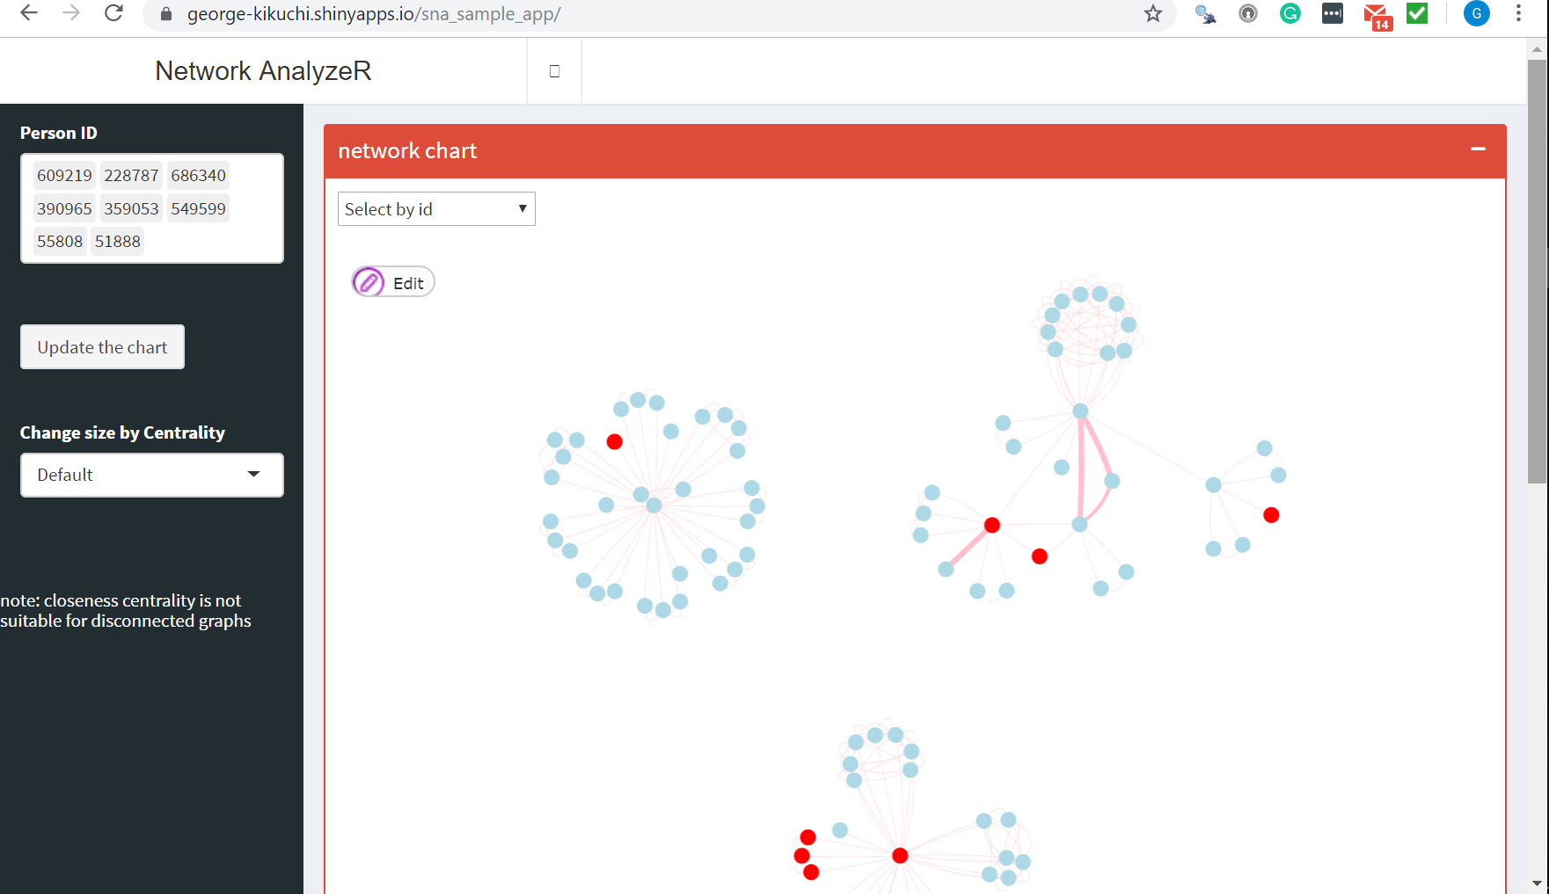
https://bit.ly/2L6fKzh or https://george-kikuchi.shinyapps.io/sna_sample_app/

Slide 3
Social Network Analysis
A visual and statistical analysis technique to examine relationships among people (and organizations)
Visualize connections among criminals
Identify key players (and secondary targets)
Simulate the secondary effect of enforcement actions

Slide 4
Social Network Analysis: Concepts
Node
circle/square
People, organization, locations, etc.
Edge
Line
connections

Slide 5
Social Network Analysis: Data Sources
Typical data sources for law enforcement are co-offending, but relationships may also come from …
investigatory stops, co-habitation, kinship ties, intelligence, victim-offender, etc.
Social Media ≠ Social Network Analysis
Social media can be a data source

Slide 6
SNA Metrics
Total Degree
Who has the most ties?
Helps identify the most active offender in your network
Be careful about the meaning of “most active”
Eigen-vector
Individual who is connected to someone who has many ties
“A guy who knows the guys”
Betweenness
Who sits between network groups?

Slide 7
SNA Metrics
You can use a single metric; alternatively, a more robust approach is to identify key individuals who score high across multiple metrics
SNA metrics make sense only when your network has a single type of mode
e.g., all of your nodes are people
If your network has people connected to incidents, for example, your data or network need to be manipulated
The app we will build assumes that the data represent people – incidents connection in an Excel file and it internally handles this data conversion to single mode data (all people)

Slide 8
Outline
Sample Demo App
Running an App on your machine using data from Excel
Excel file specs
Access / SQL ODBC version

Slide 9
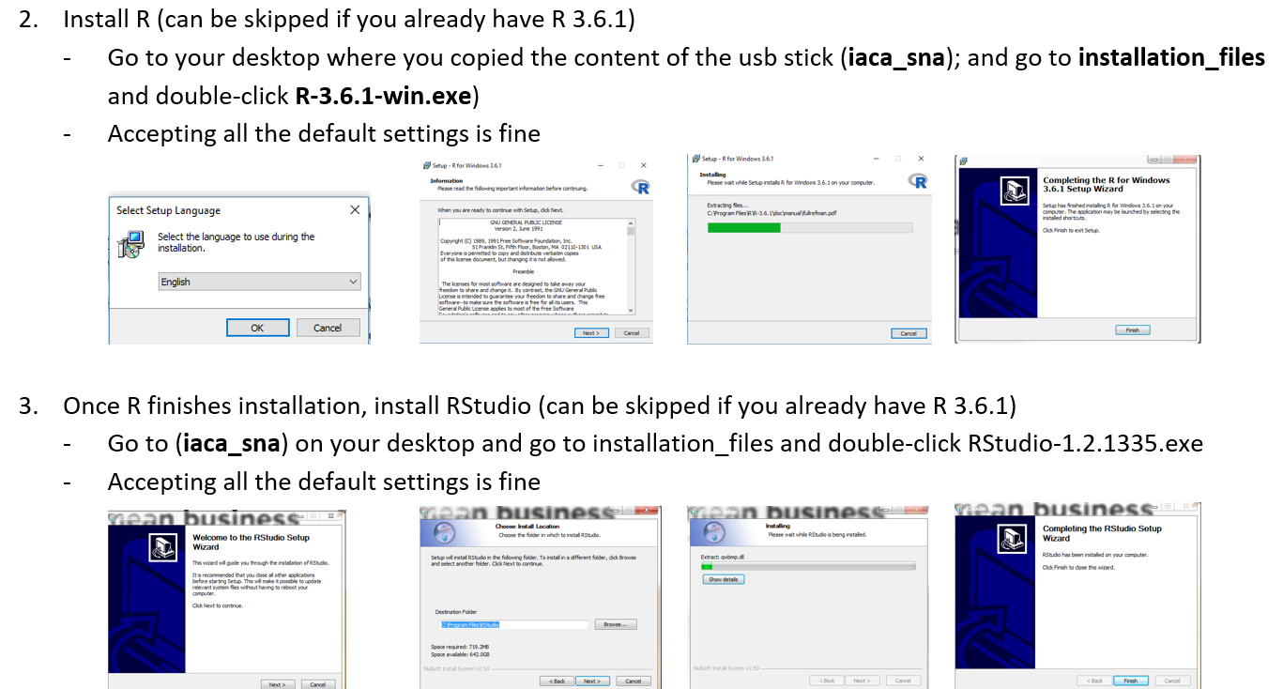
Steps 1 – 2: Install R and RStudio

Slide 10
Prerequisites
R (3.6 or higher recommended)
Rstudio
Internet connection (to download libraries)
For Access version, you will need Access ODBC Driver (.accdb), or use SQL (recommended)
The Access driver does not come with Access installation (check ODBC Administrator from the windows start menu and see if Access Driver is listed under the Driver tab)
Try 2010 or 2007, rather than 2016 version
https://www.microsoft.com/en-us/download/confirmation.aspx?id=13255
You also need to be mindful of 32 or 64bit version (Driver and R/Rstudio)

Slide 11
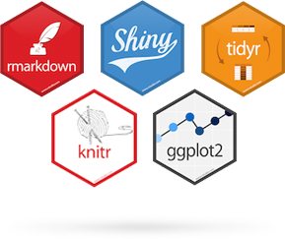


> 3000 libraries (packages) created by users for specific tasks (e.g., making a map; getting data from RMS (SQL)
All free and open source
Helps write / edit a script and mange projects
Core / Foundation software, but you nowadays do not directly use it

Slide 12
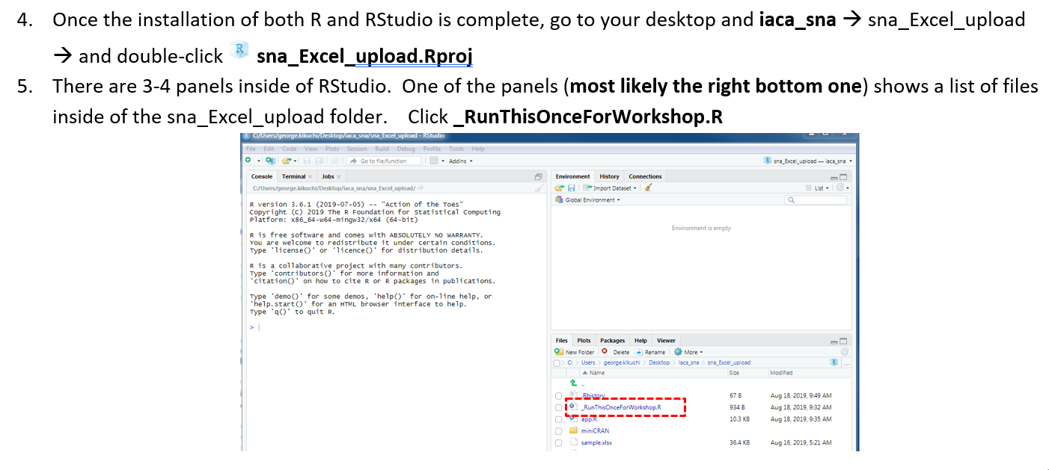
Steps 4 - 8: Opening the workshop sample file and installing packages (libraries)

Slide 13
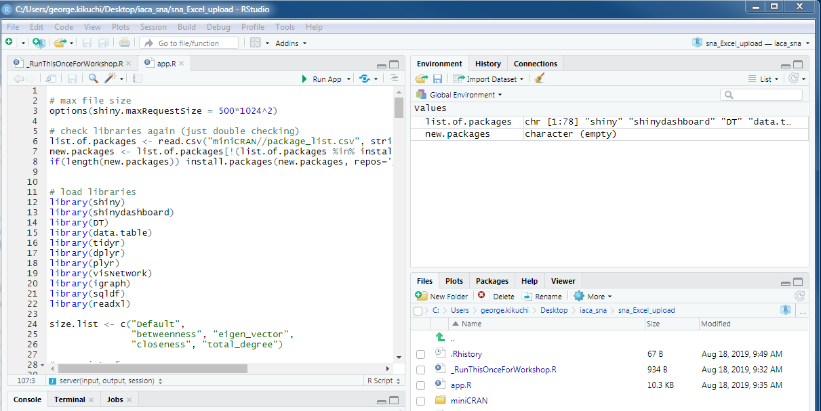
Steps 9 – 10: Running the App
2) Click Run App
1) Open app.R

Slide 14
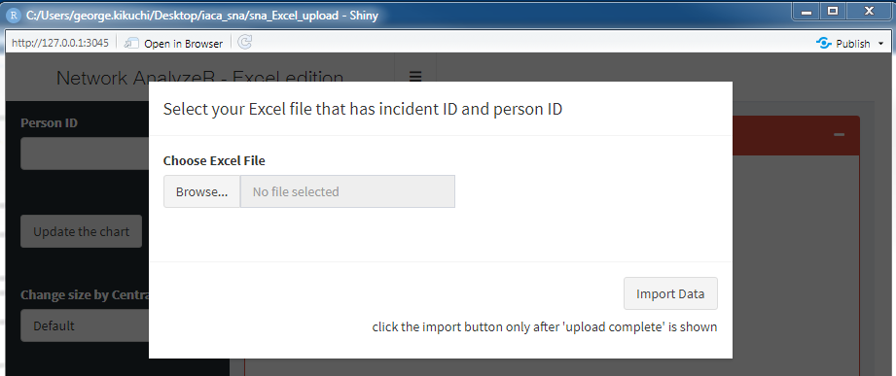

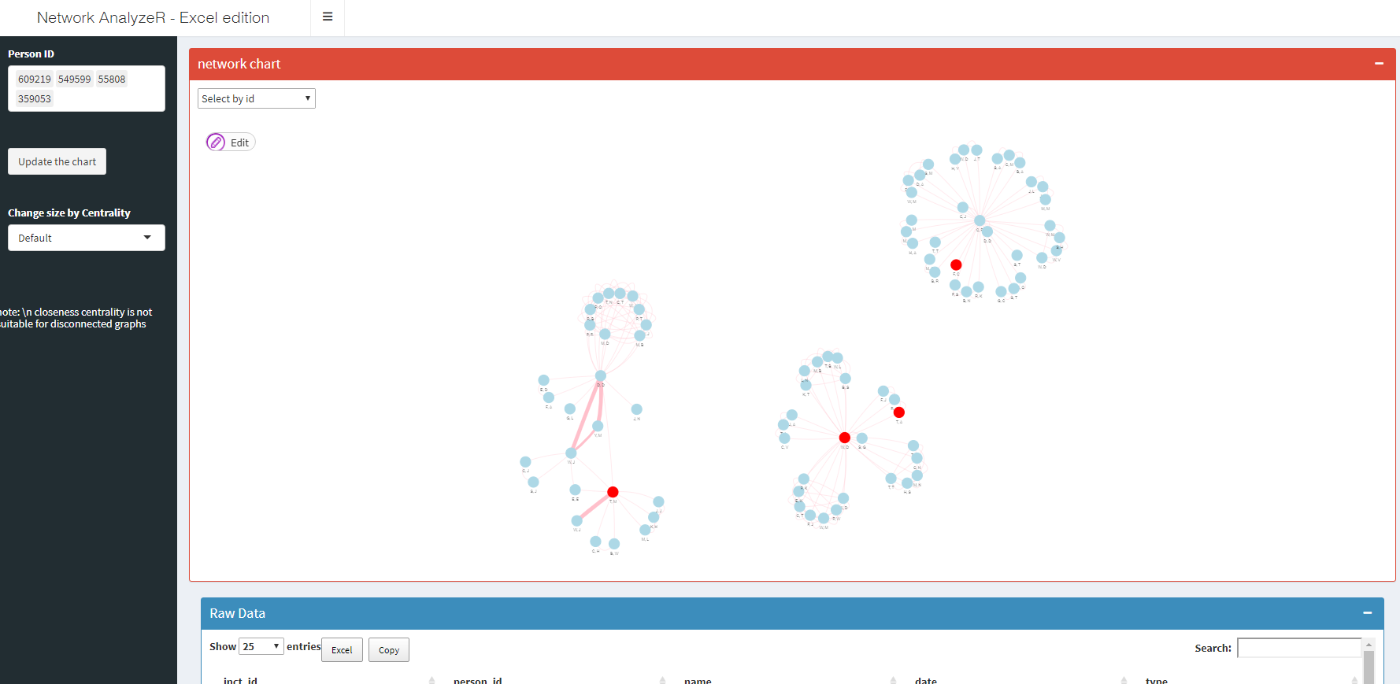
Steps 11 – 12: Import an Excel file and start your analysis
wait till the blue progress bar shows Upload Complete

Slide 15
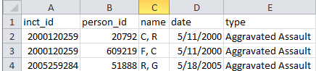
Using your own data: Excel File Format
When using your own data (e.g., arrest record data dump from your agency’s RMS), you will need to format the Excel sheet as follows.
Column names need to be exactly like these; inct_id, person_id, name, date, type. You can include more columns, but these are the required columns.
inct_id and person_id needs to be numeric
A future version of this app script may introduce more flexibility, but these are the required input fields at least at the moment.

Slide 16
Outline
Sample Demo App
Running an App on your machine using data from Excel
Excel file specs
Access / SQL ODBC version
Going beyond network analysis with R

Slide 17
Access / SQL ODBC Connection version
Advanced version that requires....
ODBC connection string information
Server name (or IP address), database name, table (or view) name, Driver name (exact spelling)
ODBC Driver installed on your computer
The right version for your computer and applications (R/Rstudio); 32 bit vs 64 bit
Read access to your database server (e.g., SQL)
‘‘backend access’’
Advantages
realtime and dynamic query (no periodic data dump)
Making the app available to other people in your agency’s network (behind firewall)

Slide 18
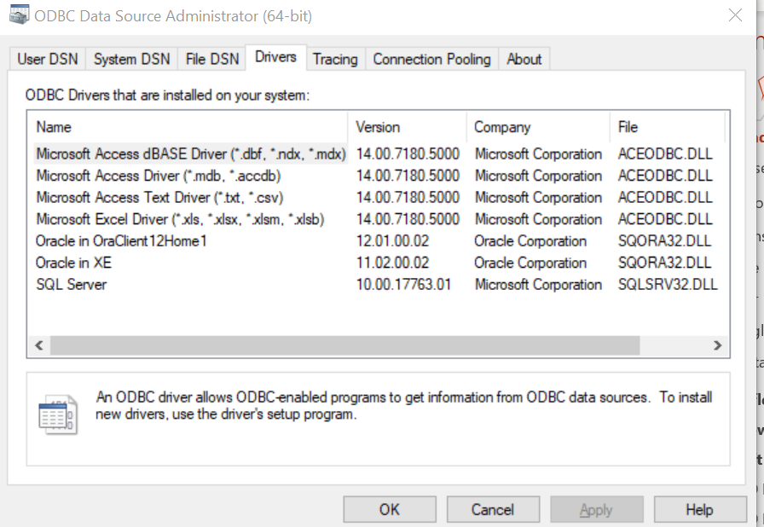
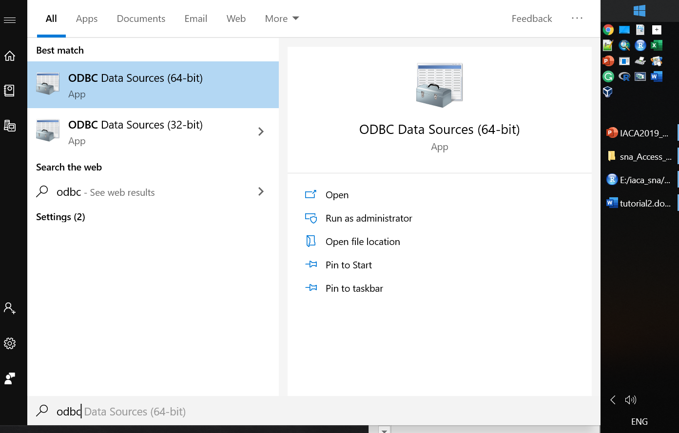
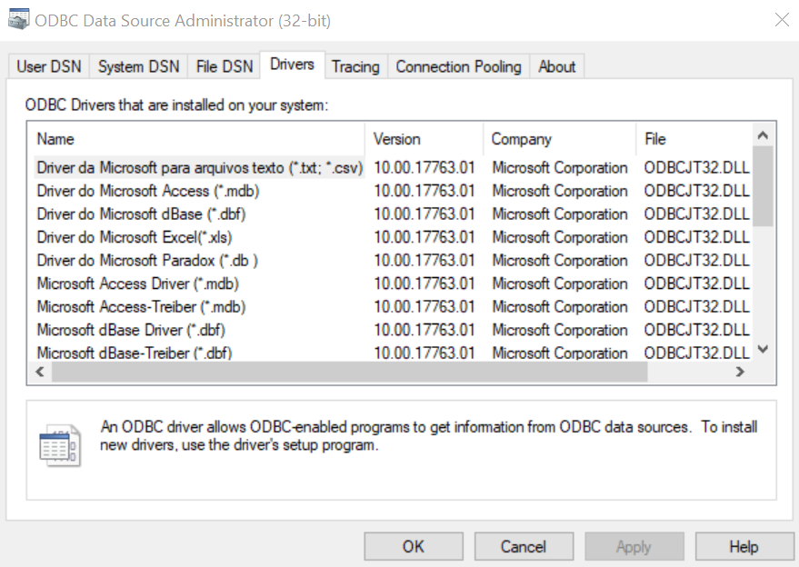
Access / SQL ODBC Connection version
Checking ODBC Driver; type ODBC in the Windows start menu and select ODBC Data Sources (XX.bit); then examine the Driver tab

Slide 19
Access / SQL ODBC Connection version
If you did not see Access driver (.accdb) under the Driver tab, you need to install necessary drivers
The Access driver does not come with Access installation (check ODBC Administrator from the windows start menu and see if Access Driver is listed under the Driver tab)
Try 2010 or 2007, rather than 2016 version
https://www.microsoft.com/en-us/download/confirmation.aspx?id=13255
You also need to be mindful of 32 or 64bit version (Driver and R/Rstudio)
Alternatively, use SQL (or equivalent): recommended
Server-side processing
SQL Driver likely comes with Windows

Slide 20
Access / SQL ODBC Connection version
App setup (this just needs to be done once)
Editing ODBC connection information in config.R file
Editing the names of your table (view) and column in the config.R file
Desktop → iaca_sna → sna_Access_SQL →
double-click sna_Access_SQL.Rproj

Slide 21
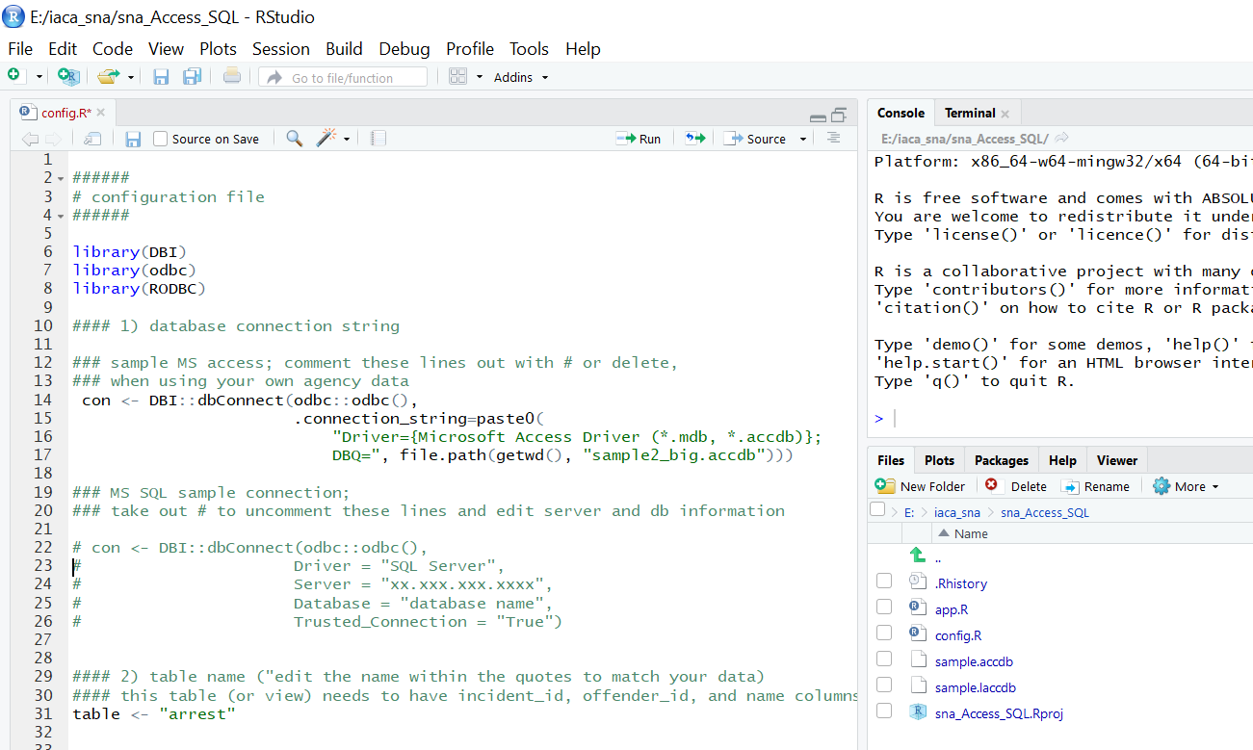
Access / SQL ODBC Connection version
2) Edit ODBC info
1) Open config.R

Slide 22
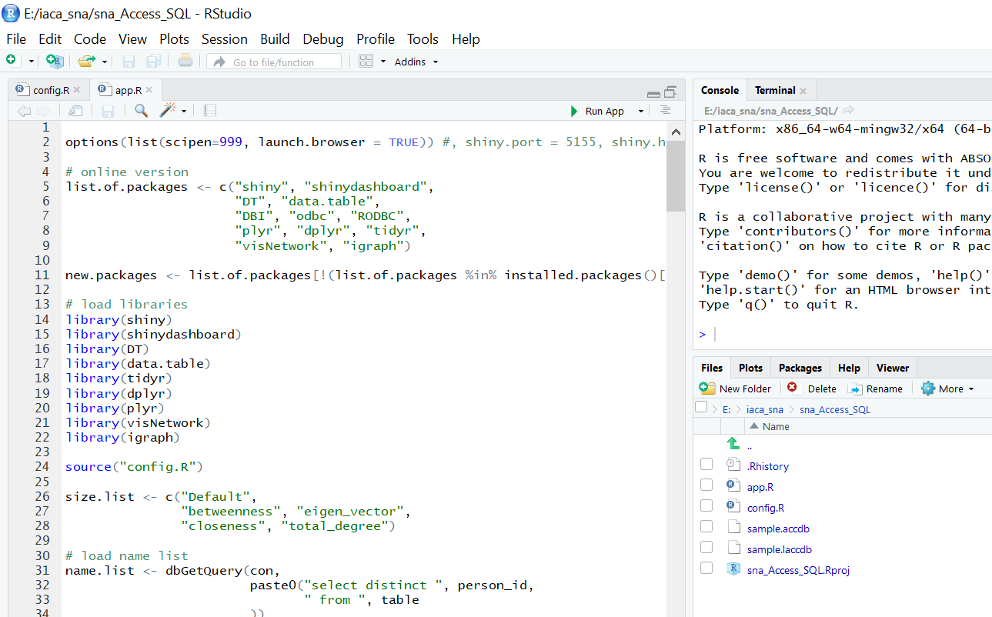
Access / SQL ODBC Connection version
2) Run App
1) Open app.R

Slide 23
SNA Applications George Kikuchi (george.kikuchi@phila.gov)

