Slide 1
Regular Expressions
George Miller

Slide 2
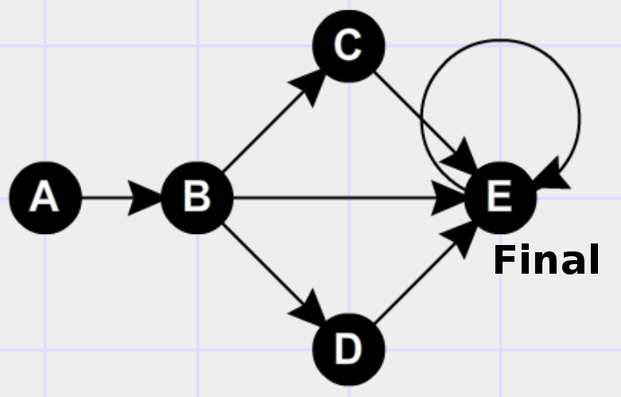
Big Picture
AB(C|D)?E+
A AB BAC CWWHHA
BAACDEEEABCDD BBA
PDJKWONRLABKJDFKPWJ
ABCEEEEE
….
Searcher
(DFS)
AB
ABC
AB
ABCEEEEE
...

Slide 3
Syntax
Good Characters
  | [ ] { } ( ) + * ? - , \ . alphanumerics
Matching Parenthesis
  ([{]}) (([)] {[(])()}
Legal ranges
  {1} {2,200} [d-e] [(as)-] {,2}
Legal Positions
  x|y|z * + ? {} *abc {1,2}?xy

Slide 4
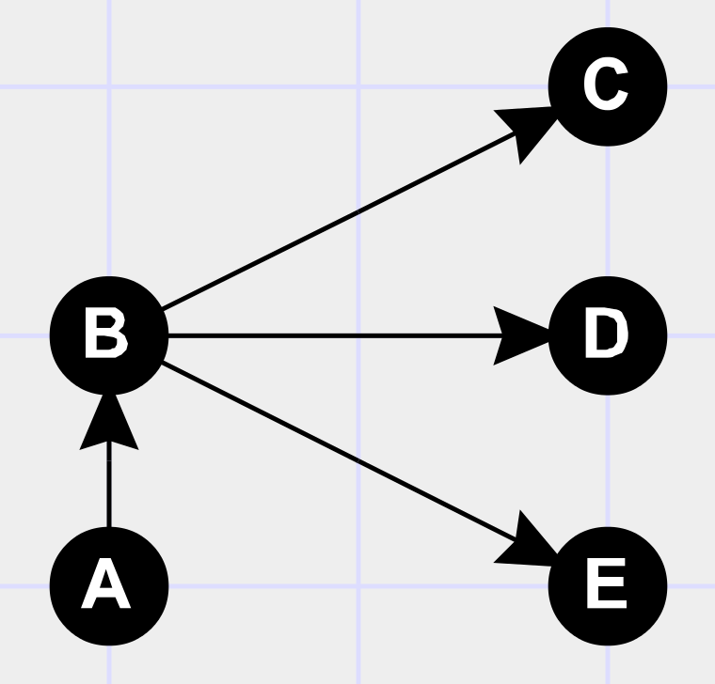
Graph
Node matches list of character codes or singular
character code (ord() and chr() help to convert)
Input
Nodes
Output
Nodes
Example Graph:
A?B(C|D|E)
Output
Nodes
Input
Nodes
Output
Nodes
Input
Nodes
Two
Previous
Output
Useful Structure:
...
Previous
Output
Previous
Input

Slide 5
Graph
Two
Previous
Output
...
Previous
Output
Previous
Input
Why is this structure useful?
+ Connect previous output to previous input to allow multiple traverses of the previous Graph
* Do above, but also add nodes from two previous output to previous output to allow skipping
A?B(C|D|E){0, 3} Shown Below
Two
Previous
Output
Previous
Output
Previous
Input

Slide 6
Searcher
Traverses Graph in DFS manner
  as deep as possible to get the most specific match
If connection is made from input node to output node, we have a match
Initiates search at every index in given text, skips indexes inside last found instance
5, 6
1 | 2 | 3 | 4 | 5 | 6
A | B | C | E | E | E
3
4
1
2
1
2
1 | 2 | 3 | 4 | 5 | 6
A | B | D | C | E | E
3

Slide 7
Demo
https://github.com/george-miller/regex

