Slide 1
SEGMENTING Multivariate Time Series WITH Inertial HMMs
George D. Montañez
Saeed Amizadeh
Nikolay Laptev

Slide 2
Motivation
Yahoo monitors millions of time series on a daily basis. Examples:
YAMAS: monitoring hardware and software units time series
RevMon: monitoring Yahoo revenue time series
Membership: monitoring Login and Mail time series
Trending Now: monitoring time series related to different topics
But why? We are looking for “interesting things” in these time series, aka anomalies. Examples:
YAMAS: failures in hardware and software units
RevMon: failures that have negative effect on our revenue
Membership: cyber attacks on Yahoo accounts
Trending Now: trending and popular topics

Slide 3
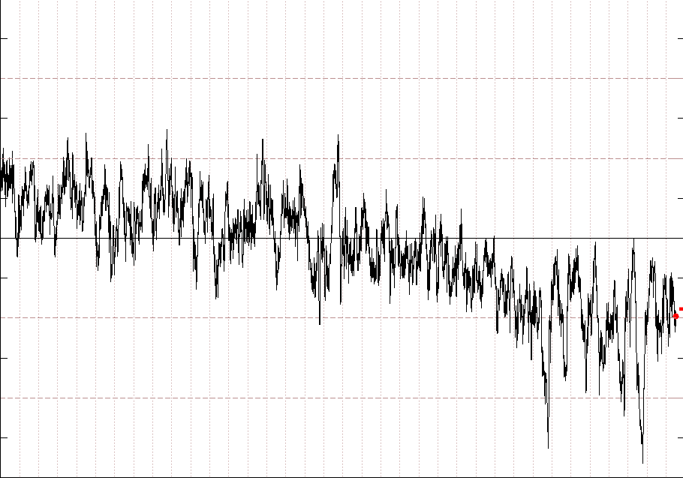
Characterizing Anomalies
Anomalies can appear in different forms depending on the application. Two of the most important examples are:
Outliers: an extreme observation as a result of a failure, noise or a sudden external impact
Change Points: change of behavior as a result of a systematic change, internally or externally
outlier
change point
outlier
Intuitively, change points are less frequent than outliers.

Slide 4
The Goal
In this project, we are interested in detecting the second type of anomalies, i.e. the change points, on multi-dimensional time series.
The goal break-down:
Segmenting a multi-dimensional time series in offline mode
Characterizing the behavior of each segment
Detecting change points (i.e. transition between two segments) in an online fashion

Slide 5
Problem Setting
Multivariate, moderate dimensional (~50D) time series.
Segment in unsupervised manner.
Segment = assign each time step to a state, for few states.

Slide 6
Problem Setting
We would like our segmentations to be:
Unsupervised (no training labels)
Simple (no rapidly changing states)
Inertial State Transition Behavior
Since states tend to persist, we refer to this as inertial transition behavior.
Goal: Develop an unsupervised method of segmentation that results in simple, inertial state transitions.

Slide 7
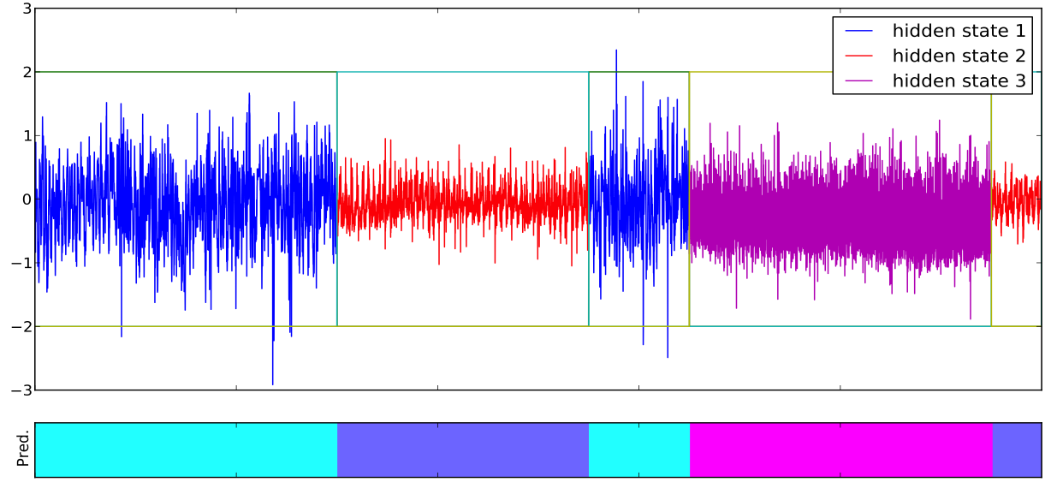
Desired Segmentation Output

Slide 8
Proposed Method: Hidden Markov Model
Z₁
Z₂
Z_{T}
…
X₁
X₂
X_{T}
Probabilistic model
Creates distribution over sequences of symbols
Markov assumption
Z_{i} – Latent (hidden) states
X_{i} – Observed symbols / output

Slide 9
Proposed Method: Hidden Markov Model
Z₁ = 2
Z₂ = 5
Z_{T} = 2
…
X₁
X₂
X_{T}
Fully defined by three sets of parameters:
π – Start probabilities for states (K x 1 vector)
A – State transition probabilities (K x K matrix)
θ – Parameters for output probability distribution
e.g., mean and variance for Gaussian parametric model
θ = (μ, σ²)

Slide 10
Proposed Method: Hidden Markov Model
Well-suited for mapping sequential data to a small number of latent states.
But, nothing prevents HMM from rapidly switching states.
Solution: Regularize the state-transition behavior.

Slide 11
Inertial Regularized HMM
Modify the likelihood function of the complete data (observations + hidden states) to include regularization term.
Two Approaches:
Dirichlet prior on transition matrix A
Simple
Must define hyperparameter(s) on Dirichlet prior
Include pseudo-observations and derive joint likelihood
Must define hyperparameter of Bernoulli distribution

Slide 12
MAP Dirichlet Prior Regularization
Add a Dirichlet prior to the joint data likelihood
Parameter is equal to zero for non-self-transitions
Parameter is equal to λ for self-transitions
Use maximum a posteriori (MAP) estimation for maximizing the joint likelihood function.
For both methods, we use standard EM for learning.
Transition update equation has form:

Slide 13
Pseudo-Observation Inertial HMM
Pretend we observed a self-transition.
The more self-transitions, the likelier this is.
Define the parameter p of Bernoulli distribution:
Transition update equation has form:

Slide 14
MAP vs Pseudo-Observations
Update equation forms:
MAP Dirichlet Prior
Pseudo-Observations

Slide 15
Consistent Regularization Strength
The regularization strength decreases with increasing size of data.
Want the strength to remain consistent as T increases.
Important for online learning methods.
Define a new parameterization, where ζ becomes our new parameter:
Sets regularization strength adapted to sequence length.

Slide 16
Experiment
Obtained 45D human activity accelerometer data
Activities included jumping, playing basketball, rowing, ascending stairs and walking.
Created 100 time series consisting on different combinations of activities and segmentations, 10K time steps each series.
Tested how well regularized methods performed vs standard HMM as a baseline.
Evaluated using:
Accuracy (for best permutation of labels)
Variation of Information
Number of Segments Difference
Segment Number Ratio

Slide 17
Results
Method | Accuracy | SNR | SND | VOI | Perfect
Standard HMM | 0.87 | 121.93 | 438.37 | 0.29 | 20/100
MAP HMM (ζ = 73) | 0.97 | 1.02 | 0.19 | 0.06 | 77/100
PsO HMM (ζ = 73) | 0.98 | 1.02 | 0.18 | 0.06 | 77/100
Standard HMM has poor segmentation performance.
MAP and Pseudo-observation HMMs have the same performance.
Both are strong improvements over standard HMM.

Slide 18
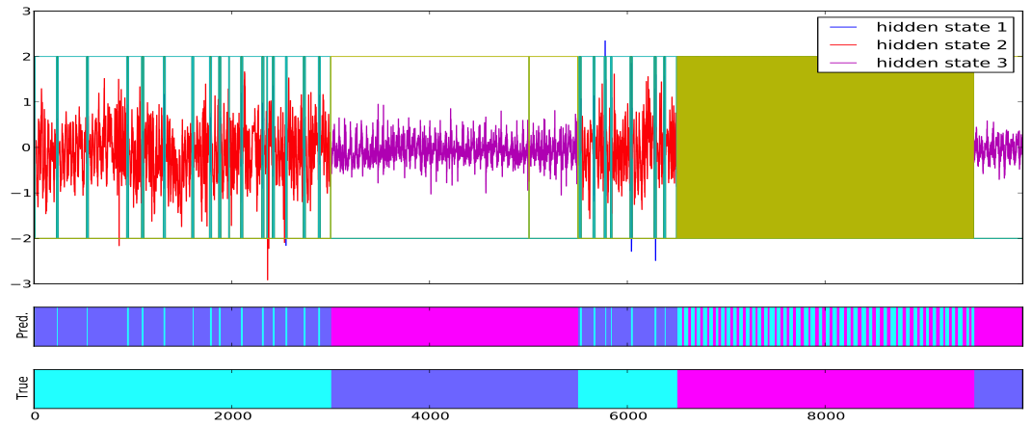
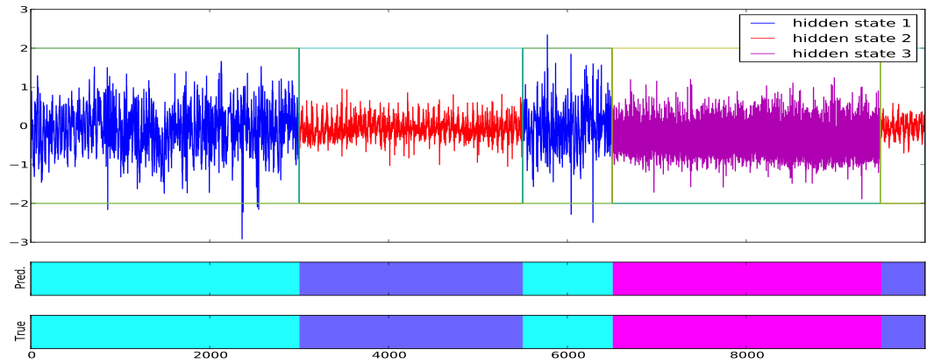
Results
Standard HMM
Inertial HMM

Slide 19
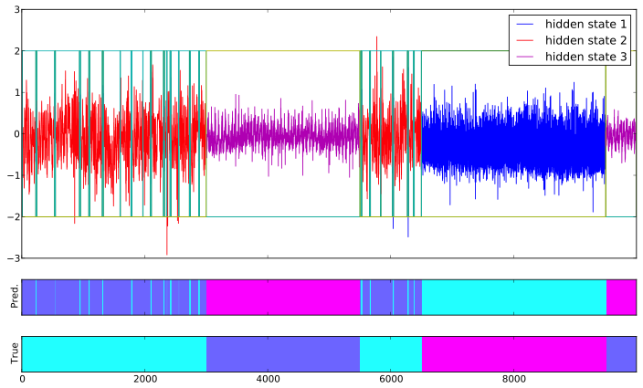
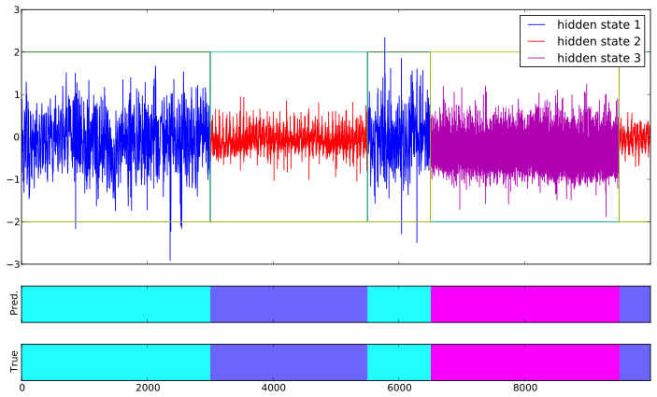
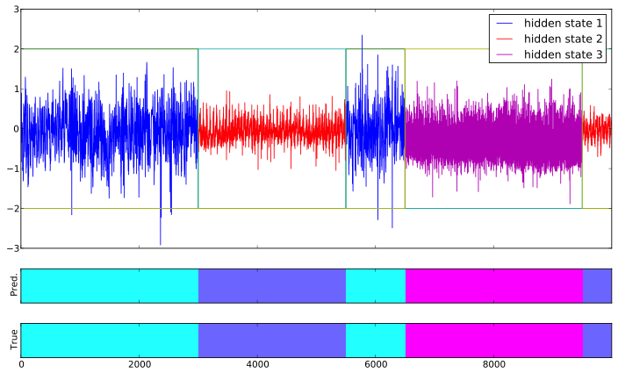

(In)sensitivity of ζ Parameter
ζ = 1.5
ζ = 3
ζ = 30
ζ = 70

Slide 20
Related Work
Sticky HDP-HMM (Fox et al.)
Hierarchical Dirichlet Process HMM learned by truncated Gibbs sampling
Strengths:
Persistent states – Chinese Restaurant Process
No need to specify number of states a priori
Weaknesses:
Complex implementation / process
Computationally intensive (must be truncated and block sampled)
Must define priors / hyperparameters
Switching Linear Dynamical Systems
Each HMM state has unique linear dynamical system associated with it
Strengths:
Can learn sub-state dynamics
Allows for more accurate forecasting
Weaknesses:
Requires variational or sampling methods for learning

Slide 21
Related Work
Change-Point Detection Methods
Use statistical tests to determine when a signal is no longer a good match to the historical signal
Strengths:
Can be done in online manner
No need to specify number of states beforehand
Weaknesses:
No states given – only segmentation points
Additional ad hoc clustering must be performed to recover state identities

Slide 22
Our Method
Inertial Regularized HMM
Add state persistence regularization to standard HMM
Strengths:
Easy implementation – single change to standard update rule
Low computational overhead
Outputs persistent state sequences
May be extended to online learning methods
Weaknesses:
Need to specify number of states in advance
Must specify regularization parameter ζ

Slide 23
Future Work and Extensions
Comparison with Sticky HDP-HMM Method
Will compare our method to the Sticky HDP-HMM on the same segmentation task
Online Learning
Can replace batch process with online learning of inertial HMM
Allows for scaling to massive datasets
SLDS with state persistence
Done by Fox et al. on sticky HDP-HMM with SLDS dynamics (2011)
Extend using BATS/TBATS models? Online learning?

Slide 24
Thank You!
Questions?
I will now happily embarrass myself attempting to answer them.

