Slide 1
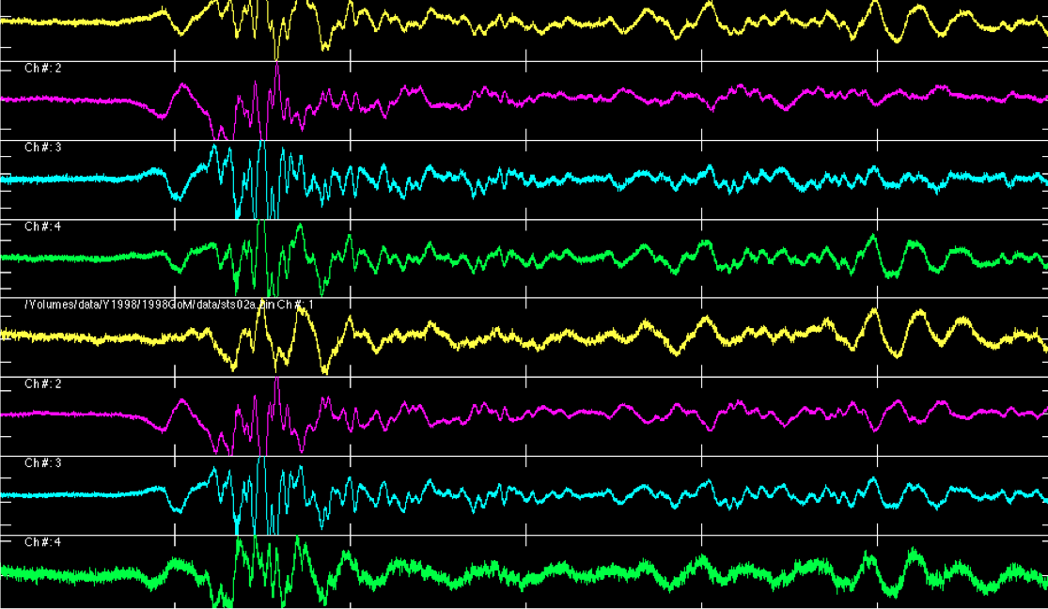
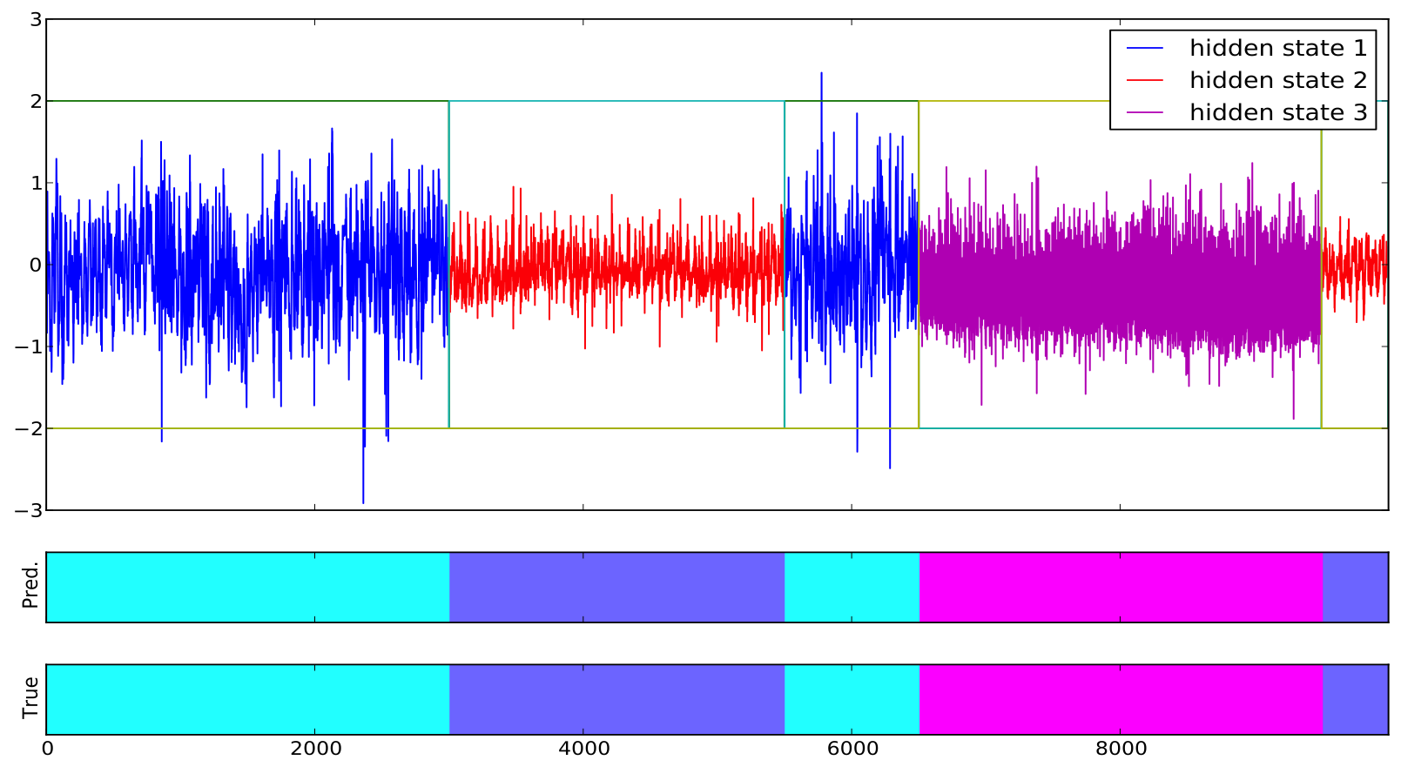
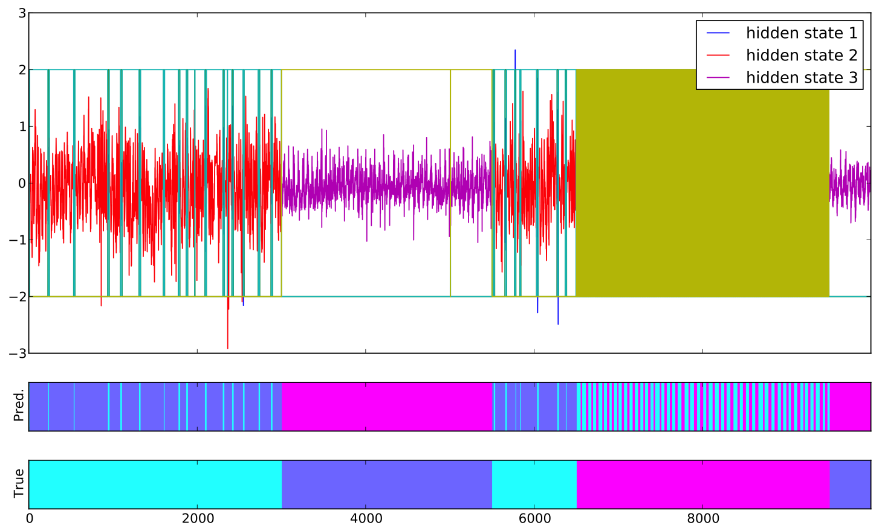



Inertial Hidden Markov Models: Modeling Change in Multivariate Time Series
George D. Montañez (Carnegie Mellon University) | Saeed Amizadeh (Yahoo Labs) | Nikolay Laptev (Yahoo Labs)
Motivation
Dataset
Results
Yahoo monitors millions of time series each day, looking for changes in the signals for advanced analytics.
Goal: Given a multivariate time series, find where systematic changes occur and map segments to a small number of states with infrequent state transitions, aka state persistence.
45D human activity accelerometer data
Activities included jumping, playing basketball, rowing, ascending stairs and walking.
Created 100 time series consisting on different combinations of activities and segmentations, 10K time steps each series.
Tested inertial methods performed vs standard HMM and Sticky HDP-HMM of Fox et al.
MAP Inertial HMM – Example Segmentation
Hidden Markov Models
Works well for segmenting sequential data.
However, may over-segment leading to frequent state transitions.
We need to impose state-persistence, i.e., few state changes over time.
Extensions
Automated parameter selection for inertial HMMs.
Used to select parameters in Results section.
Online learning of inertial HMM model.
Evaluation Metrics
Evaluated using:
Accuracy (for best permutation of labels)
Variation of Information
Number of Segments Difference (not shown)
Segment Number Ratio (not shown)
Main Advantages
Works well on synthetic and real-world data.
Very simple (change single update equation).
Computationally efficient.
Only two parameters, one automatically selected.
Does not suffer from extreme sensitivity to parameter settings, as does sticky HDP-HMM.
Sticky HDP-HMM
Inertial HMMs
State-of-the-art Bayesian hierarchical Dirichlet process hidden Markov model.
Used publically available HDP-HMM toolbox, with default parameters for priors.
κ – parameter, for “stickiness” of states.
Truncation parameter L set to correct number of states.
Sensitive to prior parameter values (see Results).
Two models which impose state persistence through a change to the likelihood model and corresponding expectation maximization (EM) update equations.
Conclusion
Simple modification of standard HMMs performs well on unsupervised segmentation task.
Strongly outperforms state-of-the-art sticky HDP-HMM with default parameters.
MAP Inertial HMM
Pseudo-Observation Inertial HMM
Include Dirichlet prior on transition matrix.
Governed by a strength parameter, ς
Alter the complete data-likelihood to include fictional self-transition observations.
Governed by strength parameter, ς.
Results
References
Method | Accuracy | Var. of Info.
Standard HMM | 0.79 | 0.38
Sticky HDP-HMM (κ = 100.0) | 0.60 | 0.95
MAP Inertial HMM (ς = 33.5) | 0.94 | 0.14
PsO Inertial HMM (ς = 49.0) | 0.94 | 0.15
Emily B Fox, Erik B Sudderth, Michael I Jordan, Alan S Willsky, et al., A sticky HDP-HMM with application to speaker diarization, The Annals of Applied Statistics 5 (2011), no. 2A, 1020–1056.

