Slide 1
Results of experiments 17.11

Slide 2
Algorithms impact
sberbank-russian | support | mape | rmse | mae | r2
NoAD | 2742.3 | 0.4426 | 2744678 | 1461268 | 0.6736
EE | 2742.3 | 0.4426 | 2732817 | 1459262 | 0.6763
OC-SVM | 2742.3 | 0.4424 | 2742630 | 1460358 | 0.6741
Isol-frst | 2742.3 | 0.4425 | 2743417 | 1460354 | 0.6739
LOF | 2742.3 | 0.4427 | 2739375 | 1459722 | 0.6748
Santader | support | mape | rmse | mae | r2
NoAD | 401.3 | 7.8789 | 7024610 | 4739177 | 0.2652
EE | - | - | - | - | -
OC-SVM | 401.3 | 7.9079 | 7020595 | 4731940 | 0.2658
Isol-frst | 401.3 | 7.8789 | 7024610 | 4739177 | 0.2652
LOF | 401.3 | 7.9043 | 7003920 | 4737313 | 0.2694
house-prices | support | mape | rmse | mae | r2
NoAD | 131.4 | 0.0914 | 26535.54 | 15771.94 | 0.8836
EE | 131.4 | 0.0913 | 26491.01 | 15769.29 | 0.8839
OC-SVM | 131.4 | 0.0923 | 26615.69 | 15898.83 | 0.8828
Isol-frst | 131.4 | 0.0924 | 26840.77 | 15952.57 | 0.8809
LOF | 131.4 | 0.0914 | 26526.55 | 15767.76 | 0.8837
allstate-claims-severity | support | mape | rmse | mae | r2
NoAD | 16948.6 | 0.6145 | 1893.294 | 1193.647 | 0.5739
EE | 16948.6 | 0.6147 | 1895.105 | 1193.697 | 0.5731
OC-SVM | - | - | - | - | -
Isol-frst | 16948.6 | 0.6149 | 1891.684 | 1193.541 | 0.5747
LOF | 16948.6 | 0.6151 | 1896.537 | 1194.073 | 0.5723
CaliforniaHousing | support | mape | rmse | mae | r2
NoAD | 1857.6 | 0.1815 | 47966.04 | 32189.05 | 0.8262
EE | 1857.6 | 0.1813 | 47906.37 | 32148.53 | 0.8267
OC-SVM | 1857.6 | 0.1814 | 47966.72 | 32190.47 | 0.826
Isol-frst | 1857.6 | 0.181 | 47892.01 | 32122.19 | 0.8267
LOF | 1857.6 | 0.1815 | 47989 | 32198.44 | 0.8259
R2 | NoAD | EE | OC-SVM | Isol-frst | LOF
sberbank-russian | 0.6736 | 0.6763 | 0.6741 | 0.6739 | 0.6748
house-prices | 0.8836 | 0.8839 | 0.8828 | 0.8809 | 0.8837
CaliforniaHousing | 0.8262 | 0.8267 | 0.826 | 0.8267 | 0.8259
Santader | 0.2652 | - | 0.2658 | 0.2652 | 0.2694
allstate-claims-severity | 0.5739 | 0.5731 | - | 0.5747 | 0.5723
* “-" means that method does not converged

Slide 3
Testing on anomalies data

Slide 4
Testing on normal data

Slide 5
Testing on anomalies VS normal data

Slide 6
Training on normal data

Slide 7
Testing on test data

Slide 8
Training on anomalies VS normal data

Slide 9
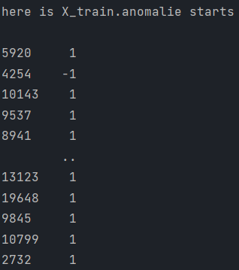
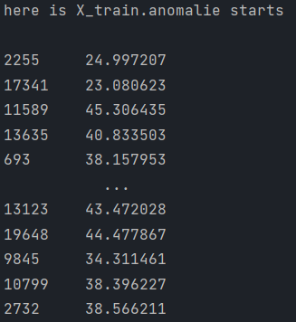
Soft(EE)
EE - shifted Mahalanobis distances. The threshold for being an outlier is 0, which ensures a compatibility with other outlier detection algorithms.

Slide 10
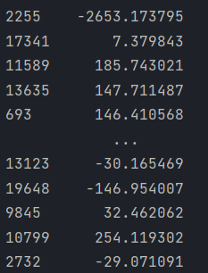
Soft (OC-SVM) - Signed distance to the separating hyperplane.

Slide 11
iForest - Average anomaly score of X of the base classifiers.

Slide 12
Soft – LOF - Shifted opposite of the Local Outlier Factor of X. Bigger is better, i.e. large values correspond to inliers.

Slide 13
Appendix A. Methods

Slide 14

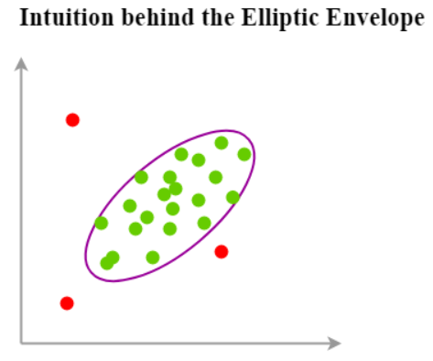
EllipticEnvelope (Anamoly score +)
EllipticEnvelope - An object for detecting outliers in a Gaussian distributed dataset.
no. of samples > no. of features ** 2
For Elliptic Envelope and Isolation Forest, we use Breast Cancer Winsoncin data from UCI.

Slide 15
Methods
OneClassSVM - OCSVM assumes that anomalies can form dense clusters as long as they form a low-density region in the training dataset.

Slide 16
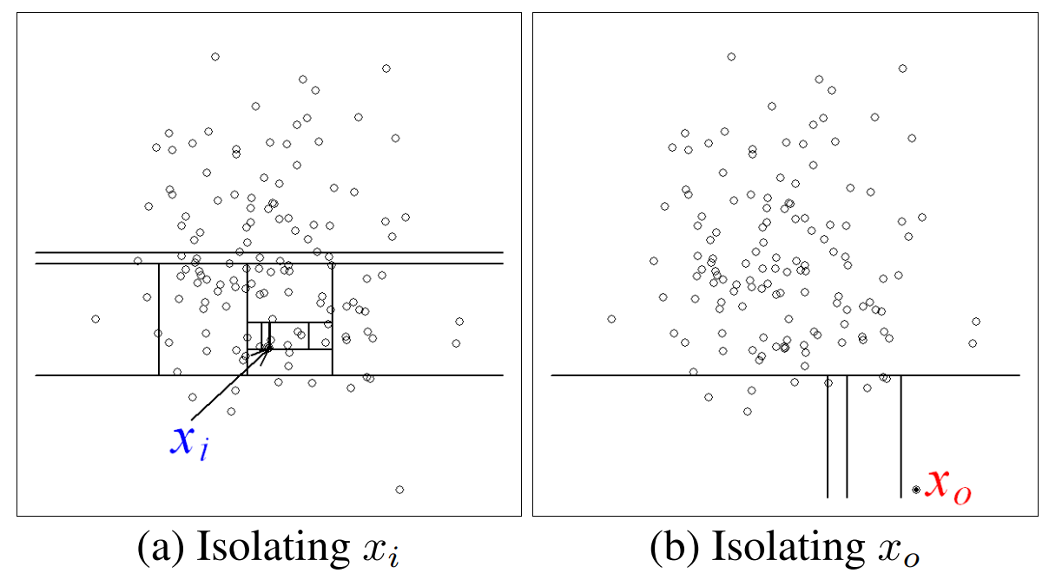
IsolationForest (Anamoly score +)
IsolationForest - Isolation Forest isolates anomalies instead of profiling the normal data points.
*https://cs.nju.edu.cn/zhouzh/zhouzh.files/publication/icdm08b.pdf?q=isolation-forest
The Isolation forest isolates the observation by applying a recursive partition to randomly select a feature and then randomly select a split value between the minimum and maximum value for the selected feature.
Isolation forest is built on an ensemble of ExtraTreeRegressor.
The IsolationForest ‘isolates’ observations by randomly selecting a feature and then randomly selecting a split value between the maximum and minimum values of the selected feature.

Slide 17

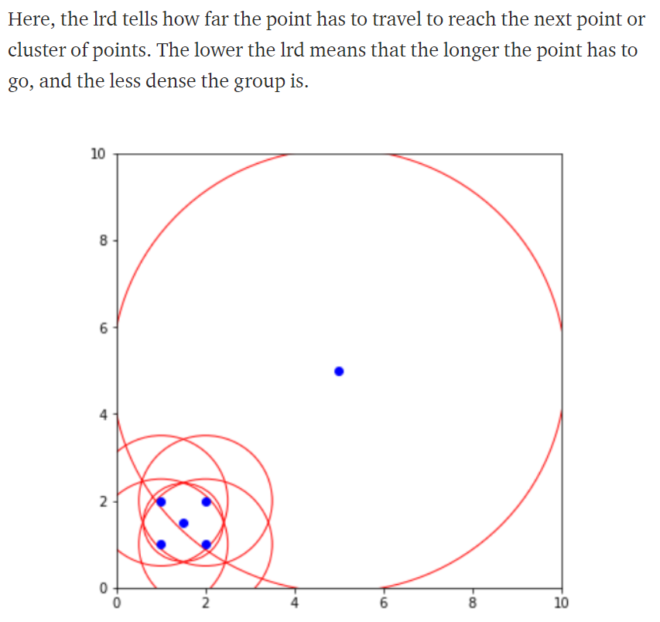
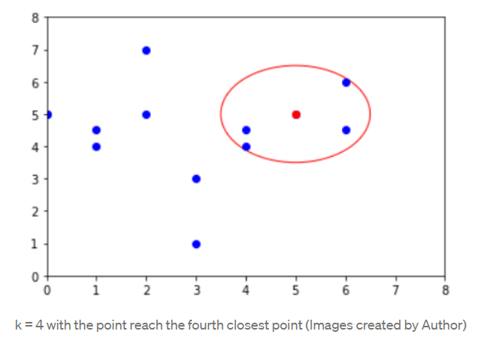
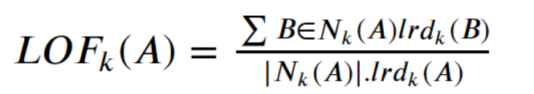
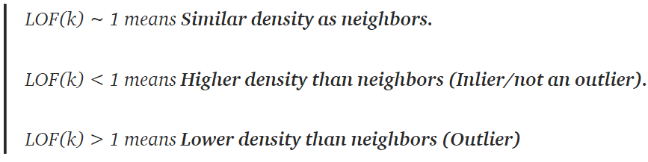
Methods. LocalOutlierFactor (Anamoly score +)
Measuring the local deviation of a given data point with respect to its k-nearest neighbors.
The distance is now used to define what we called reachability distance. This distance measure is either the maximum of the distance of two points or the k-distance of the second point.

Slide 18
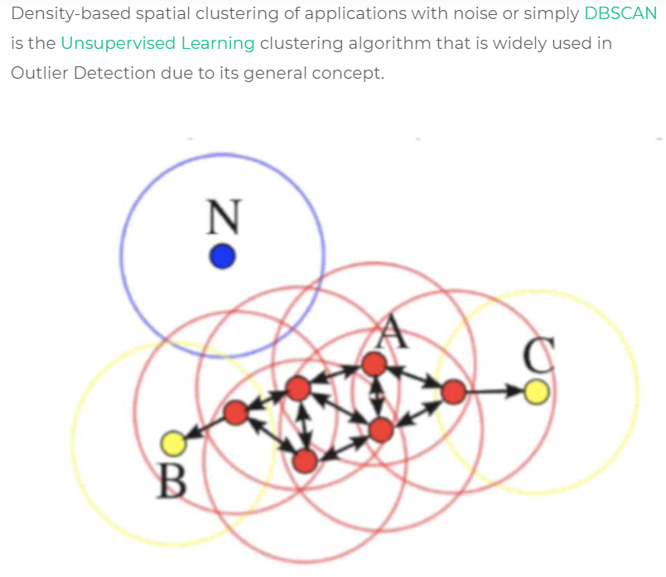
Need to add DBSCAN?

Slide 19
Sources
https://medium.com/swlh/anomaly-detection-techniques-part-1-962b0494f9cf
https://medium.com/learningdatascience/anomaly-detection-techniques-in-python-50f650c75aaf

