Slide 1
Classification for detecting anomalies. Research of categorical encoders and imputation methods

Slide 2
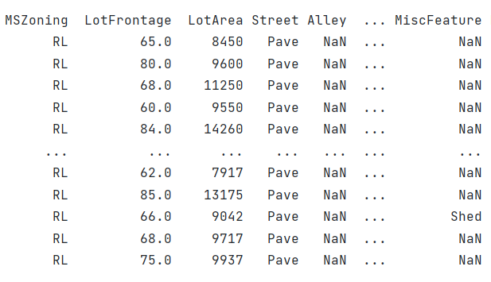
Project description
Classification methods for detecting anomalies can help in solving important applied problems in engineering, finance and medicine. They process data and help to learn new information about objects.
But for anomaly detection algorithms, the data must be of good quality, which is not common. Due to the inability of anomaly detection algorithms to work with categorical values and missing data encoding and imputation models have been presented. The study of the effect of these methods is the purpose of this research.
Table 1. Example of data with categorical values and missing data in “house-prices-advanced-regression-techniques” dataset.

Slide 3
Pipeline
Encoding of categorical data
Imputation of missing data
Anomaly Detection
Dummy Encoding
Hash Encoding
Target Encoding
Discard data
Complete-case analysis
Available case analysis
Univariate imputation
Mean
Median
Mode
Multiple Imputation by Chained Equations
K-Nearest Neighbor
Elliptic Envelope
One-Class SVM
Isolation Forest
LocalOutlierFactor

Slide 4
Performance evaluating & description of datasets
The performance of the methods is considered by the effect on the final RMSE when solving the regression problem by LightGBM. The RMSE mean and standard deviation of 10-fold Cross-Validation are used.
Evaluation metrics were calculated on: "house-prices-advanced-regression-techniques". Missing values: 6965 / 115340, (6.039%). The following ratio of "NaN" data are used:
6% of missed data (Initial dataset)
30% of missed data
50% of missed data
* In dataset "house-prices-advanced-regression-techniques" there are missing data in each row. Complete-Case Analysis is not available.

Slide 5
Expirements (Best combinations)
6% of missing data | RMSE | The importance of the anomaly indicator
1. Default model | 27582.549 (5511.916) | -
2. Target Encoding + Median imputation | 27535.075 (5445.082) | -
3. Elliptic Envelope (Target Encoding + Median imputation) | 27517.042 (5544.918) | 0.0000518 (0.0000541)
4. One-Class SVM (Target Encoding + Median imputation) | 27467.854 (5394.370) | -0.0000723 (0.0001001)
5. Isolation Forest (Target Encoding + Mode imputation) | 27451.540 (5365.327) | -0.0016849 (0.0059135)
6. LocalOutlierFactor( Target Encoding + K-NN) | 27537.623 (5437.554) | 0.0000096 (0.0000337)
30% of missing data | RMSE | The importance of the anomaly indicator
1. Default model | 33165.202 (4617.468) | -
2. Target Encoding + MICE | 30188.023 (5813.186) | -
2. Elliptic Envelope (Target Encoding + MICE) | 30094.619 (5741.747) | -0.0003155 (0.0000924)
3. One-Class SVM(Target Encoding + MICE) | 30142.952 (5766.397) | -0.0004070 (0.0003780)
4. Isolation Forest (Target Encoding + MICE) | 30037.433 (5642.734) | -0.0095051 (0.0035107)
5. LocalOutlierFactor (Target Encoding + MICE) | 30108.693 (5764.039) | -0.0000030 (0.0000933)
50% of missing data | RMSE | The importance of the anomaly indicator
1. Default model | 40571.481 (5936.180) | -
2. Target Encoding + MICE | 35892.779 (5715.790) | -
3. Elliptic Envelope (Target Encoding + MICE) | 35725.265 (5618.712) | 0.0001082 (0.0001855)
4. (Best) One-Class SVM(Target Encoding + MICE) | 35629.558 (5657.682) | -0.0003512 (0.0002492)
5. Isolation Forest (Target Encoding + MICE) | 35720.589 (5642.171) | -0.0181765 (0.0067545)
6. LocalOutlierFactor (Target Encoding + MICE) | 35775.763 (5683.544) | 0.0001991 (0.0001781)

Slide 6
Results (Best combinations)
Using the pipeline described above is beneficial because the RMSE values are improving in all cases.
Best preprocessing combination: Target Encoding + MICE
Anomaly detection methods reduce RMSE compared to cases with default data / encoding & imputation only.

Slide 7
Expirements (progress since last report)
Anomalies detection method | Concept | RMSE | Importance | Count
Elliptic Envelope | (Old) One-Hot Encoding (nan has become a feature of *_nan) | 27626.411 (5486.364) | 0.0000406 (0.0000190) | 113
 | (New) Target Encoding + Median imputation + Elliptic Envelope | 27517.042 (5544.918) | 0.0000518 (0.0000541) | 146
One-Class SVM | (Old) One-Hot Encoding (nan has become a feature of *_nan) | 27678.004 (5533.849) | 0.0000345 (0.0000809) | 560
 | (New) Target Encoding + Median imputation + Elliptic Envelope | 27467.854 (5394.370) | -0.0000723 (0.0001001) | 730
Isolation Forest | (Old) One-Hot Encoding (nan has become a feature of *_nan) | 27173.646 (5636.475) | 0.0025560 (0.0025115) | 112
 | (New) Target Encoding + Median imputation + Elliptic Envelope | 27451.540 (5365.327) | -0.0016849 (0.0059135) | 146
LocalOutlierFactor | (Old) One-Hot Encoding (nan has become a feature of *_nan) | 27733.654 (5553.494) | -0.0002322 (0.0005277) | 30
 | (New) Target Encoding + Median imputation + Elliptic Envelope | 27552.646 (5413.188) | -0.0001870 (0.0003610) | 73

Slide 8
Thank you for watching!

Slide 9
Plans
How to incorporate partial information labels of anomalous/normal data, if it exists (semi-supervised learning scenario)?
How to perform model selection, e.g. to select the kernel width? Is it possible to perform efficient multiple kernel learning and use it for model selection?
Whether we can efficiently introduce privileged information about object features during the learning phase?
How to perform efficient incremental learning?
Apply casual-inference?

