Slide 1

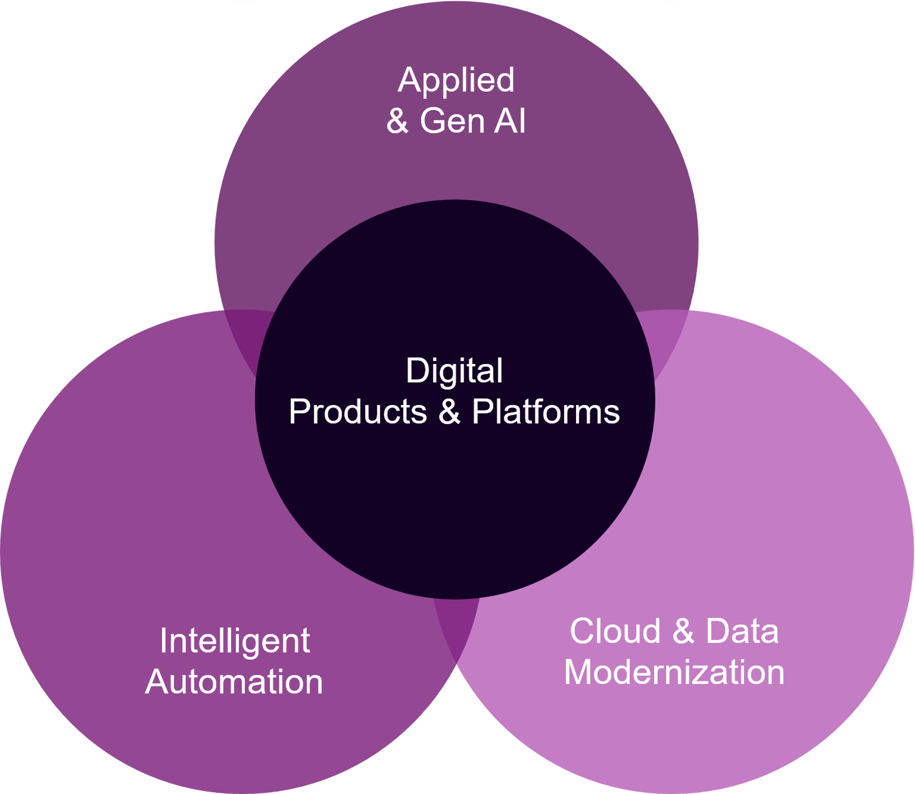
Xebia response to Zeppelin Power EMS RFP
A new AI-driven era of digital transformation has emerged. At Xebia, we’ve moved beyond the outdated definitions and siloed IT Services that served the last era of business transformation. Instead, we have redefined our consulting, engineering, and upskilling services to address five core areas of digital convergence that our clients have prioritized to ensure their success in the modern era of business.
These areas of convergence in our expertise and client needs are built on 20+ years of foundational experience building software and partnering with our clients on their digital transformation journey.
Foundational Competencies
AI-powered Industry Digitalization
Digital Strategy & CX
Agile Ways of Working
Enterprise Architecture
Product Management
Technology Strategy
Change Management
Design Thinking
Industry
Enterprise Function
Technology
Consulting | Engineering Training
We partner with clients and across our ecosystem to design, build, manage, and upskill organizations to thrive in this AI era of digital transformation.
Upskilling & Staffing
Academy
Xccelerated
University
Partner Ecosystem
AWS
Microsoft
Google
GitHub
OutSystems
Appian
Mendix
Salesforce
DataBricks
ThoughtMachine
UIPath
Atlassian
DataStax
Snowflake
Mindware
Backbase

Slide 2




At Xebia, we’ve reimagined our business to address a new AI-powered transformation agenda with our clients
Xebia response to Zeppelin Power EMS RFP
Industry Digitalization
Partner
Ecosystem
Banking, FS
& Insurance
Retail &
Consumer
Travel &
Hospitality
Technology
& Media
Other Industries
Applied &
Generative AI
Smart Onboarding
and CX
Ecommerce Solutions
Intelligent Travel Merchandizing
AI Infused SDLC
Business Outcomes
Digital Products & Platforms
Consulting
Engineering
Training
Future of Lending
Customer Relationship Management
CX & Loyalty Management
Smart Cloud Services
New Business Models
Competitive Differentiation
Accelerated Growth
Operational Efficiency
Speed to Market
Intelligent Automation
Supply Chain Management
Supply Chain Management
Personalization Engines
Data Management & Analytics
Point of Sale Systems
Point of Sale Systems
Dynamic Pricing & Revenue Management
Digital Transformation Services
AI/ML & Augmented Solutions
AI/ML & Augmented Solutions
Technical Support & Maintenance
Cloud & Data Modernization
+ More

