Slide 1
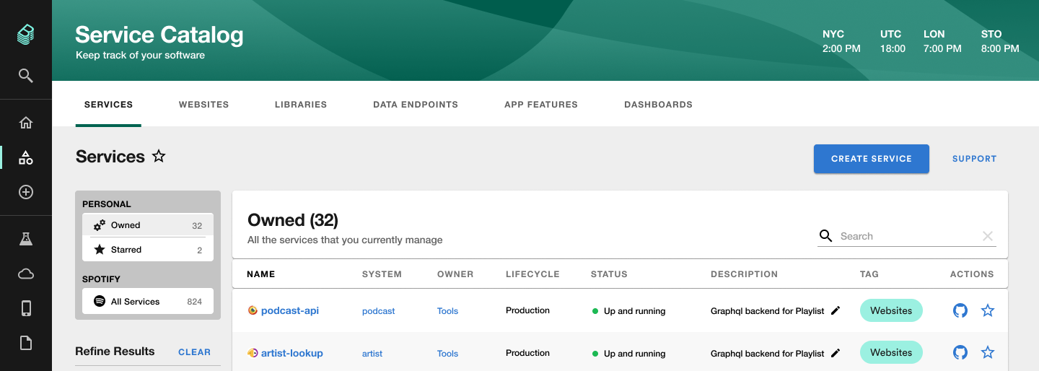
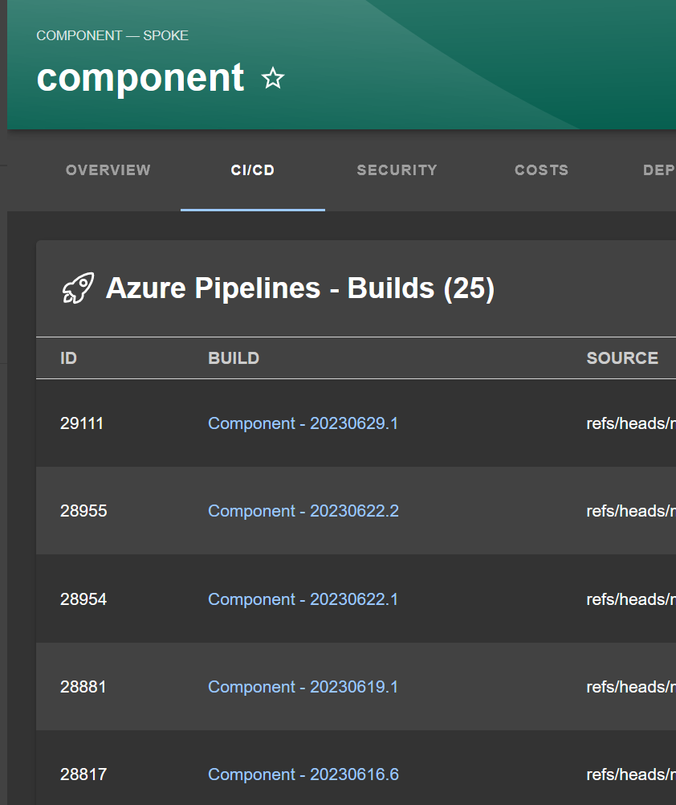
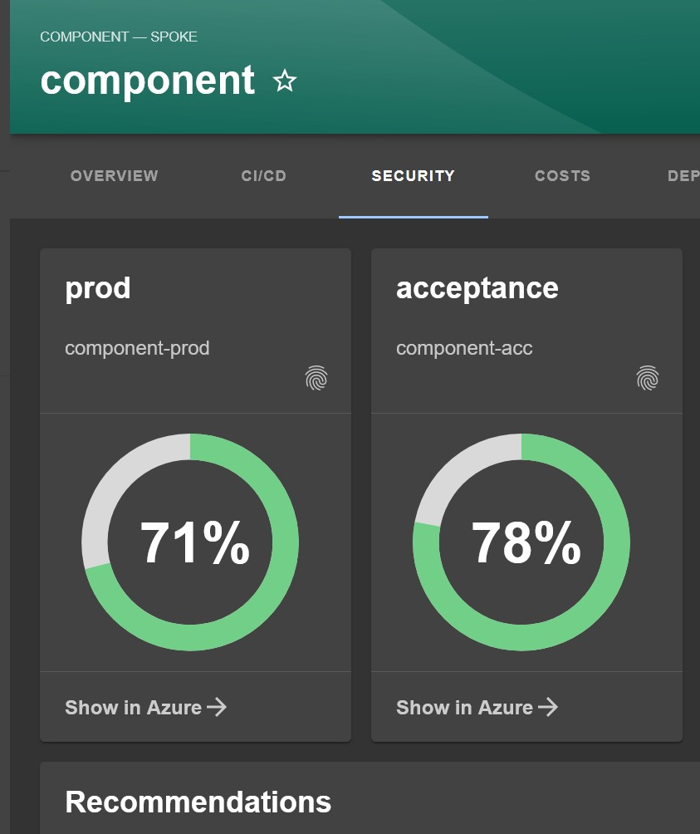
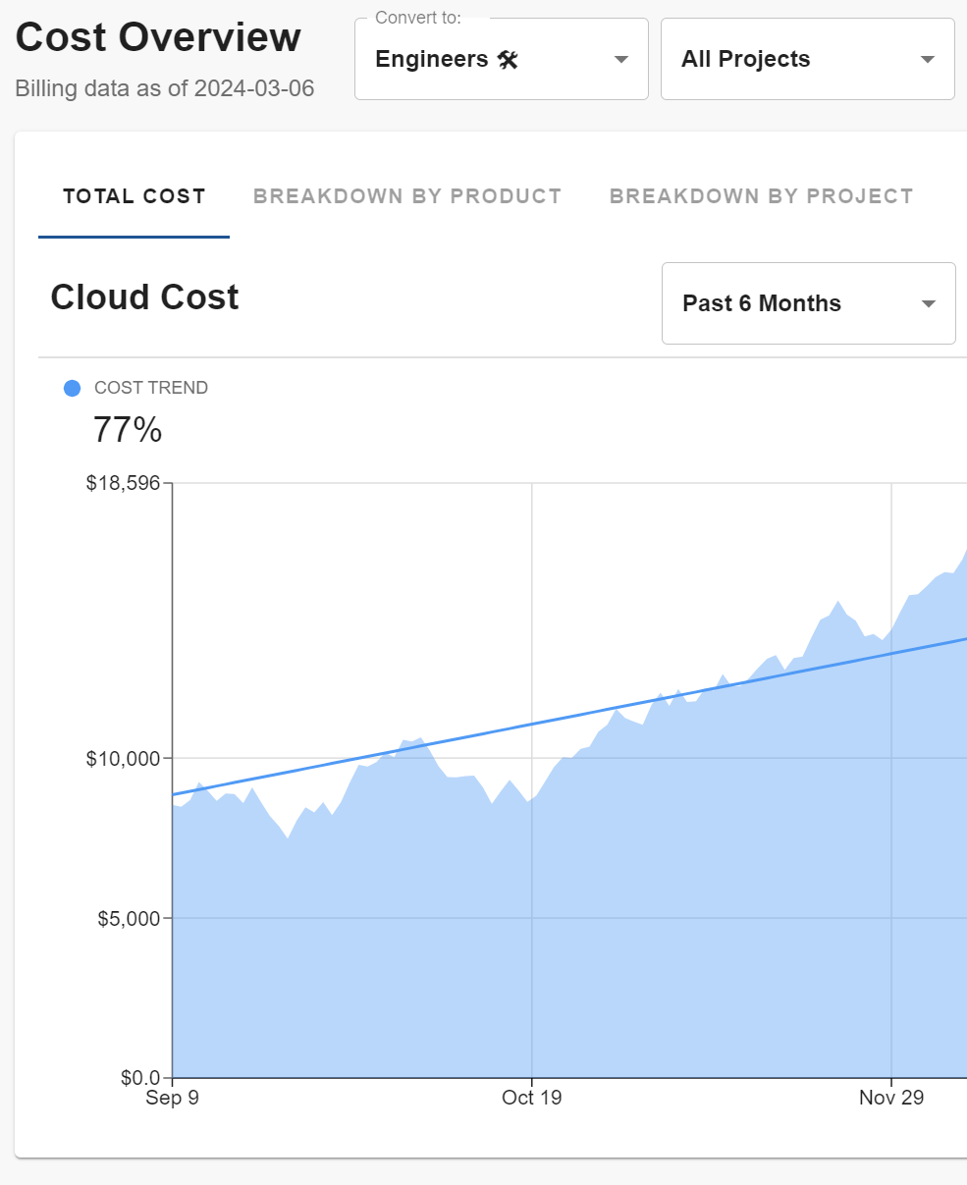
Azure Landing Zone
Service Catalog
Xebia response to Zeppelin Power EMS RFP
A well-implemented Landing Zone allows you to:
Easily provision new resources
Review cost and environmental impact of each workload
Clearly and fully separate workloads
Consistently apply and update security policies
Create self-supporting application teams
Pipeline Status
Security Insights
Cost Insights

