Slide 1

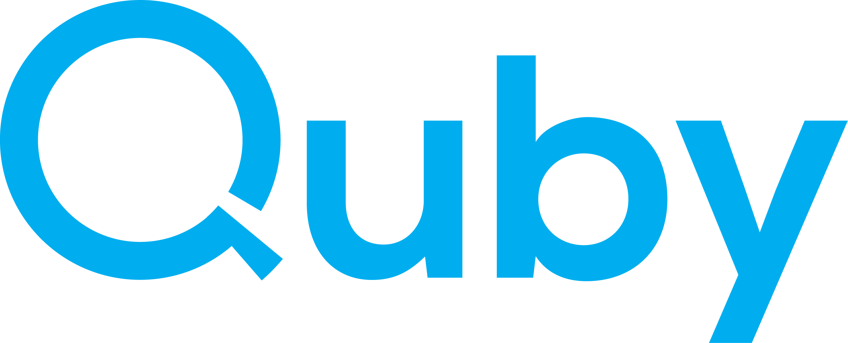
Xebia response to Zeppelin Power EMS RFP
Unified Data Analytics Platform on AWS Infrastructure
Business Challenge
The client was facing a challenge in implementing a scalable & flexible infrastructure​:
The backend system for ‘the smart thermostat’ was running in an on-premises data centre in Amsterdam​
To effectively roll-out smart thermostats and connected apps throughout Europe, it needed a flexible and scalable infrastructure that could be easily activated by its own operations teams​
Become a data-driven organization that develops applications that help customers save energy, while respecting their privacy
Solution
Created an immutable infrastructure using AWS CloudFormation, Mesos & Marathon and Docker​
Evaluated cloud-based analytics solutions to improve infrastructure & operations management while empowering data teams to drive better and more efficient collaboration.​
Introduced smart data-driven solutions, using Databricks on Amazon Web Services by leading the development of production-ready data products, introducing a data science workflow, and sharing knowledge, both on the job and through intensive training programs.​
Helped client to modernize its data center setup. Created an immutable infrastructure using AWS CloudFormation, Mesos & Marathon, and Docker. ​
The project activities encompassed design and migration, as well as training client’s operations staff to adapt to the new paradigm.​
Client’s first data services from proof of concept (POC) to product took over 12 months; the second release took four months, followed by, Quby was able to release products to development within eight weeks.
Impact
Flexible and automated set-up helped to add a new tenant in a few days & completed production environment serving over 300.000 devices to the cloud within two hours after changing the DNS record​
Captured, stored, and processed ML algorithms in cloud and provided valuable data insights to customers

Slide 2

Xebia response to Zeppelin Power EMS RFP
Building a Scalable, Real-Time Data Platform
Business Challenge
Axpo sought to modernize its data infrastructure to support real-time analytics, cross-entity data collaboration, and scalable reporting across its international operations. The existing systems lacked the agility and integration capabilities required to meet evolving business demands and regulatory expectations
Our Solution
We designed and delivered a modern data platform tailored to Axpo’s enterprise-scale needs. The solution was architected on Google Cloud Platform (GCP) with Snowflake as the central data warehouse and Power BI for business reporting. Key components included:
  Data Transformation & Orchestration: All transformations were implemented using dbt, orchestrated via Apache Airflow through Google Cloud Composer, ensuring modular, testable, and version-controlled pipelines.
  Real-Time Data Integration: A real-time ingestion layer was built using Google Cloud’s Managed Service for Apache Kafka, enabling high-throughput, low-latency streaming
  Data Lakehouse Architecture: Data was stored in Apache Iceberg tables on Google Cloud Storage, with Kafka Connect facilitating seamless data movement between systems.
  Secure Data Sharing: Leveraging Snowflake’s Secure Data Sharing capabilities,
  Axpo can now collaborate securely with other entities within its corporate group, enabling federated analytics and governance.
Business Impact
  Accelerated Time-to-Insight: Real-time data availability and streamlined reporting workflows significantly reduced the time required to generate actionable insights.
  Improved Data Governance: Centralized orchestration and transformation logic enhanced transparency, auditability, and compliance.
  Scalable Collaboration: The platform supports secure, scalable data exchange across business units and partners, fostering innovation and operational efficiency.

