Slide 1
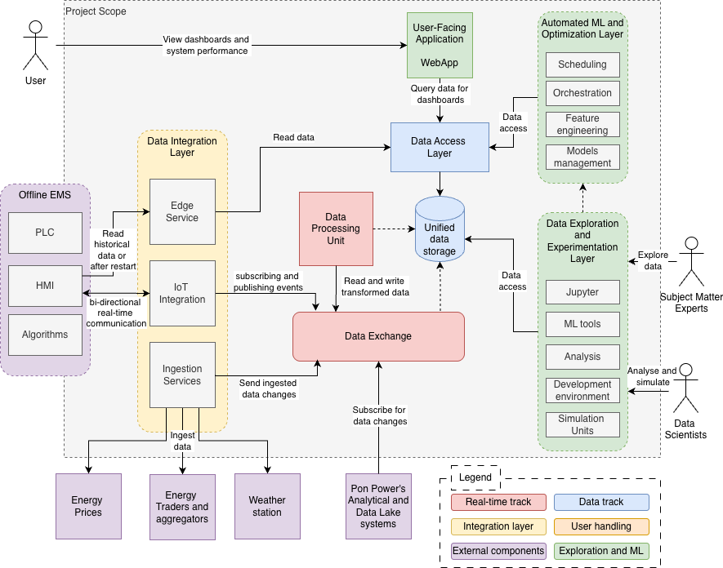
High-level architecture
Xebia response to Zeppelin Power EMS RFP
Data Integration Layer – Manages communication with external devices and third-party services.
Data Exchange Layer – Facilitates efficient communication and data flow between internal system components.
Processing Unit – Performs (near) real-time data transformations and executes rule-based algorithms.
User-Facing Application – Provides clear visibility into the performance and status of clients’ microgrid systems.
Data Access and Storage Layer – Ensures secure data retention and delivers low-latency access for operational and analytical workloads.
Machine Learning and Optimization Layer – Supports advanced analytics, model training, and delivery of optimization insights.
Data Exploration Layer – Serves as an experimentation environment for research, simulations, and analysis.

