Slide 1

Real Estate Machine
Real Estate Machine: Smart Segmentation, Accurate Pricing, and Client Guidance for Better Investments

Slide 2
Table of Contents
01
Data Cleaning & Understanding
Handle missing values, outliers, and data types.
Explore distributions, correlations, and feature importance.
02
Exploratory Analysis & Business Insights
Analyze price drivers
Provide recommendations for a real estate company (e.g., where to invest, which features matter most).
03
Unsupervised Learning (Clustering)
Apply clustering to group properties.
Define meaningful categories for clusters.
04
Category Classification
Preprocess data and build a classifier that predicts the cluster category for new houses.
05
Price Regression Modeling
Build regression models to predict prices.
Evaluate using metrics.
Students must research market-acceptable error levels.
06
LLM-based Model Interpretation
Use a Large Language Model (LLM) to interpret regression predictions:
Why was this price predicted?
Is it realistic compared to the market?.
07
Deployment
Build a Streamlit app

Slide 3
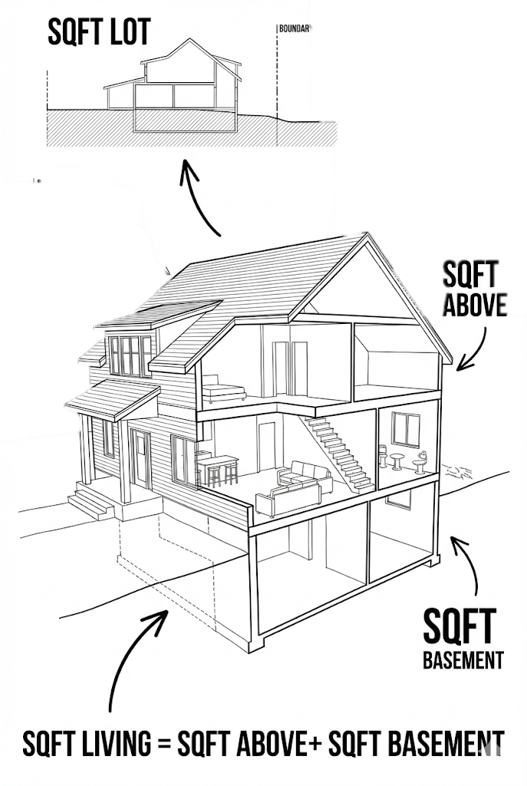
01. Data Cleaning & Understanding
Dataset Overview & Structure
Purpose: Understand the Washington housing market and prepare data for pricing and segmentation decisions.
Dataset Summary:
4,600 residential properties (Washington, USA)
18 final features after cleaning
No missing values or duplicates
Feature Groups (Business-Oriented):
Time (sale date):date
Pricing (Target):price
Property Size & Space: sqft_living, sqft_lot, sqft_above, sqft_basement
Rooms & Layout: bedrooms, bathrooms, floors
Quality & Condition: condition, view, waterfront
Property Age: yr_built, yr_renovated
Location: city, statezip, street, country
Data Consistency Check Verified: sqft_living = sqft_above + sqft_basement

Slide 4

01. Data Cleaning & Understanding
Data Cleaning & Preparation
Key Cleaning Actions: Converted date fields to proper datetime format
Removed logically invalid records:
Price = 0
Bedrooms =0
Bathrooms = 0
Removed Columns (Low Business Value):
street → Too granular, high cardinality
country → Single value (USA)
Impact:
Cleaner dataset
Reduced noise
Better generalization for models
Business Value: Prevents misleading price predictions and unrealistic property profiles.

Slide 5
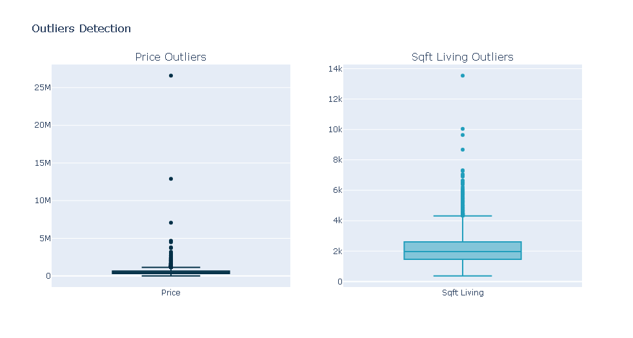
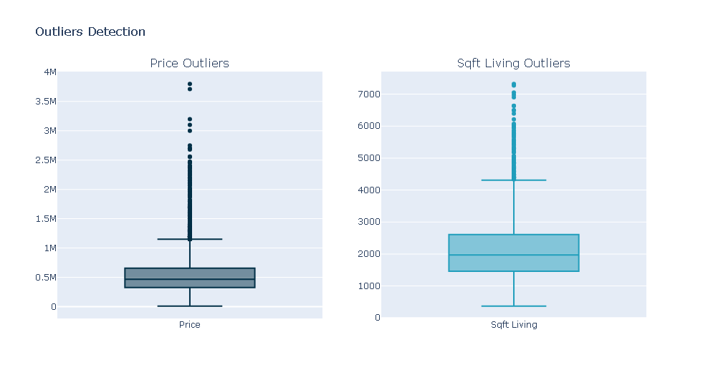
01. Data Cleaning & Understanding
Outlier Analysis (Business-Driven Filtering)
Problem Identified:
Extreme luxury properties distorted market behavior:
Max price: $26.59M
Max Sqft Living: 13.54k
Outlier Analysis Results:
Price outliers detected: 239
Sqft_living outliers detected: 127
Business Decision (Not Aggressive Removal):
Removed only extreme cases that distort the market:
Houses with price > $4,000,000 → 5 properties
Houses with sqft_living > 7,320 → 4 properties
Why This Matters:
Keeps luxury segment realistic
Improves pricing accuracy for 99% of the market

Slide 6
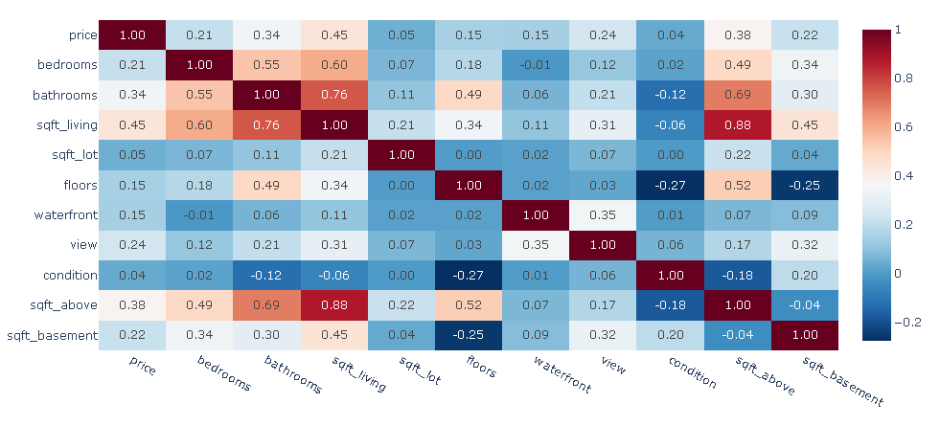
01. Data Cleaning & Understanding
Feature Correlation Heatmap

Slide 7
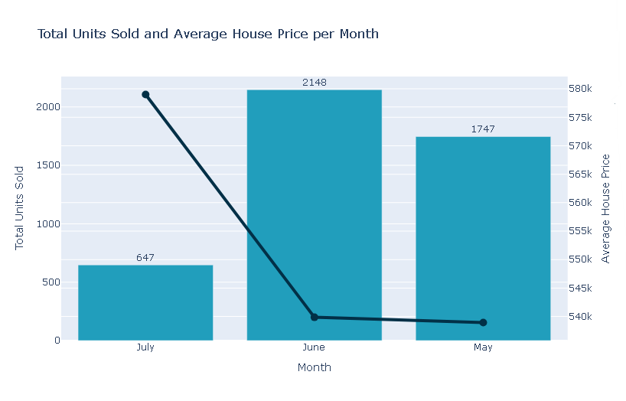
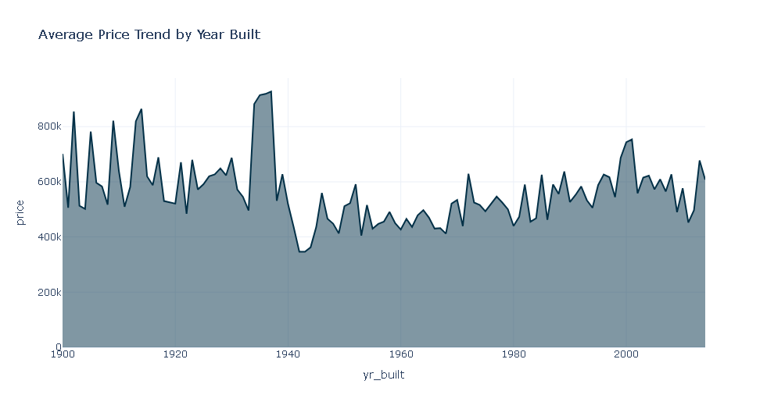
02. Exploratory Analysis & Business Insights
01. Market Timing & Property Age
Key Question: When is the best time to sell, and does house age really reduce value?
Insights:
Market Seasonality:
Sales peak in June, confirming summer as the optimal selling season for faster liquidity.
Year Built vs Price:
New houses (post-2000) command premium prices.
Very old but renovated houses also maintain high value.
Age vs Condition:
Property condition offsets age depreciation; well-maintained older homes do not lose value significantly.
Renovation Opportunity:
Only a small portion of houses are renovated, yet renovated units consistently sell at a price premium.

Slide 8
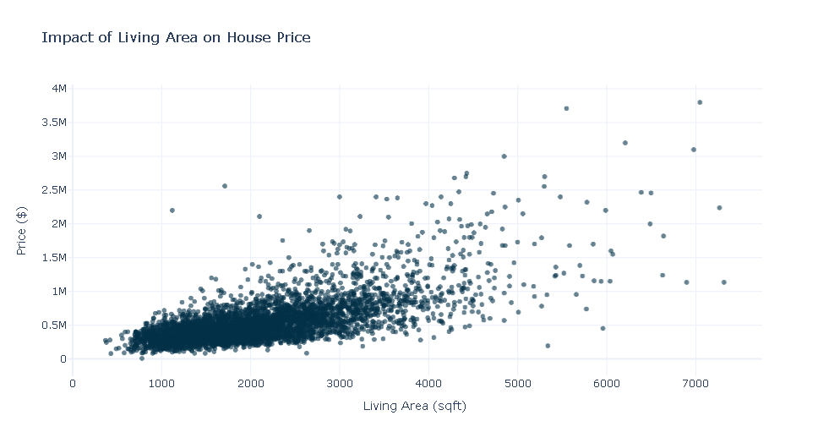
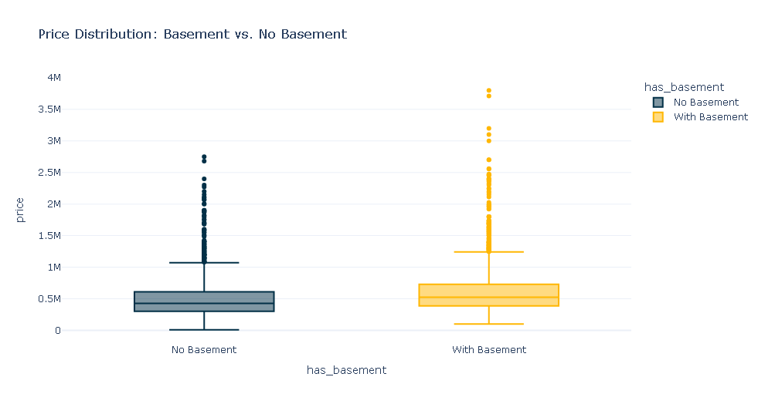
02. Exploratory Analysis & Business Insights
02. Space & Size: The Primary Price Driver
Key Question:
What physical attributes most strongly influence price?
Insights:
Living Area Domzinance:
sqft_living shows a strong positive correlation with price (ρ ≈ 0.69), making it the top pricing driver.
Basement Value:
Houses with basements sell for approximately $126K more on average, representing a strong value-add feature.
Floors Effect:
Two-story and 2.5-story houses achieve higher average prices than single-floor units.
Market Supply Reality:
Most available inventory falls between 1,500 – 2,500 sqft, aligning with highest market demand.

Slide 9
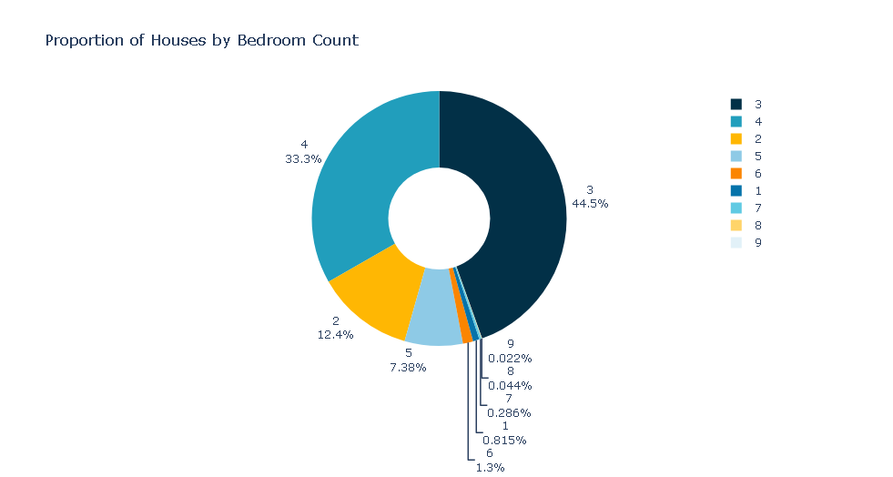
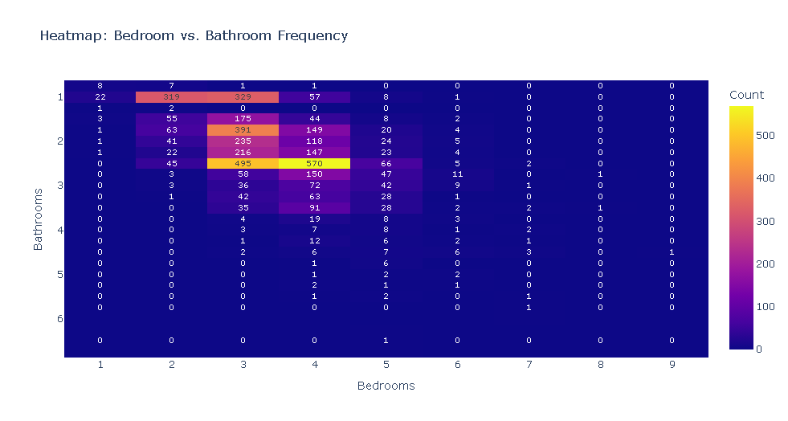
02. Exploratory Analysis & Business Insights
03. Rooms & Functional Demand
Key Question:
What configurations does the market actually want?
Insights:
Bedroom Demand:
3-bedroom houses dominate the market (~44%), confirming family-oriented demand.
Bathrooms as a Luxury Signal:
A major price jump occurs when moving from 2 to 3+ bathrooms, indicating luxury perception rather than necessity.
Golden Configuration:
The most common and demanded layout is 3 Bedrooms / 2 Bathrooms, forming the regional standard.

Slide 10
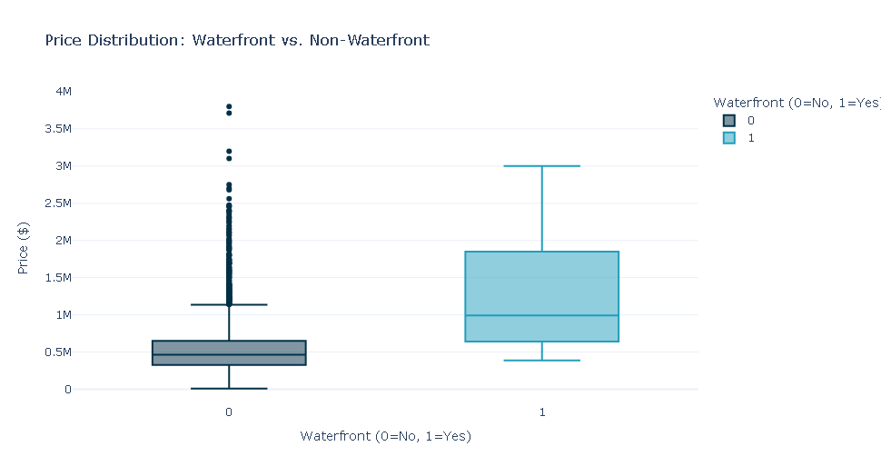
02. Exploratory Analysis & Business Insights
04. Luxury & Quality Premium
Key Question:
Why are some houses priced far above the average?
Insights:
Waterfront Effect:
Waterfront properties sell for ~2.4× the price of non-waterfront homes — the strongest premium in the dataset.
View Quality:
Price increases exponentially as view quality improves from level 0 to 4.
Luxury Profile:
Top 10% priced homes are defined more by view and location than by condition alone

Slide 11
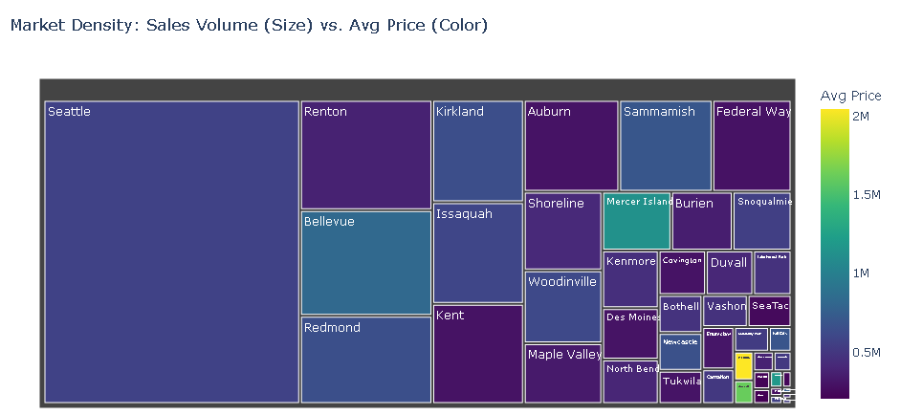
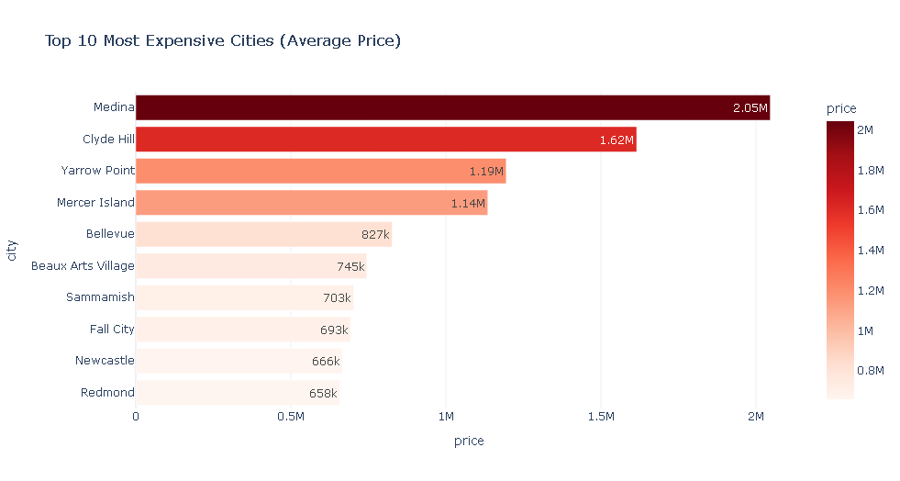
02. Exploratory Analysis & Business Insights
05. Geography & Investment Strategy
Key Question:
Where is money made fast, and where is it made big?
Insights:
High-End Safe Zones:
Medina, Clyde Hill, and Mercer Island lead in average prices - ideal for premium investments.
Liquidity vs Margin Trade-off:
Seattle: Highest transaction volume → faster exits (high liquidity)
.Luxury cities: Lower volume but significantly higher margins.
Luxury Clustering:
Waterfront properties are geographically concentrated, reinforcing persistent price premiums.

Slide 12
02. Exploratory Analysis & Business Insights
Mandatory for Business
Strategic Recommendations
Price Drivers:
Living area and waterfront view are the strongest determinants of price.
Investment Playbooks:
High Liquidity Strategy: Invest in Seattle, targeting 3-bedroom family homes.
High Margin Strategy: Invest in Bellevue, Medina, and surrounding luxury zones with premium views.
Value Creation Opportunities:
Renovating older properties and adding basements delivers ROI exceeding construction costs.

Slide 13
03. Unsupervised Learning (Clustering)
Why Clustering & Model Choice
Why Clustering?
The real estate market is not homogeneous
Similar houses behave differently in price and demand
Segmentation improves pricing, marketing, and client targeting
Why We Did NOT Use Price in Clustering?
To avoid data leakage
Clusters represent property profiles, not price labels
Enables fair classification for new, unseen properties
Features Used (Business-Driven):
Living area (size)
Bedrooms & bathrooms
View & waterfront
Property condition
House ageWhy K-Means?
Real estate properties naturally form compact, interpretable groups
Scales well to large housing datasets
Easy to explain and deploy in production
Why Not Other Models?
Hierarchical → not scalable for production
DBSCAN → sensitive to density, unstable with mixed housing types

Slide 14
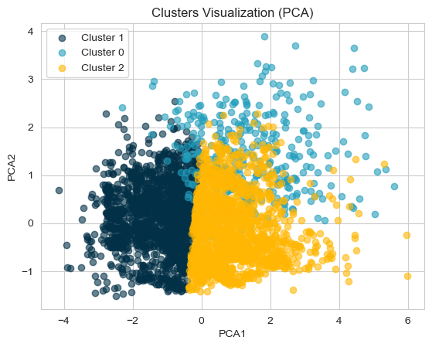
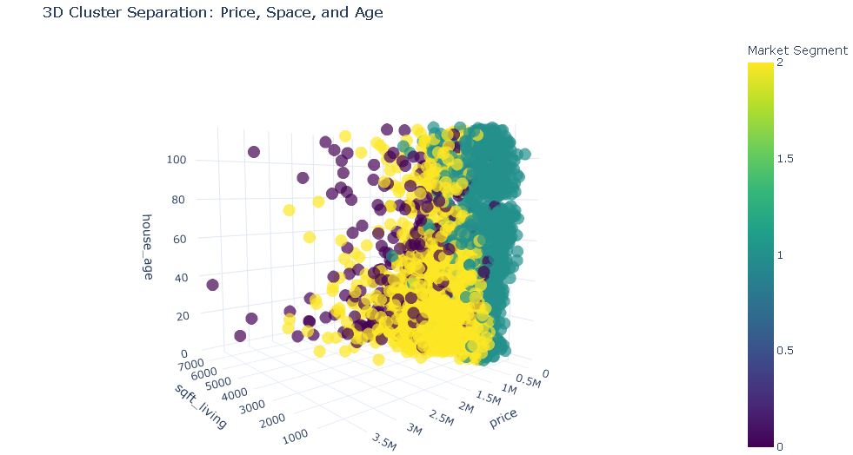
03. Unsupervised Learning (Clustering)
Identified Segment
Entry-Level / Affordable Homes
Smaller, older properties
Minimal premium features
Price-sensitive buyers
Mid-Market / Family Homes
3–4 bedrooms, balanced space
Largest market share
High transaction volume
Premium / Luxury Homes
Large space, views, waterfront
High margins, lower volume
Market Distribution:
Mid-Market: ~50%
Entry-Level: ~40%
Premium: ~7%
Business Impact:
Segment-specific pricing
Targeted marketing strategies
Better client recommendations

Slide 15
04. Category Classification
Step | Description
Feature Selection | Property profile features (size, rooms, condition, view, location signal)
Leakage Control | Price excluded to prevent target leakage
Scaling | RobustScaler to handle outliers
Train/Test Split | 80% / 20% with stratified sampling
Models Tested | Logistic Regression, Random Forest, XGBoost
Final Model | XGBoost Classifier
We built a clean classification pipeline that learns property profiles, not prices.

Slide 16
04. Category Classification
Metric | Result
Accuracy | 98.6%
Macro F1-score | ≈ 0.99
Critical Errors | Near-zero (Entry ↔ Premium)
Error Pattern | Only between neighboring segments
Business Interpretation
Reliable instant segmentation for new listings
Errors reflect real market overlap, not model failure
Safe to use for pricing & marketing automation
“High accuracy with business-safe errors enables automated decision support.”

Slide 17
05. Price Regression Modeling
Segmented Pricing Models
Modeling Approach
Market segmented into 3 clusters
One regression model per segment
Target: Log-transformed price
Models Used
XGBoost Regressor (per segment)
Selected for:
Non-linear pattern learning
Robust performance on tabular housing data
Stability under high price variance
Segment | Approx. Pricing Error | Business Interpretation
Entry-Level | ~18% | Sensitive pricing, acceptable range
Mid-Market | ~15% | High confidence pricing
Premium | ~25% | Expected due to luxury variability
“Higher error in the premium segment is expected because luxury pricing is driven by subjective and non-linear factors such as view uniqueness, exclusivity, and buyer willingness, not just property features.”

Slide 18
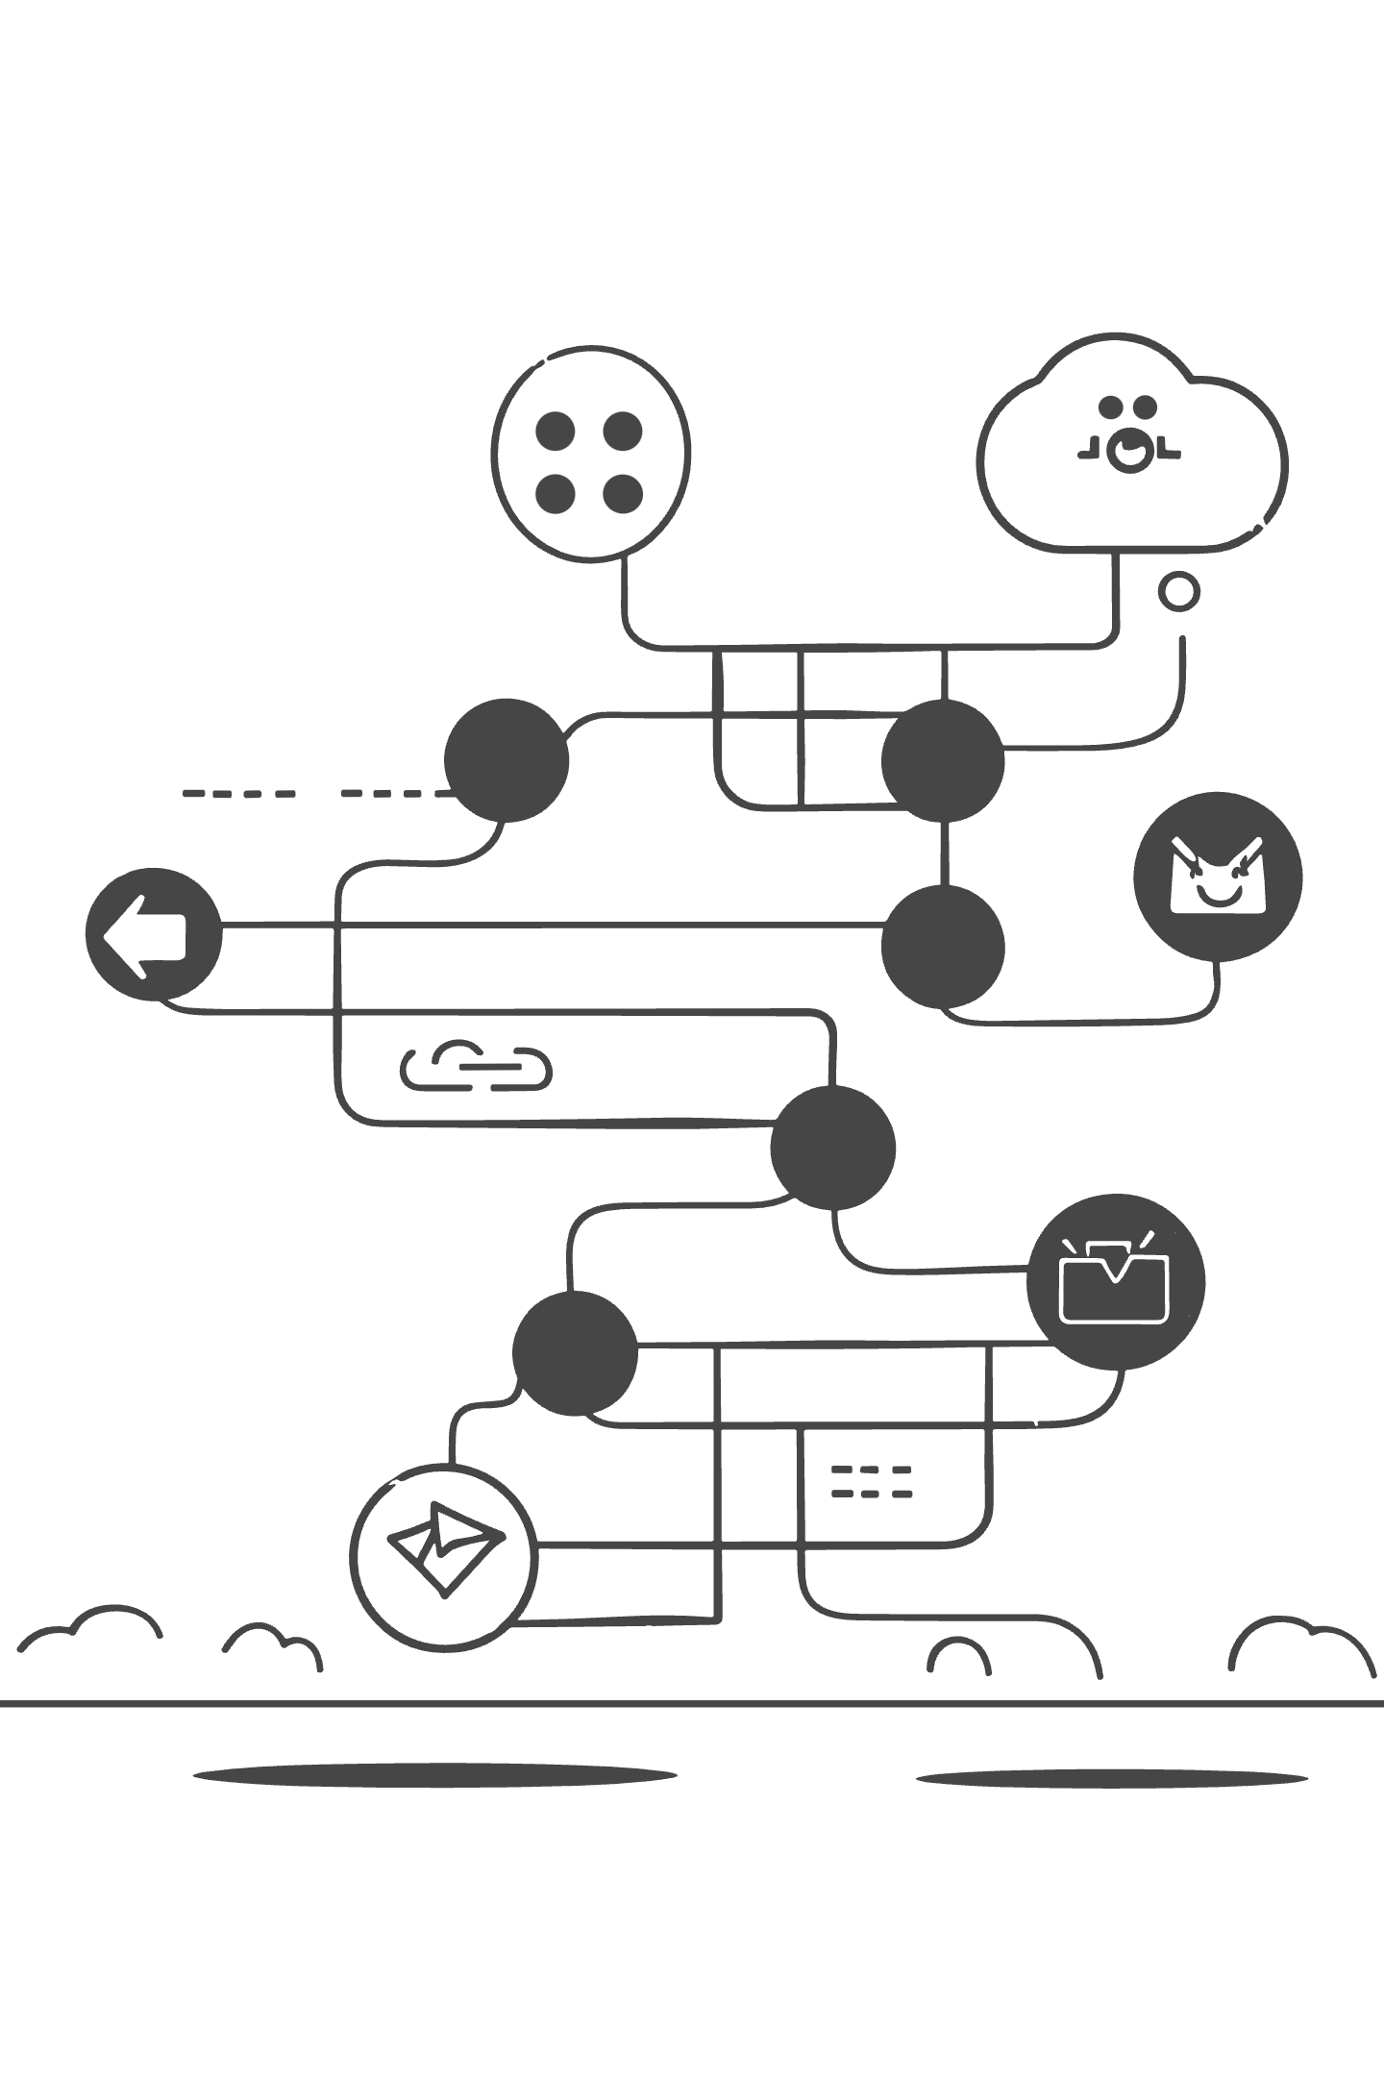
06. LLM-based Model Interpretation
Scenario-Based Price Interpretation Engine
How Scenarios Are Generated
44 city-specific market contexts
3 distinct pricing regimes (clusters)
Property-level feature logic
Total Interpretation Paths
44 × 3 = 132 deterministic explanation scenarios
Each property follows exactly one path
What Controls the LLM
Pre-built, data-grounded narratives
City- and cluster-specific constraints
No free-form price generation
LLM Role
Answers questions only within the selected scenario
Cannot hallucinate prices or market facts
Business Impact
Transparent, auditable price justification
Consistent explanations across agents

Slide 19

07. Deployment
Production-Ready Real Estate Pricing System
What’s Delivered
End-to-end pipeline handling new, unseen properties
Automatic market segmentation → price estimation
Consistent preprocessing and feature handling
Why It’s Ready for Use
Same preprocessing applied at training & inference
Models and mappings exported and versioned
Deterministic output for identical inputs
User Interaction
Non-technical users interact via a simple UI
System returns price + market segment explanation
Live Artifacts
GitHub (code & models): https://github.com/george-yacope/Real-Estate-Full-AI-Project
Streamlit App (user demo): https://real-estate-full-ai-project.streamlit.app

