Slide 1

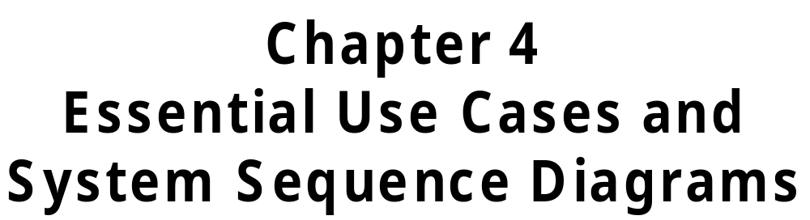
.
Stumpf and Teague
Object-Oriented Systems Analysis and Design with UML
© 2005 Prentice Hall
4-<number>

Slide 2
Learning Objectives
Identify use cases based on prior
event analysis.
Derive a use case diagram from an
event table.
Draw a use case diagram.
Discover use case scenarios.
© 2005 Prentice Hall
4-<number>

Slide 3
Learning Objectives
(continued)
Write both high-level and expanded essential use case narratives.
Define system inputs and outputs.
Draw a system sequence diagram
for a use case scenario.
© 2005 Prentice Hall
4-<number>

Slide 4
Overview
Chapter 4 discusses Steps 2, 3, and 4
of the process for object-oriented analysis. It introduces the Unified Modeling Language (UML), a
standard notation for describing object-oriented systems.
The use case model and system sequence diagrams presented here begin to describe the system’s required response to events in its environment.
© 2005 Prentice Hall
4-<number>

Slide 5
Overview
(continued)
Use case diagrams show the use cases within the scope of the system and the actors in the environment with which each use case is associated.
There is a least one use case narrative for each use case. A use case narrative is a structured narrative showing what the system must do
to respond to a specific event.
© 2005 Prentice Hall
4-<number>

Slide 6
Overview
(continued)
We write an expanded use case narrative for every use case corresponding to an external event; these are the use cases in which there is input to the system.
An expanded use case narrative captures the sequence of messages from an actor to the system as well as the system’s response to each message. The narrative also reveals the structure and content of the messages.
© 2005 Prentice Hall
4-<number>

Slide 7
Overview
(continued)
Use case narratives for analysis should be essential – they should not mention any possible implementing technology.
A system sequence diagram shows graphically the sequence, structure, and content of each message from an actor to the system. It also shows messages from the system to external systems.
© 2005 Prentice Hall
4-<number>

Slide 8
Overview
(continued)
There is one system sequence diagram for each use case corresponding to
an external event. If the use case is complex, several system sequence diagrams may be desirable.
The specific data elements contained in each message are usually shown in a system sequence diagram.
© 2005 Prentice Hall
4-<number>

Slide 9
Procedure for Object-Oriented Systems Analysis
Step 1. Identify the business events and make an event table.
Step 2. Identify the use cases and produce a use case diagram for the system.
Step 3. Write a use case narrative describing the system’s response to each business event.
© 2005 Prentice Hall
4-<number>

Slide 10
Procedure for Object-Oriented Systems Analysis (continued)
Step 4. Draw a system sequence diagram for each use case scenario.
Step 5. Produce a domain model
showing the concepts, attributes and associations in the problem
domain of the system.
Step 6. Write a contract for each system operation.
© 2005 Prentice Hall
4-<number>

Slide 11
Step 2 of Object-Oriented
Systems Analysis
Identify the use cases and produce a use case diagram for the system.
© 2005 Prentice Hall
4-<number>

Slide 12
Use Cases
A use case is the sequence of actions which occur when an actor uses a system to complete a process.
A use case is a model of a requirement.
A use case name is a short phrase beginning with a verb.
Each event corresponds to at least one use case.
© 2005 Prentice Hall
4-<number>

Slide 13
Events and Use Cases
Event
Department submits class schedule.
Time to produce University Class Schedule
Student registers for classes.
Time to produce Class Roster
Use case
Submit Department Class Schedule.
Produce University Class Schedule.
Register for Classes.
Produce Class Roster.
© 2005 Prentice Hall
4-<number>

Slide 14
Identifying Actors
An actor is a person, organization, or system which interacts with a system
by sending messages to the system or receiving messages from the system.
Actors play roles with respect to the system.
The actors were identified during event analysis.
© 2005 Prentice Hall
4-<number>

Slide 15
Types of Actors
An initiating actor initiates a use case
by initiating an external event. Thus, initiating actors provide system inputs.
A participating actor is involved in a use case but does not initiate it. Thus, participating actors receive system outputs.
© 2005 Prentice Hall
4-<number>

Slide 16
The Use Case Model
A use case diagram for the entire system – a graphic model
One or more use case narratives for each use case – descriptions in text
  high-level
  expanded
In the UML, use cases are part of the
User View Model
© 2005 Prentice Hall
4-<number>

Slide 17

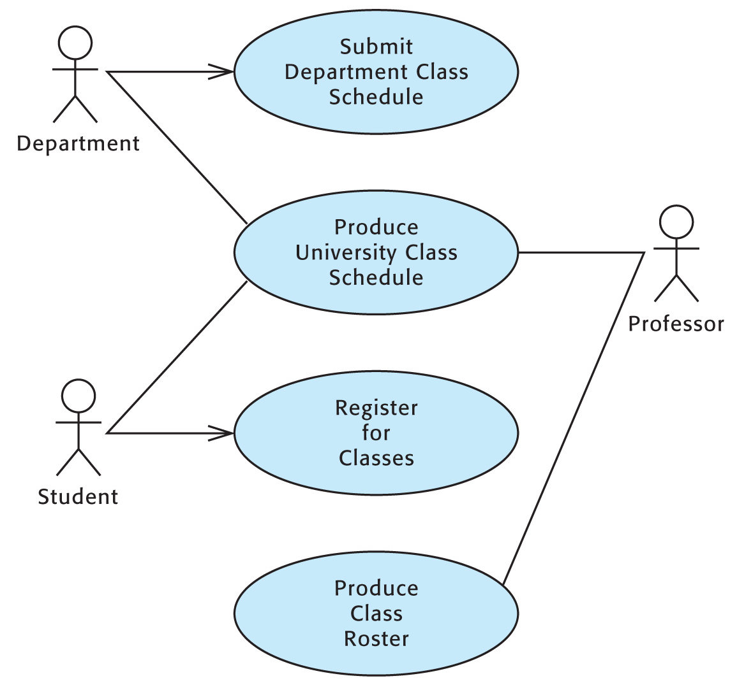
Use Case Diagram
.
© 2005 Prentice Hall
4-<number>

Slide 18
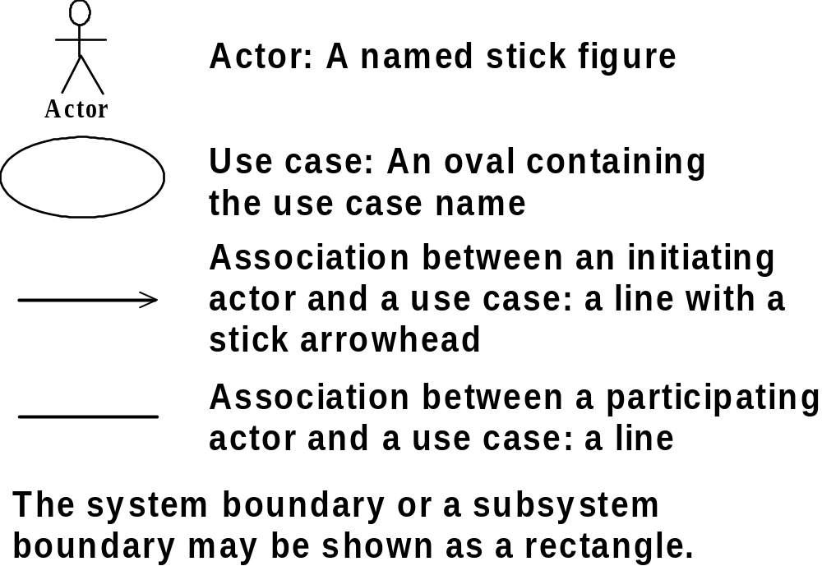
Components of a
Use Case Diagram
© 2005 Prentice Hall
4-<number>

Slide 19
Step 3 of Object-Oriented
Systems Analysis
Write a use case narrative describing the system’s response to each business event.
© 2005 Prentice Hall
4-<number>

Slide 20

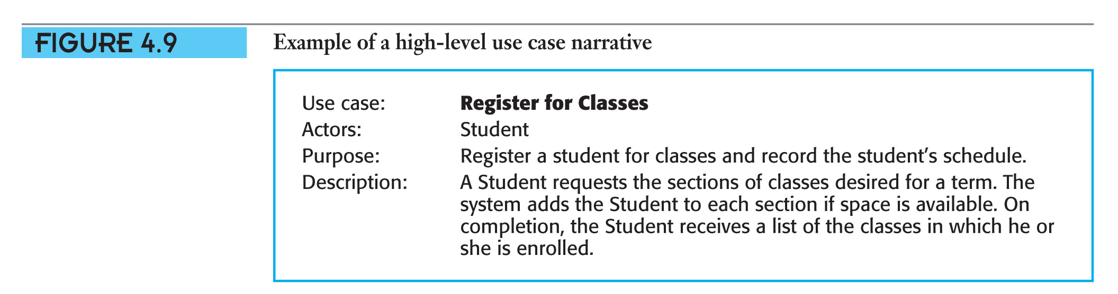
High-Level Use Case Narrative
.
© 2005 Prentice Hall
4-<number>

Slide 21

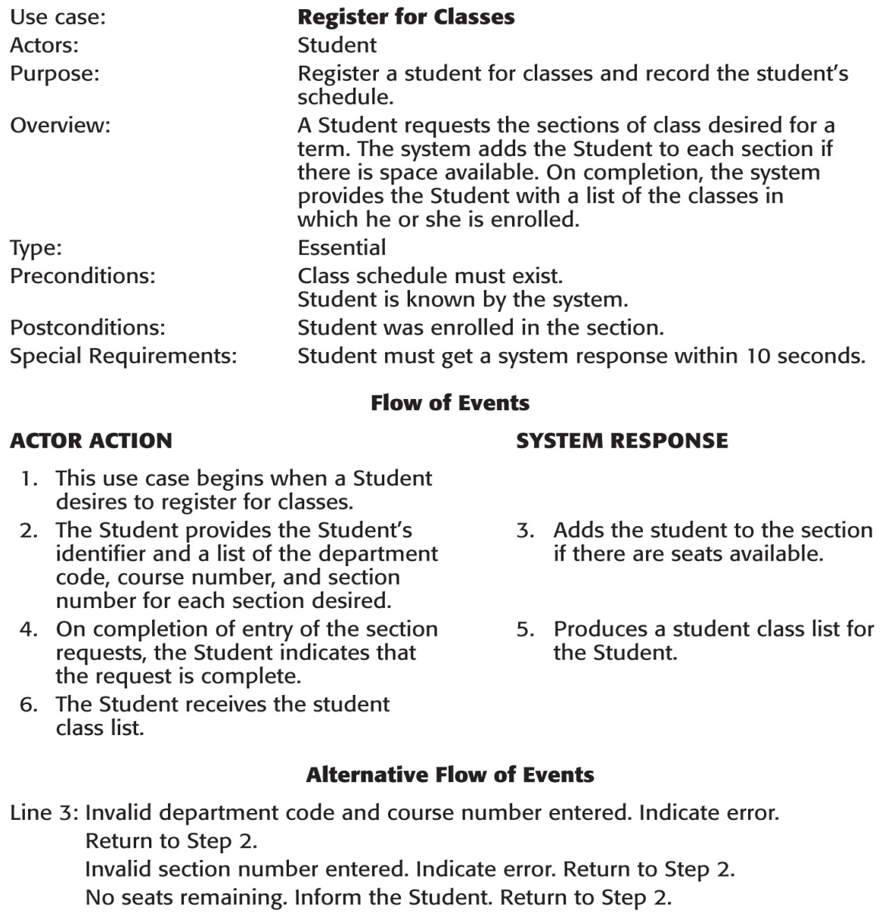
Expanded Use Case Narrative
.
© 2005 Prentice Hall
4-<number>

Slide 22
Parts of an
Expanded Use Case Narrative
Use Case Name:
Actors:
Purpose:
Overview:
Type: (Essential)
Preconditions:
Postconditions:
Special Requirements:
Flow of Events:
Actor Action System Response
Alternative Flow of Events:
© 2005 Prentice Hall
4-<number>

Slide 23
Terms in an
Expanded Use Case Narrative
Precondition: A condition which must
be true in order for the use case to
begin and produce the desired results.
Postcondition: A condition which must
be true after the use case has been completed.
© 2005 Prentice Hall
4-<number>

Slide 24
Terms in an Expanded
Use Case Narrative (continued)
Special Requirements: A requirement
which is critical to users’ acceptance
and use of the system.
Alternative Flow of Events: What the
system should do in the case of exceptional conditions or errors.
© 2005 Prentice Hall
4-<number>

Slide 25

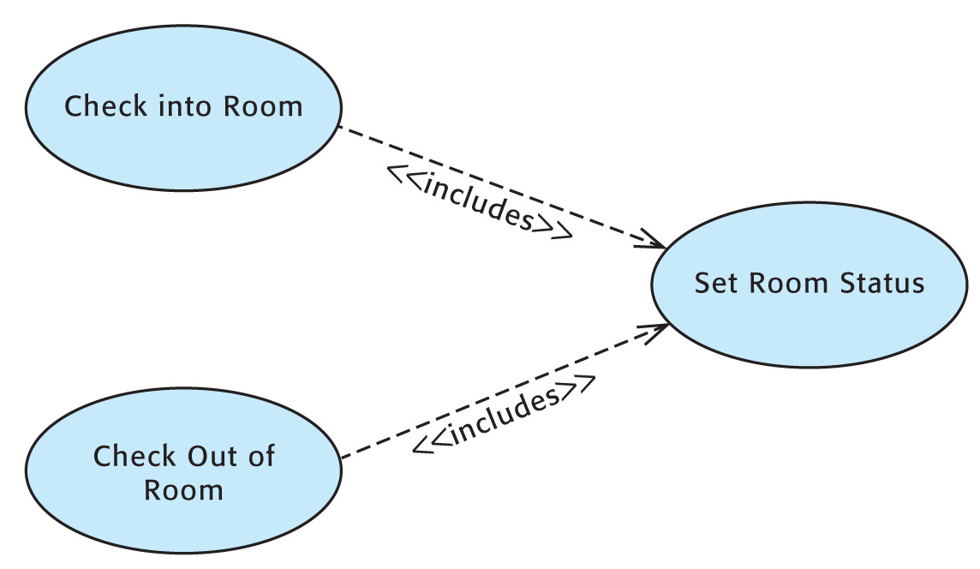
Associations Between
Use Cases
The «includes» association always occurs when the use case which includes it occurs.
© 2005 Prentice Hall
4-<number>

Slide 26

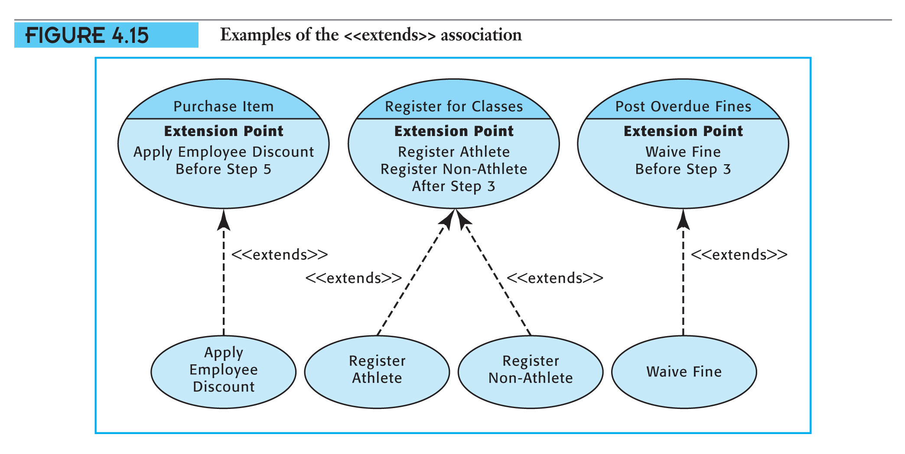
Associations Between
Use Cases (continued)
The occurrence of an «extends» association depends on a true condition in the use case which it extends.
© 2005 Prentice Hall
4-<number>

Slide 27
Use Case Scenarios
A use case scenario is a narrative of a single occurrence of a use case. It describes specifics of a real-world enactment of the use case.
Use case scenarios can help discover alternative paths through a use case
or test the completeness or correctness of a use case narrative.
© 2005 Prentice Hall
4-<number>

Slide 28
Shortcomings of a
Use Case Diagram
No distinction between an initiating
actor and a participating actor in the
UML standard
Does not show the system input or output
No clear indication of the difference between a temporal and an external
event
© 2005 Prentice Hall
4-<number>

Slide 29
Step 4 of Object-Oriented
Systems Analysis
Draw a system sequence diagram
for each use case scenario.
© 2005 Prentice Hall
4-<number>

Slide 30
System Sequence Diagram
A system sequence diagram shows the
interaction between an actor and the
system for one use case scenario.
It shows:
The system (as a black box)
The initiating actor
Each external system which sends messages
to the system
The messages into and out of the system
The sequence in which the messages occur
© 2005 Prentice Hall
4-<number>

Slide 31
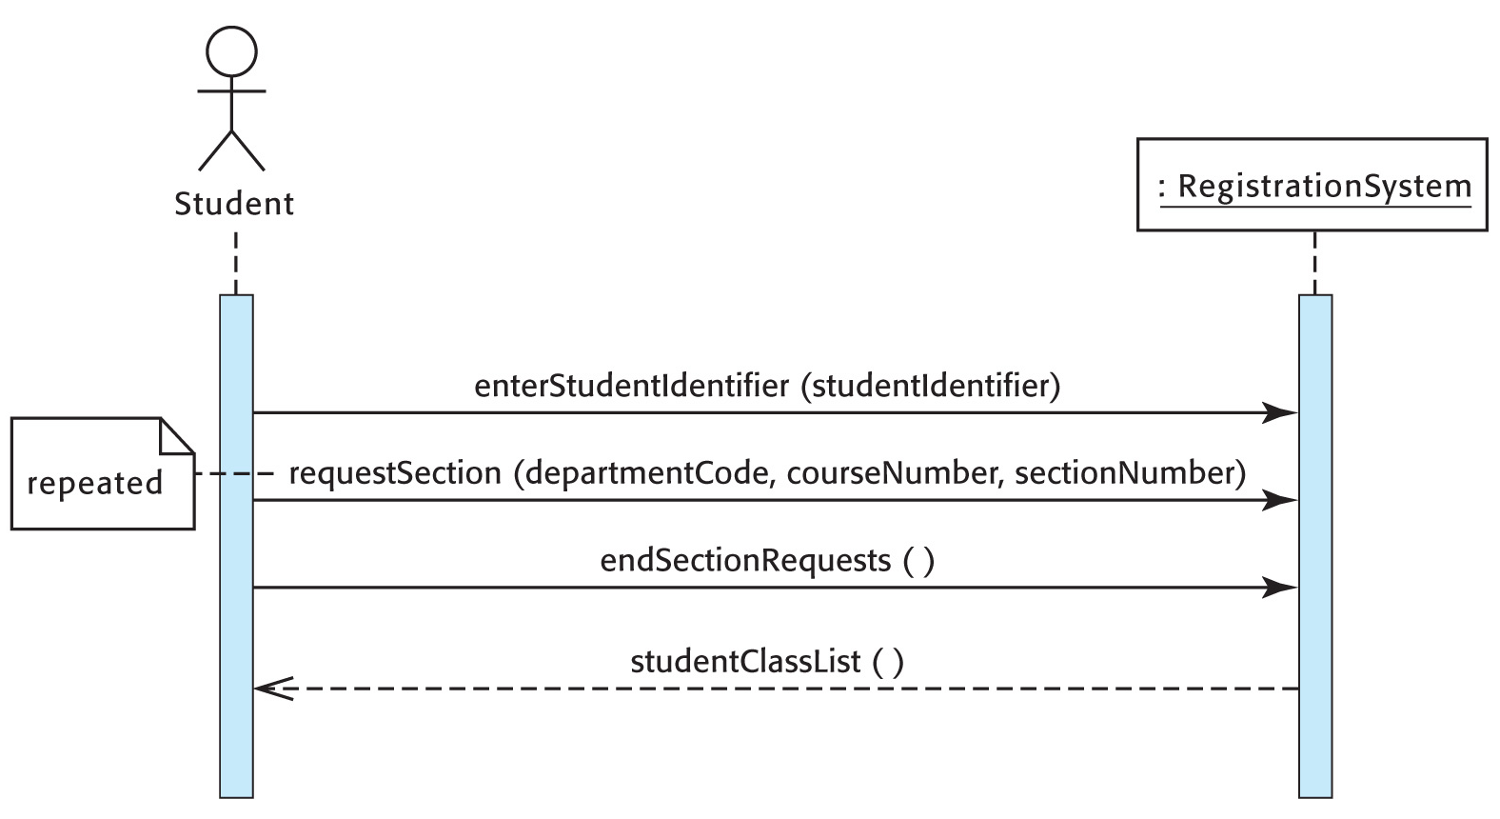

System Sequence Diagram (continued)
Note carefully the UML conventions for the arrows and arrowheads.
© 2005 Prentice Hall
4-<number>

Slide 32
System Sequence Diagram (continued)
A system sequence diagram focuses
on the content and structure of the system input.
It should show whether any messages
are repeated or are alternatives.
A system sequence diagram is not
the place to show the design of
the detailed interaction between
the user and the system.
© 2005 Prentice Hall
4-<number>

Slide 33
Creating a
System Sequence Diagram
Draw a rectangle representing the system. Label the rectangle and draw
a lifeline beneath it.
At the left, draw a stick figure for each actor. Label it with the actor’s name
and draw a lifeline beneath it.
© 2005 Prentice Hall
4-<number>

Slide 34
Creating a System
Sequence Diagram (continued)
For each system input, draw a
message arrow from the actor’s lifeline
to the system’s lifeline. Label it with
the message name and parameters.
Confirm that the sequence of messages (from top to bottom) is correct.
© 2005 Prentice Hall
4-<number>

Slide 35
Message Formats in
System Sequence Diagrams
The UML format for a message consists
of a message name followed (in parentheses) by a parameter list.
All names begin with a lower-case letter.
There are no spaces in a name.
Upper-case letters separate the words within a name.
Names in the parameter list are separated by commas.
© 2005 Prentice Hall
4-<number>

Slide 36
Outgoing Messages
(System Outputs)
There are two types of outgoing messages:
A response of the system which completes an event
A message from the system to an external system requesting action
and a reply
Remember that every output must be derivable from the input to the use
case combined with stored data.
© 2005 Prentice Hall
4-<number>

Slide 37
Summary
Step 2 of object-oriented systems analysis identifies the use cases and produces
a use case diagram for the system.
Step 3 of object-oriented systems analysis writes a use case narrative describing the system’s response to each business event.
Step 4 of object-oriented systems analysis draws a system sequence diagram for each use case scenario.
© 2005 Prentice Hall
4-<number>

