Slide 1
What is Software Design?
Introduction
  Software design consists of two components, modular design and packaging.
    Modular design is the decomposition of a program into modules.
    A module is a group of executable instructions with a single point of entry and a single point of exit.
    Packaging is the assembly of data, process, interface, and geography design specifications for each module.
Notes:
No additional notes provided.
510

Slide 2
Structured Design
Introduction
  Structured design was developed by Ed Yourdon and Larry Constantine.
    This technique deals with the size and complexity of a program by breaking up a the program into a hierarchy of modules that result in a computer program that is easier to implement and maintain.
Notes:
The concept of structured design is simple. Design a program as a top-down hierarchy of modules. The top-down structure of these modules is developed according to various design rules and guidelines. The resulting hierarchy of modules can then be evaluated according to certain quality acceptance criteria to ensure the best modular design for the program. Upon completion, the modules are to be implemented using structured programming principles.
511

Slide 3
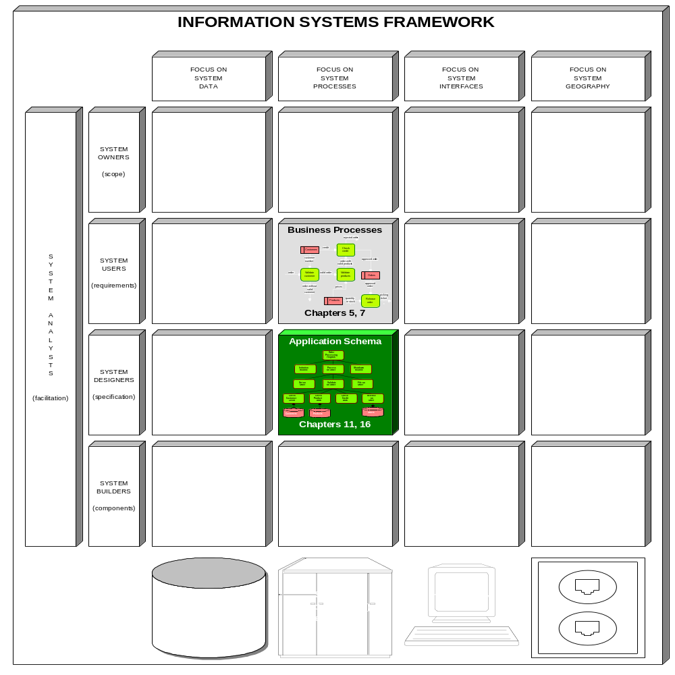

Notes:
Figure 15.1 Information Systems Framework Focus of Structured Design
During structured design the system designer’s primary focus is upon the process component of the information systems framework. And as you will soon see, the business process model is instrumental in identifying and deriving the hierarchy of modules for a program.
511-512

Slide 4
Structured Design
Structure Charts
  The primary tool used in structured design is the structure chart.
    Structure charts are used to graphically depict a modular design of a program.
      Specifically, they show how the program has been partitioned into smaller more manageable modules, the hierarchy and organization of those modules, and the communication interfaces between modules.
      Structure charts, however, do not show the internal procedures performed by the module or the internal data used by the module.
Notes:
The concept of structured design is simple. Design a program as a top-down hierarchy of modules. The top-down structure of these modules is developed according to various design rules and guidelines. The resulting hierarchy of modules can then be evaluated according to certain quality acceptance criteria to ensure the best modular design for the program. Upon completion, the modules are to be implemented using structured programming principles.
511

Slide 5
Structured Design
Structure Charts
  Structure chart modules are depicted by named rectangles.
  Structure chart modules are presumed to execute in a top-to-bottom, left-to-right sequence.
  An arc shaped arrow located across a line (representing a module call) means that the module makes iterative calls.
  A diamond symbol located at the bottom of a module means that the module calls one and only one of the other lower modules that are connected to the diamond.
  Program modules communicate with each other through passing of data.
Notes:
No additional notes provided.
511-512

Slide 6
Structured Design
Structure Charts
  Programs may also communicate with each other through passing of messages or control parameters, called flags.
  Library modules are depicted on a structure chart as a rectangle containing an vertical line on each side.
Notes:
No additional notes provided.
511

Slide 7
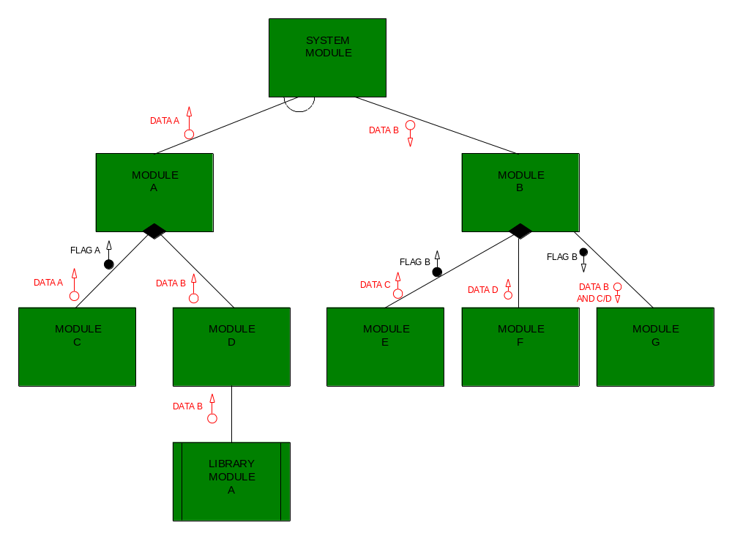
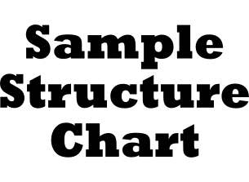
1
2
3
5
6
4
4
5
6
7
Notes:
Figure 15.2 Sample Structure Chart
The figure above depicts the symbol set used for structure charts. We draw your attention to the following:
Structure chart modules are depicted by named rectangles. Modules are factored, from the top down, into submodules. The highest level module is referred to as the system or root module. It serves to coordinate or “boss” the modules appearing directly beneath it. In turn, those modules may serve to coordinate those modules appearing immediately below them.
Structure chart modules are presumed to execute in a top-to-bottom, left-to-right sequence. The line connecting two modules represents a normal call. For example, SYSTEM MODULE calls MODULE B.
An arc shaped arrow located across a line (representing a module call) means that the module makes iterative calls. Thus, SYSTEM MODULE calls MODULE A to be performed N number of times, or until some condition is met.
A diamond symbol located at the bottom of a module means that the module calls one and only one of the other lower modules that are connected to the diamond. Thus, MODULE A can call MODULE C or MODULE D. Notice however that MODULE B can call MODULE G and it can call either MODULE E or MODULE F. This diagram construct is referred to as a transaction center.
Program modules communicate with each other through passing of data. Data being passed is represented by named arrows with a small circle on one end. The direction of the arrow is significant. Note that DATA A is being passed “up” from MODULE C to its parent, MODULE A. The downward direction of the arrow for DATA B implies that SYSTEM MODULE is passing it to MODULE B.
Programs may also communicate with each other through passing of messages or control parameters, called flags. Control flags are depicted by an arrow with a darkened circle on one end. As with data, the direction of the arrow implies the source and receiving modules.
Often times a systems designer recognizes the opportunity to utilize a pre-defined or library module. For example, perhaps one function of a program is to perform a special sort routine that was previously developed and placed in the program library for use by other developers for applications that might reuse that function. Such modules are depicted on a structure chart as a rectangle containing an vertical line on each side.
511-513
7
6
5
4
3
2
1

Slide 8
Structured Design
Data Flow Diagrams of Programs
  Structured design requires that data flow diagrams (DFDs) first be drawn for the program.
  Processes appearing on the logical, elementary DFDs may represent modules on a structure chart.
  Logical DFDs need to be revised to show more detail in order to be used by programmers
  The following revisions may be necessary:
    Processes appearing on the DFD should do one function.
    Processes need to be added to handle data access and maintenance.
    DFDs must be revised to include editing and error handling processes, and processes to implement internal controls.
Notes:
Processes appearing on the DFD should do one function. Thus, some elementary processes may need to be expanded into two or more, smaller processes that each accomplish a single function. As a general rule of thumb, a process should have either one input or one output.
In order to keep DFDs from becoming overly cluttered and overwhelming user, processes for reading, modifying, and deleting data in a data store were not included on the elementary DFDs. Thus, processes now need to be added to handle data access and maintenance. Thus, you would need to locate each process that accesses or maintains data in a data store and add an intermediate process that will be responsible for that data base action.
If you recall, data flow diagrams are often drawn from the perspective of a perfect world thus, many of the trivial business processing exceptions and internal controls are not shown. Let’s consider three typical situations. First, perhaps a DFD may show a process receiving data from a boundary (such as a customer), doing some processing of that data, and then passing the output to another process. In reality, the original input data may need to be edited and proper error handling routines performed. Second, perhaps a process accesses data from a data store, yet the data cannot be found. The data flow diagram may depict processes for handling this exception. Third, perhaps internal controls were established requiring that processing data for a particular business event be logged to provide an audit trail. But a programmer must know the details! Therefore, DFDs must be revised to include editing and error handling processes that were purposefully ignored during systems analysis, and processes to implement internal controls established during systems design.
513-515

Slide 9
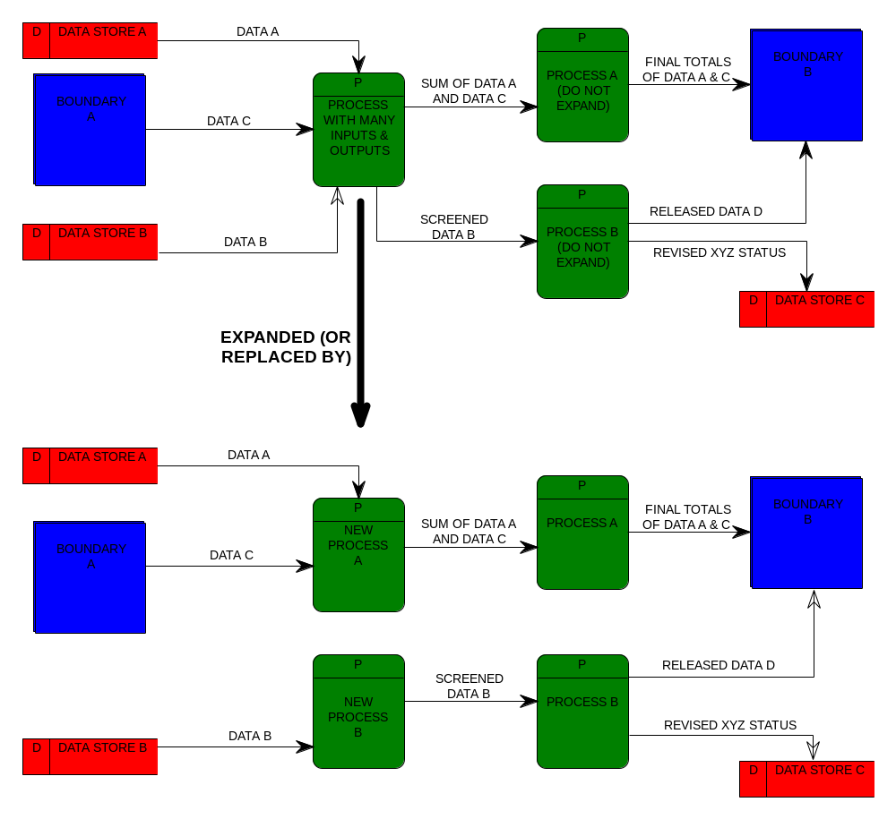
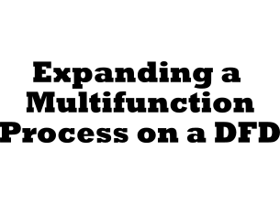
Notes:
Figure 15.3 Expanding a Multifunction Process on a DFD
As demonstrated in figure (a) above, PROCESS WITH MANY INPUTS & OUTPUTS should be expanded. It should be expanded into two or more processes each smaller processes should contain either one input or one output as demonstrated in figure (b).
513-514

Slide 10
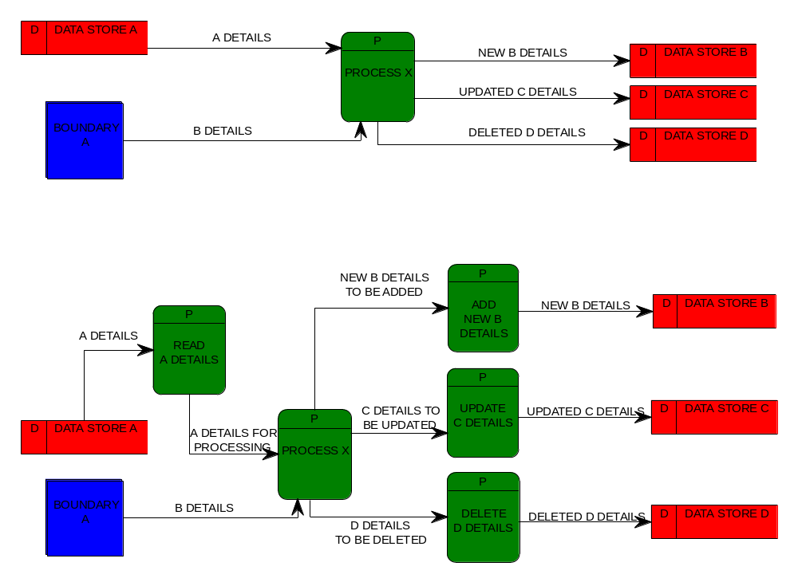

Notes:
Figure 15.4 Adding Data Access and Maintenance Process to a DFD
Figure (a) above contains a process with four data flow connections to data stores — representing a read, add, update, and delete action. Figure (b) shows the addition of four new processes to accomplish that will accomplish those database functions.
514-515

Slide 11
Structured Design
Transform Analysis
  One approach used to derive a program structure chart from program DFD is transform analysis.
    Transform analysis is an examination of the DFD to divide the processes into those that perform input and editing, those that do processing or data transformation (e.g., calculations), and those that do output.
      The portion consisting of processes that perform input and editing is called the afferent.
      The portion consisting of processes that do actual processing or transformations of data is called the central transform.
      The portion consisting of processes that do output is called the efferent.
Notes:
No additional notes provided.
515-516

Slide 12
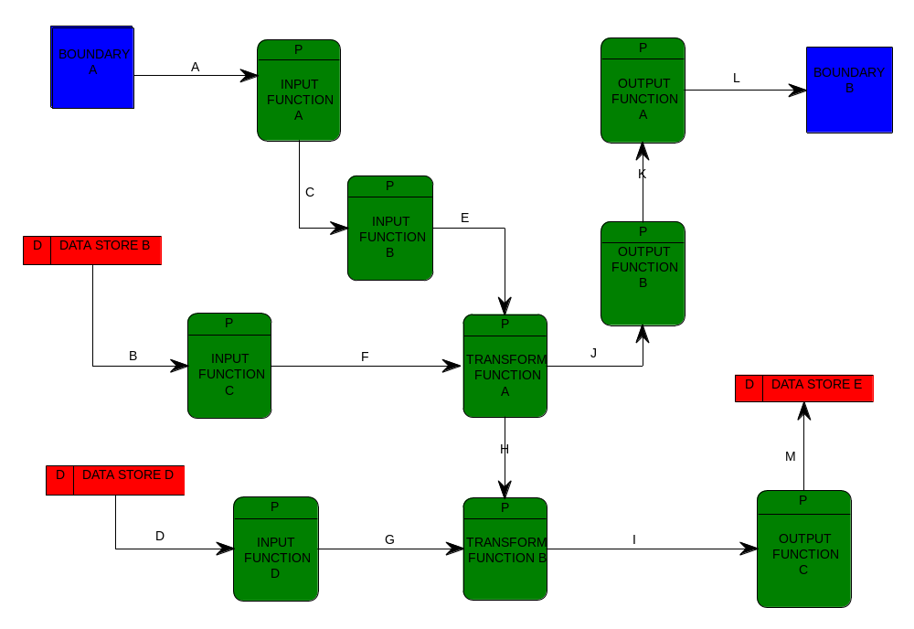

Central
Transform
Afferent
Efferent
Notes:
Figure 15.5 Sample Partitioned DFD during Transform Analysis
No additional notes provided.
516

Slide 13
Structured Design
Transform Analysis
  The strategy for identifying the afferent, central transform, and efferent portions of a begins by first tracing the sequence of processing for each input.
    There may be several sequences of processing.
    A sequence of processing for a given input may actually split to follow different paths.
Notes:
No additional notes provided.
516

Slide 14
Structured Design
Transform Analysis
  Once sequence paths have been identified, each sequence path is examined to identify process along that path that are afferent processes.
    The steps are as follows:
      Step 1 - Beginning with the input data flow, the data flow is traced through the sequence until it reaches a process that does processing (transformation of data) or an output function.
      Step 2 - Beginning with an output data flow from a path, the data flow is traced backwards through connected processes until a transformation processes is reached (or a data flow is encountered that first represents output).
      Step 3 - All other processes are then considered to be part of the central transform!
Notes:
The steps are as follows:
Beginning with the input data flow, the data flow is traced through the sequence until it reaches a process that does processing (transformation of data) or an output function. For example, the path of input data flow A can be traced until it reaches TRANSFORM FUNCTION A. The data flow going to a process that does transformation is then typically marked with an arc as a visual clue. Thus, the data flow E was marked accordingly. This mark suggests that all processes encountered along the path until that arc is reached are said to be afferent processes. They represent processes that perform input oriented functions (such as initialization of counters, reading the first record, editing incoming data prior to processing).
Beginning with an output data flow from a path, the data flow is traced backwards through connected processes until a transformation processes is reached (or a data flow is encountered that first represents output). For example, the output data flow L can be traced to the point where data flow J is exiting TRANSFORM FUNCTION A. Likewise, that data flow is marked as a visual clue. All process encountered during the backward tracing along the path are considered efferent process. They are said to perform output preparation or presentation functions (such as writing an updated record to a database, formatting a report line, or printing report totals, or displaying information to a user).
All other processes are then considered to be part of the central transform! These represent the processes that do the real work — making decisions or transform data (such as checking a customer’s credit or calculating an employee’s pay). They can be characterized as processes that produce an output that can clearly be distinguished from the input data flow(s). In other words, the output data flow clearly is different in content or meaning from the incoming data flow.
516-517

Slide 15
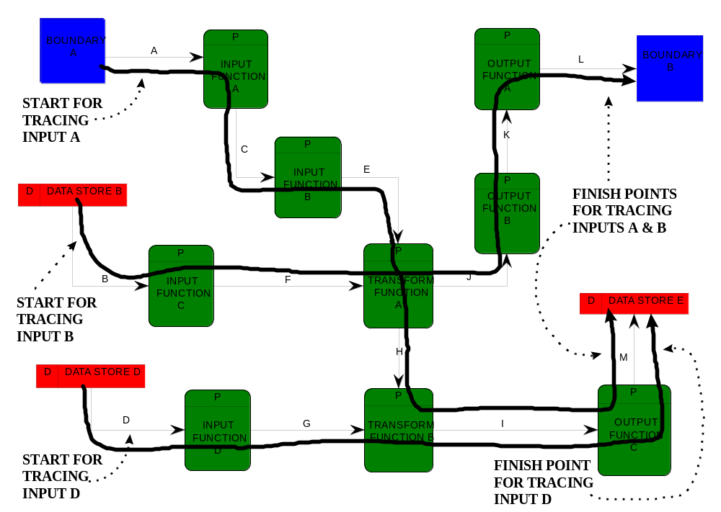
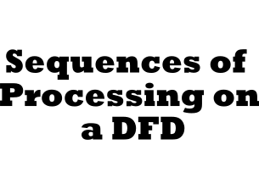
Notes:
Figure 15.6 Sequences of Processing on a DFD
As is depicted in the figure above, each sequence of processing begins with an input and ends with an output(s). For example, the sequence of processing followed by input D concludes with the output M. A sequence of processing for a given input may actually split to follow different paths. For example, the sequence path followed by both input A and input B split at TRANSFORM FUNCTION A into two separate paths, resulting in the output L and the output M respectively.
516-517

Slide 16
Structured Design
Transform Analysis
  Once the DFD has been partitioned, a structure chart can be created that communicates the modular design of the program.
    Step 1 - Create a process that will serve as a “commander and chief” of all other modules.
      This module manages or coordinates the execution of the other program modules.
    Step 2 - The last process encountered in a path that identifies afferent processes becomes a second-level module on the structure charts.
    Step 3 - Beneath that module should be a module that corresponds to its preceding process on the DFD.
    This would continue until all afferent processes in the sequence path are included on the structure chart.
Notes:
No additional notes provided.
518

Slide 17
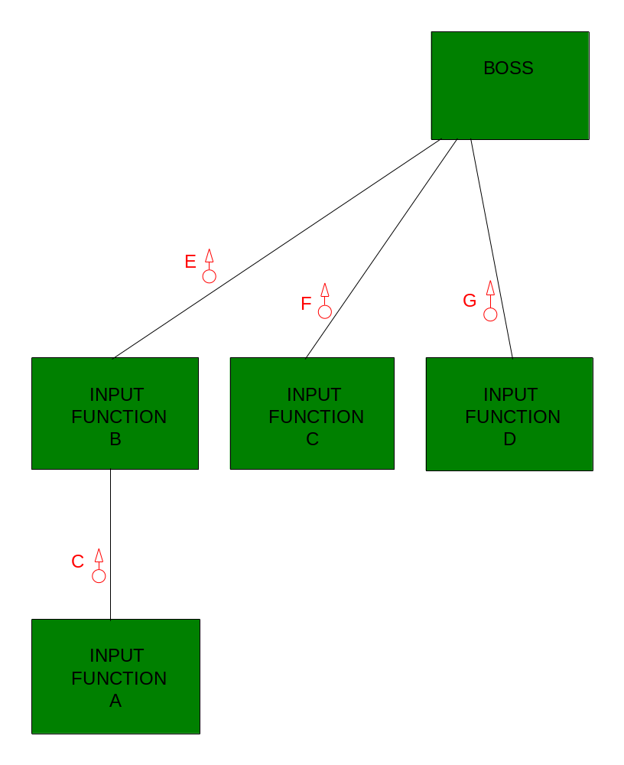

Notes:
Figure 15.7 Afferent Portion of Structure Chart
Notice in the figure above, when a process appearing on the DFD is added to the structure chart, data flows from the DFD are also brought along. For example, notice that the output data flow F from the process INPUT FUNCTION C on our DFD was show as a data communication between the module INPUT FUNCTION C and the module BOSS.
518

Slide 18
Structured Design
Transform Analysis
    Step 4 - If there is only one transformation process, it should appear as a single module directly beneath the boss module.
      Otherwise, a coordinating module for the transformation processes should be created and located directly above the transformation process..
    Step 5 - A module per transformation process on the DFD should be located directly beneath the controller module.
Notes:
No additional notes provided.
518

Slide 19
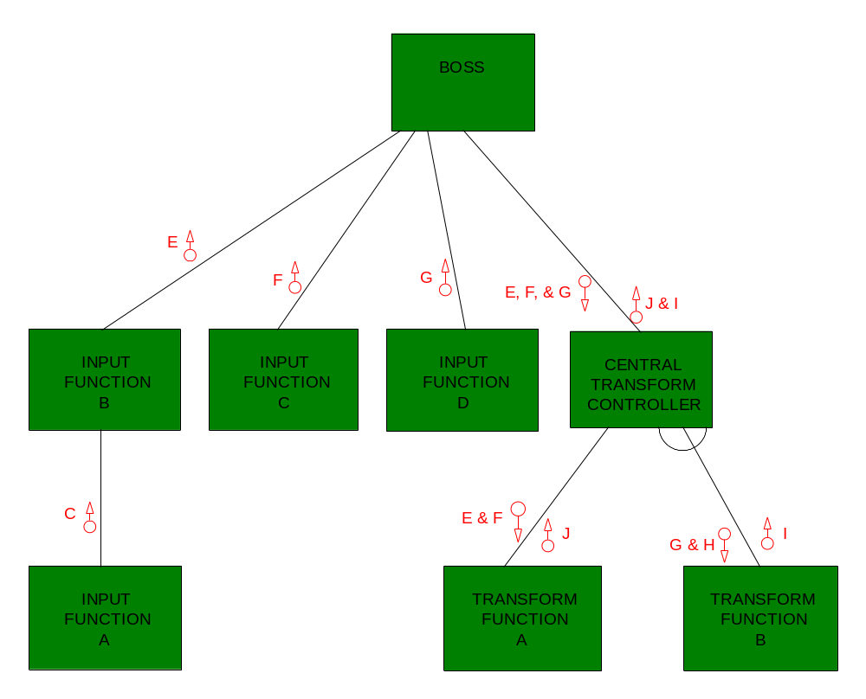
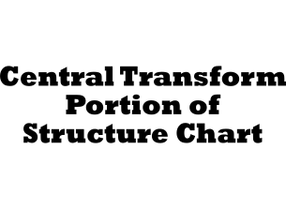
Notes:
Figure 15.8 Central Transform Portion of Structure Chart
Notice in the figure above, that the structure chart has notation to communicate that the module CENTRAL TRANSFORM CONTROLLER makes an iterative call to TRANSFORM FUNCTION B. As modules are added to a structure chart, such procedural information needs to be added.
518-519

Slide 20
Structured Design
Transform Analysis
    Step 6 - The last process encountered in a path that identifies efferent processes becomes a second-level module on the structure chart.
    Step 7 - Beneath the module (in step 6) should be a module that corresponds to the succeeding process appearing on the sequence path.
      Likewise any process immediately following that process would appear as a module beneath it on the structure chart.
Notes:
The above steps represent a simplified discussion of the transform-centered approach to structured chart development. In reality, a designer is not guaranteed that these steps will automatically result in a good modular design for a program. In reality, the designer would review the quality of the design. They may revisit this approach after evaluating the final design — making numerous revisions to the DFD and structure chart.
518-519

Slide 21
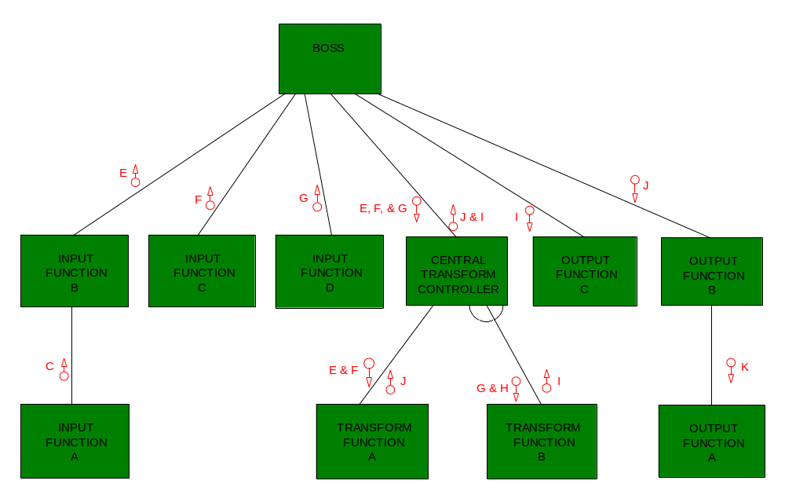

Notes:
Figure 15.9 Efferent Portion of Structure Chart
No additional notes provided.
518-520

Slide 22
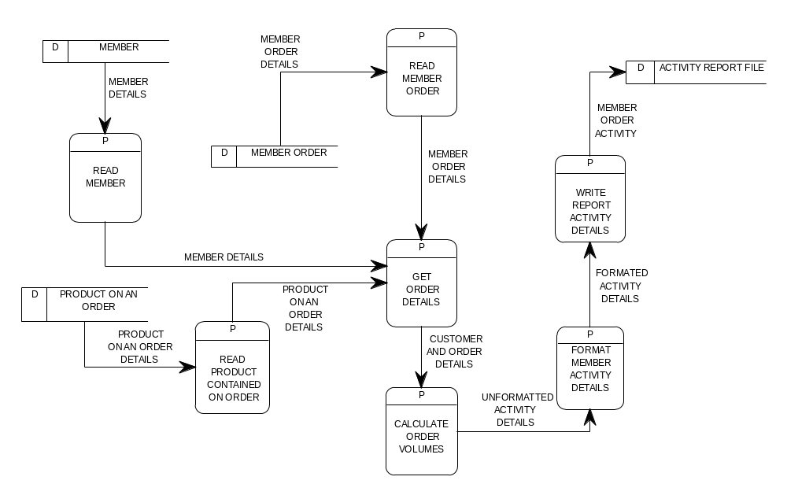
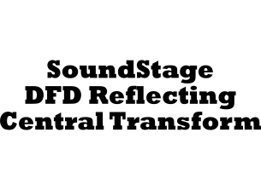
Notes:
Figure 15.10 Sample SoundStage DFD Reflecting Central Transform
As you can see in the figure above, the transform center consists of a single process, CALCULATE ORDER VOLUMES. Therefore, there was no need to add a controller module on our structure chart. Notice that the GET ORDER DETAILS receives input from three processes.
519-520

Slide 23
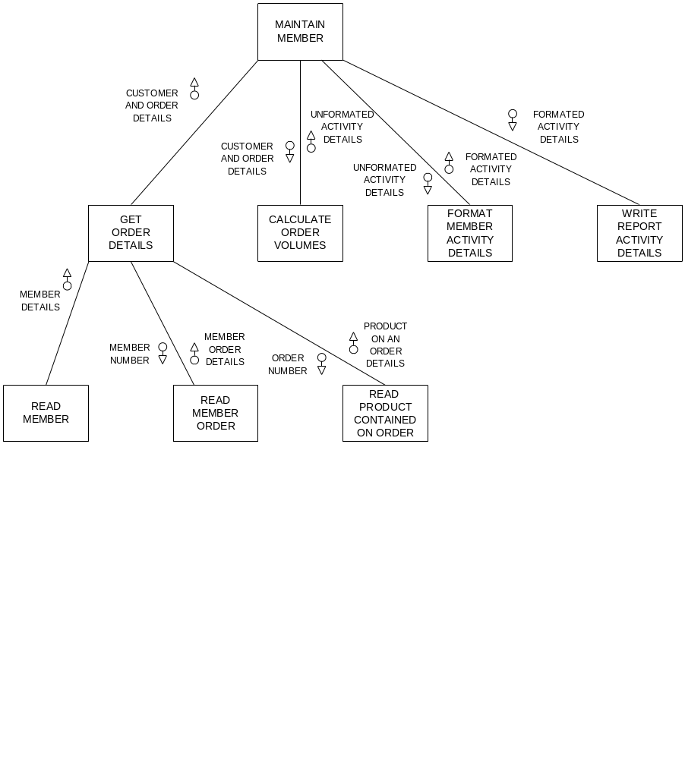

Notes:
Figure 15.11 Sample SoundStage Structure Chart from Transform Analysis
On the structure chart above, the sequence for which GET ORDER DETAILS calls the three input processes is very significant. It is essential that READ MEMBER precedes READ MEMBER ORDER, which in turn must precede READ PRODUCT CONTAINED ON ORDER. How might we have known this sequencing requirement? The designer must consider facts that can be communicated in previous design specifications. For example, the purpose of this DFD is to generate a report. The design of this output would communicate that data on the output is organized by member, then by orders for each member, followed by details regarding products appearing on each order. The fact that READ MEMBER ORDER must precede READ PRODUCT CONTAINED ON ORDER is also reinforced by examining our data model diagram and noticing the relationship paths (for example, MEMBER is related to MEMBER ORDER, which is related to PRODUCT CONTAINED ON ORDER).
519-521

Slide 24
Structured Design
Transaction Analysis
  An alternative structured design strategy for developing structure charts is called transaction analysis.
    Transaction analysis is the examination of the DFD to identify processes that represent transaction centers.
      A transaction center is a process that does not do actual transformation upon the incoming data (data flow); rather, it serves to route the data to two or more processes.
        You can think of a transaction center as a traffic cop that directs traffic flow.
        Such processes are usually easy to recognize on a DFD, because they usually appear as a process containing a single incoming data flow to two or more other processes.
Notes:
No additional notes provided.
521

Slide 25
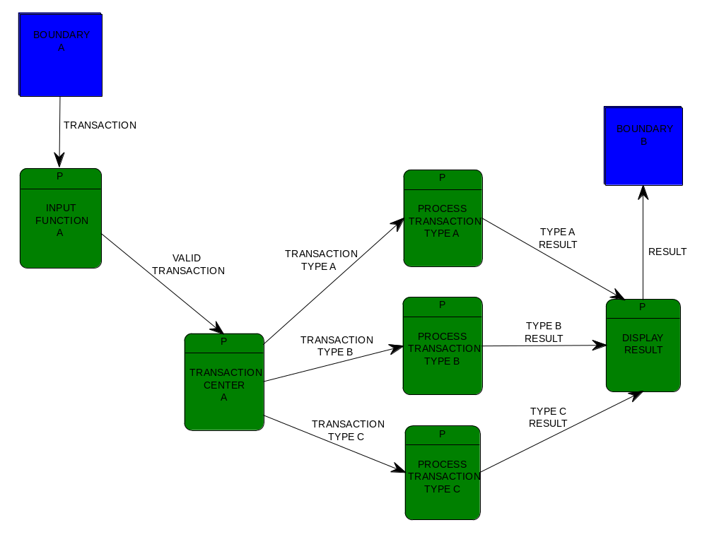
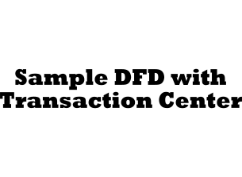
Notes:
Figure 15.12 Sample DFD with Transaction Center
No additional notes provided.
521-522

Slide 26
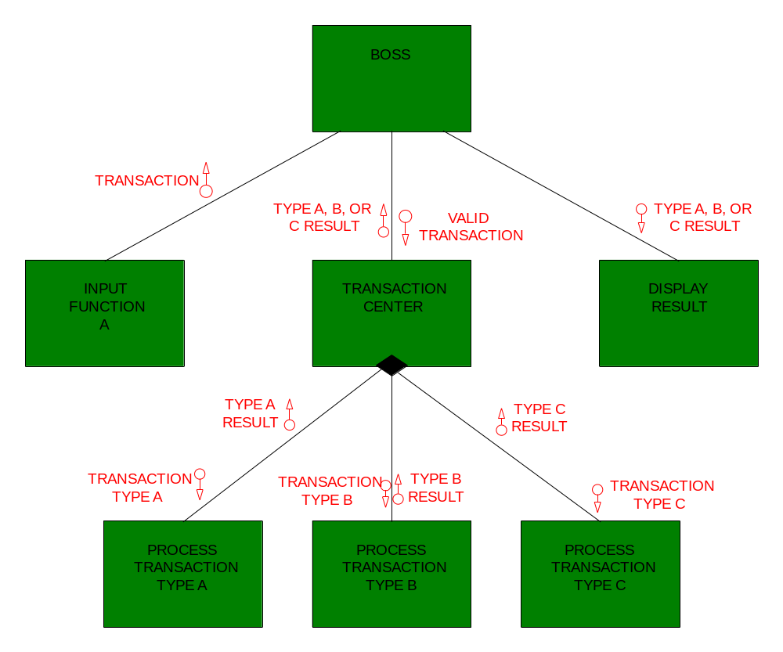
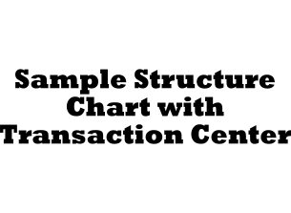
Notes:
Figure 15.13 Sample Structure Chart with Transaction Center
Notice that the transaction center is shown as a high-level module containing a diamond to suggest that it will call one and only one of the subordinate modules.
521-522

Slide 27
Structured Design
Transaction Analysis
  The primary difference between transaction analysis and transform analysis is that transaction analysis recognizes that modules can be organized around the transaction center rather than a transform center.
Notes:
There are a few classic examples of applications that would lend themselves to this strategy. A data flow diagram of each of these applications would contain a transaction center that routes the application’s input to the appropriate function.
A file maintenance program typically supports at least three functions that might be performed based upon the type of input transaction: adding a new record, deleting an existing record, or modifying an existing record.
An on-line system typically supports multiple levels of transactions. For instance, the main menu may offer three choices: EMPLOYEE FILE MAINTENANCE, PERSONNEL TRANSACTION, and EMPLOYEE INQUIRY. Each of these subfunctions may consist of multiple transactions. EMPLOYEE FILE MAINTENANCE might be factored as described in the preceding example. PERSONNEL TRANSACTION could be factored into SICK LEAVE PROCESSING, TIME CARD PROCESSING, VACATION PROCESSING, and so on. Thus, it is possible that an application contain multiple transaction centers — in this case, a transaction center may route a transaction to a module that also serves as a transaction center.
Although DFDs may help you identify transaction centers found in such applications, it depends on how detailed the analyst drew those DFDs (for instance, many analysts won't factor the DFD process, MAINTAIN EMPLOYEE FILE, into three separate processes). As with the transform analysis strategy discussed earlier, DFDs will likely first need to be revised to show missing details.
521-523

Slide 28
Structured Design
Structure Chart Quality Assurance Checks
  Coupling:
    In structured design, the decomposition of a program in manageable modules should be done in such a way that the modules are independent as possible from one another.
    In structured design programs appearing on a structure chart are evaluated relative to their degree coupling.
    Coupling refers to the level of dependency that exists between modules.
    Loosely coupled modules are less likely to be dependent on one another.
Notes:
Structure charts developed through structured design are evaluated for quality. By using the Yourdon/Constantine strategy to divide a program into modules, you are able to end up with modules that are said to be loosely coupled and highly cohesive. In the following sections we examine these two measures of program design quality. As you study these two measures, recognize that the data and control flow symbols depicted on a structure chart can serve as aids in determining the degree of coupling and cohesion of modules.
523

Slide 29
Structured Design
Structure Chart Quality Assurance Checks
  Coupling:
    Types of coupling: (from best to worst)
      Data coupling — two modules are said to be data coupled if their dependency is based on the fact that they communicate by passing of data.
      Stamp coupling — two modules are said to be stamp coupled if their communication of data is in the form of an entire data structure or record.
      Control coupling — two modules are said to be control coupled if their dependency is based on the fact that they communicate by passing of control information or flags.
      Common coupling — modules are said to be common coupled if they refer to the same global data area.
Notes:
Data coupling — two modules are said to be data coupled if their dependency is based on the fact that they communicate by passing of data. Other than communicating through data, the two modules are independent; that is, each module performs it’s own function with no regard to what or how the other module completes its functions. In examining modules for data coupling, careful attention should be made to ensure that no module communication contains “tramp” data. Tramp data is any unnecessarily data communicated between the modules. For example, a module might call a second module to have it calculate an employee’s net pay. Only data needed by the second module to complete its task should be passed from the calling module. By ensuring that modules only communicate necessary data, module dependency is minimized. This helps to avoid the “ripple effect” wherein making changes in one module inadvertently affects another module that happens to receive the same data.
Stamp coupling — two modules are said to be stamp coupled if their communication of data is in the form of an entire data structure or record. Since not all data making up the structure is usually necessary in the communication between the modules, stamp coupling typically involves tramp data. The passing of an entire data structure or record is also undesirable because any changes to the data structure or record may adversely affect any module that uses it.
Control coupling — two modules are said to be control coupled if their dependency is based on the fact that they communicate by passing of control information or flags. Control coupled modules represent a higher level of dependency. The mere fact that one module passes control information to another module suggest that the first module is involved in changing or coordinating the functions to be accomplished in the receiving module.
Common coupling — modules are said to be common coupled if they refer to the same global data area. Global data areas are commonly found in third generation programming languages (3GLS) such as COBOL. Common coupling represents an even higher level of module dependency. For example, all modules that reference the global data area could be adversely affected by any changes that any of the other modules made to data in that global data area.
523-525

Slide 30
Structured Design
Structure Chart Quality Assurance Checks
  Coupling:
    Types of coupling: (continued)
      Content coupling — two modules are said to be content coupled (also referred to as hybrid coupled) when one module actually modifies the procedural contents of another module.
Notes:
Content coupling — two modules are said to be content coupled (also referred to as hybrid coupled) when one module actually modifies the procedural contents of another module. In essence, the connection that exists between the two modules represents control. Content coupling represents the highest degree of module dependency.
Finally, it should be pointed out that quality checks for coupling are typically be performed upon the modules appearing on a structure chart. However, those experienced in structured design are sometimes capable of performing coupling checks upon the processes appearing on DFD that would be used to subsequently derive that structure chart.
523-526

Slide 31
Structured Design
Structure Chart Quality Assurance Checks
  Cohesion:
    Cohesion refers to the degree to which a module's instructions are functionally related.
    Highly cohesive modules contain instructions that collectively work together to solve a specific task.
    The goal is to ensure that modules exhibit a high degree of cohesiveness.
    Programs that are implemented with highly cohesive modules tend to be easier to understand, modify, and maintain.
Notes:
No additional notes provided.
526

Slide 32
Structured Design
Structure Chart Quality Assurance Checks
  Cohesion:
    There are seven types or levels of cohesion and they are as follows: (from most desirable to least desirable)
      Functional cohesion — are modules whose instruction are related because they collectively work together to accomplish a single well-define function.
      Sequential cohesion — are modules whose instructions are related because the output data from one instruction is used as input data to the next instruction.
      Communicational cohesion — are modules whose instructions accomplish tasks that utilize the same piece(s) of data.
      Procedural cohesion — are modules whose instructions accomplish different tasks, yet have been combined because there is a specific order in which the tasks are to be completed.
Notes:
Functional cohesion — are modules whose instruction are related because they collectively work together to accomplish a single well-define function. Examples of functionally cohesive module would be modules that: check customer account balance, add a new customer, delete a customer, and query a customer. In each example, the module would be accomplishing a single, simple function.
Sequential cohesion — are modules whose instructions are related because the output data from one instruction is used as input data to the next instruction. An example of this type of module would be one whose instructions might accomplish the following series of tasks: get a an order, edit the order, release the order to the warehouse for filling and shipping, and then bill customer for shipped order. This type of module does not typically present serious coupling and cohesion problems that would affect its maintainability. However, since several functions have been included in a single module, the reuse of any given function is not possible.
Communicational cohesion — are modules whose instructions accomplish tasks that utilize the same piece(s) of data. For example, a module may consist of numerous instructions that each accomplish a task using customer data - such as checking a customer balance, adding a new customer, canceling a customer, updating a customer’s record, changing a customers status, or querying a customer. Such modules are easier to modify and maintain if it is expanded into separate modules that accomplish their own separate task.
Procedural cohesion — are modules whose instructions accomplish different tasks, yet have been combined because there is a specific order in which the tasks are to be completed. These types of modules are typically the result of first flowcharting the solution to a program and then selecting a sequence of instructions to serve as a module. Since these modules consists of instructions that accomplish several tasks that are virtually unrelated, these types of modules tend to be less maintainable.
526

Slide 33
Structured Design
Structure Chart Quality Assurance Checks
  Cohesion:
    There are seven types or levels of cohesion and they are as follows: (continued)
      Temporal cohesion — are modules whose instructions appear to have been grouped together into a module because of “time”.
      Logical cohesion — are modules that contain instructions that appear to be related because they fall into the same logical class of functions.
      Coincidental cohesion — are modules that contain instructions that have little or no relationship to one another.
Notes:
Temporal cohesion — are modules whose instructions appear to have been grouped together into a module because of “time”. For example, a temporal cohesive module may contain instructions that were grouped together because they perform start-up or initialization activities (such as setting program counters or control flags) associated with the program. Or perhaps the a set of instructions were to be performed at the end of the program; such as printing final report totals, closing a file, or display an end-of-job message to the user.
Logical cohesion — are modules that contain instructions that appear to be related because they fall into the same logical class of functions. For example, the instructions were group together as a module perhaps because they all involve editing or arithmetic operations. Unfortunately, logically cohesive modules do not meet our goal of a module containing instructions that belong together because they collectively serve to accomplish a single function or task.
Coincidental cohesion — are modules that contain instructions that have little or no relationship to one another. Coincidental cohesive modules that appear to have been derived with no attention given to the actual “function” being served by the module. In fact, their existence is typically based merely upon coincidence. For example, a designer may decide to create a module that will consist of a series of program instructions that they encountered several times elsewhere in the programs logic.
,It should be pointed out that quality checks for cohesion can be performed upon the modules appearing on a structure chart, or upon the processes appearing on DFD that would be used to subsequently derive that structure chart.
526-527

Slide 34
Packaging Program Specifications
Introduction
  As an systems analyst, you are responsible for packaging that set of design documentation into a format suitable for the programmer.
    This package is called a technical design statement.
    The technical design statement should include all data, process, interface, and geography building block specifications developed by the designer.
Notes:
527
Using the design techniques presented in this unit, you have accumulated a good number of design specifications for the new system. Perhaps some or all of the documentation was done using a CASE product and resides in a repository. What do we actually package together? Put yourself in the role of the computer programmer. Are those specifications in a format that will help you write the programs?

Slide 35
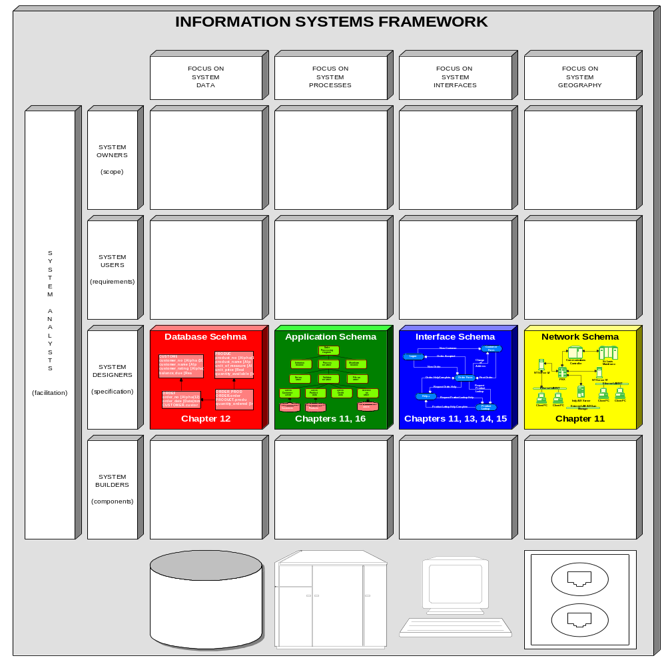

Notes:
Figure 15.16 Information Systems Framework Focus of Packaging
No additional notes provided.
527-528

