Slide 1

George Teifel · Mary Teifel
UNM & CNM APP CONTEST 2026
Notes:
[before the timer. 0 s]
(Wait for the go-ahead. Say nothing. Click once: the next slide is a 10-second film that starts by itself.)

Slide 2
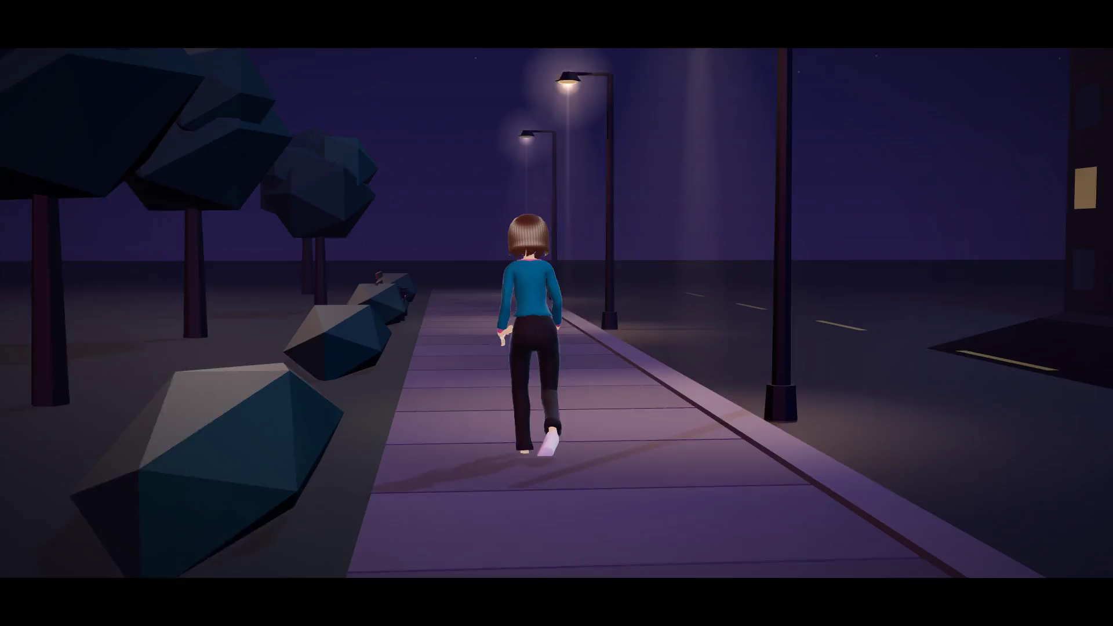
Notes:
[0:00 to 0:12, 12 s]
(The film plays by itself with sound: 10 seconds. Don't talk over it. It ends on the SafetySense logo. Let the logo sit for one beat, then advance.)
(If it doesn't start: click the picture once. If it still doesn't, advance and say: "Picture someone walking home. Someone comes up behind her, she freezes, and she can't reach her phone. We built an app for that moment.")

Slide 3



WHO WE ARE
SafetySense calls for help when you can't.
George Teifel
Mary Teifel
University of New Mexico
Central New Mexico Community College
Senior · Electrical Engineering
Freshman · Mechanical Engineering
Built the iOS app and the backend
Led research, UX and the app's wording
SafetySense · 3
Notes:
[0:12 to 0:40, 28 s]
GEORGE: That's the moment we built SafetySense for. I'm George Teifel, a senior in electrical engineering at UNM. I built the app and the backend.
MARY: And I'm Mary Teifel, a freshman in mechanical engineering at CNM. I led the research, the design and every word the app says.
GEORGE: SafetySense is an iPhone safety app for students out at night.

Slide 4



THE PROBLEM
Most safety apps wait for you to press a button or set a timer
70%
Freezing is involuntary
It is a normal response, not a choice.
of 298 women reported significant tonic immobility, an involuntary freeze, during sexual assault
Phones get taken, broken or switched off
A dead phone sends nothing.
Speaking isn't always possible
Möller et al., Acta Obstet Gynecol Scand, 2017 (n = 298)
New Mexico is still listed as the only state without text-to-911.
What should a phone do when she can't?
“Most safety apps”: based on the documentation of the apps we reviewed. We did not test them.
SafetySense · 4
Notes:
[0:40 to 1:27, 47 s]
We built this for UNM and CNM students out at night: parties, first dates, rideshares, the walk back to the car.
Most safety apps we reviewed wait for you to press a button or set a timer.
That fails exactly when it matters. In a clinical study of 298 women seen after a sexual assault, 70 percent reported significant tonic immobility: an involuntary freeze. It's a normal response, not a choice.
Phones also get taken, broken or switched off, and a dead phone sends nothing. And New Mexico is still listed as the only state without text-to-911.
So we asked one question: what should a phone do when she can't?
(Source if asked: Möller, Söndergaard and Helström, 2017. 298 women at a Stockholm emergency clinic; 70% significant, 48% extreme.)
(Re-check the text-to-911 status before Nov 20. Never say there is "no way at all" to text.)

Slide 5





OUR ANSWER
You turn on a Guard. If you can't respond, it acts for you.
START IT
WHAT IT WATCHES FOR
Before a walk home, a night out, a date or a ride, tap Start Guard.
Screams
Breaking glass
Safe word
Fall, then stillness
Or skip straight to an alert with the Action Button or Siri.
It only listens while a Guard is on.
BUILT WITH
Native SwiftUI on iOS 26 · Apple on-device sound, speech and motion
Supabase · Twilio · Noonlight (sandbox)
SafetySense · 5
Notes:
[1:27 to 1:59, 32 s]
Our answer starts before anything goes wrong. Before a walk home, a night out, a date or a ride, you turn on a Guard. One tap.
It's a native iPhone app using Apple's on-device sound, speech and motion frameworks, on a Supabase backend.
Then the phone watches for signs that something's wrong: a scream, breaking glass, your safe word, or a fall followed by stillness. It only listens while a Guard is on.
(Twilio and Noonlight are on the slide. Don't read them out: slide 12 explains what each one does.)

Slide 6
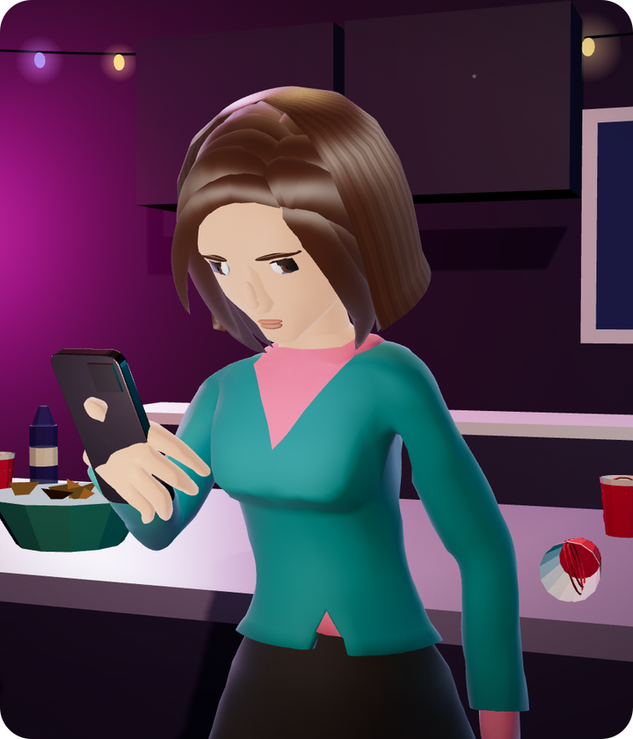
Watch three things.
1
It asks before it alerts.
2
What her friend sees.
3
What happens if someone makes her cancel, or breaks her phone.
Notes:
[1:59 to 2:19, 20 s]
You saw her phone already calling. Here's how it gets there, on another night out. Watch three things: it asks before it alerts, what her friend sees, and what happens if someone makes her cancel or breaks her phone.
(Advance. The clip starts by itself.)

Slide 7

Notes:
[2:19 to 3:15, 56 s]
(52-second clip with its own voice. Don't talk over it. It ends holding on "Alert raised by itself". Advance when the sound has faded.)
(If the video won't play: jump to appendix slide A4 and give the 40-second spoken version in its notes, then come back to slide 8.)

Slide 8
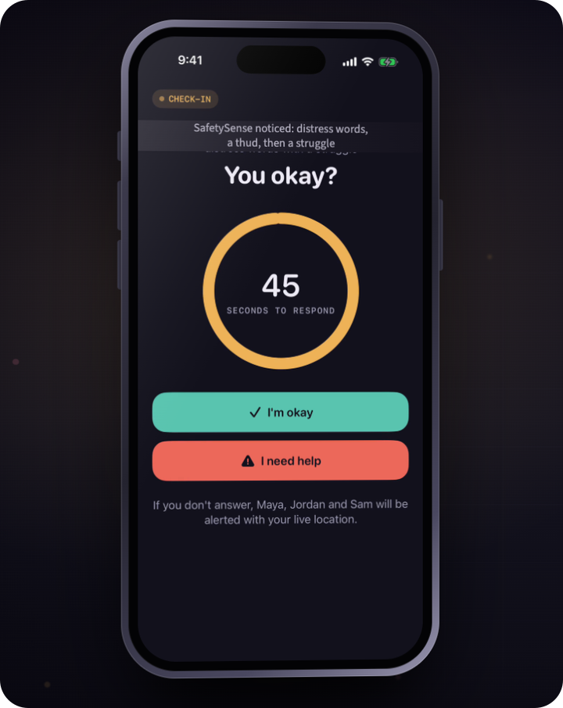
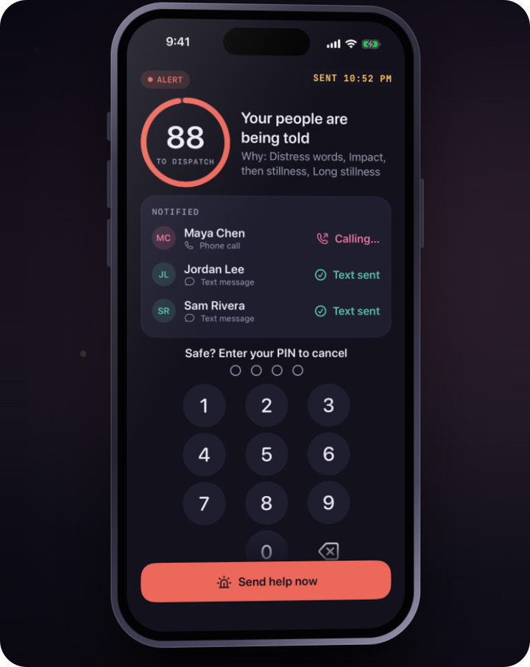
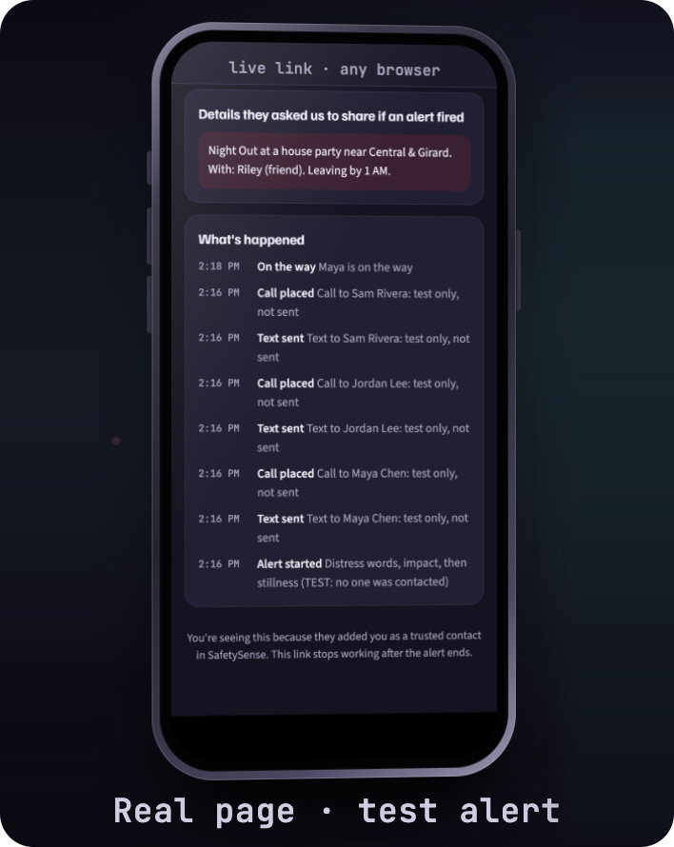
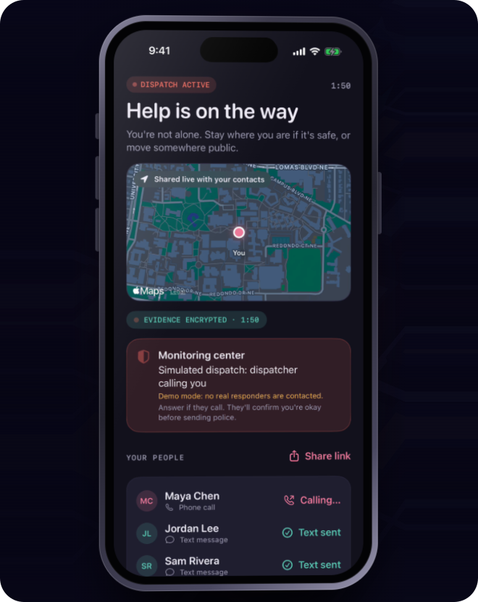
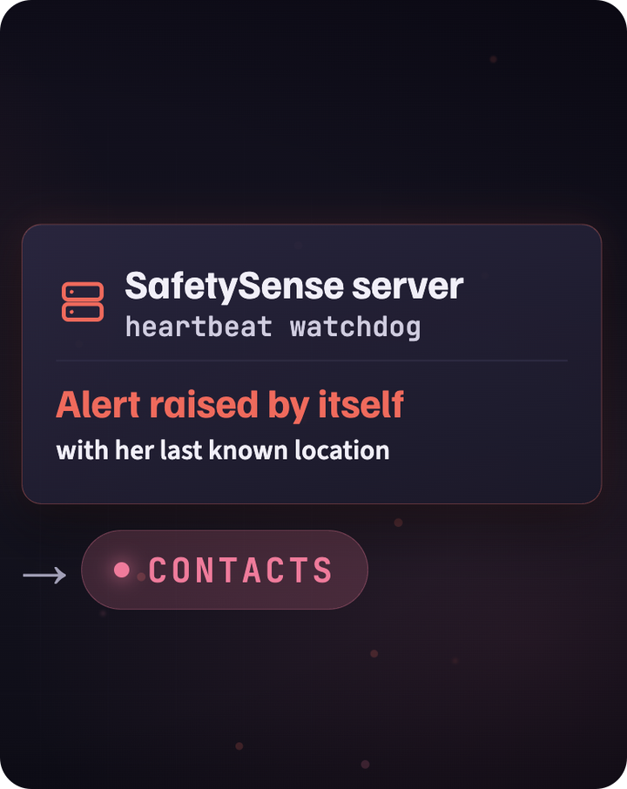
WHAT YOU JUST SAW
The app is real. Here's exactly what was simulated.
REAL APP
CALLS WORK
REAL PAGE
SIMULATED
ANIMATION
Recorded in the simulator, in demo mode
Real calls in our tests, not in this recording. Texts are sent but don't arrive yet.
Screenshot of a test alert
No police contacted. We test with Noonlight's sandbox
Of a server check we've deployed
Waits are sped up, and Ava and Maya are animated characters.
The duress PIN is built; what it reaches is the same simulated dispatch.
SafetySense · 8
Notes:
[3:15 to 3:59, 44 s]
Those phone screens are our app, recorded in the iPhone simulator in demo mode, with a scripted night and the waits sped up. A few, including the alert in the opening film, are redrawn for the big screen.
Outside the video, the app places real calls to a verified number, and the friend's page is a real web page. The text is written, but doesn't arrive yet on our trial account.
Dispatch is simulated: we've only used Noonlight's sandbox, and no police were contacted. The duress PIN keeps that same simulated dispatch coming.
And the smashed phone is an animation of a server check we've deployed.
(If asked "was that call real in the video?": no. The recording used demo mode, which places no calls. Real calls work in our tests, to a verified number.)
(Only say "deployed" for the heartbeat check. Don't say it has been tested in a live alert unless that test has been run by then.)

Slide 9
ORIGINALITY
Others have pieces. We connected the chain.
 | UNM Safe | Noonlight | bSafe | Apple built-in | SafetySense
Notices distress on its own | – | Crash (paid) | – | Crash; fall on Watch | ✓ Sound, motion, context
Acts when the phone goes dark | – | Not documented | – | Check In, timing varies | ✓ Server heartbeat (deployed)
Duress PIN (fake cancel) | – | – | – | – | ✓ The two PINs you saw
Professional dispatch | Call UNMPD | ✓ | – | 911 call | ✓ Noonlight (sandbox)
Live location to a friend | ✓ | ✓ | ✓ | ✓ Check In | ✓
From each product's documentation; not tested by us. These are four tools a student could already have.
Their columns are shipped products. Ours is a prototype; dispatch runs in Noonlight's sandbox.
SafetySense · 9
Notes:
[3:59 to 4:42, 43 s]
We compared tools a student could already have: UNM Safe, Noonlight, bSafe and the iPhone itself, from their documentation.
Other apps have pieces of this, and we'll name them. Centinela listens for a scream and has a duress PIN, but stops at your friends. aegis+ has a duress PIN and dispatch, but its listing describes nothing that notices on its own. We found no product that documents the whole chain.
Ours notices on its own, tells your people, and reaches dispatch, in a sandbox today, including the two cases you just saw: the forced cancel and the smashed phone.
And we link to UNM Safe.
(Say "we found no product that documents", never "no one else does this". Their columns are shipped products; ours is a prototype.)
(If asked: some apps also document a server-side dead-phone alert. We read documentation; we did not test them.)

Slide 10





DESIGN AND EXPERIENCE
Designed for the worst night of someone's life
Calm words, never blame
Written to be calm and never blaming. Advocate review is our next step.
Your first alert is a drill
Onboarding ends with a practice run marked TEST.
Afterward, you choose
An advocate, medical care, reporting, or keeping it private.
The practice drill
Support, afterward
SafetySense · 10
Notes:
[4:42 to 5:17, 35 s]
MARY: We designed this for the worst night of someone's life, so the words matter as much as the features.
We wrote every line to be calm and to never blame the person holding the phone. Advocates haven't reviewed it yet; that's our next step. You saw it in the video: the first thing it says is just "You okay?"
Onboarding ends with a practice drill marked TEST, so your first alert is a practice one.
And afterward, the Support screen offers an advocate, medical care, reporting, or keeping it private. Nothing is required.

Slide 11



PRIVACY AND SECURITY
Private by default. Evidence only when it matters.
1
2
3
4
Guard on
30-second buffer
Only if an alert fires
Vault
Listening happens on the phone
In memory, overwriting itself
Audio is encrypted on the phone before upload
Opens with your Face ID. You decide who hears it
No audio is saved unless an alert fires
No ad or analytics SDKs
Live links are built to expire after the alert
SafetySense · 11
Notes:
[5:17 to 5:57, 40 s]
MARY: An app that listens has to earn trust, so here's exactly what happens to audio.
All the listening happens on the phone. Audio sits in a 30-second buffer in memory that keeps overwriting itself. No audio is saved.
Only if an alert fires is audio kept. It's encrypted on the phone before upload, so our server only holds ciphertext.
It goes into a vault that opens with your Face ID, and you decide whether anyone hears it.
There are no ad or analytics SDKs, and the live link is built to expire when the alert ends.
(Say "no audio is saved". Never "nothing is saved": location does go to the server during a Guard.)

Slide 12


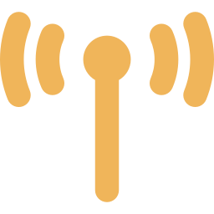
TECHNOLOGY
A real app on a real backend
heartbeat
+ location
no audio
while guarding
On the iPhone
Our server (Supabase)
Reaching people
Apple sound, speech and motion models
Rules-based risk engine
On-device language model as a second opinion
Alerts and the ladder
Heartbeat watchdog, once a minute
Twilio: calls and texts to contacts
Live-link web page
Noonlight: professional dispatch (sandbox today)
SafetySense · 12
Notes:
[5:57 to 6:30, 33 s]
GEORGE: Under the hood, it's a native iOS 26 app on a live backend.
On the phone, Apple's sound, speech and motion frameworks feed a rules-based risk engine, so it can always explain why it escalated. Apple's on-device language model gives a second opinion, but can never be the only reason to escalate.
The server runs the alert steps and a once-a-minute heartbeat check. Twilio carries the calls, and Noonlight is the dispatch service.

Slide 13
PATHWAY
How we'll know it works, and what we haven't proven yet
TARGETS, NOT YET MEASURED
Not proven yet
< 1
< 60 s
No field test in real, noisy places
Real-device run on an iPhone 16e is pending
Live dispatch and our relay still need Noonlight's sign-off
Internal TestFlight only
false alert per 10 h
scream to ringing phone
< 8%
80%
battery per hour
finish onboarding
NEXT
Student usability tests and advocate review
TestFlight pilot
Campus partnership
SafetySense · 13
Notes:
[6:30 to 7:06, 36 s]
Here's how we'll know it works. Our targets are on the left: under one false alert in ten hours of guarding, and under a minute from a scream to a ringing phone.
Those are targets; we haven't field-tested them. The app is on internal TestFlight only, our real-device run is still to come, and we still need Noonlight's sign-off before any live dispatch.
Next: usability tests with UNM and CNM students, a review of our wording by advocates, then a TestFlight pilot and a campus partnership.
(If the iPhone 16e run is done by Nov 20, replace that line with the measured numbers.)

Slide 14

SAFETYSENSE
When you can't call for help, SafetySense does.
SafetySense supplements 911. It never replaces it.
George Teifel UNM Mary Teifel CNM
Thank you. We'd love your questions.
Notes:
[7:06 to 7:23, 17 s. Total 7:23, leaving 37 s of slack.]
GEORGE: SafetySense supplements 911. It never replaces it. But when you can't call for help, SafetySense does.
MARY: We'd love to pilot it with students at UNM and CNM. Thank you. We're happy to take your questions.
(Stop. Stay on this slide for Q&A. The appendix slides are only for answering questions.)

Slide 15
APPENDIX · Q&A PREP 1 OF 3
Likely judge questions: trust and tech
What about false alarms?
Won't listening kill the battery?
Escalation needs a combination of signals that fade over time, and the first step is always a quiet “You okay?” that one tap clears. Contacts come before dispatch, and the monitoring center's call is forwarded to you to confirm before sending police. Target: under 1 false alert per 10 hours.
It only listens during a Guard session you start, not all day. Sensing runs on Apple's on-device frameworks, and the server heartbeat is one small request a minute. Our target is under 8% per hour. We haven't measured it on a real phone yet; an iPhone 16e run is next.
Is it recording my conversations?
Will Apple approve it?
No. Audio sits in a 30-second memory buffer that overwrites itself and is never written to storage. Only an Alert keeps audio, and that's encrypted on the phone. Transcription and AI run on the device. The server sees ciphertext only.
We follow the rules rather than fight them: listening only during user-started sessions with a visible Live Activity, no auto-dialing 911 (iOS doesn't allow it), and dispatch would go through Noonlight, a professional monitoring service many apps already use. Apple hasn't reviewed it: the app is on internal TestFlight only.
SafetySense · A1
Notes:
Q&A backup (4:00 of judge questions). Don't present this slide during the 8 minutes. Answer in one or two sentences, then stop. Fuller answers are in presentation/QA_PREP.md.

Slide 16
APPENDIX · Q&A PREP 2 OF 3
Likely judge questions: cost, law, business
What does it cost to run?
Why not Apple Check In or UNM Safe?
A Twilio call or text costs a cent or two, and only during alerts. Supabase is free at pilot scale and about $25 a month after that. Dispatch is priced per alarm through Noonlight's partner program, which we'd confirm before launch.
Both are good, and we link to UNM Safe. Check In notices when you don't arrive or a timer runs out. UNM Safe needs you to tap. Neither listens for distress or has a duress PIN. We cover the moments you can't reach your phone.
Is recording legal?
Business model and partners?
Audio is kept only during an alert, and the user is a party to the conversation. New Mexico is generally read as a one-party-consent state (NMSA 30-12-1), but we'd get a legal review before launch. Clips belong to the user and are shared only if they choose.
Free for students. Proposed revenue is a campus licence paid from safety and Title IX budgets, plus a paid plan for non-students. Partners we hope to work with: LoboRESPECT, the Women's Resource Center, UNMPD and CNM Security.
SafetySense · A2
Notes:
Q&A backup (4:00 of judge questions). Don't present this slide during the 8 minutes. Answer in one or two sentences, then stop. Fuller answers are in presentation/QA_PREP.md.

Slide 17
APPENDIX · Q&A PREP 3 OF 3
Likely judge questions: edge cases
What if nobody answers, or there's no signal?
Could an abuser use it to track someone?
If no contact responds in 90 seconds, dispatch takes over. If the phone loses signal or dies mid-session, the server notices the missing heartbeats and alerts contacts with the last known location.
Location is shared only while you're guarding or in an alert, and only you can start that. Contacts can't pull your location on demand, and live links are built to expire after the alert.
What about older iPhones?
Android? Other campuses?
The Action Button needs a newer iPhone, so there's also a Lock Screen control, Siri, a spoken safe word and a hold-to-release SOS. Without Apple Intelligence the app runs on rules only. It needs iOS 26.
We started with iOS so we could use Apple's on-device AI. The backend is platform-neutral, and the contacts' live link already works in any browser. Android and other campuses come after the student pilot.
SafetySense · A3
Notes:
Q&A backup (4:00 of judge questions). Don't present this slide during the 8 minutes. Answer in one or two sentences, then stop. Fuller answers are in presentation/QA_PREP.md.

Slide 18
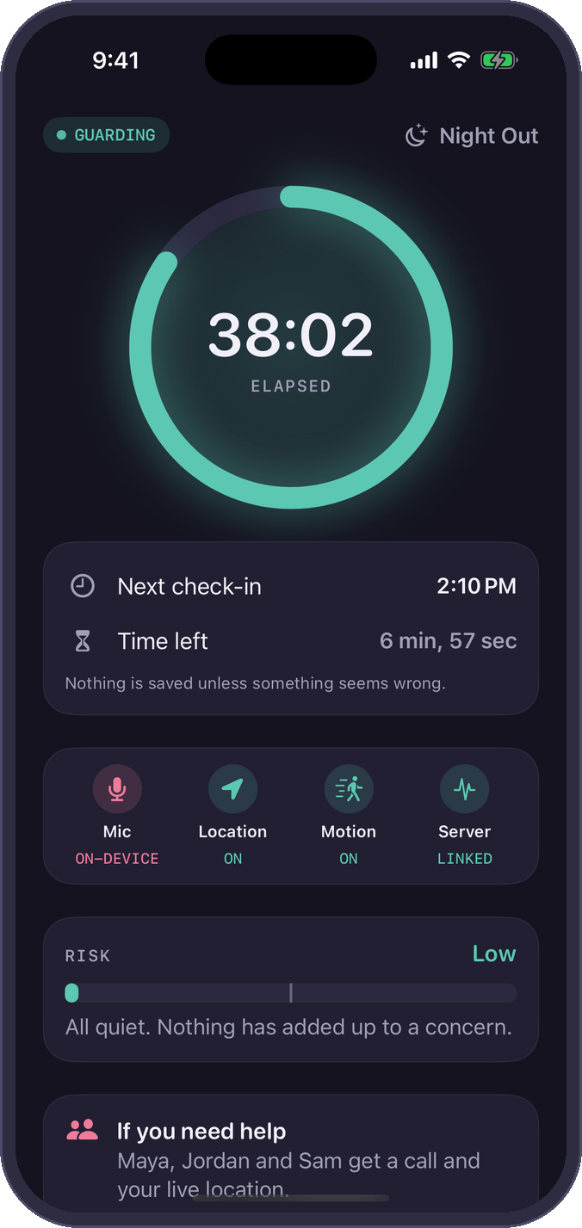
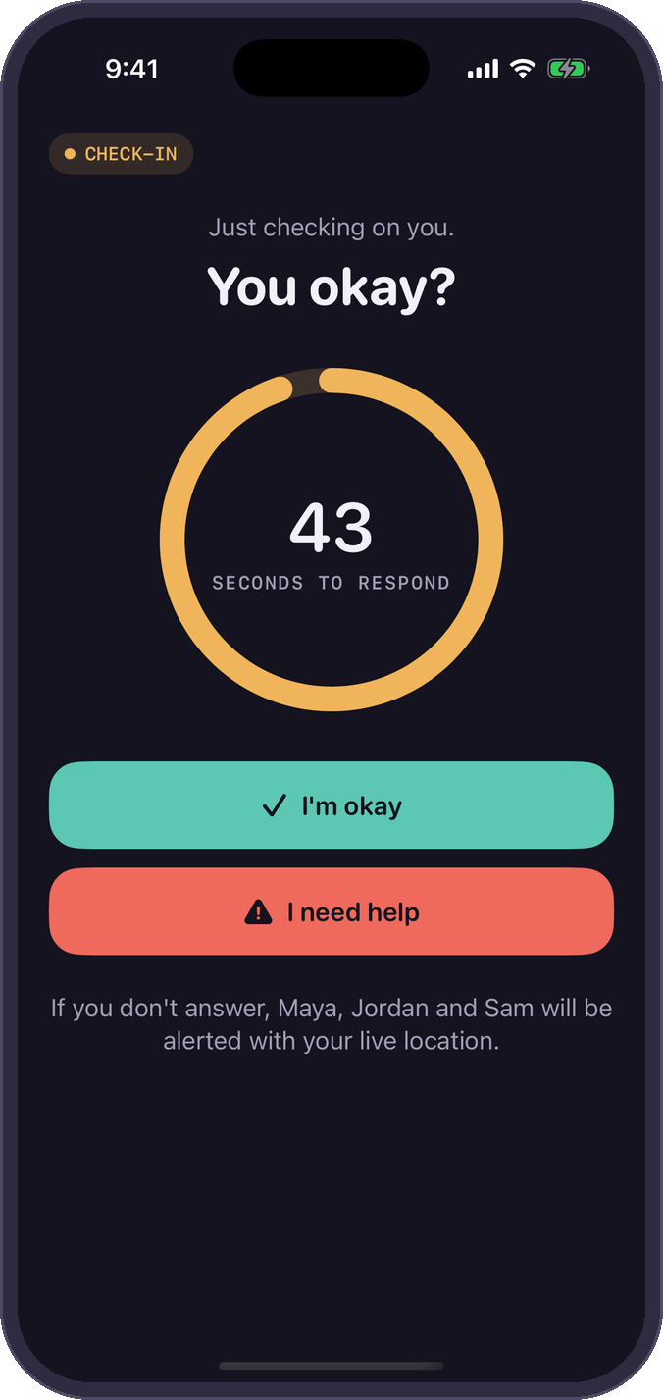
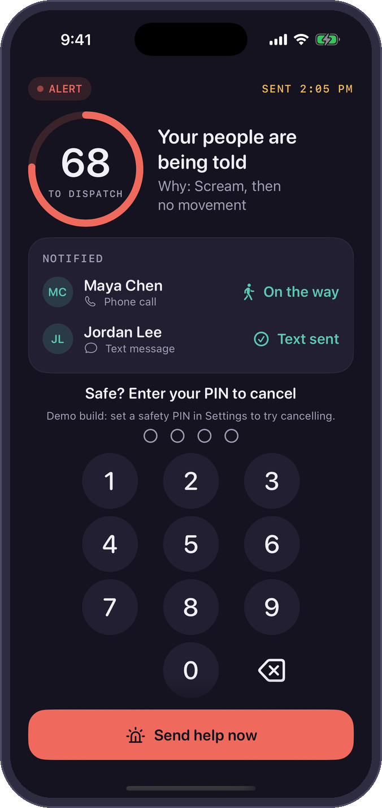
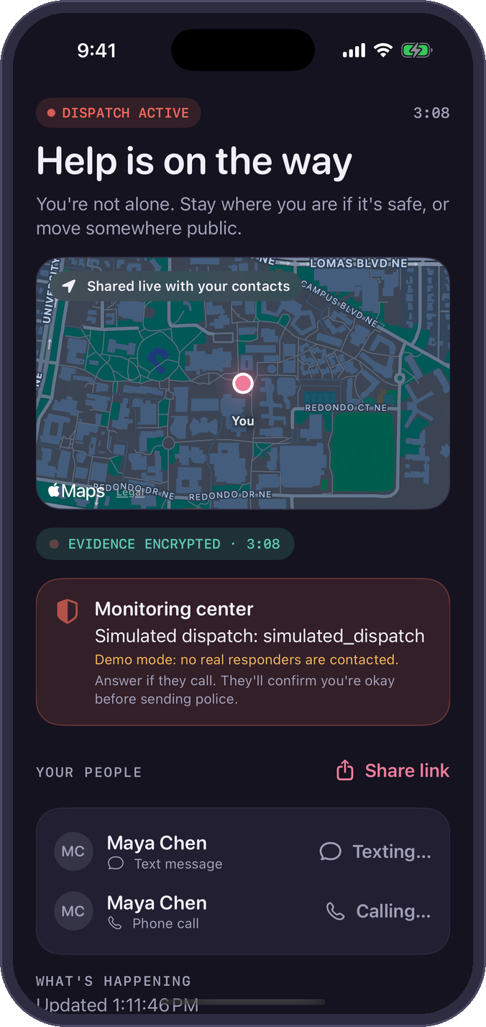
APPENDIX · IF THE VIDEO FAILS
One calm ladder, from “You okay?” to dispatch
0 · Guarding
1 · Check-in
2 · Alert
3 · Dispatch (simulated)
Audio stays in a 30 s memory buffer. No audio is saved.
A quiet haptic: “You okay?” You have 45 seconds to tap.
Your people get a call and a live map. Evidence is encrypted.
After 90 s or “Send help,” a monitoring center calls and can send police. Simulated here.
SafetySense · A4
Notes:
[Only if clip B fails. About 50 s.]
Here's what the video shows. When something seems wrong, the app asks quietly: "You okay?" One tap ends it.
If there's no answer in 45 seconds, her trusted contacts get a phone call and a link to her live location, and they can tap "I'm on my way" or "Send help now".
After 90 more seconds with no answer, a professional dispatch service calls her and can send police. In our demo that step is simulated.
If someone forces her to cancel, a duress PIN looks exactly like cancelling, but help keeps coming. And if the phone is smashed, our server notices the missing heartbeat and raises the alert itself.

