Slide 1

George Teifel · Mary Teifel
UNM & CNM APP CONTEST 2026
Notes:
[before the timer. 0 s]
(Wait for the go-ahead. Then advance to the next slide and start speaking; the timer starts with your first word.)

Slide 2



WHO WE ARE
SafetySense calls for help when you can't.
George Teifel
Mary Teifel
University of New Mexico
Central New Mexico Community College
Senior · Electrical Engineering
Dual credit student · Mechanical Engineering
Built the iOS app and the backend
Research, design and the app's wording
SafetySense · 2
Notes:
[0:00 to 0:38, 38 s]
GEORGE: Picture a student walking home at night. Someone comes up behind her. She freezes. She can't get to her phone. That's the moment we built SafetySense for. I'm George Teifel. I'm a senior in electrical engineering at UNM, and I built the app and the backend.
MARY: I'm Mary Teifel, a dual credit student at CNM, studying mechanical engineering. I worked on the research, the design and the wording in the app.
GEORGE: SafetySense is an iPhone app for students who are out at night.

Slide 3


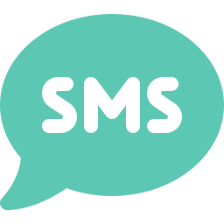
THE PROBLEM
Most safety apps wait for you to press a button or set a timer
70%
Freezing is involuntary
It is a normal response, not a choice.
of 298 women reported significant tonic immobility, an involuntary freeze, during sexual assault
Phones get taken, broken or switched off
A dead phone sends nothing.
Speaking isn't always possible
Möller et al., Acta Obstet Gynecol Scand, 2017 (n = 298)
Even texting 911 takes a phone in your hand.
What if you can't press the button?
“Most safety apps”: based on the documentation of the apps we reviewed. We did not test them.
SafetySense · 3
Notes:
[0:38 to 1:40, 62 s]
We built this for UNM and CNM students: parties, first dates, rideshares, the walk back to the car.
MARY: (Your own experience, in your own words: 2 or 3 sentences, about 15 seconds. For example, a night you or a friend felt unsafe, or what you and your friends already do to look out for each other. Only say what you're comfortable saying to a room, and only what's true.)
GEORGE: Most safety apps we looked at need you to do something. Press a button, or set a timer.
But that's exactly what you can't do when it matters. In one clinical study of 298 women seen after a sexual assault, 70 percent said they froze. It's involuntary. It's a normal response, not a choice.
Phones also get taken, broken or switched off. And even texting 911 takes a phone in your hand.
So our question was simple: what if you can't press the button?
(Source if asked: Möller, Söndergaard and Helström, 2017. 298 women at a Stockholm emergency clinic; 70% significant, 48% extreme.)
(Don't say New Mexico has no text-to-911. The state has been rolling it out since its 2025 911 upgrade.)

Slide 4





OUR ANSWER
You turn on a Guard. If you can't respond, it acts for you.
START IT
WHAT IT WATCHES FOR
Before a walk home, a night out, a date or a ride, tap Start Guard.
Screams
Breaking glass
Safe word
Fall, then stillness
Or skip straight to an alert with the Action Button or Siri.
It only listens while a Guard is on.
BUILT WITH
A native iPhone app · The listening happens on the phone
Real phone calls · Professional dispatch (test system today)
SafetySense · 4
Notes:
[1:40 to 2:12, 32 s]
So here's our answer. Before you head out, for a walk home, a night out, a date or a ride, you turn on a Guard. It's one tap.
From then on, your phone pays attention for you. It listens for a scream, breaking glass or your safe word, and it notices a fall followed by no movement. It only listens while the Guard is on, and all of that happens on the phone.

Slide 5
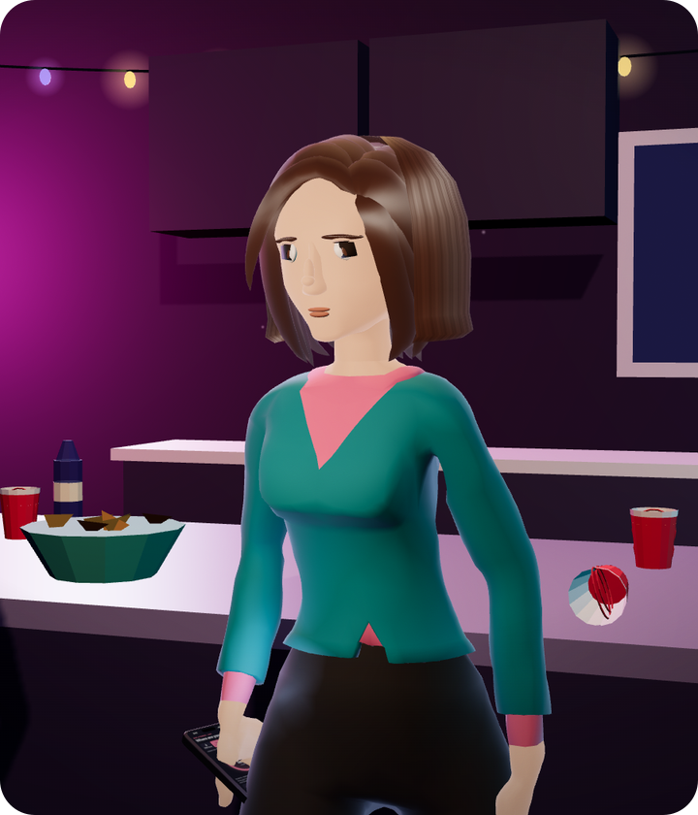
Watch three things.
1
It asks before it alerts.
2
What her friend sees, and who's called if no one answers.
3
What happens if someone makes her cancel, or breaks her phone.
Notes:
[2:12 to 2:32, 20 s]
Let me show you. This is a night out. Watch for three things. It asks before it alerts anyone. What her friend sees, and who gets called if nobody answers. And what happens if someone forces her to cancel, or breaks her phone.
(Advance. The clip starts by itself.)

Slide 6

Notes:
[2:32 to 3:28, 56 s]
(52-second clip with its own voice. Don't talk over it. It ends holding on "Alert raised by itself". Advance when the sound has faded.)
(If the video won't play, say the steps yourself: it asks "You okay?" and gives her 45 seconds. No answer, and her contacts get a call and a live map. Still no answer, and professional dispatch is called. A duress PIN looks like a cancel but keeps help coming. And if the phone is smashed, our server notices and raises the alert.)

Slide 7
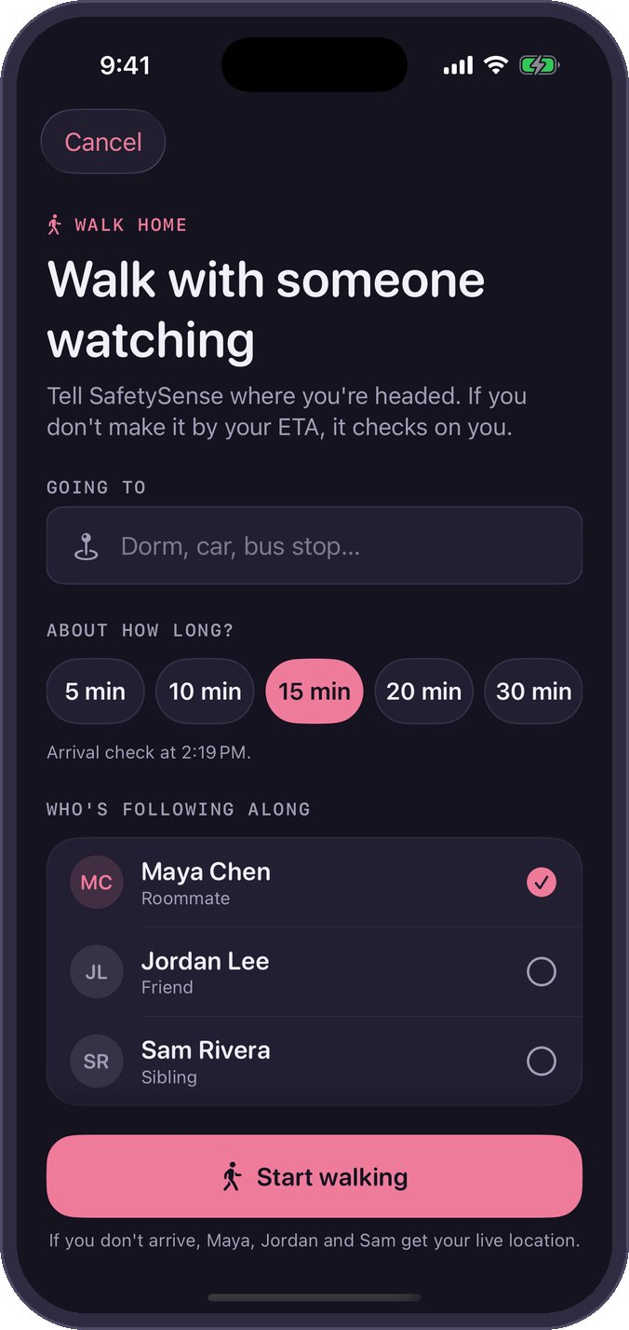
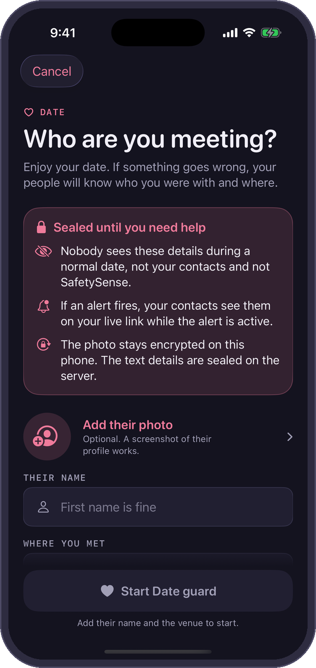
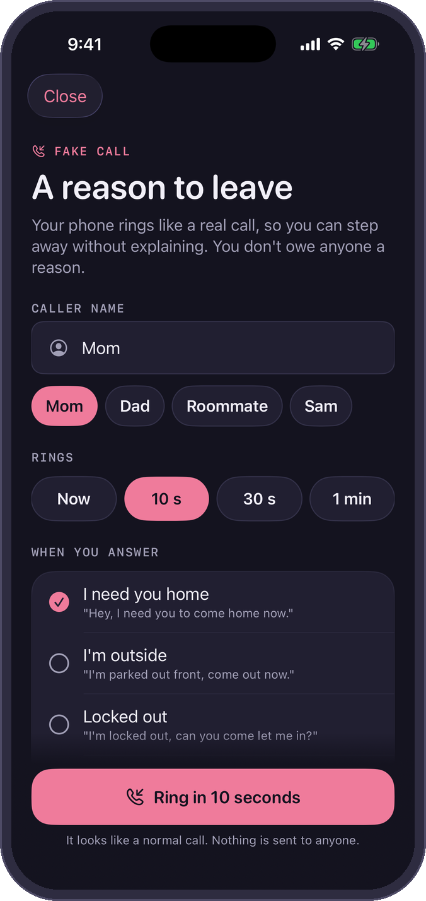
MORE THAN ONE NIGHT
Built for the nights students actually have
Walking home
A first date
A way out
If you don't arrive on time, it checks on you.
Who you're meeting stays sealed unless you need help.
A fake call gives you a reason to leave.
SafetySense · 7
Notes:
[3:28 to 4:06, 38 s]
Everything you saw is our real app. The one thing that's simulated is dispatch: no police were actually called.
That was a night out. But it's built for other nights too.
Walking home, you tell it where you're headed. If you don't get there on time, it checks on you.
On a first date, you can save who you're meeting. That stays sealed, and your friend only sees it if you need help.
And if you just want out of a situation, a fake call gives you a reason to leave.
(If asked "was that call real in the video?": no. The recording used demo mode, which places no calls. Real calls work in our tests.)
(If asked about texts: they are sent but don't get delivered yet on our trial account.)
(If asked about the smashed phone: that part is an animation of a check our server runs. Don't say it has been tested in a live alert unless it has.)
(If asked what else was staged: the night was scripted, the waiting was sped up, and Ava and Maya are animated characters.)

Slide 8
ORIGINALITY
Others have pieces. We connected the chain.
 | UNM Safe | Noonlight | bSafe | Apple built-in | SafetySense
Notices distress on its own | – | Crash (paid) | Voice phrase | Crash; fall on Watch | ✓ Sound, motion, context
Acts when the phone goes dark | – | Not documented | Not listed | Check In, timing varies | ✓ Our server notices
Duress PIN (fake cancel) | – | – | Not listed | – | ✓ The two PINs you saw
Professional dispatch | Call UNMPD | ✓ | – | 911 call | ✓ Yes (test system)
Live location to a friend | ✓ | ✓ | ✓ | ✓ Check In | ✓
From each product's documentation; not tested by us. These are four tools a student could already have.
Their columns are shipped products. Ours is a prototype; dispatch runs in a test system.
SafetySense · 8
Notes:
[4:06 to 4:53, 47 s]
We looked at what a student could already have: UNM Safe, Noonlight, bSafe and the iPhone itself, going by their documentation.
Other apps do parts of this, and I'll name two. Centinela listens for a scream and has a duress PIN, but it stops at your friends. aegis+ has a duress PIN and dispatch, but nothing in its listing notices trouble on its own. We couldn't find one that documents the whole chain.
Ours notices on its own, tells your people, and reaches dispatch, in a test system for now. That includes the two cases you just saw: the forced cancel and the smashed phone.
And we link to UNM Safe.
(Say "we found no product that documents", never "no one else does this". Their columns are shipped products; ours is a prototype.)
(If asked: some apps also document a server-side dead-phone alert. We read documentation; we did not test them.)
(If asked about bSafe: it can trigger on a spoken phrase. Its documentation doesn't describe listening for screams or falls.)

Slide 9





DESIGN AND EXPERIENCE
Designed for the worst night of someone's life
Calm words, never blame
Written to be calm and never blaming.
Your first alert is a drill
Onboarding ends with a practice run marked TEST.
Afterward, you choose
An advocate, medical care, reporting, or keeping it private.
The practice drill
Support, afterward
SafetySense · 9
Notes:
[4:53 to 5:33, 40 s]
MARY: We designed this for the worst night of someone's life. So the words matter as much as the features.
We tried to make every line calm, and to never blame the person holding the phone. You saw it in the video. The first thing it says is just, "You okay?"
Setup ends with a practice drill, marked TEST, so your first alert is never a real one.
And afterward, the app offers an advocate, medical care, reporting, or keeping it private. Nothing is required.
(Mary's only full slide. George takes every other slide; Mary also has the intro line and the closing line.)

Slide 10



PRIVACY AND SECURITY
Private by default. Evidence only when it matters.
1
2
3
4
Guard on
Only the last 30 seconds
Only if an alert fires
Vault
Listening happens on the phone
Kept in memory, then overwritten
Audio is locked on the phone before upload
Opens with your Face ID. You decide who hears it
No audio is saved unless an alert fires
No ads, no trackers
Live links are built to expire after the alert
SafetySense · 10
Notes:
[5:33 to 6:11, 38 s]
GEORGE: An app that listens has to earn your trust. So here's what happens to the audio.
The listening happens on your phone. Only the last 30 seconds exist at any time, and they keep getting overwritten. No audio is saved.
Audio is only kept if an alert fires. It's locked on the phone before it's uploaded, so even we can't listen to it.
It opens with your Face ID, and you decide if anyone ever hears it.
No ads, no trackers. And the link your friends get is built to expire after the alert.
(Say "no audio is saved". Never "nothing is saved": location does go to the server during a Guard.)

Slide 11



WHAT'S NEXT
From a working app to students' phones
1
2
3
Students test it
Advocates review it
Campus partnership
UNM and CNM students use it and tell us what to fix.
People who work with survivors check every word.
Work with the safety and advocacy offices on campus.
HOW IT PAYS FOR ITSELF
Free for students.
The school pays for a campus licence, the way schools already pay for safety apps.
A paid plan for people who aren't students.
Today: a working app in a private test build. Not tested with real users yet, and no agreements signed.
SafetySense · 11
Notes:
[6:11 to 6:57, 46 s]
So what's next? First, students. We want UNM and CNM students to use it and tell us what's confusing, what's annoying, and what they'd actually keep turned on.
Second, advocates. The people who work with survivors should check every word in it.
Then a campus partnership, working with the safety and advocacy offices here.
The business model is simple. It's free for students. The school pays for a campus licence, the same way schools already pay for safety apps.
To be straight about today: it's a working app in a private test build. It hasn't been tested with real users yet, and we don't have any agreements signed.
(If asked about partners: we haven't talked to any yet. The ones we hope to work with are LoboRESPECT, the Women's Resource Center, UNMPD and CNM Security.)
(If asked about targets: under one false alert in ten hours of guarding, and under a minute from a scream to a ringing phone. Neither is measured yet.)
(If asked what a licence costs: we haven't set a price. Say that, and that it would be confirmed with a first campus.)

Slide 12

SAFETYSENSE
When you can't call for help, SafetySense does.
SafetySense supplements 911. It never replaces it.
George Teifel UNM Mary Teifel CNM
Thank you. We'd love your questions.
Notes:
[6:57 to 7:14, 17 s. Total 7:14, leaving 46 s of slack.]
GEORGE: SafetySense supplements 911. It never replaces it. But when you can't call for help, SafetySense does.
MARY: We'd love to pilot it with students at UNM and CNM. Thank you. We'd love your questions.
(Stop. Stay on this slide for Q&A.)

