Slide 1
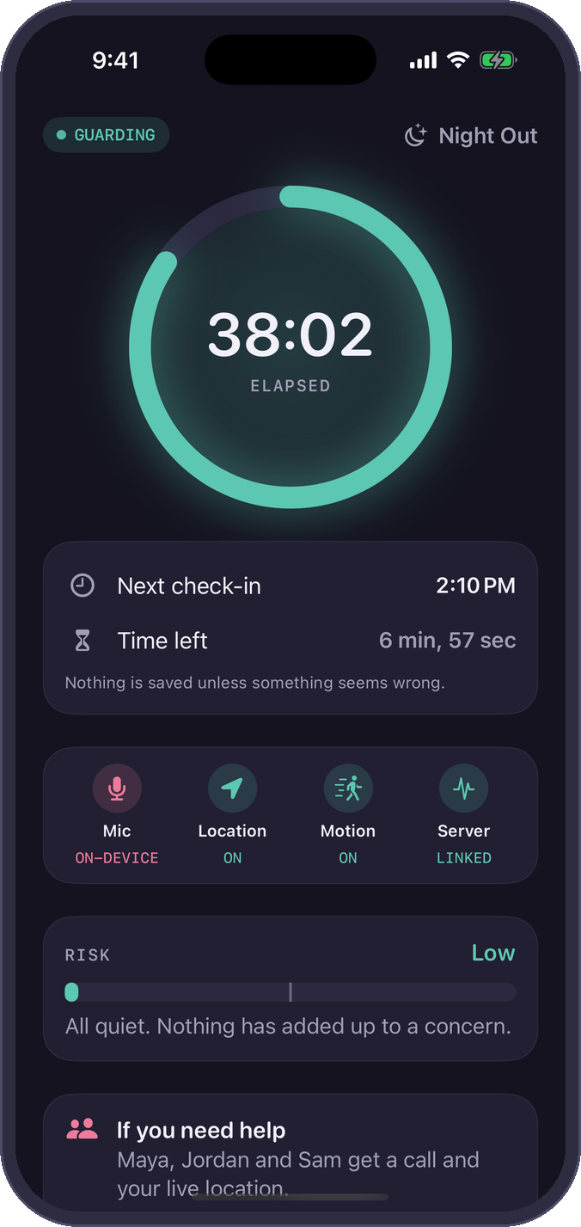
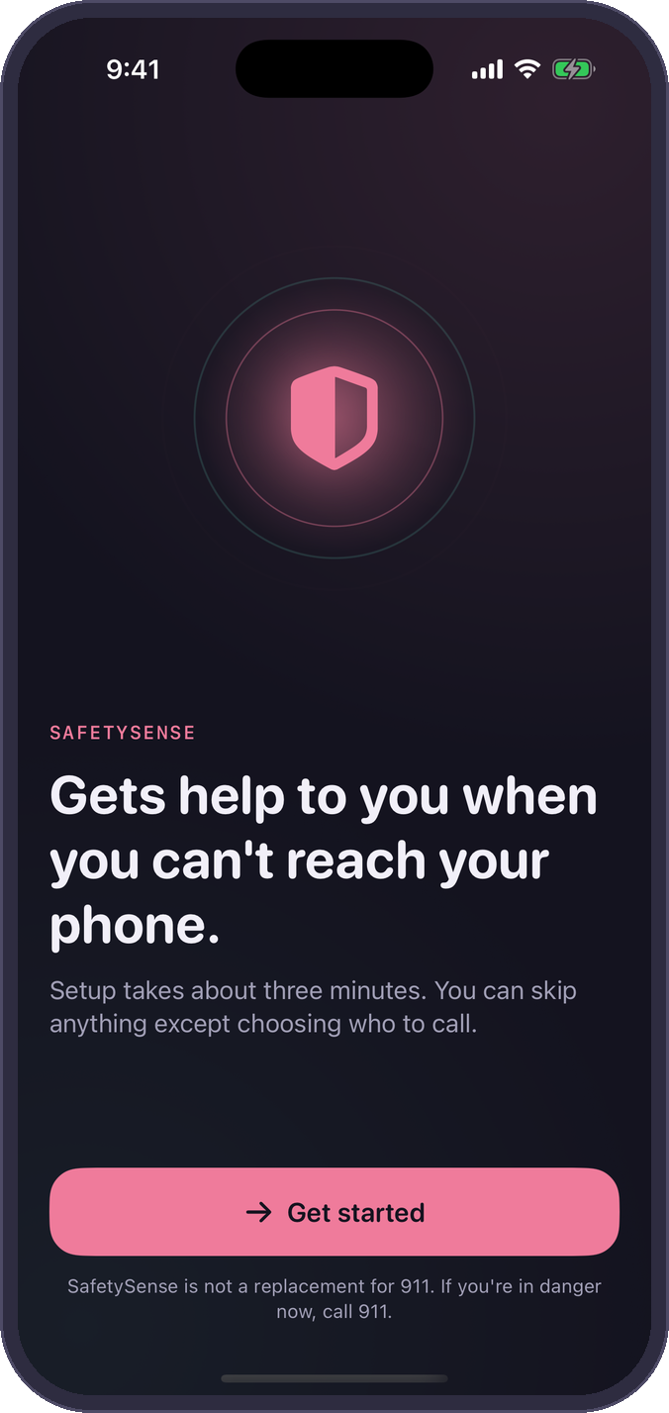

UNM & CNM APP CONTEST 2026
SafetySense
Calls for help when you can't.
A proactive personal-safety app for UNM and CNM students. It notices when something is wrong and brings in your people, then professional dispatch, even if you can't reach your phone.
George Teifel UNM Mary Teifel CNM
SafetySense supplements 911. It never replaces it.
Notes:
[0:00 to 0:15, 15 s]
Hi, I'm George Teifel from UNM, and this is my sister Mary Teifel from CNM. We built SafetySense, a safety app that calls for help when you can't.
(Pause. Let the tagline land before advancing.)

Slide 2




WHO WE ARE
Two siblings, two campuses, one problem
George Teifel
THE APP IN 30 SECONDS
University of New Mexico
You start a Guard session for a night out, a walk home, a date or a ride. SafetySense listens and watches on your phone only. If you go quiet, can't answer, or your phone goes dark, it calls your people with a live map and then brings in professional dispatch.
Senior · Electrical Engineering
Built the iOS app and the backend
Mary Teifel
Native iOS 26 app: Swift 6 and SwiftUI
Central New Mexico Community College
On-device AI: SoundAnalysis, SpeechAnalyzer, Foundation Models
Freshman · Mechanical Engineering
Research, UX and the app's wording
Supabase, Twilio voice, Noonlight dispatch (sandbox)
SafetySense · 2
Notes:
[0:15 to 0:45, 30 s]
George is a senior studying electrical engineering at UNM, and he built the app and the backend. Mary is a freshman studying mechanical engineering at CNM, and she led research, UX and the app's wording.
Here's the whole idea: before a night out, a walk home, a date or a ride, you start a Guard session. SafetySense watches on your phone only. If you go quiet, can't answer, or your phone goes dark, it calls your people, then professional dispatch.
(Fill in the brackets before Nov 16. The contest asks for name, institution, year and area of study.)

Slide 3
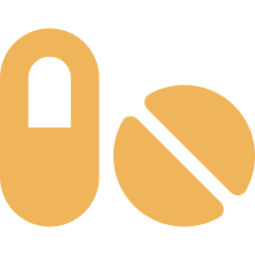


THE PROBLEM
Most safety apps assume you can press a button
Our users: UNM and CNM students, 18 to 25, out at night at parties, bars, first dates, rideshares and the walk back to the car.
70%
Drugging takes away the ability to act
Someone who has been drugged may not recognize danger or be able to unlock a phone. No phone can detect a drug, but it can notice that you stopped responding.
of women in a clinical study of assault survivors reported significant tonic immobility: involuntary paralysis.
The phone gets taken or thrown
Most apps can’t tell a dead phone from a quiet night. SafetySense’s server treats a lost heartbeat as a warning sign.
A panic button does nothing for someone who can't move.
New Mexico still has no text-to-911
It’s still listed as the only US state without it. The statewide 911 upgrade began in 2025, but if you can’t speak, you can’t just text 911 here.
Möller et al., Acta Obstet Gynecol Scand, 2017 (n = 298)
SafetySense · 3
Notes:
[0:45 to 1:30, 45 s]
Most safety apps we tested assume one thing: that in the moment, you can press a button.
That fails exactly when it matters. In a clinical study of almost 300 survivors, 70 percent reported significant tonic immobility, an involuntary paralysis during the assault.
Someone who's been drugged may not be able to unlock a phone. Phones get taken or thrown, and most apps can't tell that silence from a quiet night. And New Mexico is still listed as the only state without text-to-911, so if you can't speak, you can't just text for help.
SafetySense is help for when you can't ask.
(Source if asked: Möller, Söndergaard and Helström, Acta Obstetricia et Gynecologica Scandinavica, 2017. 298 women at a Stockholm rape emergency clinic: 70% significant tonic immobility, 48% extreme.)

Slide 4






OUR ANSWER
It watches, so you don't have to tap
SIGNALS, ON THE PHONE ONLY
1
It only listens when you turn it on
Night Out, Walk Home, Date or Ride. Clear start, clear end.
Screams, shouts, crying, glass breaking
Your safe word or “get off me”
2
Nothing is saved unless something's wrong
Audio lives in a 30-second memory buffer that overwrites itself.
A fall, then stillness
Off route, or not where you said
3
Help comes even if you can't tap
Missed check-ins, distress sounds or a dead phone start the ladder.
A missed “You okay?”
Phone goes dark: the server notices
Five modes, one tap to start
SafetySense · 4
Notes:
[1:30 to 2:05, 35 s]
So instead of waiting for a tap, you start a Guard session, and we make three promises. It only listens when you turn it on. Nothing is saved unless something's wrong: audio sits in a 30-second memory buffer that keeps overwriting itself. And help comes even if you can't tap.
While guarding, the phone watches for screams, your safe word, a fall followed by stillness, and missed check-ins. If the phone goes dark completely, our server notices and acts on its own.

Slide 5
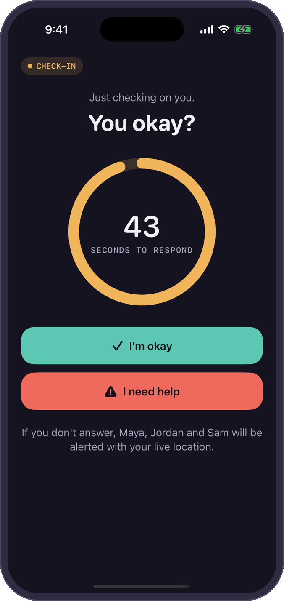
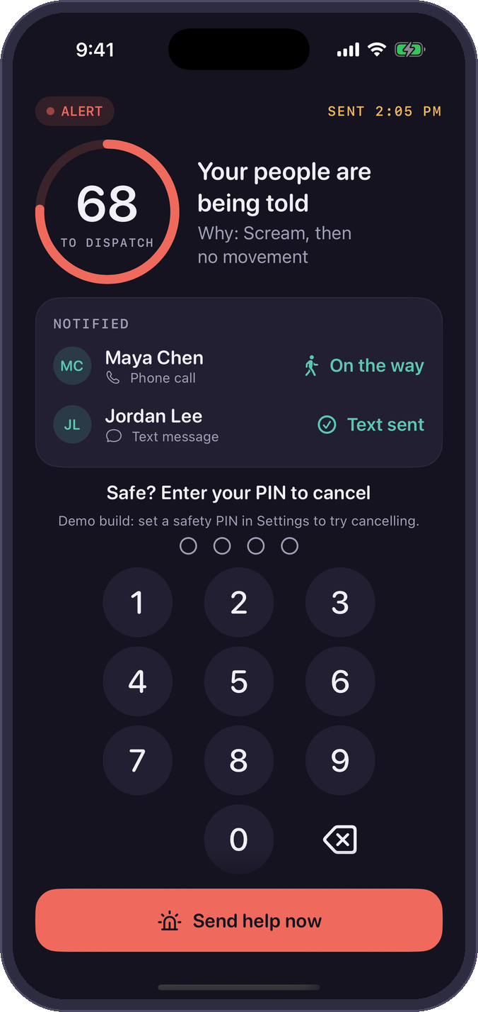
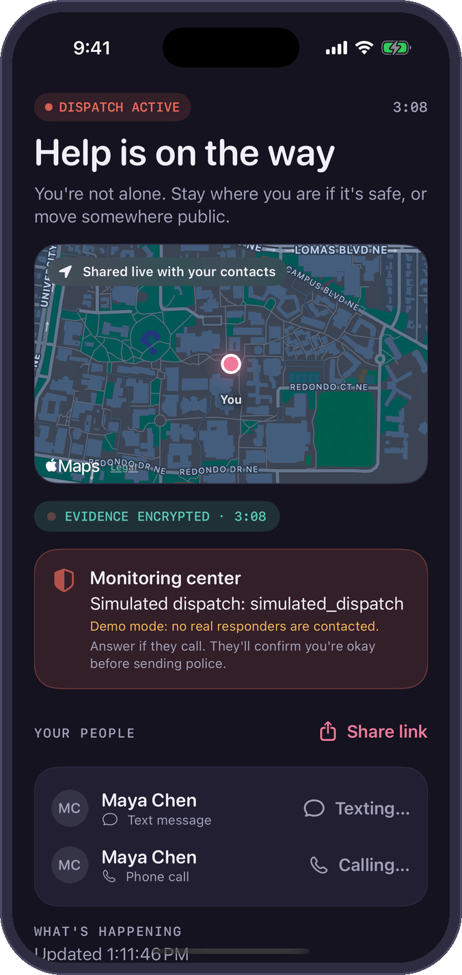
HOW IT ESCALATES
One calm ladder, from “You okay?” to dispatch
0 · Guarding
1 · Check-in
2 · Alert
3 · Dispatch
Audio stays in a 30 s memory buffer. Nothing is saved.
A quiet haptic: “You okay?” You have 45 seconds to tap.
Your people get a call and a live map. Evidence is encrypted.
After 90 s or “Send help,” a monitoring center calls, then sends police.
SafetySense · 5
Notes:
[2:05 to 2:55, 50 s]
When something looks wrong, SafetySense climbs a calm ladder.
Level one is a check-in: a quiet buzz and "You okay?" One tap and it goes away. Most false alarms end right here.
No answer in 45 seconds, your safe word, or the Action Button, and it's level two: your trusted contacts get a phone call and a live-location link, and evidence is encrypted on the phone.
After 90 seconds with no cancel, or the moment a contact taps "Send help," a professional monitoring center calls you and, if needed, sends police.
And if someone forces you to cancel, a duress PIN looks exactly like cancelling, but help still comes.

Slide 6
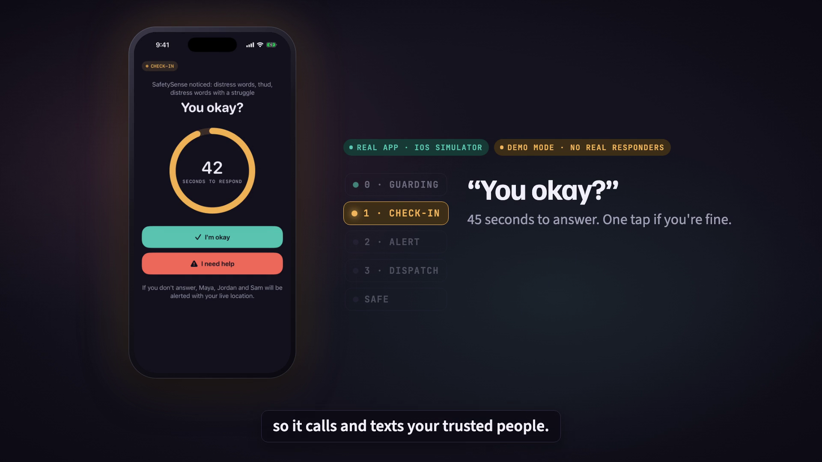
LIVE DEMO · RECORDED
Night Out: a thud, then silence
1
Night Out guard on
Mic, motion and location are checked on the phone. Nothing saved.
2
A thud, then “get off me”
Detected on the phone. “You okay?” appears.
3
No answer in 45 s
Trusted contacts get a call, a text and a live link.
4
Dispatch, then safe
Simulated monitoring step. The safety PIN cancels it.
5
The contact's live link
Location, battery, and “I'm on my way.”
SafetySense · 6
Notes:
[2:55 to 4:25, 90 s. Set up the clip (about 15 s), let the 39 s clip play (it has its own voiceover and captions; don't talk over it), then the follow-up below (about 30 s).]
Before the clip: This is the real app, recorded in the iPhone simulator, running a Night Out session in demo mode. No real responders were contacted. Watch what happens when the person can't respond.
(Play the clip.)
After the clip: Two things to notice. First, nobody touched the phone between the thud and the dispatch step. Second, the contact needed no app: just a link, with live location and an "I'm on my way" button. In the real flow, contacts also get an automated phone call, and dispatch goes to a professional monitoring center that calls you first; in this demo that step is simulated, never live 911.
(If the video won't play: use the PDF backup and narrate over the screenshots on the ladder slide.)

Slide 7
ORIGINALITY
We built the basics. Then we built what’s missing.
 | UNM Safe | Noonlight | bSafe | Apple built-in | SafetySense
Notices distress on its own | – | Crash (paid) | – | Crash; fall on Watch | ✓ Sound, motion, context
Acts when the phone goes dark | – | – | – | Check In, may be late | ✓ Server heartbeat
Duress PIN (fake cancel) | – | – | – | – | ✓
Date details sealed until needed | – | Tinder notes | – | – | ✓
Professional dispatch | Call UNMPD | ✓ | – | 911 call | ✓ Noonlight
Voice trigger | – | Alexa (paid) | ✓ | Siri | ✓ Offline safe word
Live location to a friend | ✓ | ✓ | ✓ | ✓ Check In | ✓
The top four rows are the reason SafetySense exists. Everything else is table stakes, and we link out to UNM Safe instead of rebuilding it.
SafetySense · 7
Notes:
[4:25 to 5:00, 35 s]
We compared what students already have: UNM Safe, Noonlight, bSafe, and what's built into the iPhone.
We do the basics too. But look at the top four rows: noticing distress on its own, acting when the phone goes dark, a duress PIN, and date details sealed until something goes wrong. No app we compared combines them, and they're exactly where a button fails.
We're not competing with UNM Safe. We link to it.

Slide 8
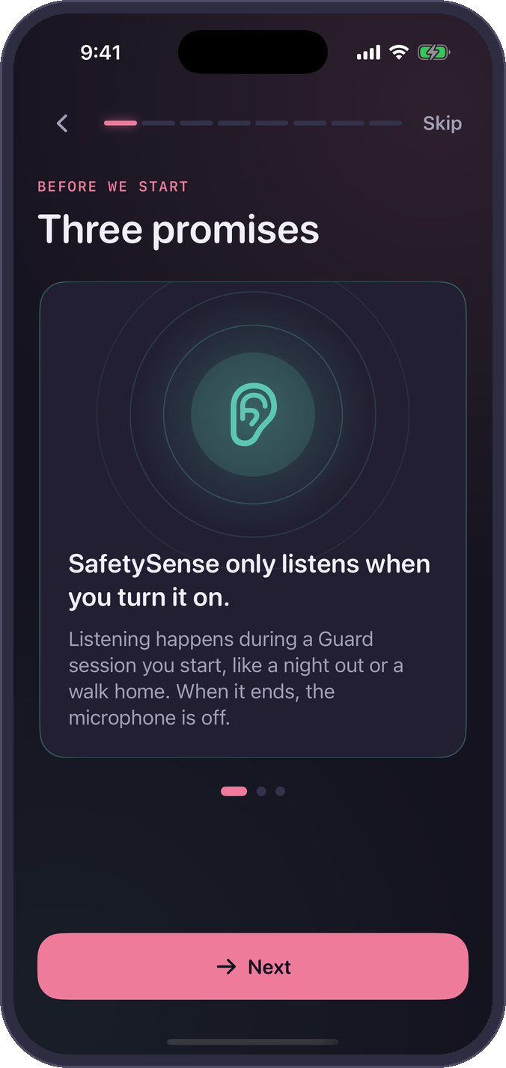






DESIGN AND EXPERIENCE
Designed for the worst night of someone's life
Calm, never blaming
“Whatever happened, it isn't your fault.” Plain words, no alarms in the copy.
Practice before it's real
Onboarding ends with a drill. Contacts see it marked TEST.
Safe if someone grabs the phone
Duress PIN, Face ID vault, a discreet app icon.
Nothing forced afterward
Advocate, medical care, reporting, or keeping it private. Your choice.
Three promises
Practice drill
Support, after
SafetySense · 8
Notes:
[5:00 to 5:35, 35 s]
We designed this for the worst night of someone's life, so tone matters as much as features.
The copy is calm and never blames. Onboarding ends with a practice drill marked TEST, so your first alert is never a real one. If someone grabs your phone, there's the duress PIN, a Face ID vault and a discreet icon.
And afterward, Support offers an advocate, medical care, reporting, or keeping it private. Nothing is required.

Slide 9
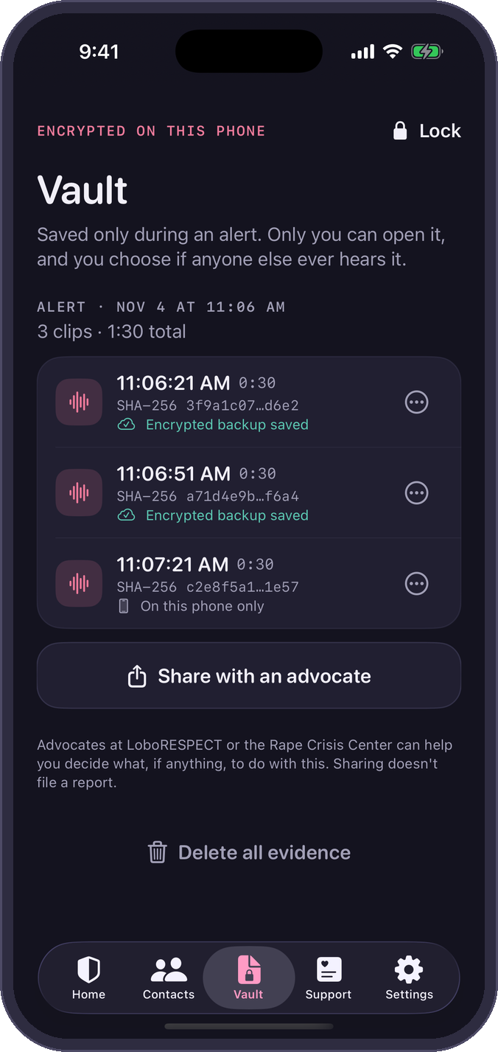






PRIVACY AND SECURITY
Private by default. Evidence only when it matters.
Guarding
No ad or analytics SDKs
Duress PIN
30 s audio buffer in RAM only, overwritten constantly
No third-party trackers at all.
Looks like a cancel. Help still comes.
Alert fires
That buffer plus live audio is captured
Expiring live links
Sealed date details
Contacts see your location only during an alert.
Shown to contacts only if an alert fires.
Encrypted on the phone
AES-GCM (CryptoKit), key in the Keychain
Delete everything
SHA-256 per clip
Uploaded while recording
Server stores ciphertext only. Survives a smashed phone
Location is deleted after 30 days by default.
Timestamped and hashed, so tampering shows.
Vault: Face ID, hashed clips
SafetySense · 9
Notes:
[5:35 to 6:10, 35 s]
An app that can listen has to earn trust.
While guarding, audio exists only in that 30-second memory buffer. Only when an alert fires do we keep it, encrypted on the phone with AES-GCM and uploaded as it records, so evidence survives a smashed phone. Our server only ever holds ciphertext, and every clip is hashed.
No ad or analytics SDKs. Live links only work during an alert. And "Delete everything" means everything.

Slide 10
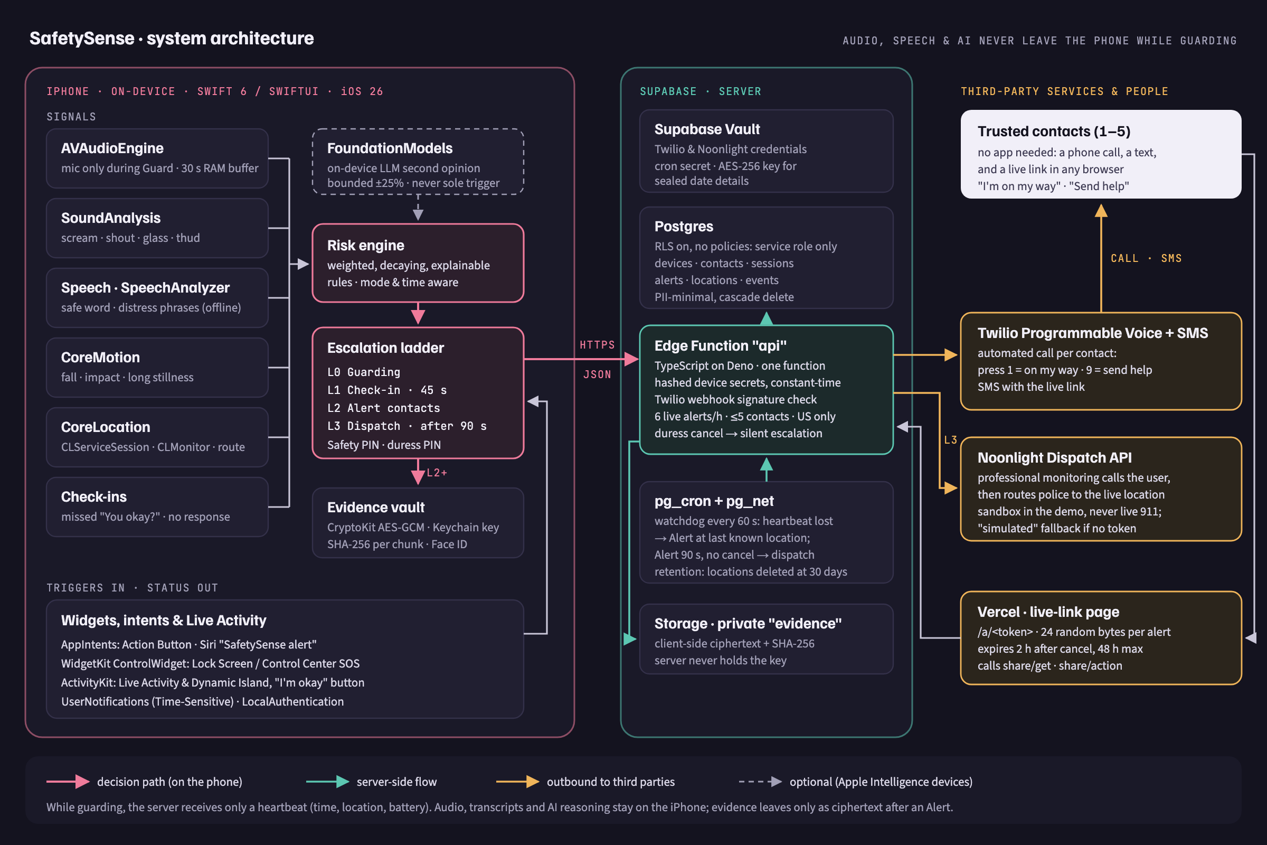
TECHNOLOGY
Real app, real backend, AI that stays on the phone
SafetySense · 10
Notes:
[6:10 to 6:45, 35 s]
This is a native iOS 26 app on a live backend, not a mockup.
On the phone, Apple's sound classifier and speech recognition feed a rules-based risk engine, so it can always explain why it escalated. Apple's on-device language model gives a second opinion, but it can never be the only reason to escalate.
Supabase runs the alerts and the heartbeat watchdog. Twilio calls your contacts, a web link shows them your location, and Noonlight handles dispatch. For the contest, that's their sandbox, never live 911.

Slide 11
PATHWAY TO SATISFACTION
How we'll know it works
< 1
< 60 s
< 8%
≥ 80%
false alert per 10 hours of Night Out guarding
from a scream to contacts being called
battery per hour while guarding
of new users finish onboarding
ROLLOUT
Now
Next
Pilot
Partner
Working iOS prototype on a live backend
Usability tests with UNM and CNM students; advocates review the copy
TestFlight pilot with a student organization
Campus partnership: orientation, Women's Resource Center, UNMPD
SafetySense · 11
Notes:
[6:45 to 7:10, 25 s]
Our targets: under one false alert per ten hours of guarding, under 60 seconds from a scream to a ringing phone, under 8 percent battery an hour, and 80 percent finishing onboarding.
Next: usability tests with UNM and CNM students and advocate review, then a TestFlight pilot, then a campus partnership.

Slide 12

SAFETYSENSE
When you can't call for help, SafetySense does.
Help us pilot it with students at UNM and CNM.
George Teifel UNM Mary Teifel CNM
Thank you. We'd love your questions.
SafetySense supplements 911. It never replaces it.
Notes:
[7:10 to 7:25, 15 s. Total about 7:25, leaving about 35 s of slack.]
When you can't call for help, SafetySense does. We'd love to pilot it with students at UNM and CNM. Thank you. We're happy to take your questions.
(Stop. Stay on this slide for Q&A. The appendix slides are only for answering questions.)

Slide 13
APPENDIX · Q&A PREP 1 OF 3
Likely judge questions: trust and tech
What about false alarms?
Won't listening kill the battery?
Escalation needs a combination of signals that fade over time, and the first step is always a quiet “You okay?” that one tap clears. Contacts come before dispatch, and the monitoring center calls you to confirm before sending police. Target: under 1 false alert per 10 hours.
It only listens during a Guard session you start, not all day. Sensing runs on Apple's on-device frameworks, and the server heartbeat is one small request a minute. Our target is under 8% per hour, and we're measuring it on an iPhone 16e.
Is it recording my conversations?
Will Apple approve it?
No. Audio sits in a 30-second memory buffer that overwrites itself and is never written to storage. Only an Alert keeps audio, and that's encrypted on the phone. Transcription and AI run on the device. The server sees ciphertext only.
We follow the rules rather than fight them: listening only during user-started sessions with a visible Live Activity, no auto-dialing 911 (iOS doesn't allow it), and dispatch through Noonlight, an established partner. Permissions are explained when they're asked for.
SafetySense · A1
Notes:
Q&A backup (4:00 of judge questions). Don't present this slide during the 8 minutes. Answer in one or two sentences, then stop. Fuller answers are in presentation/QA_PREP.md.

Slide 14
APPENDIX · Q&A PREP 2 OF 3
Likely judge questions: cost, law, business
What does it cost to run?
Why not Apple Check In or UNM Safe?
A Twilio call or text costs a cent or two, and only during alerts. Supabase is free at pilot scale and about $25 a month after that. Dispatch is priced per alarm through Noonlight's partner program, which we'd confirm before launch.
Both are good, and we link to UNM Safe. Check In notices when you don't arrive or a timer runs out. UNM Safe needs you to tap. Neither listens for distress or has a duress PIN. We cover the moments you can't reach your phone.
Is recording legal?
Business model and partners?
Audio is kept only during an alert, and the user is a party to the conversation. New Mexico is generally read as a one-party-consent state (NMSA 30-12-1), but we'd get a legal review before launch. Clips belong to the user and are shared only if they choose.
Free for students. Proposed revenue is a campus licence paid from safety and Title IX budgets, plus a paid plan for non-students. Partners we hope to work with: LoboRESPECT, the Women's Resource Center, UNMPD and CNM Security.
SafetySense · A2
Notes:
Q&A backup (4:00 of judge questions). Don't present this slide during the 8 minutes. Answer in one or two sentences, then stop. Fuller answers are in presentation/QA_PREP.md.

Slide 15
APPENDIX · Q&A PREP 3 OF 3
Likely judge questions: edge cases
What if nobody answers, or there's no signal?
Could an abuser use it to track someone?
If no contact responds in 90 seconds, dispatch takes over. If the phone loses signal or dies mid-session, the server notices the missing heartbeats and alerts contacts with the last known location.
Location is shared only while you're guarding or in an alert, and only you can start that. Contacts can't pull your location on demand, and live links are built to expire after the alert.
What about older iPhones?
Android? Other campuses?
The Action Button needs a newer iPhone, so there's also a Lock Screen control, Siri, a spoken safe word and a hold-to-release SOS. Without Apple Intelligence the app runs on rules only. It needs iOS 26.
We started with iOS so we could use Apple's on-device AI. The backend and the contacts' live link already work from any phone or browser. Android and other campuses come after the student pilot.
SafetySense · A3
Notes:
Q&A backup (4:00 of judge questions). Don't present this slide during the 8 minutes. Answer in one or two sentences, then stop. Fuller answers are in presentation/QA_PREP.md.

