Slide 1

George Teifel · Mary Teifel
UNM & CNM APP CONTEST 2026
Notes:
[before the timer. 0 s]
(Wait for the go-ahead. Then advance to the next slide and start speaking; the timer starts with your first word.)

Slide 2



WHO WE ARE
SafetySense calls for help when you can't.
George Teifel
Mary Teifel
University of New Mexico
Central New Mexico Community College
Senior · Electrical Engineering
Dual credit student · Mechanical Engineering
Built the iOS app and the backend
Research, design and the app's wording
SafetySense · 2
Notes:
[0:00 to 0:38, 38 s]
GEORGE: Picture a student walking home at night. Someone comes up behind her. She freezes. She can't get to her phone. That's the moment we built SafetySense for. I'm George Teifel. I'm a senior in electrical engineering at UNM, and I built the app and the backend.
MARY: I'm Mary Teifel, a dual credit student at CNM, studying mechanical engineering. I worked on the research, the design and the wording in the app.
GEORGE: SafetySense is an iPhone app for students who are out at night.

Slide 3


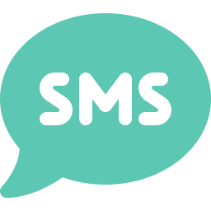
THE PROBLEM
Most safety apps wait for you to press a button or set a timer
70%
Freezing is involuntary
It is a normal response, not a choice.
of 298 women reported significant tonic immobility, an involuntary freeze, during sexual assault
Phones get taken, broken or switched off
A dead phone sends nothing.
Speaking isn't always possible
Möller et al., Acta Obstet Gynecol Scand, 2017 (n = 298)
Even texting 911 takes a phone in your hand.
What if you can't press the button?
“Most safety apps”: based on the documentation of the apps we reviewed. We did not test them.
SafetySense · 3
Notes:
[0:38 to 1:40, 62 s]
We built this for UNM and CNM students: parties, first dates, rideshares, the walk back to the car.
MARY: (Your own experience, in your own words: 2 or 3 sentences, about 15 seconds. For example, a night you or a friend felt unsafe, or what you and your friends already do to look out for each other. Only say what you're comfortable saying to a room, and only what's true.)
GEORGE: Most safety apps we looked at need you to do something. Press a button, or set a timer.
But that's exactly what you can't do when it matters. In one clinical study of 298 women seen after a sexual assault, 70 percent said they froze. It's involuntary. It's a normal response, not a choice.
Phones also get taken, broken or switched off. And even texting 911 takes a phone in your hand.
So our question was simple: what if you can't press the button?
(Source if asked: Möller, Söndergaard and Helström, 2017. 298 women at a Stockholm emergency clinic; 70% significant, 48% extreme.)
(Don't say New Mexico has no text-to-911. The state has been rolling it out since its 2025 911 upgrade.)

Slide 4



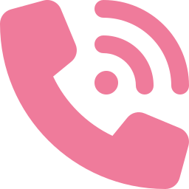
OUR ANSWER
You turn on a Guard. If you can't respond, it acts for you.
One tap before you go
A walk home, a night out, a date or a ride.
It pays attention for you
A scream, breaking glass, your safe word, a fall.
If you can't respond, it gets help
First your people, then professional dispatch.
It only listens while a Guard is on, and the listening happens on your phone.
SafetySense · 4
Notes:
[1:40 to 2:08, 28 s]
So here's our answer. Before you head out, you turn on a Guard. It's one tap.
From then on, your phone pays attention for you. And if something's wrong and you can't respond, it gets help: first the people you trust, then professional dispatch.
It's a real iPhone app, and it only listens while the Guard is on.

Slide 5
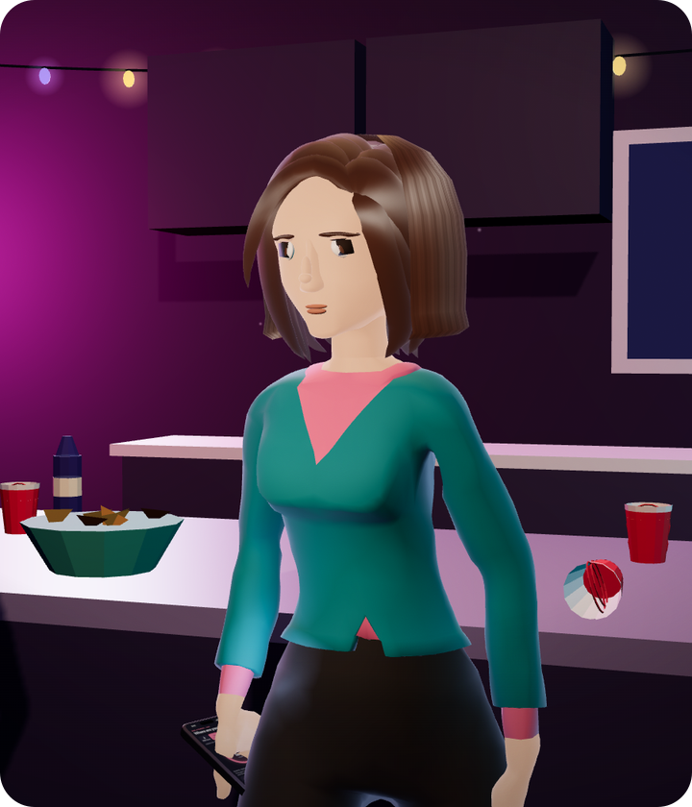
Watch three things.
1
It asks before it alerts.
2
What her friend sees, and who's called if no one answers.
3
What happens if someone makes her cancel, or breaks her phone.
Notes:
[2:08 to 2:26, 18 s]
Let me show you. This is a night out. Watch for three things. It asks before it alerts anyone. What her friend sees, and who gets called if nobody answers. And what happens if someone forces her to cancel, or breaks her phone.
(Advance. The clip starts by itself.)

Slide 6

Notes:
[2:26 to 3:22, 56 s]
(52-second clip with its own voice. Don't talk over it. It ends holding on "Alert raised by itself". Advance when the sound has faded.)
(If the video won't play, say the steps yourself: it asks "You okay?" and gives her 45 seconds. No answer, and her contacts get a call and a live map. Still no answer, and professional dispatch is called. A duress PIN looks like a cancel but keeps help coming. And if the phone is smashed, our server notices and raises the alert.)

Slide 7
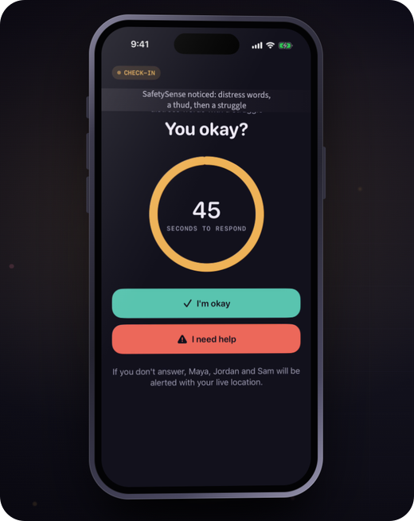
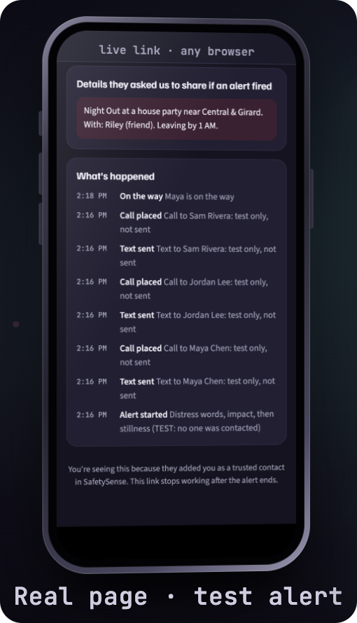
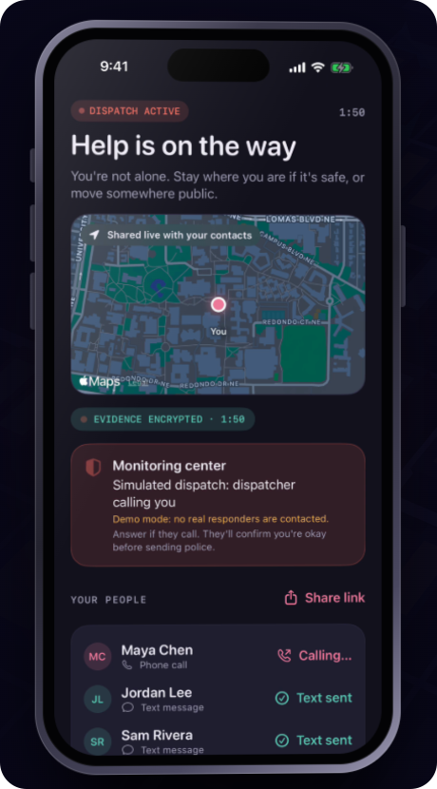
WHAT YOU JUST SAW
The app is real. One part of that was simulated.
REAL
REAL
SIMULATED
Our app
Calls and the page
Dispatch
Those screens are the app itself, in demo mode.
It makes real phone calls, and her friend's page is a real web page.
No police were contacted. It's a test system for now.
The waiting is sped up, Ava and Maya are animated characters, and text messages don't arrive yet on our trial account.
SafetySense · 7
Notes:
[3:22 to 3:54, 32 s]
So, what was real in that? The phone screens are our actual app. We scripted the night and sped up the waiting.
The app makes real phone calls, and the page her friend opened is a real web page.
The one simulated part is dispatch. We've only used the dispatch company's test system, so no police were ever contacted.
(If asked "was that call real in the video?": no. The recording used demo mode, which places no calls. Real calls work in our tests.)
(If asked about the smashed phone: that part is an animation of a check our server runs. Don't say it has been tested in a live alert unless it has.)
(If asked about texts: they are sent but don't get delivered yet on our trial account.)

Slide 8




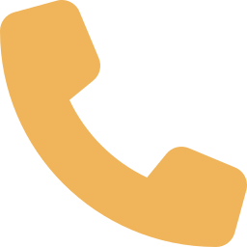
WHAT IT DOES
Four kinds of nights. One tap to start.
Walk home
Night out
First date
Ride
Shares your location with one friend and checks that you got there.
Listens for trouble, checks in on you, and reminds you about your drink.
Keeps who you're meeting sealed. Your friend sees it only if an alert fires.
Notices if the ride leaves the route or stops where it shouldn't.
Need a way out?
A fake call gives you a reason to leave. And a duress PIN looks like a cancel, but keeps help coming.
SafetySense · 8
Notes:
[3:54 to 4:36, 42 s]
That was one night. The app has four modes, for four kinds of nights.
Walking home, it shares your location with one friend and checks that you got there.
On a night out, it's what you just saw, and it reminds you to keep an eye on your drink.
On a first date, you can save who you're meeting. That stays sealed, and your friend only sees it if an alert fires.
In a ride, it notices if the car leaves the route.
And if you just need a way out, a fake call gives you a reason to leave.
(These are the app's four modes. Don't claim any of them has been tested with real users yet.)

Slide 9





DESIGN AND EXPERIENCE
Designed for the worst night of someone's life
Calm words, never blame
Written to be calm and never blaming.
Your first alert is a drill
Onboarding ends with a practice run marked TEST.
Afterward, you choose
An advocate, medical care, reporting, or keeping it private.
The practice drill
Support, afterward
SafetySense · 9
Notes:
[4:36 to 5:16, 40 s]
MARY: We designed this for the worst night of someone's life. So the words matter as much as the features.
We tried to make every line calm, and to never blame the person holding the phone. You saw it in the video. The first thing it says is just, "You okay?"
Setup ends with a practice drill, marked TEST, so your first alert is never a real one.
And afterward, the app offers an advocate, medical care, reporting, or keeping it private. Nothing is required.
(Mary's only full slide. George takes every other slide; Mary also has the intro line and the closing line.)

Slide 10



TRUST
An app that listens has to earn your trust
It only listens when you turn it on
No audio is saved unless an alert fires
You decide who hears it
Never in the background, never all day.
Then it's locked on your phone before it goes anywhere.
It opens with your Face ID. No ads, no trackers.
The link your friends get is built to expire after the alert.
SafetySense · 10
Notes:
[5:16 to 5:48, 32 s]
GEORGE: An app that listens has to earn your trust. So we make three promises.
It only listens when you turn it on.
No audio is saved unless an alert fires. And then it's locked on your phone before it goes anywhere, so even we can't listen to it.
And you decide who hears it. It opens with your Face ID. There are no ads and no trackers.
(Say "no audio is saved". Never "nothing is saved": location does go to the server during a Guard.)

Slide 11
ORIGINALITY
Others have pieces. We connected the chain.
 | UNM Safe | Noonlight | bSafe | Apple built-in | SafetySense
Notices distress on its own | – | Crash (paid) | Voice phrase | Crash; fall on Watch | ✓ Sound, motion, context
Acts when the phone goes dark | – | Not documented | Not listed | Check In, timing varies | ✓ Our server notices
Duress PIN (fake cancel) | – | – | Not listed | – | ✓ The two PINs you saw
Professional dispatch | Call UNMPD | ✓ | – | 911 call | ✓ Yes (test system)
Live location to a friend | ✓ | ✓ | ✓ | ✓ Check In | ✓
From each product's documentation; not tested by us. These are four tools a student could already have.
Their columns are shipped products. Ours is a prototype; dispatch runs in a test system.
SafetySense · 11
Notes:
[5:48 to 6:34, 46 s]
We looked at what a student could already have: UNM Safe, Noonlight, bSafe and the iPhone itself, going by their documentation.
Other apps do parts of this, and I'll name two. Centinela listens for a scream and has a duress PIN, but it stops at your friends. aegis+ has a duress PIN and dispatch, but nothing in its listing notices trouble on its own. We couldn't find one that documents the whole chain.
Ours notices on its own, tells your people, and reaches dispatch, in a test system for now. That includes the two cases you just saw: the forced cancel and the smashed phone.
And we link to UNM Safe.
(Say "we found no product that documents", never "no one else does this". Their columns are shipped products; ours is a prototype.)
(If asked: some apps also document a server-side dead-phone alert. We read documentation; we did not test them.)
(If asked about bSafe: it can trigger on a spoken phrase. Its documentation doesn't describe listening for screams or falls.)

Slide 12
WHERE WE ARE
What works today, and what we still have to prove
Today
Not proven yet
Next
A working iPhone app
Real calls and a real page for your friend
A private test build, not public yet
Real, noisy places like a bar
A full run on a real phone
Live dispatch, which needs our partner's sign-off
Tests with UNM and CNM students
Advocates review our wording
A student pilot, then a campus partnership
SafetySense · 12
Notes:
[6:34 to 7:06, 32 s]
So where are we? Today it's a working iPhone app. It makes real calls, and it's a private test build.
What we haven't proven yet: how it does in a real, noisy place, a full run on a real phone, and live dispatch, which needs our dispatch partner's sign-off.
What's next: tests with UNM and CNM students, advocates reviewing our wording, then a student pilot and a campus partnership.

Slide 13

SAFETYSENSE
When you can't call for help, SafetySense does.
SafetySense supplements 911. It never replaces it.
George Teifel UNM Mary Teifel CNM
Thank you. We'd love your questions.
Notes:
[7:06 to 7:23, 17 s. Total 7:23, leaving 37 s of slack.]
GEORGE: SafetySense supplements 911. It never replaces it. But when you can't call for help, SafetySense does.
MARY: We'd love to pilot it with students at UNM and CNM. Thank you. We'd love your questions.
(Stop. Stay on this slide for Q&A.)

