Slide 1
Planes and Ships -a small game-

Slide 2
Game concept
The map
Map concept
Map tile

Slide 3
The map

Slide 4
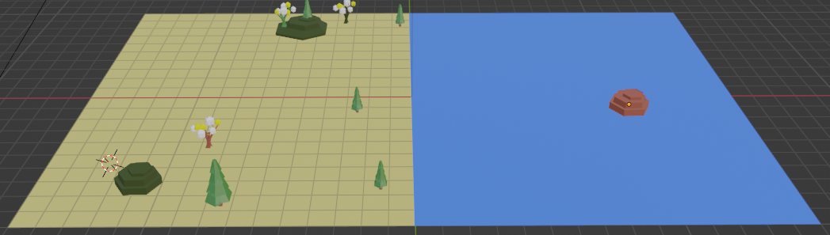
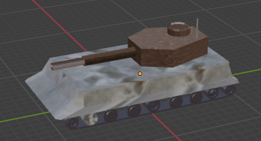
Map concept
The map is composed by map tiles each tile shall be able to host some passive elements (trees, landscape parts, buildings, etc) as well as active elements (game actors: tanks, planes, ships).
The map will have two sides: left player side and the right player side (the right one is usually covered by “fog of war” and it is the “enemy” side)
Map tile
Passive elements
Active element

Slide 5
Map class diagram
GameMap::GameObject
GameObjectArray
1
<extends>
1..n
GameMapSide(right)
GameMapSide::GameObjectComponent
<extends>
GameMapSide (left)
1
GameTile
AbstractGameCavan
1..n
GameTile::GameObjectMesh
Note:
A map tile will have a square shape of an specific size (defined inside GameTile::TILE_SIZE)
Important! Class hierarchy follows the one from the GameObject class diagram

Slide 6
Class diagrams

Slide 7
AbstractGameCavan
XYZMaterial
iAmbientMaterialColor
iDiffuseMaterialColor
iAmbientFileNameID
iDiffuseFileNameID
1
iMaterial
1
1
vertexBuffer
XYZVertex
Coordinate (x,y,z)
uvTexture(u,v)
Normal (x,y,z)
vertexColor
1..n

Slide 8
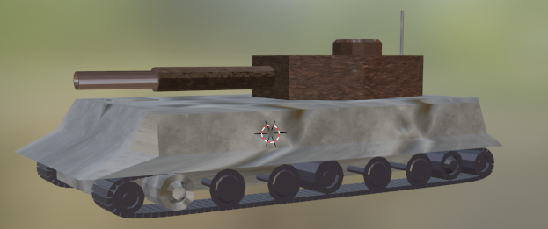

GameObject
GameObject
String Name
GameObjectArray <GameObjectComponent> [] componentsArray
GameObjectArray
1
0..n
GameObjectComponent
1
AbstractGameCavan
<extends>
0..n
GameObjectMesh
GameObject: a collection of “parts” that together forms a game object (i.e. tank). You can apply to the complete body rotation or movement.
GameObjectComponent: a collection of sub-parts that can be handled separately from the main body: example: you rotate the turret of the tank but the rest of the body will not rotate.
GameObjectMesh: the smallest sub component: it can move, rotate and/or have own material or color. Here is where all the OpenGL operations are taking part.

Slide 9
Projektmeilensteine
Q1 2OJJ
Finanzplan Beginnt
Q2 20JJ
Q3 20JJ
Beta-Registrierung beginnt für die Öffentlichkeit
Werbekampagne Start
Q4 20JJ
MVC wird in allen Märkten gestartet
500 Abonnenten
200 Abonnenten
Anfängliche Abonnenten
Endgültige Abonnenten

