Slide 1
Planes and Ships -a small game-

Slide 2
Game concept
The map
Map concept
Map tile
Map tile types
Game Actors
Passive actors
Active actors
Class diagrams

Slide 3
The map

Slide 4
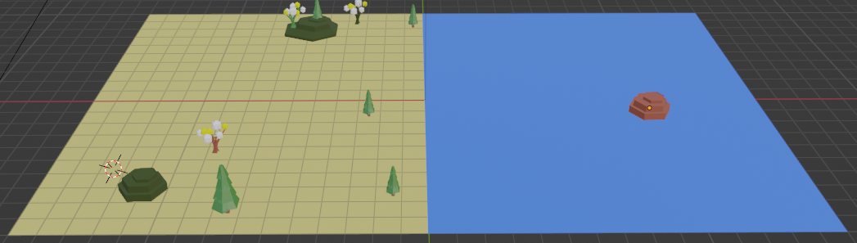
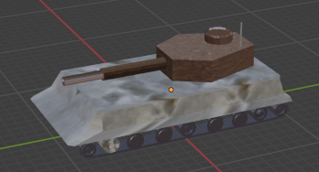
Map concept
The map is composed by map tiles each tile shall be able to host some passive elements (trees, landscape parts, buildings, etc) as well as active elements (game actors: tanks, planes, ships).
The map will have two sides: left player side and the right player side (the right one is usually covered by “fog of war” and it is the “enemy” side)
Active element (“actors”)
Map tile
Passive elements
Enemy side of the map (usually hidden)
Active side of the map

Slide 5
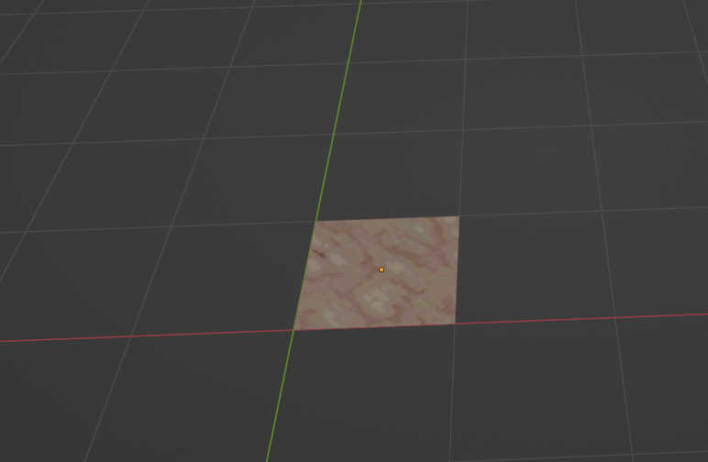
Map tile
The map tile has a size (in Blender) of 1x1 as square.
A 1x1 map tile

Slide 6
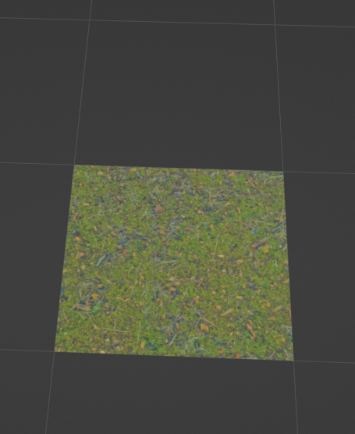
Map tile: type of tiles
The following type of tiles are defined:
Rocky tile
Grass tile

Slide 7
Game Actors

Slide 8
Game Actors: common properties
Each actor, either passive or active one, will have a maximum size of a tile: 1x1.

Slide 9
Game Actors: passive actors
…

Slide 10
Game Actors: active actors
The following categories are the “active actors”:
Tanks
Rocket/missile launchers
Ships
Airplanes
Radars and anti missile launchers

Slide 11
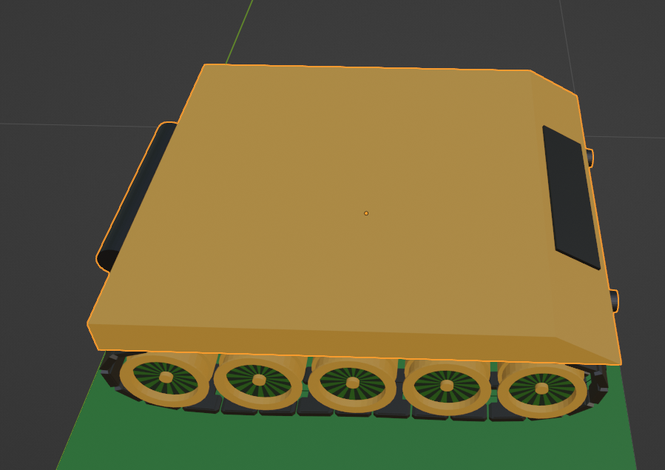
Game Actors: active actors: tanks
The tank has the following characteristics / features / parts:
Tanks have a body-chassis with:
Main body chassis
Tracks and/or wheels to move and steer
Lights with ON/OFF materials
Tank has a body-turret with one or two main guns with:
TBD
Tank main characteristics:
- A tank must have a center of rotation common for all components to make possible to rotate individual components against the same single point of rotation. While using in Blender the “join” feature this must be kept in mind.

Slide 12
Game Actors: active actors: tank chassis
The tank chassis have the following components:
Main body chassis with own material(s) that are fixed during the game
Tracks and/or wheels with materials that may change in between to simulate the rotation/movement
Lights with ON/OFF materials

Slide 13
Class diagrams

Slide 14
Map class diagram
GameMap::GameObject
GameObjectArray
1
<extends>
1..n
GameMapSide(right)
GameMapSide::GameObjectComponent
<extends>
GameMapSide (left)
1
GameTile
AbstractGameCavan
1..n
GameTile::GameObjectMesh
Note:
A map tile will have a square shape of an specific size (defined inside GameTile::TILE_SIZE)
Important! Class hierarchy follows the one from the GameObject class diagram

Slide 15
AbstractGameCavan
XYZMaterial
iAmbientMaterialColor
iDiffuseMaterialColor
iAmbientFileNameID
iDiffuseFileNameID
1
iMaterial
1
1
vertexBuffer
XYZVertex
Coordinate (x,y,z)
uvTexture(u,v)
Normal (x,y,z)
vertexColor
1..n

Slide 16
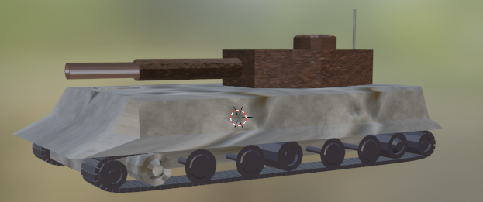
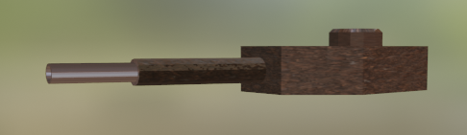
GameObject
GameObject
String Name
GameObjectArray <GameObjectComponent> [] componentsArray
GameObjectArray
1
0..n
GameObjectComponent
1
AbstractGameCavan
<extends>
0..n
GameObjectMesh
GameObject: a collection of “parts” that together forms a game object (i.e. tank). You can apply to the complete body rotation or movement.
GameObjectComponent: a collection of sub-parts that can be handled separately from the main body: example: you rotate the turret of the tank but the rest of the body will not rotate.
GameObjectMesh: the smallest sub component: it can move, rotate and/or have own material or color. Here is where all the OpenGL operations are taking part.

Slide 17
Projektmeilensteine
Q1 2OJJ
Finanzplan Beginnt
Q2 20JJ
Q3 20JJ
Beta-Registrierung beginnt für die Öffentlichkeit
Werbekampagne Start
Q4 20JJ
MVC wird in allen Märkten gestartet
500 Abonnenten
200 Abonnenten
Anfängliche Abonnenten
Endgültige Abonnenten

