Slide 1
Planes and Ships -a small game-

Slide 2
Game concept
The map
Map concept
Map tile
Map tile types
Game Actors
Passive actors
Active actors
Class diagrams

Slide 3
The map

Slide 4
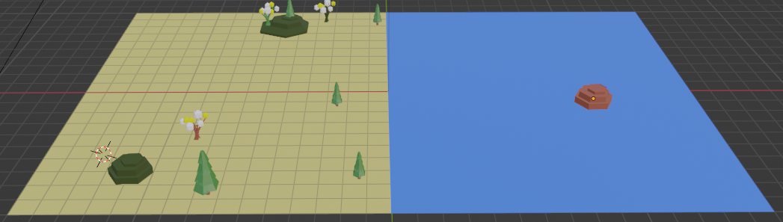
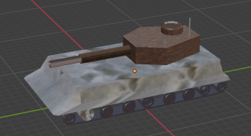
Map concept
The map is composed by map tiles each tile shall be able to host some passive elements (trees, landscape parts, buildings, etc) as well as active elements (game actors: tanks, planes, ships).
The map will have two sides: left player side and the right player side (the right one is usually covered by “fog of war” and it is the “enemy” side)
Active actors
Map tile
Passive actors
Enemy side of the map (usually hidden)
Active side of the map

Slide 5
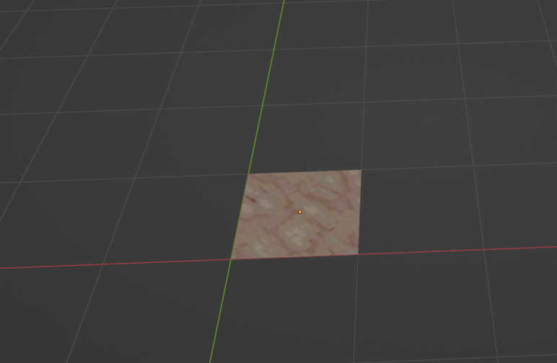
Map tile
The map tile has a size (in Blender) of 1x1 as square.
A 1x1 map tile

Slide 6
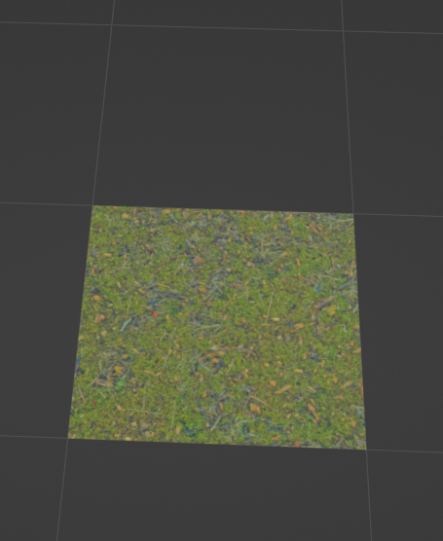
Map tile: type of tiles
The following type of tiles are defined:
Rocky tile
Grass tile

Slide 7
Game Actors

Slide 8
Game Actors: common properties
Each actor, either passive or active one, will have a maximum size of a tile: 1x1.

Slide 9
Game Actors: passive actors
…

Slide 10
Game Actors: active actors
The following categories are the “active actors”:
Tanks
Rocket/missile launchers
Ships
Airplanes
Radars and anti missile launchers

Slide 11
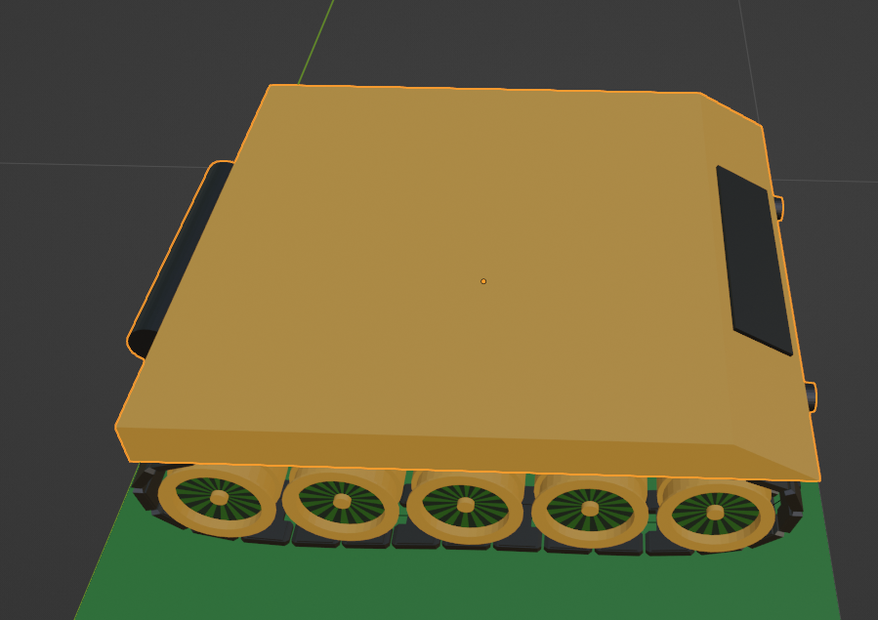
Game Actors: active actors: tanks
The tank has the following characteristics / features / parts:
Tanks have a body-chassis with:
Main body chassis
Tracks and/or wheels to move and steer
Lights with ON/OFF materials
Tank has a body-turret with one or two main guns with:
TBD
Tank main characteristics:
- A tank must have a center of symmetry common for all components to make possible to rotate individual components against the same single point of rotation. While using in Blender the “join” feature this must be kept in mind. See each individual model details.

Slide 12
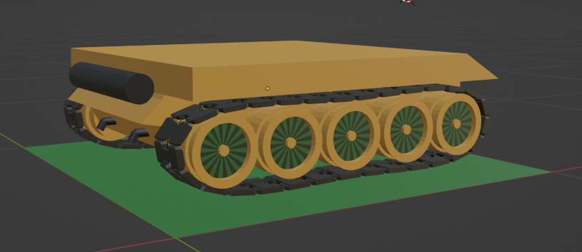
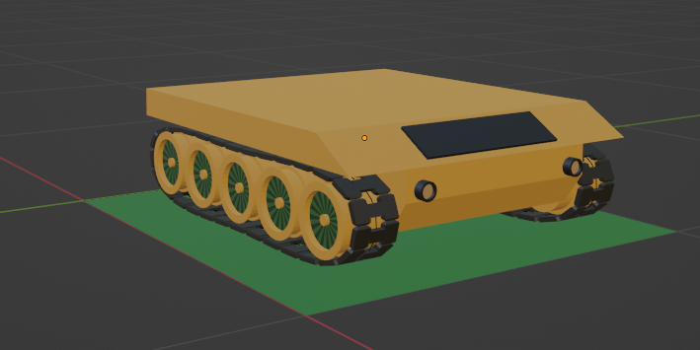
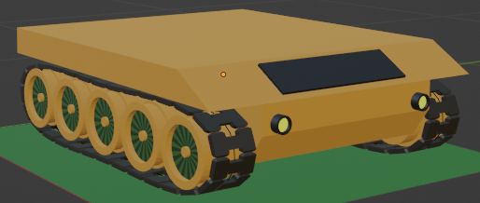
Game Actors: active actors: tank chassis
The tank chassis have the following components:
Main body chassis with own material(s) that are fixed during the game
Tracks and/or wheels with materials that may change in between to simulate the rotation/movement
Lights with ON/OFF materials (as part of the main body!). See next slides for details.

Slide 13
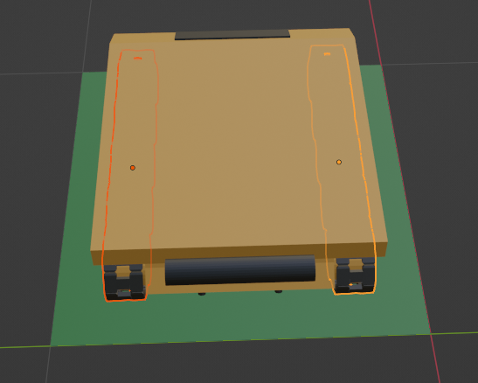
Game Actors: active actors: tank chassis
The tank chassis have the following components that may act independent while moving or rotating:
Main body chassis (called in Blender “Tank_Chassy” will contain also lights embedded. The only way to control the lights ON/OFF is by changing the materials “Material.LightOn” with “Material.LightOff” each other.
Tracks and/or wheels are separated left from links as well as separated from the main body:
Track_Right
Track_Left
The tank chassis properties:
Point of symmetry
TBD
…
Front side

Slide 14
Game Actors: ..: tank chassis: A-Type
The tank chassis of A-Type is a lightweight chassis designed for speed and maneuverability.
Main characteristics:
Point of symmetry, as defined in Blender:
X: 0.5
Y: 0.5
Z: 0.186

Slide 15
Class diagrams

Slide 16
Map class diagram
GameMap::GameObject
GameObjectArray
1
<extends>
1..n
GameMapSide(right)
GameMapSide::GameObjectComponent
<extends>
GameMapSide (left)
1
GameTile
AbstractGameCavan
1..n
GameTile::GameObjectMesh
Note:
A map tile will have a square shape of an specific size (defined inside GameTile::TILE_SIZE)
Important! Class hierarchy follows the one from the GameObject class diagram

Slide 17
AbstractGameCavan
XYZMaterial
iAmbientMaterialColor
iDiffuseMaterialColor
iAmbientFileNameID
iDiffuseFileNameID
1
iMaterial
1
1
vertexBuffer
XYZVertex
Coordinate (x,y,z)
uvTexture(u,v)
Normal (x,y,z)
vertexColor
1..n

Slide 18
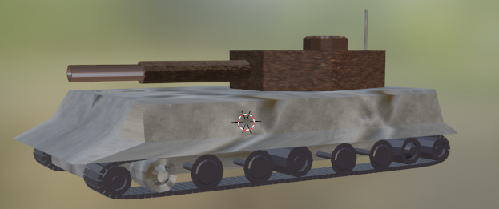
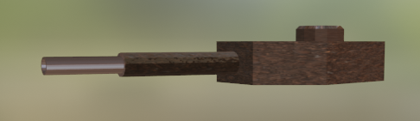
GameObject
GameObject
String Name
GameObjectArray <GameObjectComponent> [] componentsArray
GameObjectArray
1
0..n
GameObjectComponent
1
AbstractGameCavan
<extends>
0..n
GameObjectMesh
GameObject: a collection of “parts” that together forms a game object (i.e. tank). You can apply to the complete body rotation or movement.
GameObjectComponent: a collection of sub-parts that can be handled separately from the main body: example: you rotate the turret of the tank but the rest of the body will not rotate.
GameObjectMesh: the smallest sub component: it can move, rotate and/or have own material or color. Here is where all the OpenGL operations are taking part.

Slide 19
Projektmeilensteine
Q1 2OJJ
Finanzplan Beginnt
Q2 20JJ
Q3 20JJ
Beta-Registrierung beginnt für die Öffentlichkeit
Werbekampagne Start
Q4 20JJ
MVC wird in allen Märkten gestartet
500 Abonnenten
200 Abonnenten
Anfängliche Abonnenten
Endgültige Abonnenten

