Slide 1
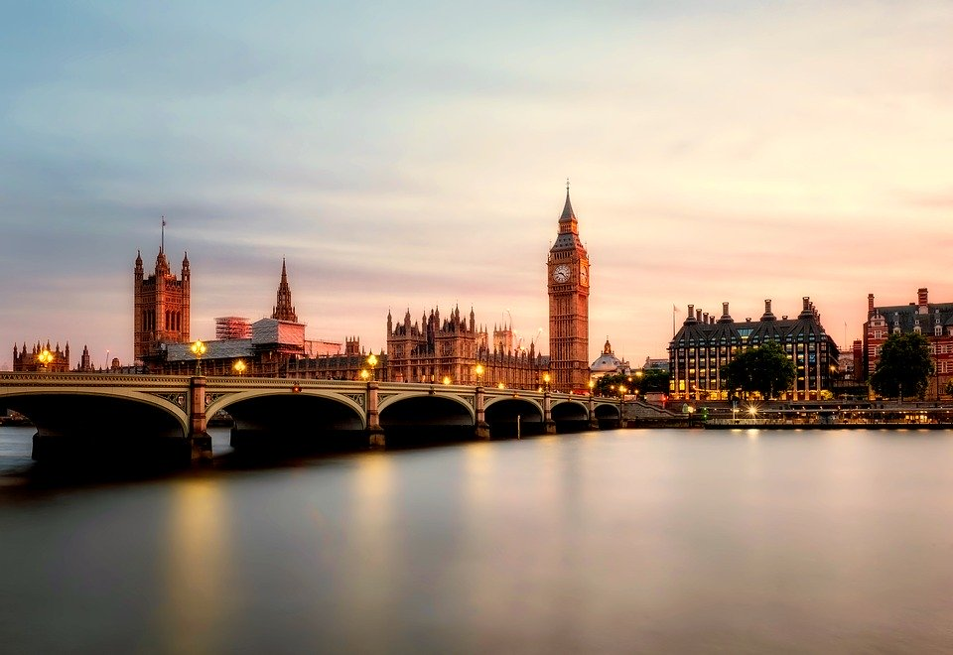
Housing Prices in London Boroughs
Case Study: October 2000 to October 2020

Slide 2
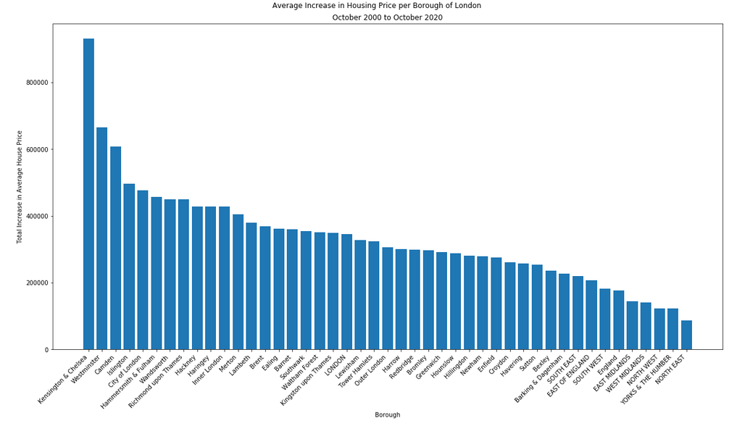
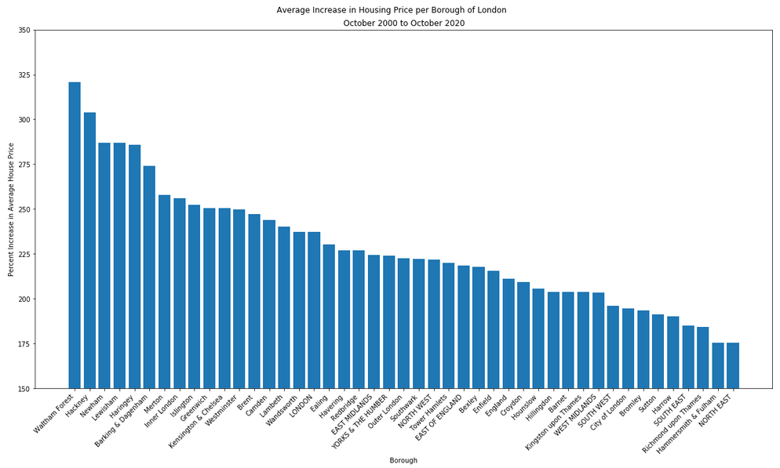
Average House Price per Borough in London
The five boroughs in London with the greatest TOTAL increase
in average housing price from Oct 2000 to Oct 2020 are:
1) Kensington & Chelsea: $930,075
2) Westminster: $664,237
3) Camden: $607,981
4) Islington: $496,555
5) City of London: $476,428
The five boroughs in London with the greatest PERCENTAGE increase
in average housing price from Oct 2000 to Oct 2020 are:
1) Waltham Forest: 321%
2) Hackney: 304%
3) Newham: 287%
4) Lewisham: 287%
5) Haringey: 286%

