Slide 1



Design and securing a corporate data center network
Prepared by:
Khaled Elawady Elgamal
Abdalrhman Saad Hamed
Gena Esbergen
Sama Mostafa
Rowaida Abdelnasser Ahmed
George Hany Fahmy

Slide 2

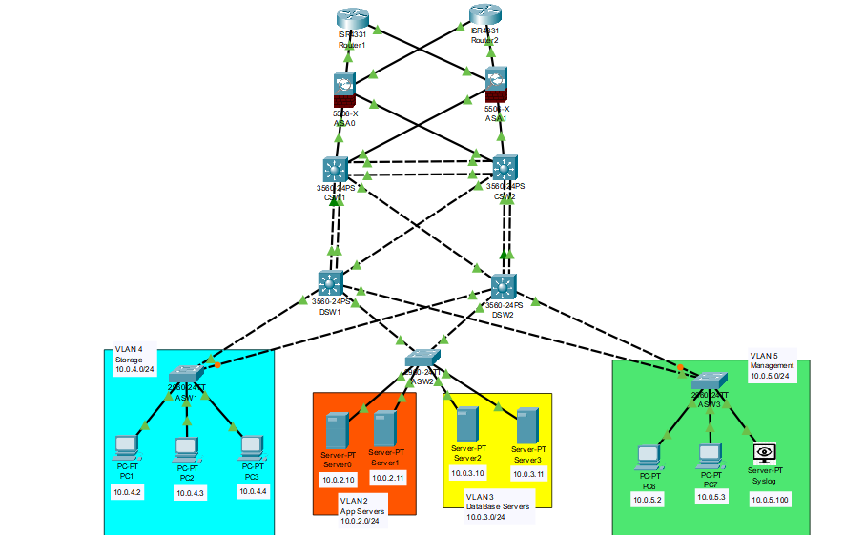

Slide 3
Project Overview
This project designs a corporate data center network with a focus on high availability, performance, and security.
It uses a three-tier architecture and integrates best practices for redundancy, segmentation, and access control.
Core elements include VLANs, HSRP, STP, OSPF routing, ACLs, and network monitoring.

Slide 4
Network Topology Overview
Three-tier model: Core, Distribution (Aggregation), and Access layers.
Core Layer: High-speed switches, backbone of the network.
Distribution Layer: Inter-VLAN routing, security enforcement.
Access Layer: Connects servers and storage; supports port security.
Redundancy: Active/standby pairs, EtherChannel, STP.
Switches: Interconnect all layers, support VLANs and link aggregation.
Routers: Layer 3 routing between VLANs and external networks.
Firewalls: Control North-South & East-West traffic.
Servers/Hosts: Application, database, and storage connected at access layer.

Slide 5
IP Addressing Scheme
Each VLAN uses a /24 subnet
Gateways assigned to .1 in each subnet
DHCP used for VLANs 4 & 5
Addresses assigned based on server roles
VLAN ID | VLAN Name | Subnet | Assigned IPs | Devices / Purpose
VLAN 2 | App Servers | 10.0.2.0/24 | 10.0.2.10, 10.0.2.11 | Server0, Server1 (App Servers)
VLAN 3 | Database Servers | 10.0.3.0/24 | 10.0.3.10, 10.0.3.11 | Server2, Server3 (DB Servers)
VLAN 4 | Storage | 10.0.4.0/24 | DHCP | PC0, PC1, PC2 (Storage Devices)
VLAN 5 | Management | 10.0.5.0/24 | DHCP | PC6, PC7 (Admin)

Slide 6
VLAN Design
VLAN 2: Application Servers (10.0.2.0/24)
VLAN 3: Database Servers (10.0.3.0/24)
VLAN 4: Storage (10.0.4.0/24) – DHCP
VLAN 5: Management (10.0.5.0/24) – DHCP
Logical segmentation improves security and manageability
VLAN ID | VLAN Name | IP Subnet | Associated Devices/Services
5 | Management | 10.0.5.0/24 | Switch/server management (SSH, SNMP); OOB management interfaces
2 | Application | 10.0.2.0/24 | Application/web servers
3 | Database | 10.0.3.0/24 | Database servers
4 | Storage | 10.0.4.0/24 | Backup

Slide 7
High Availability Measures
HSRP: Redundant default gateways for VLANs on DSW1 and DSW2
STP: Root and secondary bridges to prevent loops
EtherChannel: Link aggregation for resilience and bandwidth
Ensures fast failover and continuous service

Slide 8
OSPF Routing Protocol
OSPF enables dynamic routing in core and distribution
Allows for automatic rerouting and faster convergence
Reduces routing overhead and increases efficiency

Slide 9
Security Measures
SSH replaces Telnet for secure remote access
Basic IDS/IPS and firewall configurations initiated
Closed unused ports , closed unused applications ex:(cdp)

Slide 10
ACL Strategy
ACLs applied inbound per VLAN (except outbound for MGMT)
Least privilege model enforced
Only required protocols allowed (HTTPS, SQL, SNMP, etc.)
Logging enabled for denied traffic
Separate ACLs for App, DB, Storage, and MGMT VLANs

Slide 11
ASA Firewall Rules
INSIDE_IN ACL on ASA applied inbound Allows:
HTTPS to App Servers
SQL from App to DB
NFS/SMB from Storage to DB
Full MGMT access (SSH, RDP, monitoring)
All other traffic denied and logged

Slide 12
Network Monitoring Setup
Syslog Server: 10.0.5.100 (in MGMT VLAN)
SNMPv2c enabled on core and distribution and access devices
Enables early detection and response to issues

Slide 13
Thanks You

