Slide 1
Our Challenges

Slide 2
My sincere THANKS to AMS President Eric Friedlander, Past President Jim Glimm, Secretary Bob Daverman, Executive Director Don McClure, Associate Executive Director Ellen Maycock and all the AMS staff for their enthusiastic assistance during my Presidential term.
Notes:
Fixed misspelled “assistance”

Slide 3
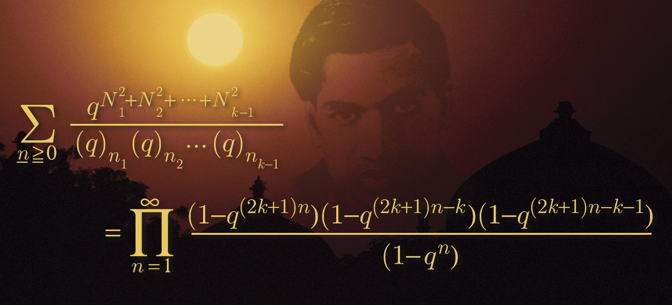
Notes:
Fixed this graphic.

Slide 4
DMS name change
DATA DELUGE and its implications
The role of metrics
“The Medium is the Message”
Education and the CCSSM
Professional Development

Slide 5
DMS NAME CHANGE
S. Pantula on BIG DATA:
“The NSF 2011-2016 Strategic Plan notes that “The revolution in information and communication technologies is another major factor influencing the conduct of 21st century research.
New cyber tools for collecting, analyzing, communicating, and storing information are transforming the conduct of research and learning.
Notes:
Missing closing quotation mark in second bullet point?

Slide 6
One aspect of the information technology revolution is the ‘DATA DELUGE,’ shorthand for the emergence of massive amounts of data and the changing capacity of scientists and engineers to maintain and analyze it.
Extracting useful knowledge from the deluge of data is critical to the scientific successes of the future. Data-intensive research will drive many of the major scientific breakthroughs in the coming decades. “
Notes:
One too many single quotation marks in first bullet point?

Slide 7

DATA DELUGE & its implications
Notes:
Brought in sharper version of the picture; removed the numerical reference to the picture which was “underneath” it (and would have been shown to the audience)

Slide 8

Notes:
Imported sharper version of the image (so that more of the words are readable to the audience)

Slide 9
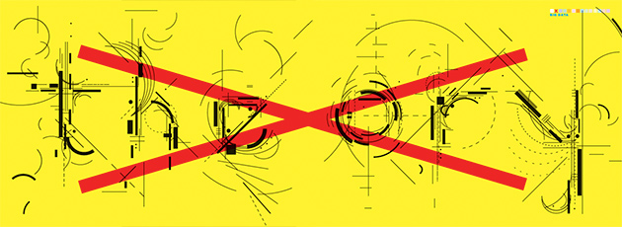

Slide 10
THE END OF THEORY: THE DATA DELUGE MAKES THE SCIENTIFIC METHOD OBSOLETE
By Chris Anderson
Wired Magazine, 6/23/08

Slide 11
““All models are wrong, but some are useful.” So proclaimed statistician George Box thirty years ago. . . .
Peter Norvig, Google’s research director, offered an update to George Box’s maxim: “All models are wrong and increasingly you can succeed without them.”

Slide 12
This is a world where massive amounts of data and applied mathematics replace every other tool that might be brought to bear. . . .
With enough data, the numbers speak for themselves.

Slide 13
The scientific method is built around testable hypotheses. These models, for the most part, are systems visualized in the minds of scientists.
The models are then tested, and experiments confirm or falsify theoretical models of how the world works. This is the way science has worked for hundreds of years.

Slide 14
Scientists are trained to recognize that correlation is not causation, that no conclusions should be drawn simply on the basis of correlation between X and Y (it could just be a coincidence).
Instead, you must understand the underlying mechanisms that connect the two. Once you have a model, you can connect the data sets with confidence. Data without a model is just noise.

Slide 15
But faced with massive data, this approach to science __ hypothesize, model, test __ is becoming obsolete. . . .
The reason that physics has drifted into theoretical speculation about n-dimensional grand unified models over the past few decades (the “beautiful story” phase of a discipline starved of data) is that we don’t know how to run the experiments that would falsify the hypotheses__
Notes:
Should there be a period at the end of the second bullet point? Or at least should it end with a “…” so the audience knows there is more to come on the next slide?

Slide 16
__ the energies are too high, the accelerators too expensive, and so on. . . .
Now biology is heading in the same direction. . . . In short, the more we learn about biology, the further we find ourselves from a model that can explain it.

Slide 17
There is now a better way. Petabytes allow us to say: “Correlation is enough.”
We can stop looking for models.
We can analyze the data without hypotheses about what it might show.
We can throw the numbers into the biggest computing clusters the world has ever seen and let statistical algorithms find patterns where science cannot.

Slide 18
Learning to use a ‘computer’ of this scale may be challenging. But the opportunity is great: The new availability of huge amounts of data, along with the statistical tools to crunch these numbers, offers a whole new way of understanding the world.

Slide 19
Correlation supersedes causation, and science can advance even without coherent models, unified theories, or really any mechanistic explanation at all.
There’s no reason to cling to our old ways. It’s time to ask: ‘What can science learn from Google?’”
Notes:
Should there be closing quotation marks at the end of bullet point 2?

Slide 20
Computational and Data-Enabled Science and Engineering (CDS&E)
(http://www.nsf.gov/mps/cds-e/)
“Computational and Data-Enabled Science and Engineering (CDS&E) is a new program. . .
CDS&E is now clearly recognizable as a distinct intellectual and technological discipline . . .
CDS&E broadly interpreted now affects virtually every area of science and technology, revolutionizing the way science and engineering are done. . .

Slide 21
Theory and experimentation have for centuries been regarded as two fundamental pillars of science. It is now widely recognized that computational and data-enabled science forms a critical third pillar. . .
NSF can make a strong statement that will lead the Foundation, researchers it funds, and US universities and colleges generally, by recognizing CDS&E as the distinct discipline it has clearly become.”
Notes:
Story about quantum computing

Slide 22
It is clear that the DATA DELUGE is the current WAVE OF THE FUTURE.
The problem is that when “waves of the future” show up they often wash away a number of worthy things and leave a number of questionable items littering the beach.

Slide 23
WHAT IS REQUIRED IS A SENSE OF PROPORTION.
The DATA DELUGE is with us. It is huge. Its impact will be great.
But an unintended consequence is the accompanying unstated implication that NOTHING is trustworthy if it is not supported by DATA.

Slide 24
THE ROLE OF METRICS
STAR METRICS
A project of the Science of Science Policy (OSTP)
Science and Technology for America’s Reinvestment - Measuring the EffecT of Research on Innovation, Competitiveness and Science
https://www.starmetrics.nih.gov/
Notes:
Should “EffecT” in the second bullet point have a capital T at the end of the word? Just asking

Slide 25
“Building an Empirical Framework
Start with scientists as the unit of analysis
Science is done by scientists. Need to identify universe of individuals funded by federal agencies (PI, co- PI, RAs, graduate students, etc.)
Include full description of input measures
Include full description of outcomes (economic, scientific and social)
Combine inputs and outcomes
Create appropriate metrics that capture all dimensions of science investments”

Slide 26
CREATE APPROPRIATE METRICS THAT CAPTURE ALL DIMENSIONS OF SCIENCE INVESTMENTS

Slide 27
IMPACT FACTOR
(discussed in Nefarious Numbers, by D. Arnold and K. Fowler)
“The impact factor for a journal in a given year is calculated by ISI (Thomson Reuters) as the average number of citations in that year to the articles the journal published in the preceding two years.
Notes:
Why is there tabbing after the second bullet point? Just looks like empty space…

Slide 28
A journal’s distribution of citations does not determine its quality
The impact factor is a crude statistic, reporting only one particular item of information from the citation distribution.

Slide 29
It is a flawed statistic. For one thing, the distribution of citations among papers is highly skewed, so the mean for the journal tends to be misleading.
For another, the impact factor only refers to citations within the first two years after publication (a particularly serious deficiency for mathematics, in which around 90% of citations occur after two years).

Slide 30
The underlying database is flawed, containing errors and including a biased selection of journals.
Many confounding factors are ignored, for example, article type (editorials, reviews, and letters versus original research articles), multiple authorship, self-citation, language of publication, etc.
Notes:
In bullet point 2, do you want “letter” or “letters” ?

Slide 31
Despite these difficulties, the allure of the impact factor as a single, readily available number __ not requiring complex judgments or expert input, but purporting to represent journal quality __ has proven irresistible to many.

Slide 32
Goodhart’s law warns us that ‘when a measure becomes a target, it ceases to be a good measure.’”
Notes:
Quotation mark inconsistencies…

Slide 33
h – INDEX (J. Hirsch, Physics, UCSD)
(The following information on indices comes from Wikipedia)
A scientist has index h if h of his/her N_{p} papers have at least h citations each, and the other (N_{p} − h) papers have no more than h citations each.

Slide 34
Hirsch suggested (with large error bars) that, for physicists, a value for h of about 12 might be typical for advancement to tenure (associate professor) at major research universities.
A value of about 18 could mean a full professorship,
15–20 could mean a fellowship in the American Physical Society,
and 45 or higher could mean membership in the United States National Academy of Sciences.
Notes:
In previous slide, “h” was NOT italicized… in first bullet point, you have italicized h. Slight inconsistency. And, what is the mark at the end of the last bullet point? Is it necessary?

Slide 35
The m-index is defined as h/n, where n is the number of years since the first published paper of the scientist.
The c-index accounts not only for the citations but for the quality of the citations in terms of the collaboration distance between citing and cited authors. . .
Bornmann, Mutz, and Daniel recently proposed three additional metrics, h2lower, h2center, and h2upper, to give a more accurate representation . . .
Notes:
Why is there a [1] in the first bullet point?

Slide 36
H.B. Mann & D.R. Whitney, On a test of whether one of two random variables is stochastically larger than the other, Ann. Math. Stat. 18(1947), 50-60. 2067 CITATIONS
H.B. Mann, A proof of the fundamental theorem on the density of sums of sets of positive integers, Ann. of Math., 43(1942), 523-527. 28 CITATIONS (AMS Cole Prize)

Slide 37
Highest cited papers among Fields Medalists
Number of Medalists Citations of most cited work
4 500+
8 400-499
10 300-399
9 200-299
6 100-199
9 50-99
4 1-49
JOHN J MEIER (PSU Science Librarian)
Notes:
Removed bullet points in left-hand column… question: Do you want to pluralize “Medalist” in the title of the slide?

Slide 38
NUMERICAL VERSUS PROSE STUDENT EVALUATIONS.
Here are two examples of written student evaluations of the same professor taken from his large lecture classes:
#1. “What this course needs is free beer, dancing girls, and pot.”
Notes:
Removed space between beer and the comma thereafter…

Slide 39
#2 The consistent quality of Professor X’s communication skills, thoroughness, clarity, anticipation of likely student problems, and helpful attitude make him a SUPERIOR instructor. . . .he stressed the derivation of concepts to deepen the understanding of their use instead of struggling through a proof without stating its relevance and then saying ‘Just use the formula.’
Notes:
Extra quotation marks at the end of the quote? Or should the quote begin with quotation marks?

Slide 40
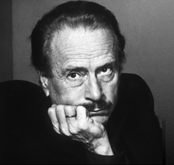
THE MEDIUM IS THE MESSAGE
Marshall McLuhan
Notes:
Removed bullet point before McLuhan’s name, then re-centered name under the picture

Slide 41
“…a few years ago, General David Sarnoff made this statement: ‘We are too prone to make technological instruments the scapegoats for the sins of those who wield them. The products of modern science are not in themselves good or bad: it is the way they are used that determines their value.’
That is the voice of the current somnambulism.”

Slide 42
“Our conventional response to all media, namely that it is how they are used that counts is the numb stance of the technological idiot.
For the ‘content’ of the medium is like the juicy piece of meat carried by the burglar to distract the watchdog of the mind.

Slide 43
“McLuhan tells us that a ‘message’ is, ‘the change of scale or pace or pattern’ that a new invention or innovation ‘introduces into human affairs.’ Note that it is not the content or use of the innovation, but the change in inter-personal dynamics that the innovation brings with it.”
M. Federman (What is the Meaning of The Medium is the Message?)

Slide 44
Federman concludes: “. . . If we discover that the new medium brings along effects that might be detrimental to our society or culture, we have the opportunity to influence the development and evolution of the new innovation before the effects become pervasive.
As McLuhan reminds us, ‘Control over change would seem to consist in moving not with it but ahead of it. Anticipation gives the power to deflect and control force.’”

Slide 45
Of central importance is the fact that a medium seeks content that is appropriate to it, and it ignores content that it cannot easily accommodate.
Metrics of all sorts are very much the type of instruments naturally required in the medium of data for comparison of large data sets.

Slide 46
What conclusions can we draw from this analysis?
(apart from the recommendation for the NSF that, by keeping the name Division of Mathematical Sciences, a sense of proportion is maintained in contemplating the DATA DELUGE).
I will examine one important matter with regard to anticipating the implications of BIG DATA:
EDUCATION
Notes:
Removed an unnecessary animation pause…

Slide 47
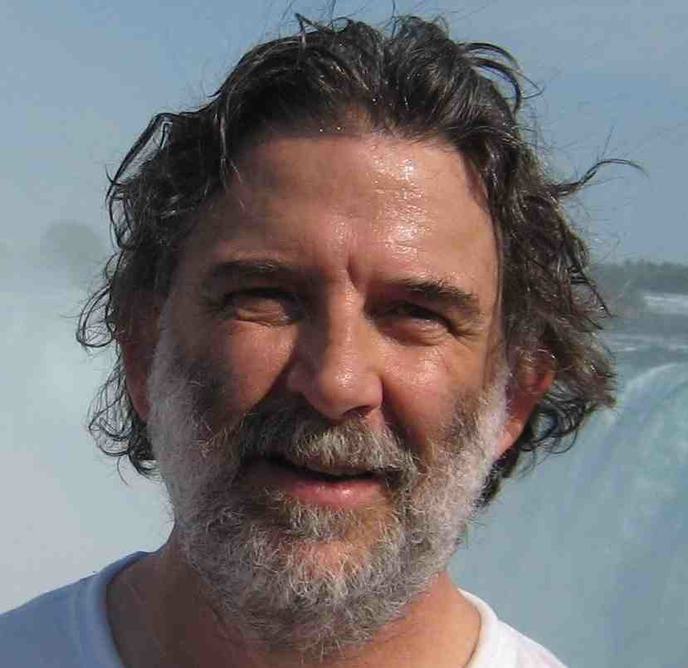
COMMON CORE STATE STANDARDS FOR MATHEMATICS (CCSSM)
Bill McCallum and his colleagues have succeeded in producing a coherent and mathematically sound set of K-12 standards. The AMS Committee on Education has rightly given a firm endorsement.
Notes:
Added a little vertical space throughout this slide… do you want those bullet points? Maybe unnecessary? And do you want the smiley face?

Slide 48
WHAT ABOUT CALCULUS ?
The word “calculus” appears twice in the CCSSM.
While calculus was effectively ignored by the CCSSM (perhaps appropriately), it is pervasive in the country’s high schools.
The quality of high school calculus courses varies tremendously, and the impact on freshman education is substantial.
Notes:
Do you really want the animation pauses to not go top-down through this list? You have them 2-1-3 right now…

Slide 49
And, as with all products of large committees, there have been compromises. Some of these are very much relevant to my topic today.
Some aspects of the CCSSM are especially intriguing when one keeps “The Medium is the Message” in mind.

Slide 50
We need a new metric:
A-INDEX (Andrews, Penn State, 2012) of a word W.
A(W) is the number of times W appears in the CCSSM

Slide 51
Words related to CDS&E
WORD A-INDEX
Data 145
Probability 77
Statistics 33
Technology 17
Computer 10

Slide 52
Words less related to CDS&E
WORD A-Index
Geometry 51
Algebra 33
Arithmetic 27
Memory 2
Mnemonic 2 (in one sentence on FOIL)
Memorization 1 (in a reference title)
Pencil 1
Rote 0

Slide 53
In grade 2: Fluently add and subtract within 20 using mental strategies. By end of grade 2, know from memory all sums of two one-digit numbers.

Slide 54
In grade 3: Fluently multiply and divide within 100, using strategies such as the relationship between multiplication and division (e.g. knowing that 8x5 = 40, one knows 40/5 = 8) or properties of operations. By the end of grade 3, know from memory all products of two one-digit numbers.

Slide 55
FOIL
Page 4, CCSSM: “There is a world of difference between a student who can summon a mnemonic device to expand a product such as (a+b)(x+y) and a student who can explain where the mnemonic comes from. The student who can explain the rule understands the mathematics, and may have a better chance to succeed at a less familiar task such as expanding (a+b+c)(x+y).”

Slide 56
From an Illinois High School Math Teacher:
“Memorization for its own sake is admittedly of limited value: however, anyone who has learned mathematics in a rigorous manner attests to the fact that ‘post-comprehension memorization’ is beneficial to promote efficiency in problem-solving.

Slide 57
Our ‘reform’ advocates over the past 20 or 25 years unfortunately have been permitted to equate in the minds of educators memorization with tedium and lack of understanding; it’s as if quick command of the facts and comprehension were somehow mutually exclusive.”

Slide 58
MEDILL Reports (Northwestern U.) 1/27/11
Writing by hand better for learning, study shows
by Gulnaz Saiyed
Notes:
You have the date on the slide in two different places… at end of first bullet point, and at the very end of the slide

Slide 59
“Researchers Anne Mangen, of the University of Stavanger in Norway, and Jean-Luc Velay, a French neuroscientist, said their research indicates the increase in digital writing in schools needs to be examined more closely.
Sure, for many, writing by hand seems a little retro. However, using a keyboard or touchscreen to write is a drastically different cognitive process from writing by hand.
Notes:
Added a period at the end of the second bullet point.

Slide 60
The physical act of holding a pencil and shaping letters sends feedback signals to the brain.
This leaves a “motor memory,” which later makes it easier to recall the information connected with the movement, according to the study.

Slide 61
The movement for “the typing of a T is no different than the typing of a Y,” Mangen said.
Further, when “you write something on the keyboard, you get the visual output somewhere else, on the screen,” as opposed to you watching your hand when you write on paper, she said.

Slide 62
Mangen said she understands the benefits of typing—it’s quite simply faster.
However, the fact that writing by hand can be comparatively “long and difficult” might be the reason it can be so helpful to triggering brain processes, she said.”

Slide 63
NOTICE HOW THE CONCERN FOR DATA BACKED ASSERTIONS IS SHAPING EVEN THIS TALK.
We can no longer merely assert “Grass is green!”
Now we must add something like the following:

Slide 64
A team of Harvard scientists has studied 9328 blades of grass from 37 randomly selected countries. They measured the wave length of light emanating from each blade when placed in the noonday sun on Harvard Square. 98.32% produced light of wave length between 520 and 570 nanometers which is the accepted standard measure for green as certified by the International Bureau of Standards.

Slide 65
“My mathematical strength lies in my ability in computation. Even now I do not mind doing lengthy computations, while years ago I could do them with relatively few errors. This is a training which is now relatively unpopular and has not been encouraged. It is still a great advantage in dealing with many problems.”
S. S. Chern

Slide 66
These concerns coupled with the co-equal appearances of “Probability & Statistics” with “Algebra, Geometry & Arithmetic” suggest that CCSSM was perhaps insufficiently vigilant in anticipating the effects of the DATA DELUGE and its concomitant educational role promoting the extensive use of technology. Thus to some extent CCSSM failed to take into account adequately how real human beings actually learn things.

Slide 67
TOP DOWN versus BOTTOM UP
PROFESSIONAL DEVELOPMENT of K-12 teachers currently in the classroom is, I believe, absolutely essential if the CCSSM has any chance of making serious improvements in mathematics education.

Slide 68
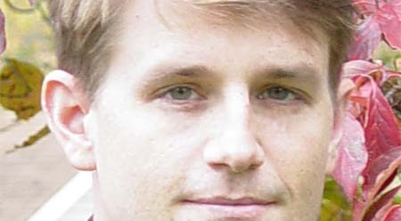
Scott Baldridge
https://www.math.lsu.edu/~sbaldrid/
Baker School Project
Notes:
Wiggled some of the centering

Slide 69
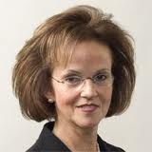
Deborah Ball
http://www-personal.umich.edu/~dball/
Center for Proficiency in Teaching Mathematics
Notes:
Inserted clearer image… fixed centering

Slide 70
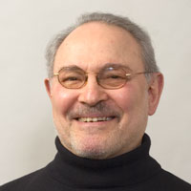
Hy Bass
http://www.soe.umich.edu/people/profile/hyman_bass/
National Medal of Science Citation includes:
“….His profound influence on mathematics education…”
Notes:
Need to add quotation marks at end… Got cleaner picture and did some centering…

Slide 71

Amy Cohen
http://math.rutgers.edu/people/index.php?type=faculty&id=62
NJ Partnership for Excellence in Middle School Mathematics
Notes:
Need to choose between one of these two images… and then fix centering as needed

Slide 72

Ken Gross
http://www.cems.uvm.edu/~gross/
VERMONT MATHEMATICS INITIATIVE
Notes:
Why is VMI in all capitals? I used a smaller image here for sharpness

Slide 73
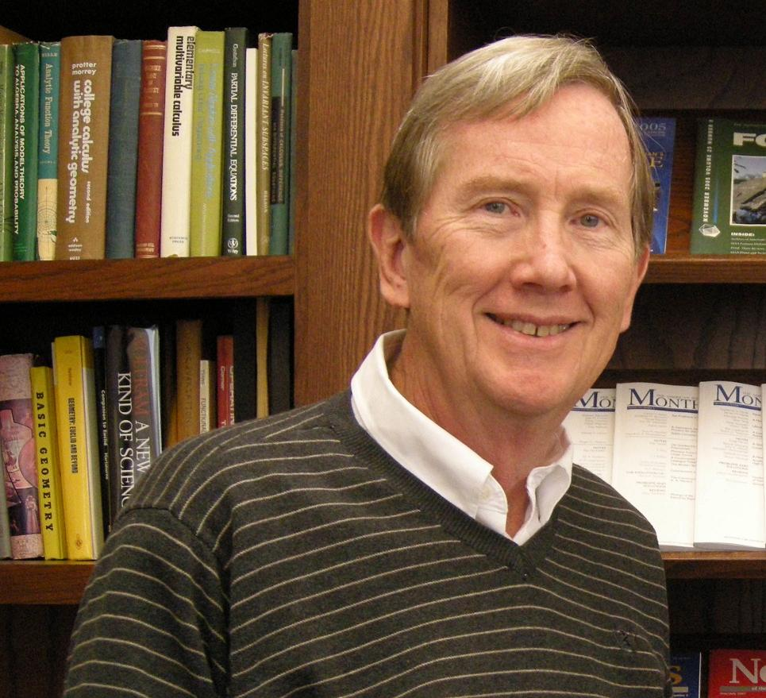
Jim Lewis
http://www.math.unl.edu/~wlewis1/
NebraskaMATH
Notes:
Found much nicer image of Jim Lewis! And newer I dare say!

Slide 74

Tom Parker
http://www.math.msu.edu/~parker/
(with S. Baldrige) Elementary Mathematics for Teachers
& Elementary Geometry for Teachers
Notes:
Sharper image of Tom Parker…

Slide 75

Hung-Hsi Wu
http://math.berkeley.edu/people/faculty
Understanding Numbers in Elementary School Mathematics
Notes:
Tried to insert a clearer image of Hung-His Wu here…

Slide 76
Copies of these slides will soon be available at
http://www.math.psu.edu/andrews/
Thank you for your attention!
LET’S GO TO WORK! THERE IS MUCH TO BE DONE!

