Slide 1


HEP NTUA Top Angular Report 29/10/2020
George Bakas

Slide 2
Summary
Start investigating ttbar Systematic Uncertainties
Top Angular Distributions: chi, |cosθ*| leading and subleading
Changed binning for the cos(θ*) distributions
Z’ analysis:
Goal is to plot the ttbar mc samples and Z’ mc’s to check sensitivity wrt angular dists
mJJ cut set to 1.5 TeV
For each mJJ cut, plot Z’ for a set of masses (1% and 10% width) [2,2.5,3]TeV and Nominal TT angular distributions
Angular distributions for 2016
PoS for ICHEP 2020

Slide 3
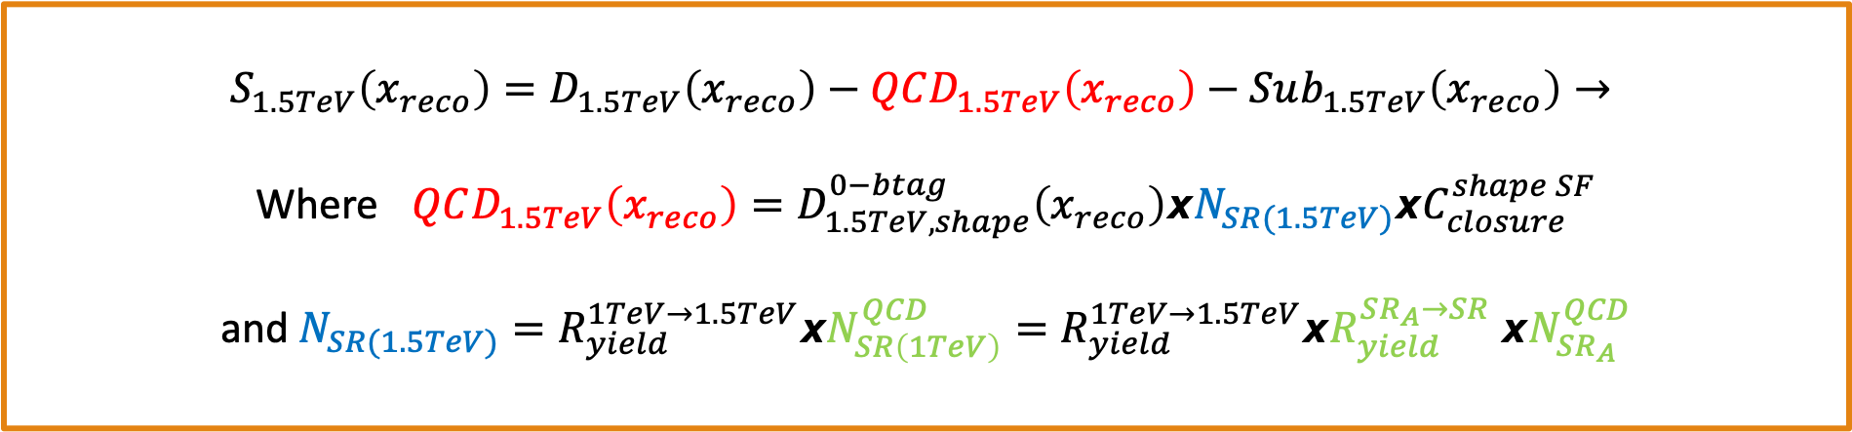
Signal Extraction
$$S_{1.5TeV}\left(x_{reco}\right)=D_{1.5TeV}\left(x_{reco}\right)−QCD_{1.5TeV}\left(x_{reco}\right)−Sub_{1.5TeV}\left(x_{reco}\right)→$$
Where $QCD_{1.5TeV}\left(x_{reco}\right)=D_{1.5TeV, shape}^{0−btag}\left(x_{reco}\right)xN_{SR(1.5TeV)}{xC}_{closure}^{shape SF}$
and $N_{SR(1.5TeV)}=R_{yield}^{1TeV→1.5TeV}xN_{SR\left(1TeV\right)}^{QCD}=R_{yield}^{1TeV→1.5TeV}xR_{yield}^{SR_{A}→SR} {xN}_{SR_{A}}^{QCD}$
The variable of interest here: x_{reco} → χ
1.5 TeV refers to the mJJ cut
We deploy a fit in the Signal Region (2btag) to extract the $N_{QCD}^{fit}$ in SR (mJJ > 1TeV)
$$D{\left(m^{t}\right)}^{(i)}=N_{tt}^{(i)}T^{(i)}\left(m^{t},k_{MassScale}, k_{MassResolution}\right)+N_{bkg}^{(i)}B\left(m^{t} \right)\left(1+k_{1}x\right)+N_{sub}^{(i)}O^{(i)}\left(m^{t}\right)$$

Slide 4
Angular Distributions
mJJ > 1.5 TeV

Slide 5
Angular Distributions (Prefit)
M_{z’} =2000, w = 1%
M_{z’} =2500, w = 1%
M_{z’} =2000, w = 10%
M_{z’} =2500, w = 10%

Slide 6
Angular Distributions (PostFit)

Slide 7
Angular Distributions (Brazilian Plot)

Slide 8
BACKUP

Slide 9
Signal Selection
Control Region Selection
Variables | Selected Cut
pT (both leading jets) | > 400 GeV
Njets | > 1
N leptons | = 0
|eta| (both leading jets) | < 2.4
mJJ | > 1000 GeV
jetMassSoftDrop (only for fit) | (50,300) GeV
Top Tagger | > 0.2, 0, 0.1
B tagging (2 btagged jets) | > Medium WP
Signal Trigger
Variables | Selected Cut
pT (both leading jets) | > 400 GeV
Njets | > 1
N leptons | = 0
|eta| (both leading jets) | < 2.4
mJJ | > 1000 GeV
jetMassSoftDrop (only for fit) | (50,300) GeV
Top Tagger | > 0.2, 0, 0.1
B tagging (0 btagged jets) | < Medium WP
Control Trigger

Slide 10
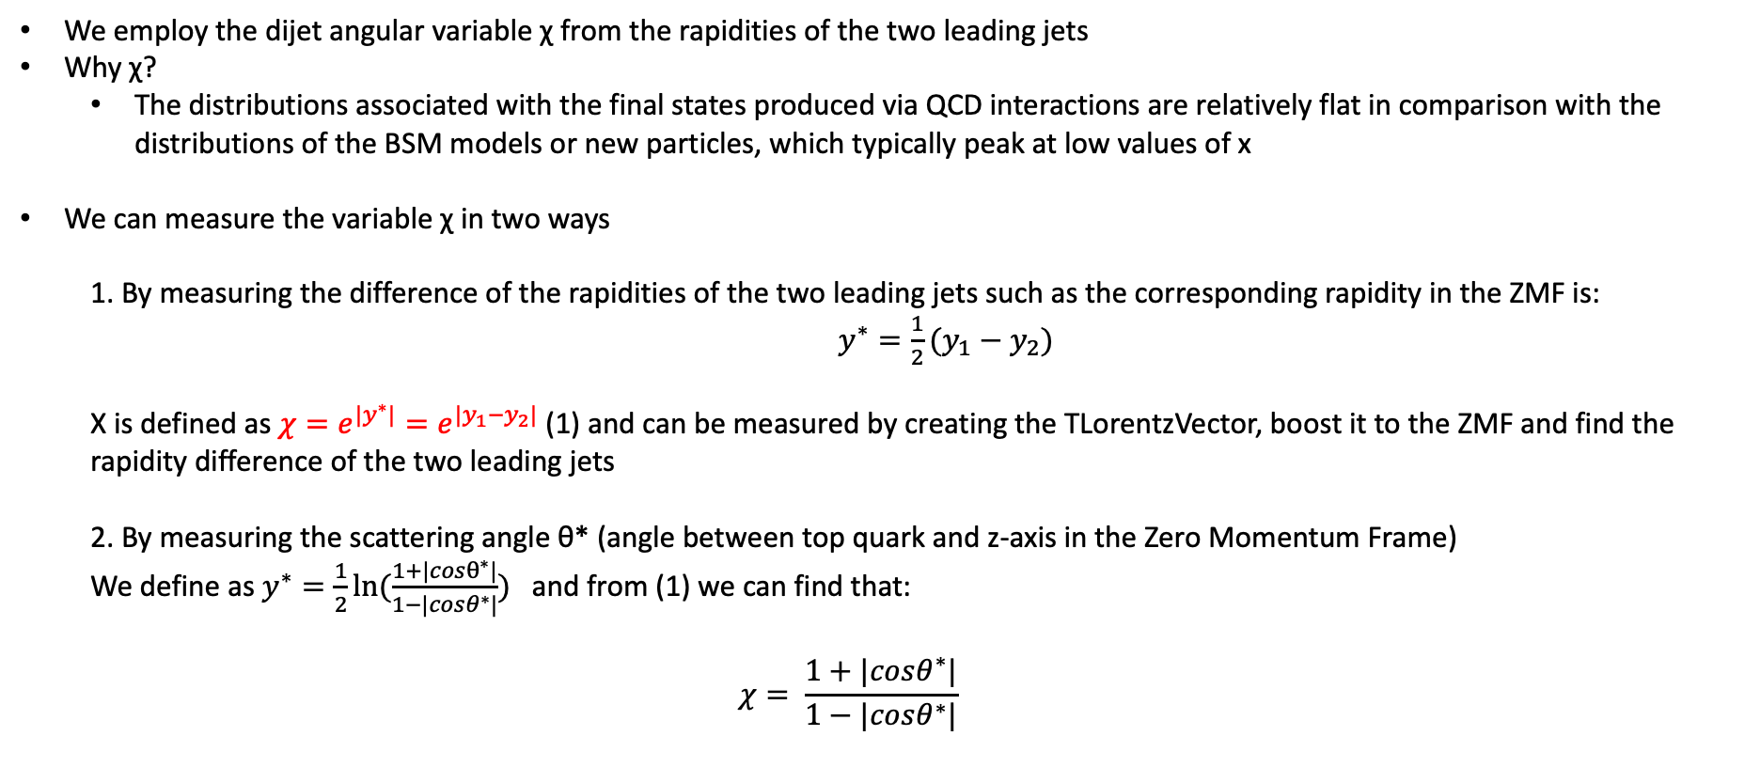
Top Angular Distributions
We employ the dijet angular variable χ from the rapidities of the two leading jets
Why χ?
The distributions associated with the final states produced via QCD interactions are relatively flat in comparison with the distributions of the BSM models or new particles, which typically peak at low values of x
We can measure the variable χ in two ways
1. By measuring the difference of the rapidities of the two leading jets such as the corresponding rapidity in the ZMF is: $y^{∗}=\frac{1}{2}(y_{1}−y_{2})$
Χ is defined as $χ=e^{{|y}^{∗}|}=e^{|y_{1}−y_{2}|}$ (1) and can be measured by creating the TLorentzVector, boost it to the ZMF and find the rapidity difference of the two leading jets
2. By measuring the scattering angle θ* (angle between top quark and z-axis in the Zero Momentum Frame)
We define as $y^{∗}=\frac{1}{2}ln⁡(\frac{1+|cosθ^{∗}|}{1−|cosθ^{∗}|})$ and from (1) we can find that:
$$χ= \frac{1+|cosθ^{∗}|}{1−|cosθ^{∗}|}$$

