Slide 1


HEP NTUA Top Angular Report 2/4/2021
George Bakas

Slide 2
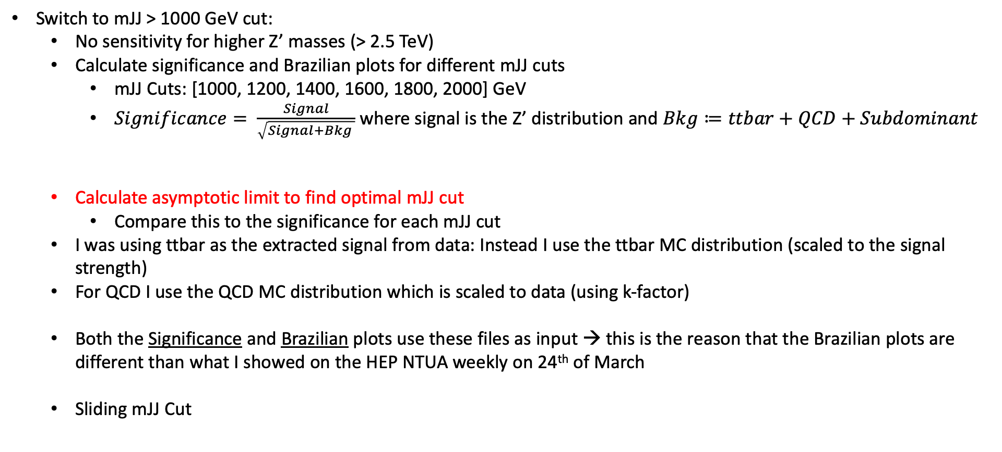
Summary Z’ Analysis
Switch to mJJ > 1000 GeV cut:
No sensitivity for higher Z’ masses (> 2.5 TeV)
Calculate significance and Brazilian plots for different mJJ cuts
mJJ Cuts: [1000, 1200, 1400, 1600, 1800, 2000] GeV
$Significance= \frac{Signal}{\sqrt{Signal+Bkg }}$ where signal is the Z’ distribution and $Bkg≔ttbar+QCD+Subdominant$
Calculate asymptotic limit to find optimal mJJ cut
Compare this to the significance for each mJJ cut
I was using ttbar as the extracted signal from data: Instead I use the ttbar MC distribution (scaled to the signal strength)
For QCD I use the QCD MC distribution which is scaled to data (using k-factor)
Both the Significance and Brazilian plots use these files as input → this is the reason that the Brazilian plots are different than what I showed on the HEP NTUA weekly on 24th of March
Sliding mJJ Cut

Slide 3
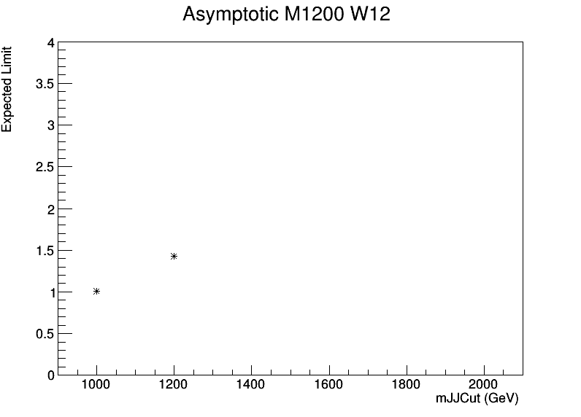
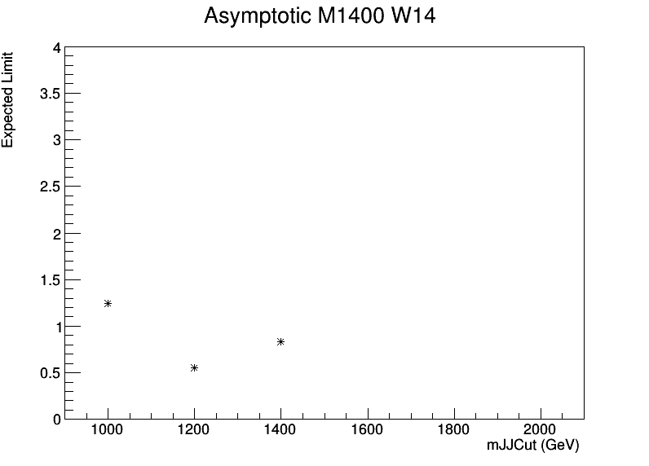
Significance (left) and Asymptotic (right) Graphs (2017)
M_{z’} =1200, w = 1%
M_{z’} = 1200, w = 1%
M_{z’} =1400, w = 1%
M_{z’} =1400, w = 1%

Slide 4
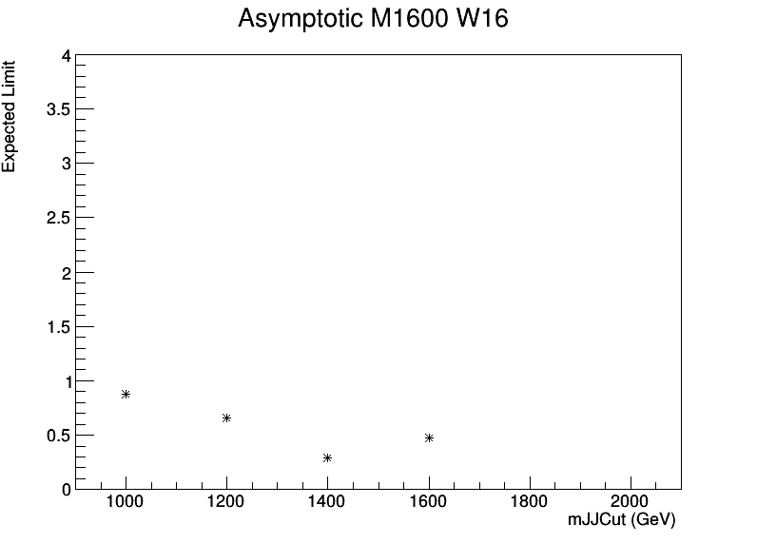
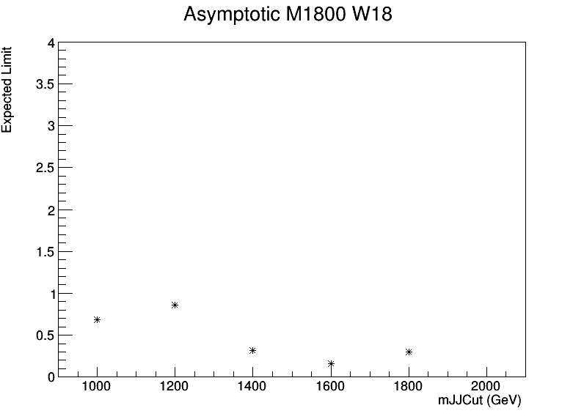
Significance (left) and Asymptotic (right) Graphs (2017)
M_{z’} =1600, w = 1%
M_{z’} =1600, w = 1%
M_{z’} =1800, w = 1%
M_{z’} =1800, w = 1%

Slide 5
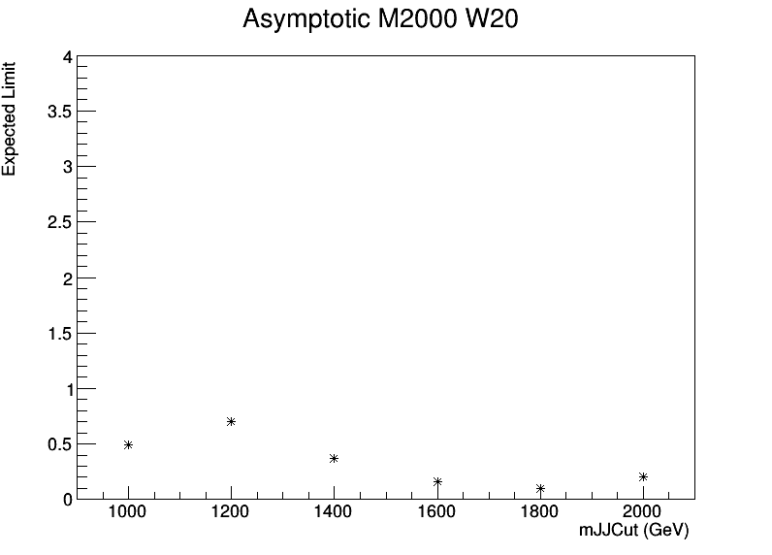

Significance (left) and Asymptotic (right) Graphs (2017)
M_{z’} =2000, w = 1%
M_{z’} =2000, w = 1%
M_{z’} =2500, w = 1%
M_{z’} =2500, w = 1%

Slide 6


Significance (left) and Asymptotic (right) Graphs (2017)
M_{z’} =3000, w = 1%
M_{z’} =3000, w = 1%
M_{z’} =3500, w = 1%
M_{z’} =3500, w = 1%

Slide 7


Significance (left) and Asymptotic (right) Graphs (2017)
M_{z’} =4000, w = 1%
M_{z’} =4000, w = 1%
M_{z’} =4500, w = 1%
M_{z’} =4500, w = 1%

Slide 8
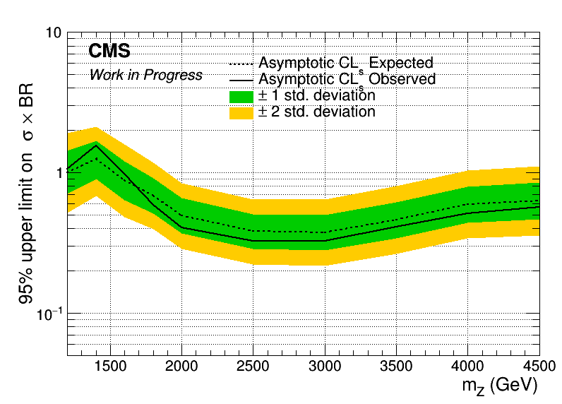
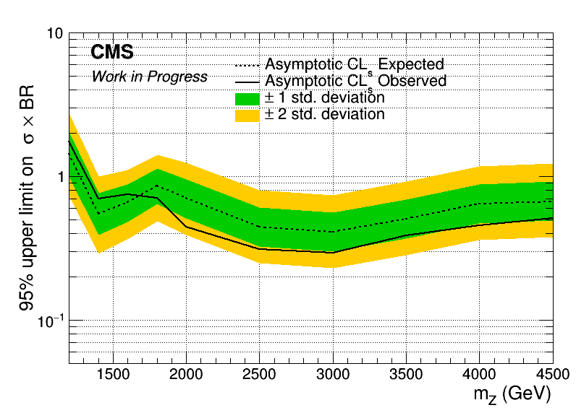
Brazilian Plots (2017)
mJJ > 1000 GeV
mJJ > 1200 GeV

Slide 9

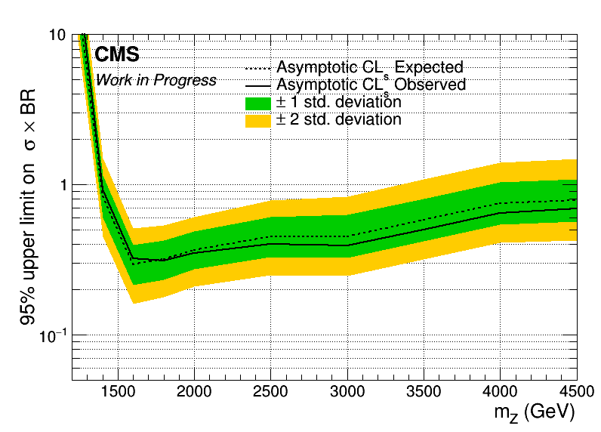
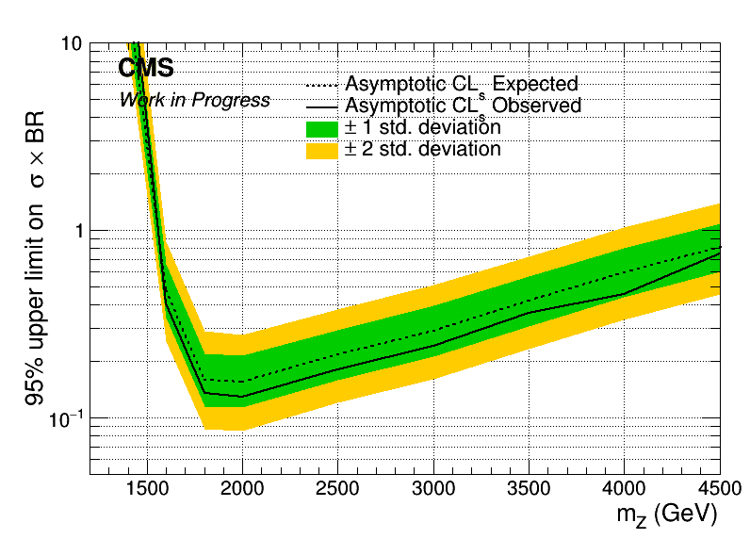
Asymptotic Limits - Brazilian Plots (2017)
mJJ > 1400 GeV
mJJ > 1600 GeV

Slide 10
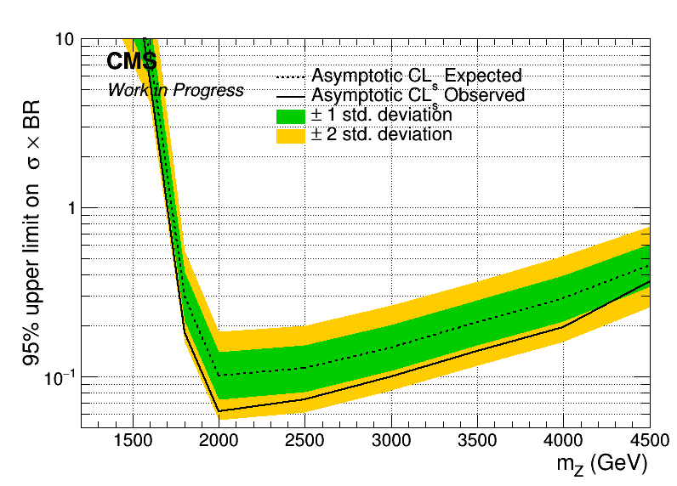
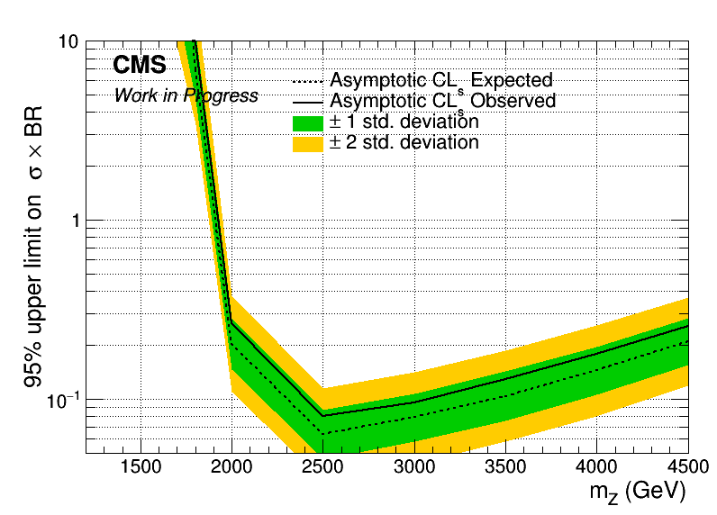
Brazilian Plots (2017)
mJJ > 1800 GeV
mJJ > 2000 GeV

Slide 11
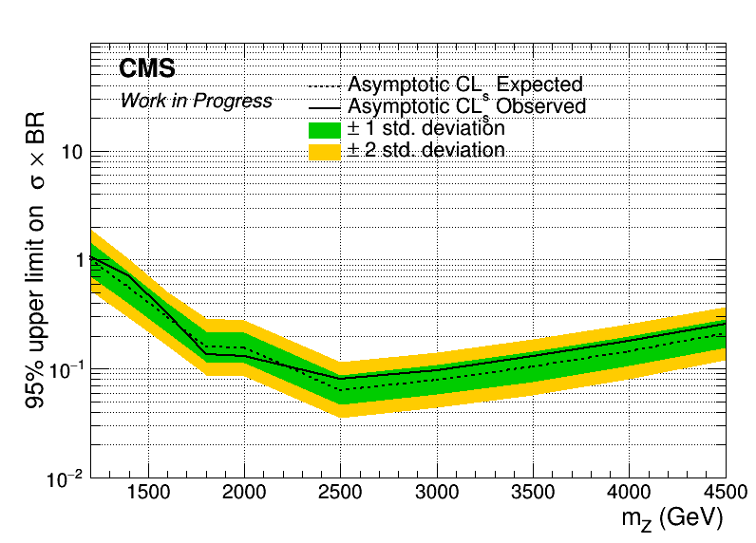
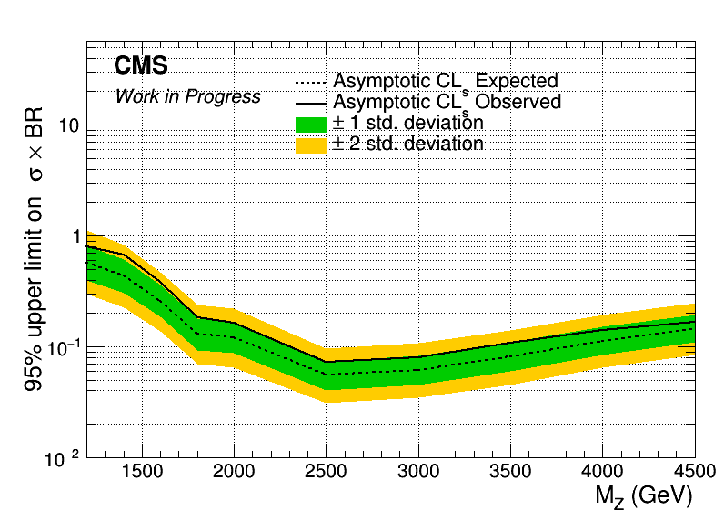
Brazilian Plots (2017 and 2018) with sliding mJJ Cut
Mass Cut Mapping
{"mZ_1200_12":1000, "mZ_1400_14":1200, "mZ_1600_16":1400, "mZ_1800_18":1600, "mZ_2000_20":1600,
"mZ_2500_25":2000, "mZ_3000_30":2000, "mZ_3500_35":2000, "mZ_4000_40":2000, "mZ_4500_45":2000}
2017
2018

Slide 12
BACKUP

Slide 13
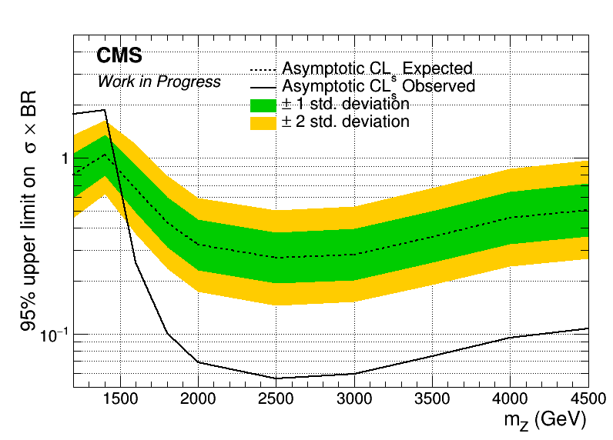
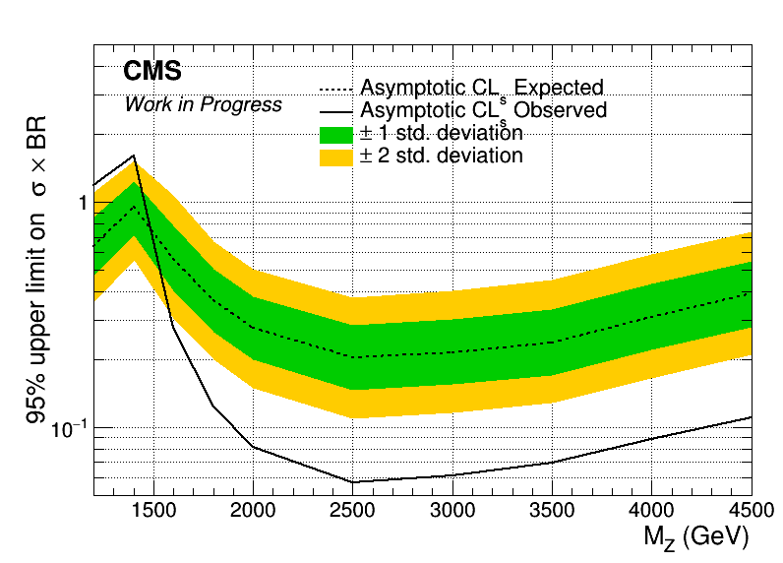
Angular Distributions (Brazilian Plot using data!!!!)
Assymptotic limits for M Z’: 1.2, 1.4, 1.6, 1.8, 2, 2.5, 3, 3.5, 4, 4.5 TeV
Width 1%
2017
2018

Slide 14
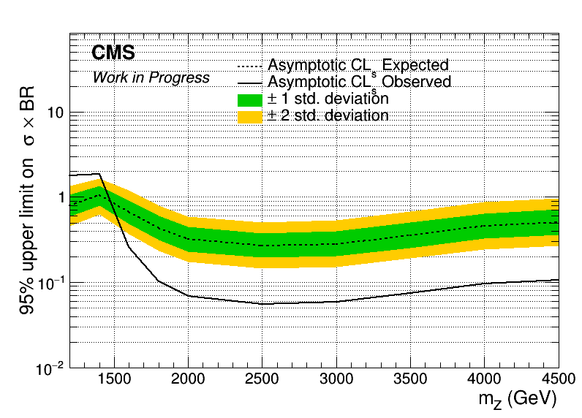
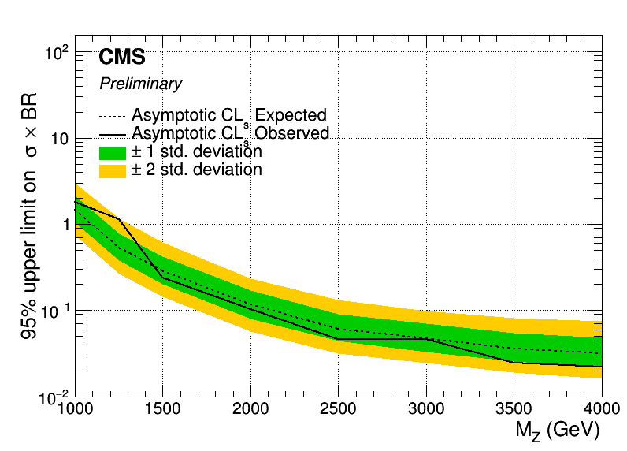
Angular Distributions (Brazilian Plot using extracted signal!!) vs B2G-16-015
Assymptotic limits for M Z’: 1.2, 1.4, 1.6, 1.8, 2, 2.5, 3, 3.5, 4, 4.5 TeV
Width 1%
2017
B2G-16-015

Slide 15
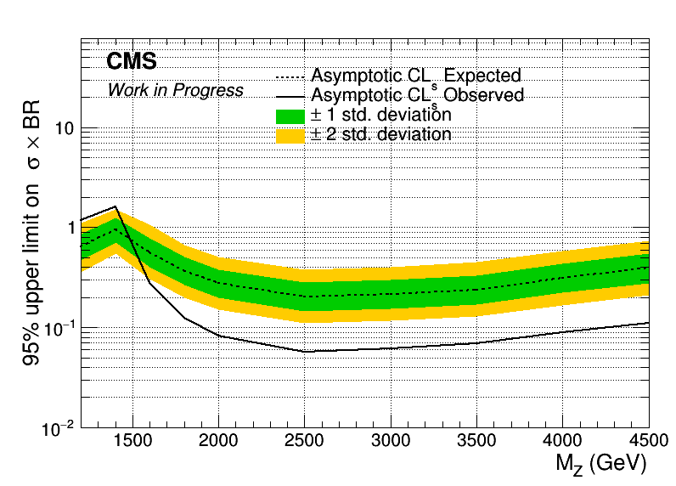
Angular Distributions (Brazilian Plot using extracted signal!!) vs B2G-16-015
Assymptotic limits for M Z’: 1.2, 1.4, 1.6, 1.8, 2, 2.5, 3, 3.5, 4, 4.5 TeV
Width 1%
2018
B2G-16-015

Slide 16
Signal Selection
Control Region Selection
Variables | Selected Cut
pT (both leading jets) | > 400 GeV
Njets | > 1
N leptons | = 0
|eta| (both leading jets) | < 2.4
mJJ | > 1000 GeV
jetMassSoftDrop (only for fit) | (50,300) GeV
Top Tagger | > 0.2, 0, 0.1
B tagging (2 btagged jets) | > Medium WP
Signal Trigger
Variables | Selected Cut
pT (both leading jets) | > 400 GeV
Njets | > 1
N leptons | = 0
|eta| (both leading jets) | < 2.4
mJJ | > 1000 GeV
jetMassSoftDrop (only for fit) | (50,300) GeV
Top Tagger | > 0.2, 0, 0.1
B tagging (0 btagged jets) | < Medium WP
Control Trigger

Slide 17
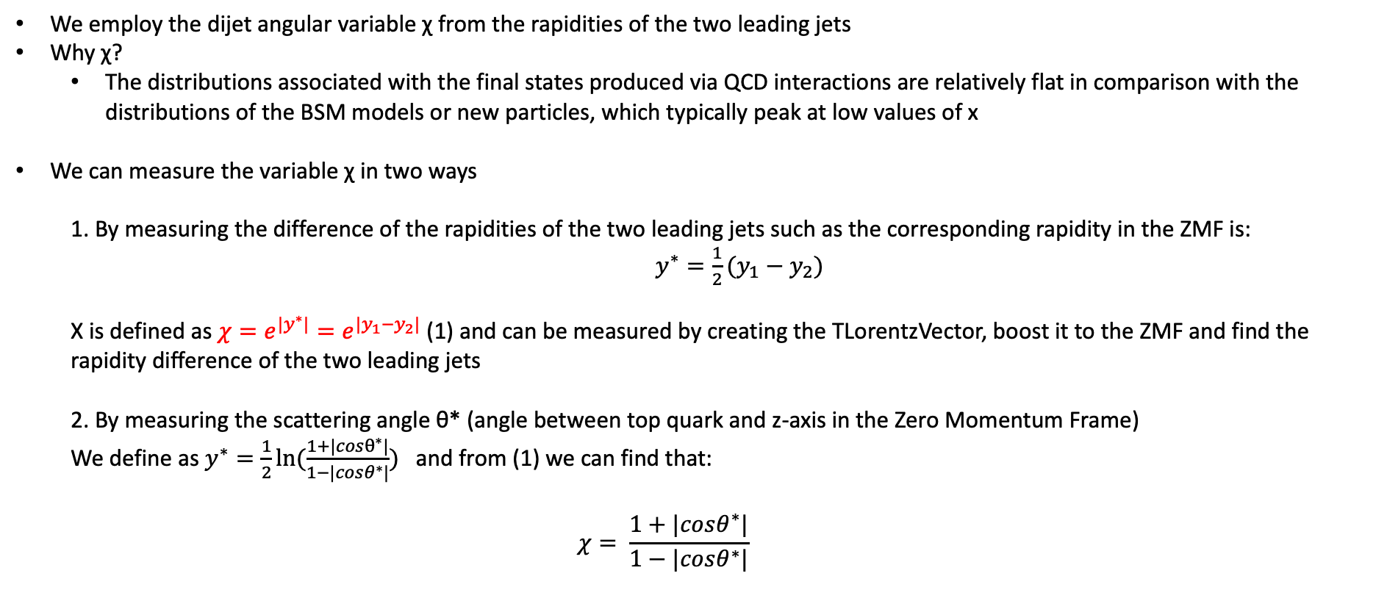
Top Angular Distributions
We employ the dijet angular variable χ from the rapidities of the two leading jets
Why χ?
The distributions associated with the final states produced via QCD interactions are relatively flat in comparison with the distributions of the BSM models or new particles, which typically peak at low values of x
We can measure the variable χ in two ways
1. By measuring the difference of the rapidities of the two leading jets such as the corresponding rapidity in the ZMF is: $y^{∗}=\frac{1}{2}(y_{1}−y_{2})$
Χ is defined as $χ=e^{{|y}^{∗}|}=e^{|y_{1}−y_{2}|}$ (1) and can be measured by creating the TLorentzVector, boost it to the ZMF and find the rapidity difference of the two leading jets
2. By measuring the scattering angle θ* (angle between top quark and z-axis in the Zero Momentum Frame)
We define as $y^{∗}=\frac{1}{2}ln⁡(\frac{1+|cosθ^{∗}|}{1−|cosθ^{∗}|})$ and from (1) we can find that:
$$χ= \frac{1+|cosθ^{∗}|}{1−|cosθ^{∗}|}$$

