Slide 1


HEP NTUA Top Angular Report 3/11/2020
George Bakas

Slide 2
Summary
New Signal Region:
SR_{C} = SR + mJJ > 1.5TeV
Contamination
Closure tests (qcd shape)
R_{yield} as transfer factor from SR to SR_{c} where the measurement is performed
Signal: S(x) for χ distribution (ttbar)
Stack histograms: (m_{Z’} 2, 2.5TeV and widths 1%, 10%)
Data vs MC (qcd scaled with k-factor to data)
TTbar scaled with signal strength
This plot can serve also as prefit distribution
Postfit distribution (m_{Z’} 2, 2.5TeV and widths 1%, 10%)
Asymptotic Limits (Brazilian plots)

Slide 3
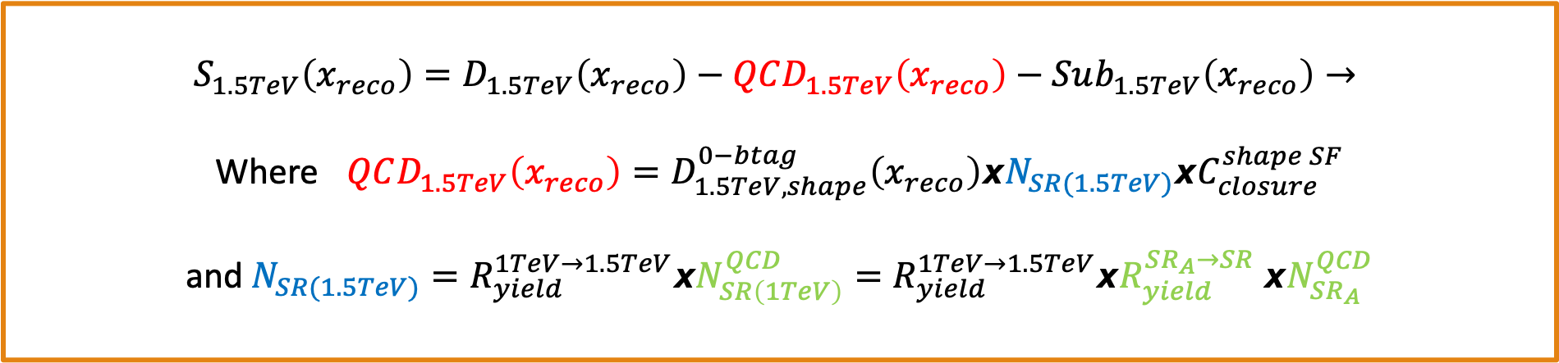
Signal Extraction
$$S_{1.5TeV}\left(x_{reco}\right)=D_{1.5TeV}\left(x_{reco}\right)−QCD_{1.5TeV}\left(x_{reco}\right)−Sub_{1.5TeV}\left(x_{reco}\right)→$$
Where $QCD_{1.5TeV}\left(x_{reco}\right)=D_{1.5TeV, shape}^{0−btag}\left(x_{reco}\right)xN_{SR(1.5TeV)}{xC}_{closure}^{shape SF}$
and $N_{SR(1.5TeV)}=R_{yield}^{1TeV→1.5TeV}xN_{SR\left(1TeV\right)}^{QCD}=R_{yield}^{1TeV→1.5TeV}xR_{yield}^{SR_{A}→SR} {xN}_{SR_{A}}^{QCD}$
The variable of interest here: x_{reco} → χ
1.5 TeV refers to the mJJ cut
We deploy a fit in the Signal Region (2btag) to extract the $N_{QCD}^{fit}$ in SRA (mJJ > 1TeV)
$$D{\left(m^{t}\right)}^{(i)}=N_{tt}^{(i)}T^{(i)}\left(m^{t},k_{MassScale}, k_{MassResolution}\right)+N_{bkg}^{(i)}B\left(m^{t} \right)\left(1+k_{1}x\right)+N_{sub}^{(i)}O^{(i)}\left(m^{t}\right)$$

Slide 4
Contamination Plots in New SR
mJJ > 1.5 TeV

Slide 5
Closure Tests in New SR (CR)
mJJ > 1.5 TeV

Slide 6
Ryields (with closure test) from mJJ > 1TeV region → 1.5TeV Signal Region

Slide 7
Angular Distributions
mJJ > 1.5 TeV

Slide 8
Angular Distributions (Prefit)
M_{z’} =2000, w = 1%
M_{z’} =2500, w = 1%
M_{z’} =2000, w = 10%
M_{z’} =2500, w = 10%

Slide 9
Cut Flow vs χ
M_{z’} =2000, w = 1%
M_{z’} =2500, w = 1%
M_{z’} =2000, w = 10%
M_{z’} =2500, w = 10%

Slide 10
Cut Flow vs JetMassSoftDrop (leading)
M_{z’} =2000, w = 1%
M_{z’} =2500, w = 1%
M_{z’} =2000, w = 10%
M_{z’} =2500, w = 10%

Slide 11
Cut Flow vs JetMassSoftDrop (subleading)
M_{z’} =2000, w = 1%
M_{z’} =2500, w = 1%
M_{z’} =2000, w = 10%
M_{z’} =2500, w = 10%

Slide 12
BACKUP

Slide 13
Signal Selection
Control Region Selection
Variables | Selected Cut
pT (both leading jets) | > 400 GeV
Njets | > 1
N leptons | = 0
|eta| (both leading jets) | < 2.4
mJJ | > 1000 GeV
jetMassSoftDrop (only for fit) | (50,300) GeV
Top Tagger | > 0.2, 0, 0.1
B tagging (2 btagged jets) | > Medium WP
Signal Trigger
Variables | Selected Cut
pT (both leading jets) | > 400 GeV
Njets | > 1
N leptons | = 0
|eta| (both leading jets) | < 2.4
mJJ | > 1000 GeV
jetMassSoftDrop (only for fit) | (50,300) GeV
Top Tagger | > 0.2, 0, 0.1
B tagging (0 btagged jets) | < Medium WP
Control Trigger

Slide 14
Angular Distributions (PostFit)
M_{z’} =2000, w = 1%
M_{z’} =2500, w = 1%
M_{z’} =2000, w = 10%
M_{z’} =2500, w = 10%

Slide 15
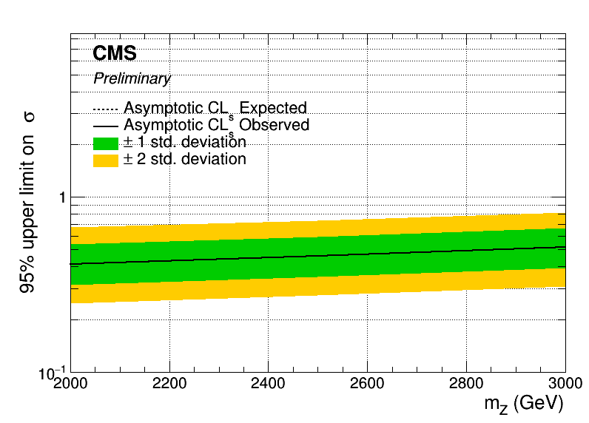
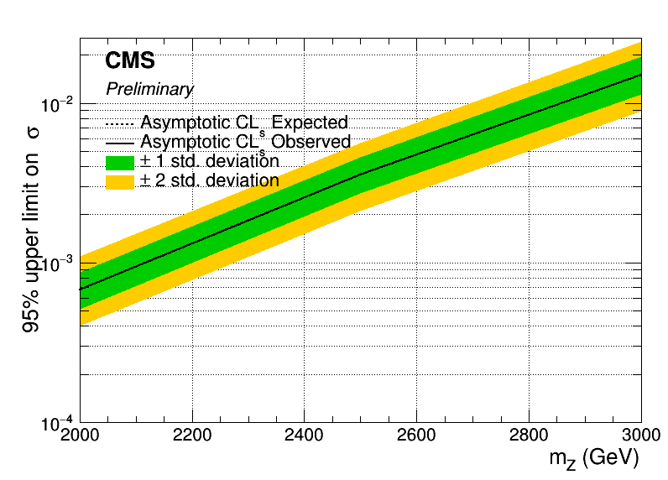
Angular Distributions (Brazilian Plot)
Assymptotic limits for M Z’: 2000, 2500, 3000:
Width 1% (left) and 10% (right)
ITS WRONG IT MUST BE TIMES THE BR ON Y AXIS

Slide 16
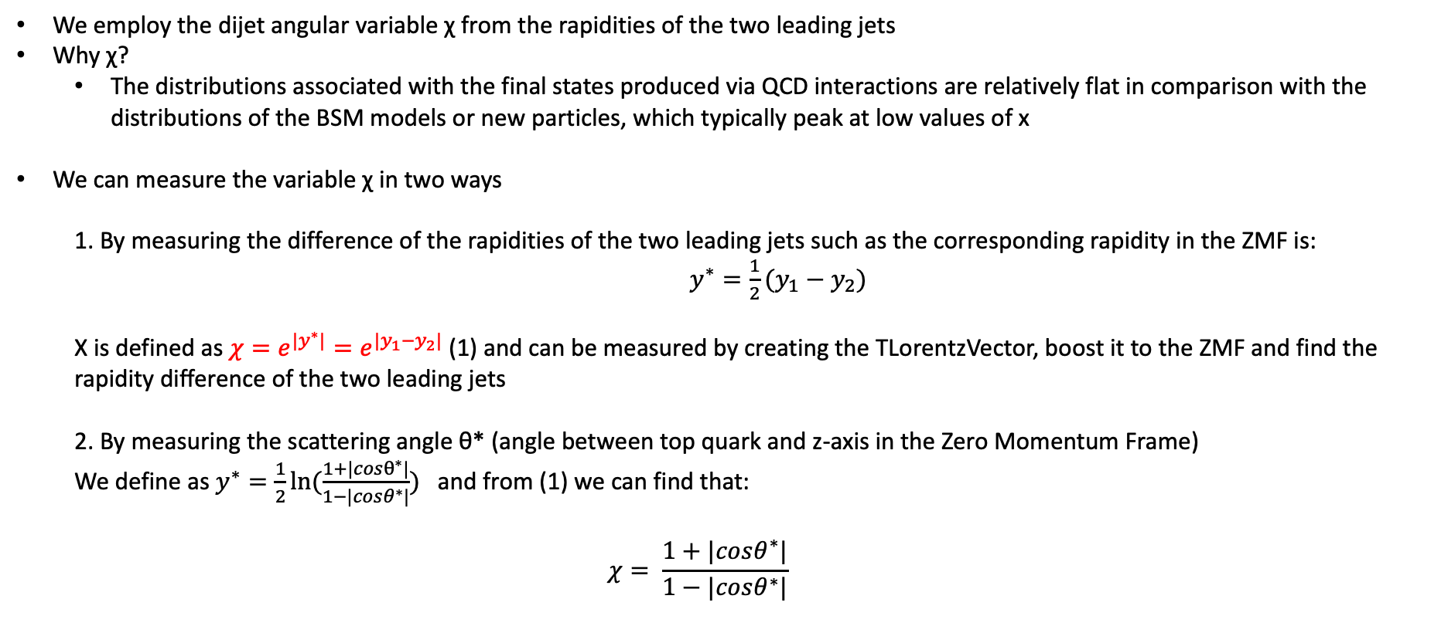
Top Angular Distributions
We employ the dijet angular variable χ from the rapidities of the two leading jets
Why χ?
The distributions associated with the final states produced via QCD interactions are relatively flat in comparison with the distributions of the BSM models or new particles, which typically peak at low values of x
We can measure the variable χ in two ways
1. By measuring the difference of the rapidities of the two leading jets such as the corresponding rapidity in the ZMF is: $y^{∗}=\frac{1}{2}(y_{1}−y_{2})$
Χ is defined as $χ=e^{{|y}^{∗}|}=e^{|y_{1}−y_{2}|}$ (1) and can be measured by creating the TLorentzVector, boost it to the ZMF and find the rapidity difference of the two leading jets
2. By measuring the scattering angle θ* (angle between top quark and z-axis in the Zero Momentum Frame)
We define as $y^{∗}=\frac{1}{2}ln⁡(\frac{1+|cosθ^{∗}|}{1−|cosθ^{∗}|})$ and from (1) we can find that:
$$χ= \frac{1+|cosθ^{∗}|}{1−|cosθ^{∗}|}$$

