Slide 1
Self Organisation in Dictyostelium Discoideum
Richard Hanes
Computational Physics

Slide 2
Presentation Overview
Life Cycle of Dictyostelium Discoideum
Motivation for Project
Model Implementation
Experiments and Results
Conclusions

Slide 3
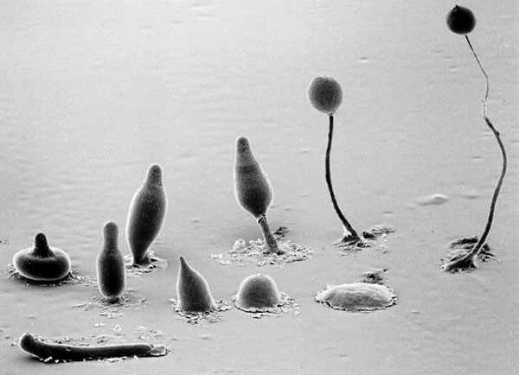
Dictyostelium Discoideum
Slime Mould that lives in top soil.
When food is scarce they aggregate and form slug.
Slug responds to heat and light (soil surface)
When slug stops it transforms into stalk and fruiting body.
Spores released form new amoeba.

Slide 4
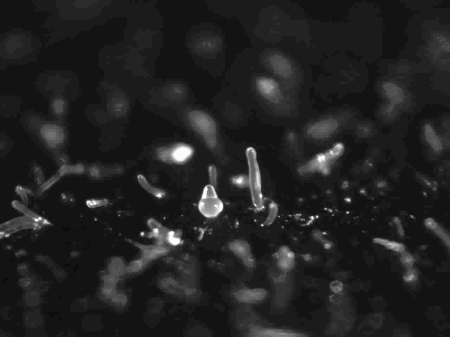

Slide 5
Project Motivation
Simulate the aggregation of Dictyostelium Discoideum using a Cellular Automata model
Recreate complex multi-cellular behaviour using simple rules
Investigate how this behaviour arises by experimenting with the model

Slide 6
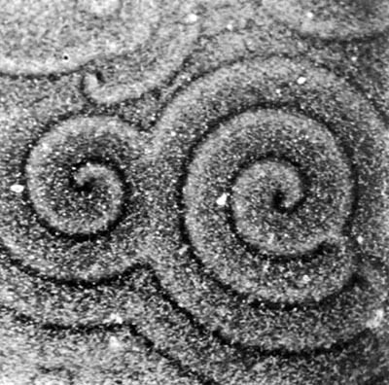
Implemented Processes
Differential Adhesion – Amoeba of different types stick together with different strengths.
Chemotaxis – Amoeba detect and move towards the source of chemical signal, cyclic Adenosine Monophosphate (cAMP).
cAMP Mediated cAMP Response – Amoeba emit cAMP when excited.

Slide 7
Amoeba States
Experimentally observed that amoeba can be in one of three distinct states:
Ready – Amoeba is stationary, cAMP receptors active
Excited – Amoeba moving chemo-tactically and emitting cAMP
Refractory – cAMP receptors desensitised, amoeba is stationary

Slide 8
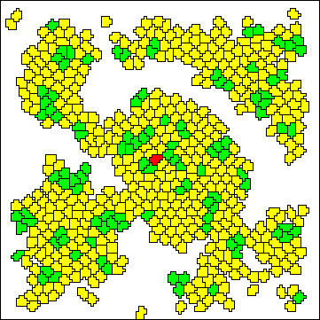
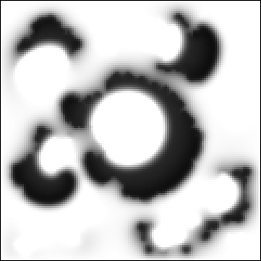
The Model
Amoeba are described by a Cellular Automata on a square lattice
cAMP dynamics controlled by a set of differential equations

Slide 9
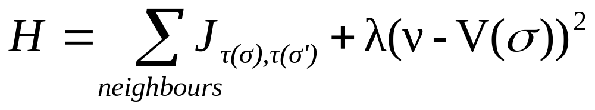
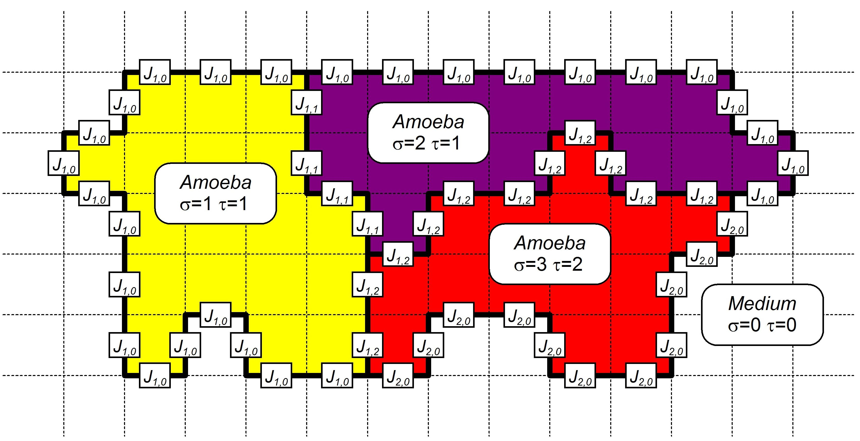
Cellular Automata

Slide 10
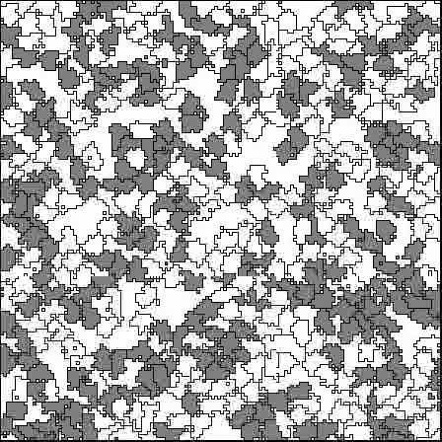
Cell Sorting
Cell sorting between two different types
In this example light cells prefer to be surrounded by dark cells and vice versa
Arrange themselves into a checkerboard pattern

Slide 11
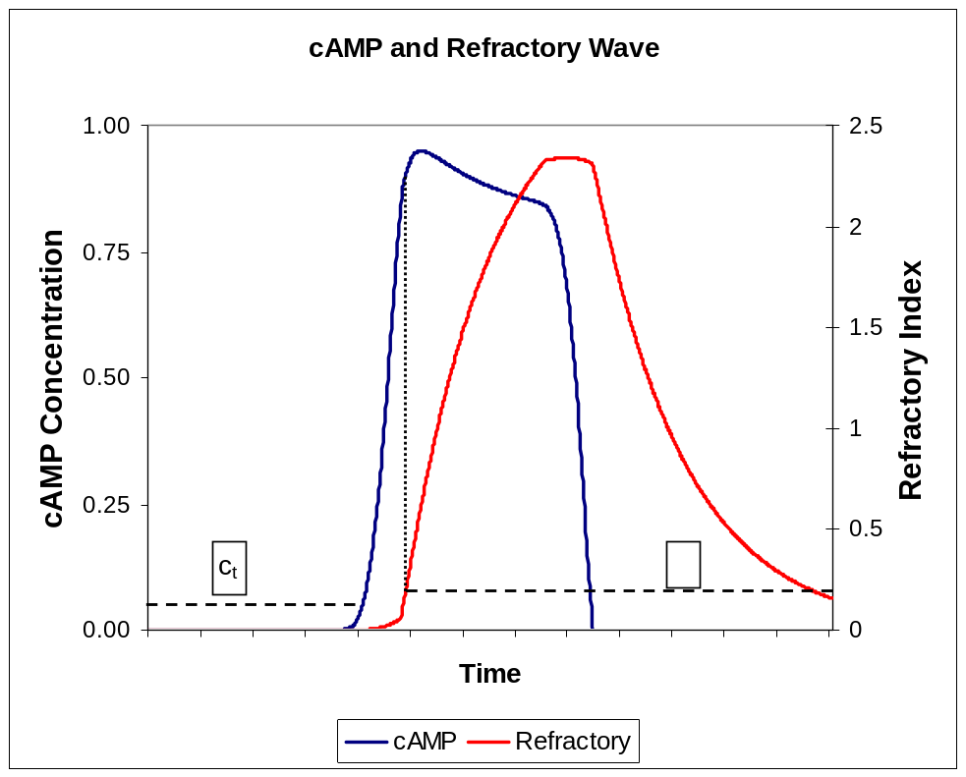
cAMP Dynamics
Implicit and Explicit models
Explicit – Amoeba dump cAMP directly to cAMP field
Implicit – Emission of cAMP controlled by excitable medium equations

Slide 12
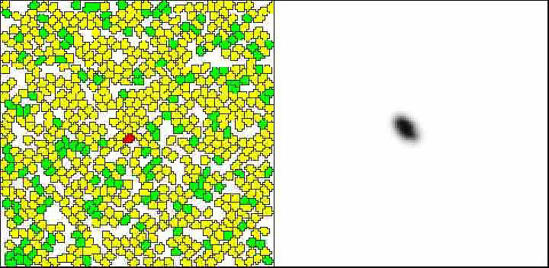
How do Spirals Form?
Caused by cAMP wave travelling round loop

Slide 13
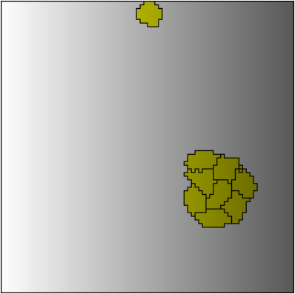
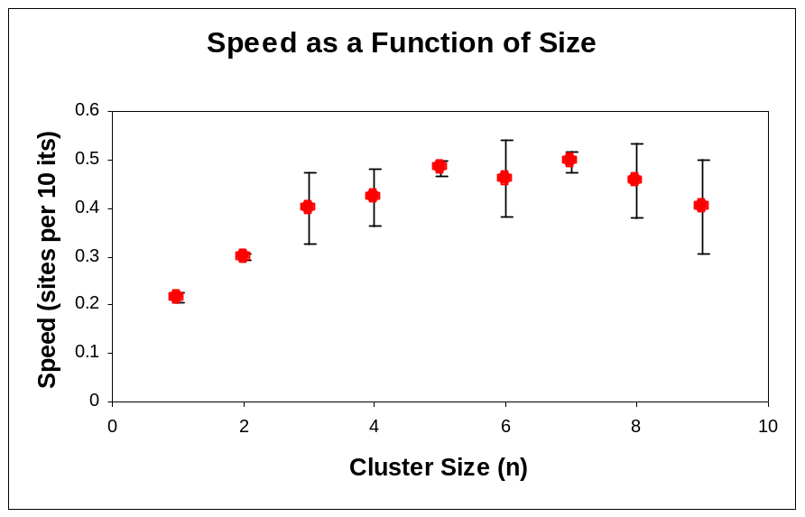
Why do Amoeba Group Together?
Synthetic Experiment with static cAMP field
Measure speed of amoeba clusters vs. the size of cluster
Individual amoeba travel slower than a group

Slide 14
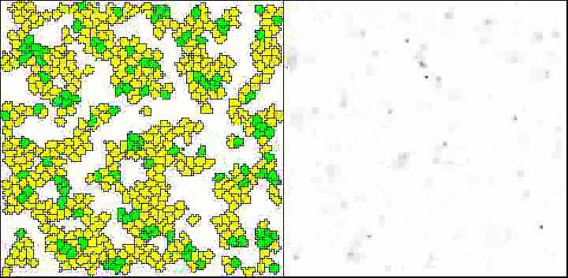
An Alternative Spiral Trigger
Random cAMP ‘Noise’ added each iteration

Slide 15
Conclusions
The model reproduces the behaviour of Dd amoeba using simple rules.
Experiments on the model can provide insight into the real organism.
Future work includes the extension to 3D and the inclusion of gravity to study the formation of the slug.

Slide 16
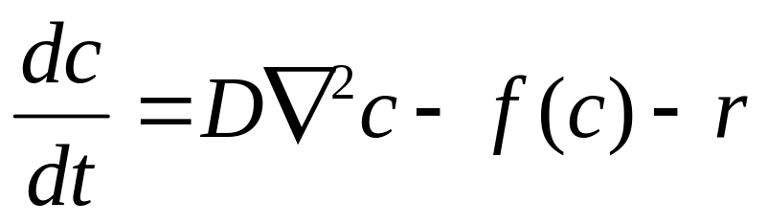
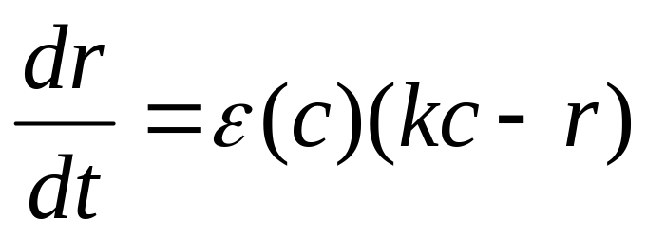
Fitzhugh-Nagumo equations

