Slide 1

Front End
用Python代码风格去写前端。

Slide 2
Front End ?
HTML HTML5
CSS CSS3
JavaScript
模块化 modular
复用 multiplex

Slide 3
Node.js
for easily building fast, scalable network applications.
编译调试环境
var http = require('http');
http.createServer(function (req, res) {
res.writeHead(200, {'Content-Type': 'text/plain'});
res.end('Hello World\n');
}).listen(1337, '127.0.0.1');
console.log('Server running at http://127.0.0.1:1337/');
node HelloWorld.js

Slide 4
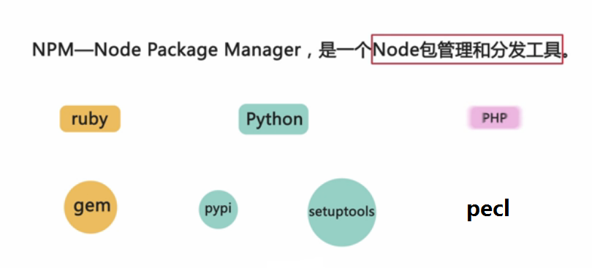
NPM
npm is the package manager for javascript.
npm install -g ...

Slide 5






Grunt
The JavaScript Task Runner

Slide 6
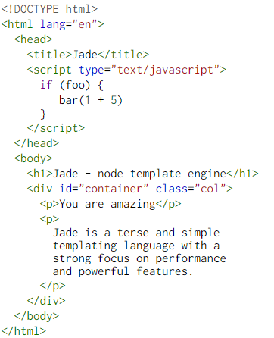
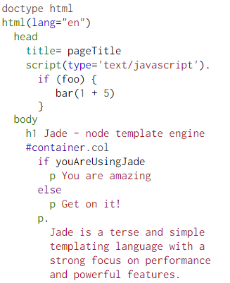
Jade
Node(html) Template Engine

Slide 7
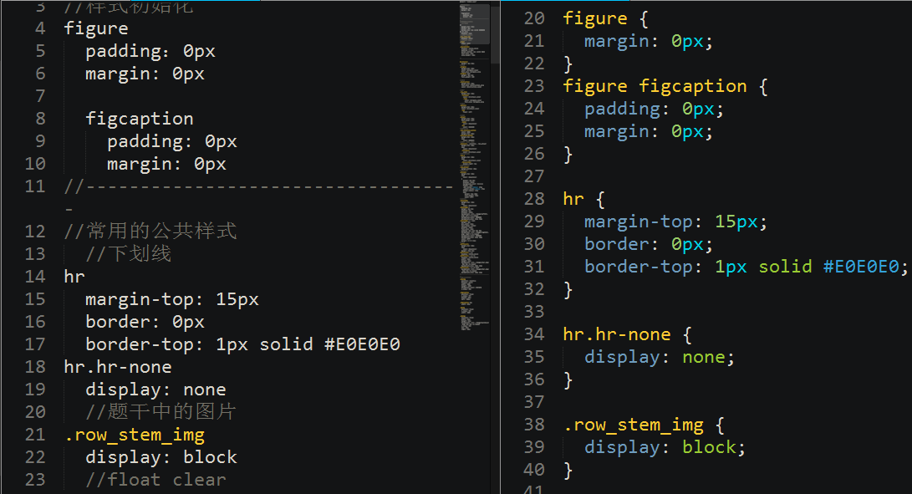
SASS
使得CSS开发更灵活和更强大

Slide 8
CoffeeScript
CoffeeScript is a little language that compiles into JavaScript.

Slide 9
MVC-AngularJS

Slide 10
Flux-REACT

