Slide 1
Movie Data Analysis from 2014 to 2018
Team Members:
Zeyu Yan
George Bendele
Mrinalini Darswal

Slide 2
Project Description
We will analyze all the movie data from 2014 to 2018 (the past 5 years) to see what interesting trends we can reveal. (Finished)
Extra: Train a classifier to classify the sentiment of movie reviews. The accuracy of the classifier should be at least over 85%. (Finished)
Optional: Analyze on all of the Marvel movie data to reveal interesting trends. (Data already gathered, but not enough time to finish)

Slide 3
Where to Get the Data?
Gather detailed movie information through OMDB API.
Crawl lists of movie names for each year from 2014 to 2018 through Wikipedia.
For IMDB movie reviews sentiment analysis, the training and testing data we used are from “Large Movie Review Dataset v1.0”, which is available from Kaggle.
Detailed Marvel movie data are also gathered through a combination of web crawling and OMDB API.

Slide 4
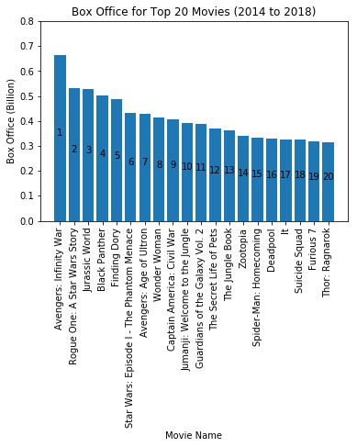
Top 20 Movies in Terms of Box Office
"Avengers: Infinity War" is the box office champion for the past 5 years.
"Rogue One: A Star War Story" and "Jurassic World" are the 2nd and 3rd.

Slide 5
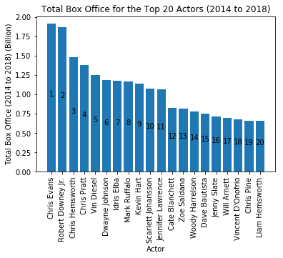
Top 20 Actors with the Highest Accumulative Box Office
Chris Evans is the accumulative box office champion for the past 5 years.
Robert Downey Jr. is right behind him and really close.

Slide 6
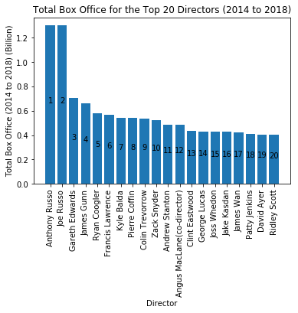
Top 20 Directors with the Highest Accumulative Box Office
Russo Brothers are the accumulative box office champion for the past 5 years.

Slide 7
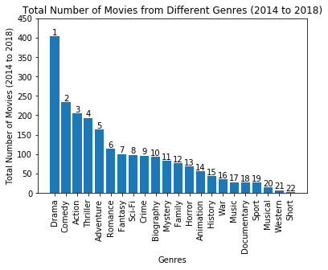
Total Number of Movies from Different Genres
The most popular genre for the past 5 years is "Drama".

Slide 8
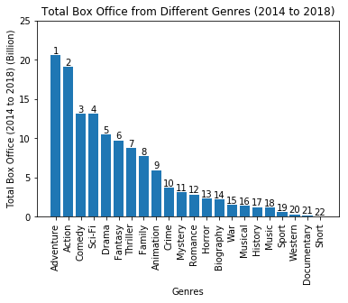
Total Box Office from Different Genres
The genre "Adventure" is the champion for the past 5 years, although the genre "Action" is really close.

Slide 9
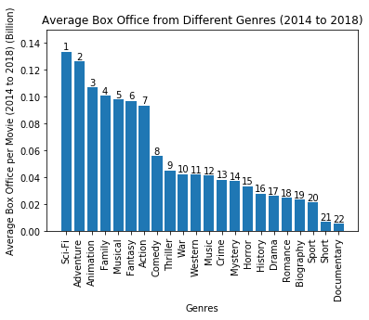
Average Box Office from Different Genres
The genre "Sci-Fi" is the champion for the past 5 years. "Adventure" is right behind it and really close.

Slide 10
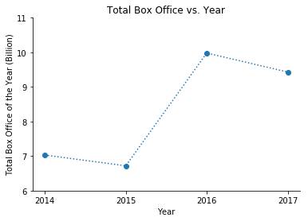
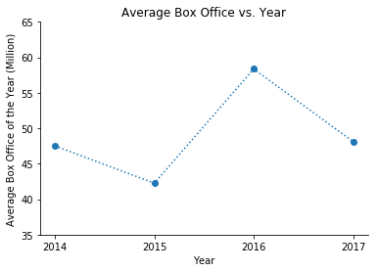
Total & Average Box Office Analysis
The data for 2018 is eliminated for this analysis due to the number of samples are not large enough.

Slide 11
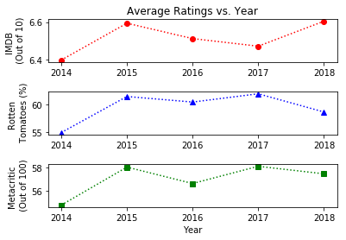
Average Ratings Analysis
The trend of rating from all 3 sources are basically the same.
Year 2015 has the lowest total and average box office, but has the highest average rating among the past 5 years.
This interesting result reveals that this is no direct relation between the rating of the movies and their box office.

Slide 12
IMDB Sentiment Classifier
Data Source: Large Movie Review Dataset v1. 0 available from Kaggle
Preprocessing: String Operations & Regular Expressions
Vectorization: TF-IDF

Slide 13
Baseline Algorithms
Method Name | 10-Fold Avg Accuracy | 10-Fold Accuracy STD
Logistic Regression | 0.8842 | 0.0058
Linear Discriminant Analysis | 0.8591 | 0.0067
Decision Tree | 0.7130 | 0.0065
Gaussian Naive Bayes | 0.8003 | 0.0094
Linear SVC | 0.8746 | 0.0065

Slide 14
Further Parameter Tuning
C Value for LR | 10-Fold Avg Accuracy | 10-Fold Accuracy STD
0.01 | 0.8429 | 0.0074
0.05 | 0.8590 | 0.0070
0.25 | 0.8764 | 0.0064
0.5 | 0.8814 | 0.0057
1 | 0.8842 | 0.0058
Final Test on Testing Dataset:
Logistic Regression: 88.08%
Linear SVC: 87.78%
Therefore, we finally pick LR over LSVC.
C Value for LSVC | 10-Fold Avg Accuracy | 10-Fold Accuracy STD
0.01 | 0.8659 | 0.0068
0.05 | 0.8825 | 0.0053
0.25 | 0.8837 | 0.0040
0.5 | 0.8789 | 0.0041
1 | 0.8746 | 0.0065

Slide 15
Film Genre Diversity by Actor
Here we look at 50 actors who performed in 5 or more films from 2013 to 2018 to evaluate diversity of roles based on film genre, which may be a measure of "type casting."
Movie data from the years 2013 through 2018 were pulled from the Open Movie Database (OMDB) for use in this analysis. For each film in the data set, the first 3 genre keywords listed for each film were used in the assessment.

Slide 16
Genre Frequency
For the 50 actors analyzed, the genres of drama, comedy, action, and adventure topped the list as most frequently sited (Figure 1), which was not surprising.
Biography held the fifth place spot, which was an interesting finding.

Slide 17
Genre Score
Genre mobility was assessed by determining the number of films each actor performed in during the analysis period and quantifying the unique genre keywords associated with those films.
A genre score was derived by subtracting the film count from the genre count and then normalizing the resulting value to the difference in genre/film count means. The resulting score was intended to quantify an individual actor's genre mobility compared to the group as a whole.

Slide 18
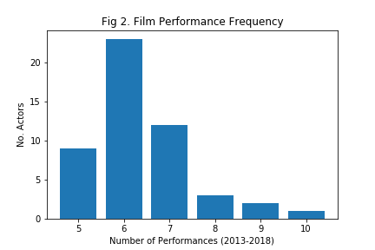
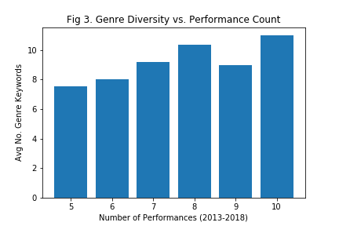
Distribution
The majority of actors (44 out of 50) performed in 5 to 7 films during the study period with only 6 actors performing in 8 or more films (Figure 2).
As expected, film genre diversity generally increased with the number of performances (Figure 3)

Slide 19
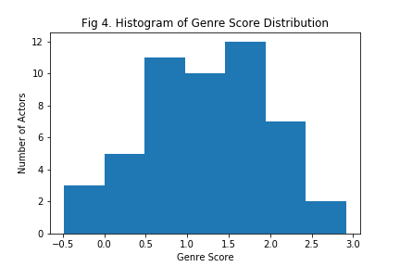
A histogram of genre scores shows that genre mobility across the data set was generally normally distributed (Figure 4).

Slide 20
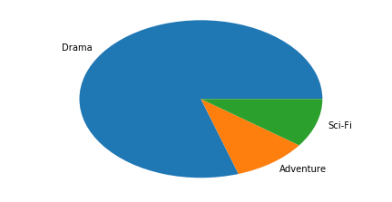
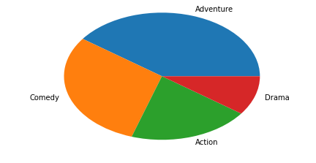
Ranking by Genre Count
The top 10 actors by genre count had drama as their primary listed genre (Figure 5).
The bottom 10 actors by genre count had adventure as their primary listed genre followed by comedy and action (Figure 6).

Slide 21
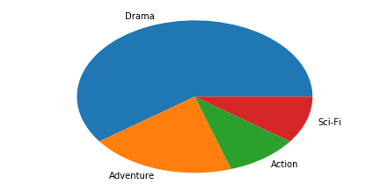
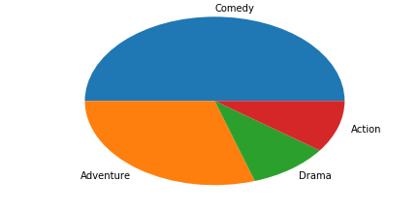
Ranking by Genre Score
When assessed by genre score, the top 10 actors had the same primary genre (drama) (Figure 7).
Whereas, the bottom 10 actors had comedy as the primary genre (Figure 8).

Slide 22
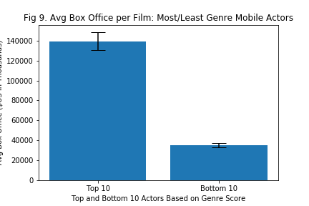
Genre Mobility and Box Office
Average box office per film was statistically significantly greater (p value<0.001) for actors that were highly genre mobile as compared to those with low genre mobility (Figure 9).

Slide 23
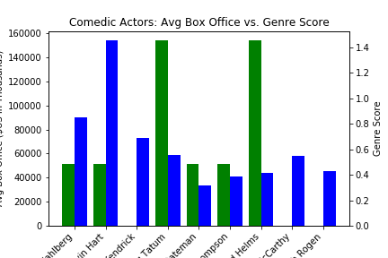
What's Up With Comedy?
Singling out primarily comedic actors, we can see that higher average box office receipts for primarily comedic actors generally correspond to lower genre mobility scores and vice versa (Figure 10).

Slide 24
Genre Mobility Conclusions
This analysis suggests that genre mobility is more prevalent among actors with primarily dramatic film roles as compared to those with primarily comedic roles. This could be the result of type casting or studio pressure to keep comedians in their lane, where they generate more profits, or it could be a result of comedians choosing to focus on these roles.
Actors with the most genre diverse roles had statistically significantly increased mean box office returns compared to the least genre mobile actors, which also suggests that an actors box office draw (i.e., star power) plays a role in their ability to successfully move between genre types.
Further investigation should include better means of quantifying genre mobility, longer timeframes, regression analysis to determine correlations, and incorporation of film ratings to determine if awards and acknowledgements affect genre mobility. Additionally, weighting the genre classifications and analyzing whether the actor had a leading or supporting role in the film could enhance the analysis

Slide 25

Thank You!

