Slide 1



SUPPLY CHAIN MANAGEMENT DASHBOARD
George Mathew
25th October 2024

Slide 2

Outline
Executive Summary
Introduction
Methodology
Results
Conclusion

Slide 3
Executive Summary
Summary of methodologies
Data Collection through csv file downloaded using link for Exploratory Data Analysis and analysing Product Performance and Supply Chain Efficiency.
Data Wrangling after importing data into SQLite and using SQL for sampling data, dealing with Nulls, ‘0’ and blank values.
Exploratory Data Analysis by creation of visualization dashboards and story in Tableau.
Summary of all results
Exploratory Data Analysis result.
Analysis of Product Performance and Supply Chain Efficiency

Slide 4
Introduction
Project background and context
Problem Statement
Supply chain analytics is a valuable part of data-driven decision-making in various industries such as manufacturing, retail, healthcare, and logistics. It is the process of collecting, analyzing and interpreting data related to the movement of products and services from suppliers to customers. The dataset collected from a Fashion and Beauty startup is based on the supply chain of Makeup products.
Task - 1
Dataset Preparation:
>> Ensure that your dataset contains all the columns mentioned: Product Type, SKU, Price, Availability, Number of products sold, Revenue generated, Customer demographics, Stock levels, Lead times, Order quantities, Shipping times, Shipping carriers, Shipping costs, Supplier name, Location, Lead time, Production volumes, Manufacturing lead time, Manufacturing costs, Inspection results, Defect rates, Transportation modes, Routes, Costs.

Slide 5
Project background and context contd/-
Task - 2
Create the following visualizations:
2.1. Product Performance Dashboard:
a) Product Sales: Create a bar chart showing Number of products sold for each Product Type.
b) Revenue Analysis: Create a line chart showing Revenue generated over time. Filter by Product Type to see how different products are performing.
c) Price Distribution: Use a histogram to show the distribution of Price for different Product Types.
d) Stock Levels: Create a heat map to visualize Stock levels across different SKU and Product Type.
2.2. Supply Chain Efficiency Dashboard:
a) Lead Times vs. Order Quantities: Use a scatter plot to analyze the relationship between Lead times and Order quantities across different Supplier names.
b) Shipping Costs by Carrier: Create a bar chart showing Shipping costs per Shipping carrier. Filter by Location to see regional differences.
c) Manufacturing Efficiency: Create a dual-axis chart with Manufacturing lead time on one axis and Production volumes on the other to analyze manufacturing efficiency over time.
d) Defect Rates: Create a pie chart or a bar chart to visualize Defect rates by Supplier name or Location.

Slide 6
Project background and context contd/-
Task - 2
2.3. Customer Demographics:
a) Demographic Breakdown: Create a demographic distribution chart (such as a pie chart or stacked bar chart) to show the breakdown of customers by age group, gender, or other available demographics.
b) Revenue by Demographics: Use a treemap to show Revenue generated segmented by Customer demographics.
Task - 3
3.1. Analysis Questions:
a) Which Product Type generates the highest revenue ?
b) Are there any significant correlations between Lead times and Order quantities ?
c) How do Shipping costs vary by Shipping carrier and Location ?
d) Which suppliers have the most efficient manufacturing processes based on Manufacturing lead time and Production volumes ?
e) What demographic group contributes the most to sales ?
Task - 4
4.1. Storytelling:
>> Combine the above visualizations into a Tableau story that walks through product performance and supply chain efficiency, highlighting key insights.

Slide 7
Section 1

Slide 8
Methodology
Executive Summary
Data collection methodology:
Data was collected using the download link provided.
Perform data wrangling
Wrangling done using Sampling data and dealing with Nulls, ‘0’ and blank values.
Perform exploratory data analysis (EDA) using dashboards visualisations.
Perform analysis of factors affecting crop production and also predicting crop production.
By preparing charts in Tableau, dashboards and the story, analysis of Product Performance and Supply Chain Efficiency is done.

Slide 9
Data Collection and its Presentation
Data was collected using the download link provided.
Inspecting Data: Check the types and initial content.
Wrangling done using Sampling data and dealing with Nulls, ‘0’ and blank values. (Details as per Appendix – 1)
Creation of Calculated Fields: Calculated fields were created for preparation of various charts.

Slide 10
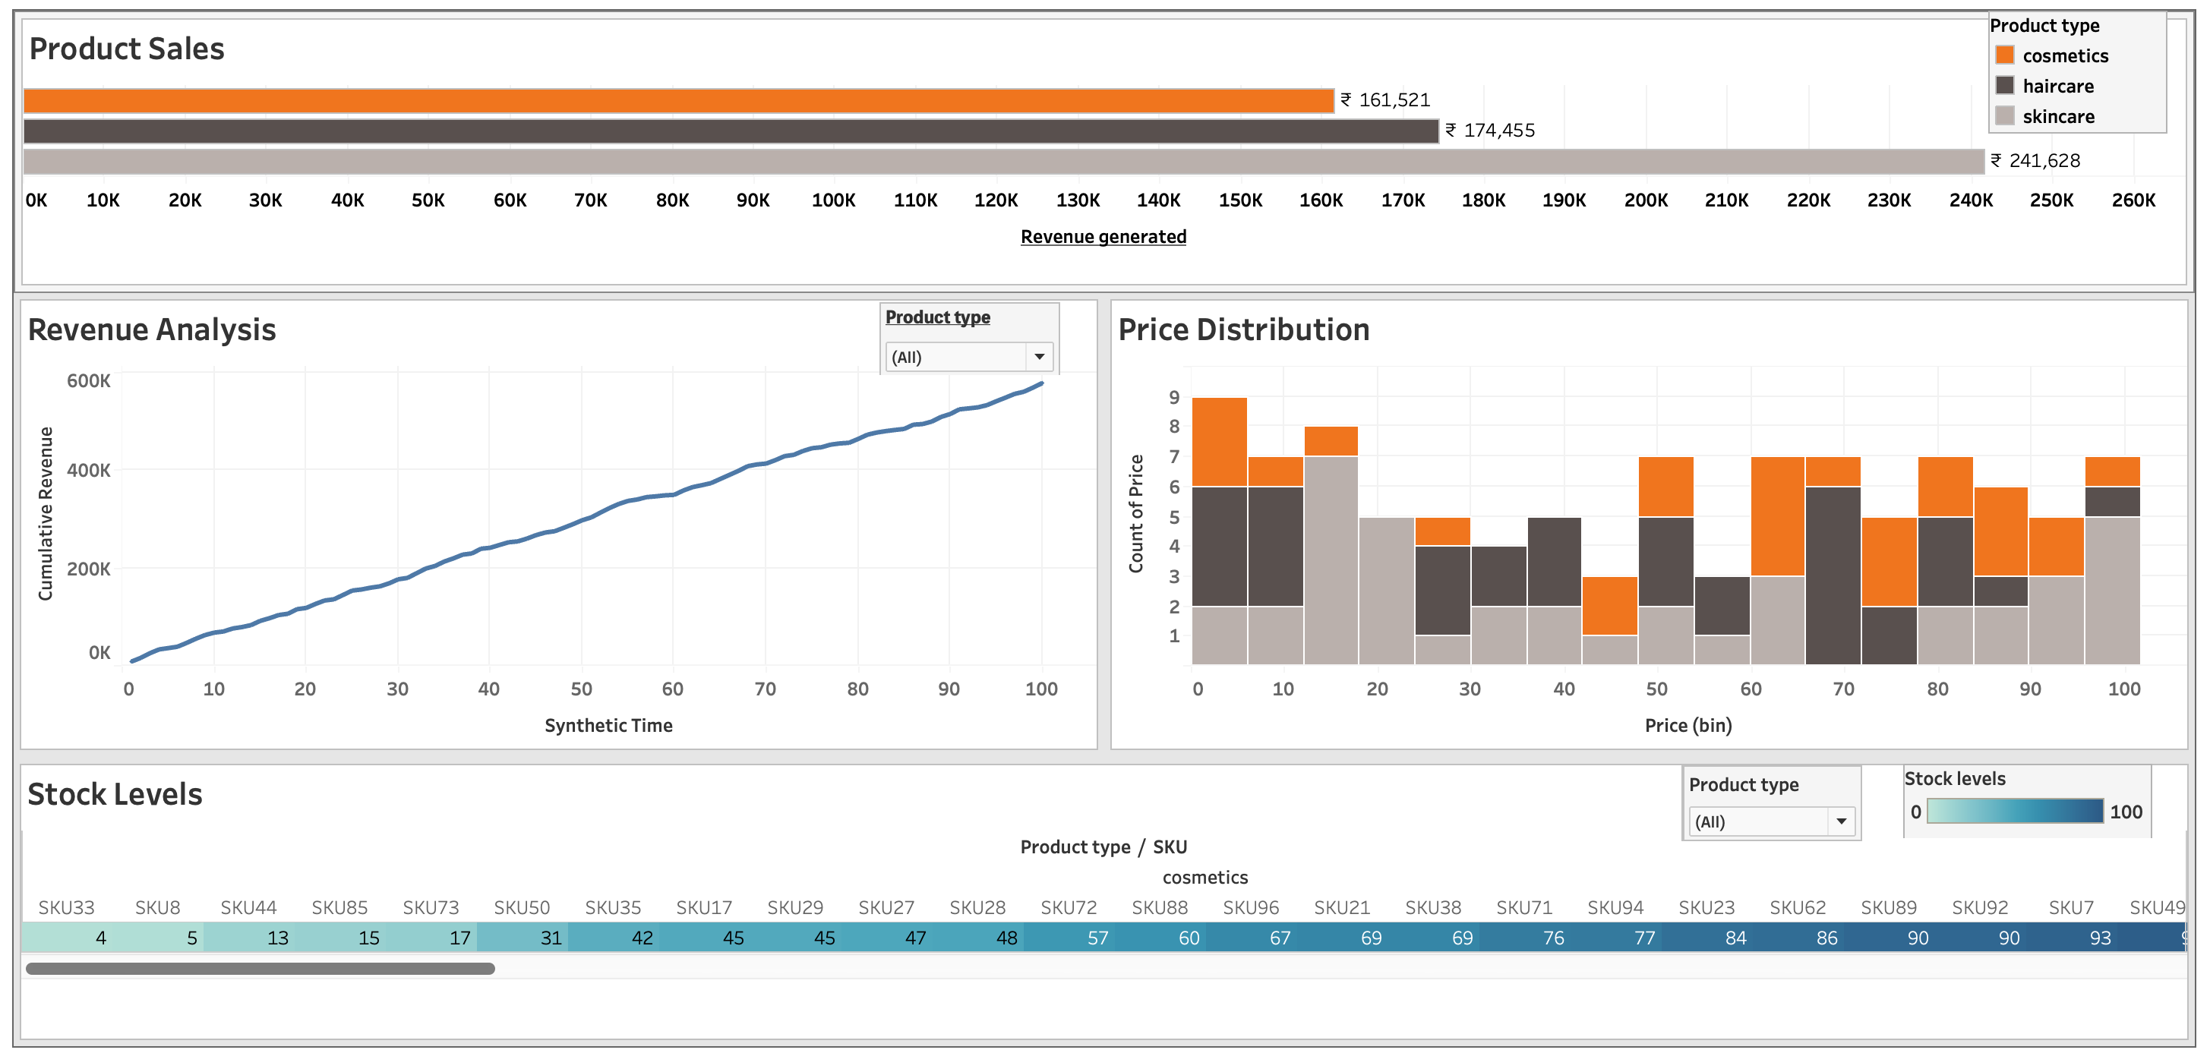
EDA with Data Visualisation
Dashboards used to make Story – Page - 1

Slide 11
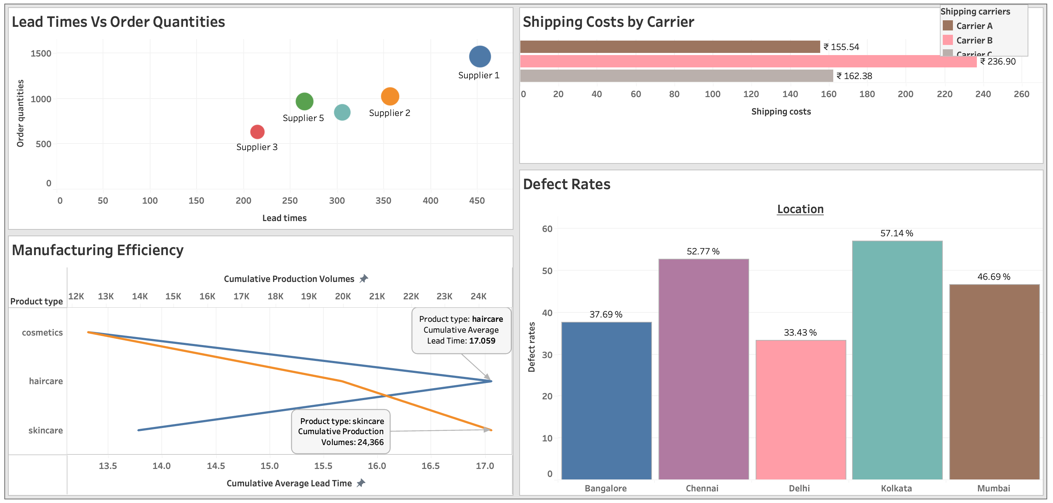
EDA with Data Visualisation
Dashboards used to make Story – Page - 2

Slide 12
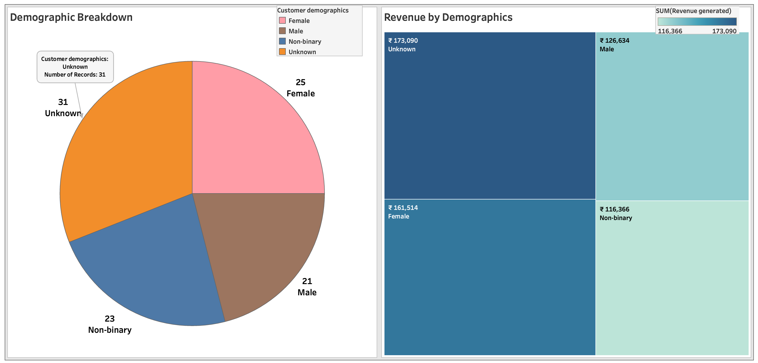
EDA with Data Visualisation
Dashboards used to make Story – Page - 3

Slide 13
Section 2

Slide 14
Results
Exploratory data analysis results
Using Exploratory Data Analysis the analysis of Product Performance and Supply Chain Efficiency is done.
Story – Page - 1
>> The Bar chart of Product sales shows ‘skincare’ as the product having the highest sales revenue of ₹ 241,628 and the next being ’haircare’ with sales revenue of ₹ 174,455, the sales revenue of ‘cosmetics’ is ₹ 161521.
>> The line chart of product-wise as-well-as overall revenue analysis depicts an almost 45% line leading to the conclusion that over a period the sales revenue has been increasing consistently.
>> The Bar chart of Price Distribution shows ‘skincare’ as the product having the highest product sales in the price range ₹ 10 to ₹ 20 and ₹ 90 to ₹ 100 while that of ‘haircare’ it is ₹ 65 to ₹ 80 and that of ‘cosmetics it is ₹ 0 to ₹ 5, ₹ 60, and ₹ 70 to ₹ 85.
>> The granular product-wise heat map for stock levels depicts the granular stock levels of each category of product and can be understood based on the visualization of the intensity of the colour.
Story – Page - 2
>> The Scatter plot of Lead times Vs Order quantities depicts that the Supplier 1 has the highest lead time and Order quantities while the Supplier 3 has the lowest lead times and Order quantities.

Slide 15
Results
Exploratory data analysis results
Story – Page – 2 contd/-
>> The Bar chart of Shipping costs by Carrier depicts that Carrier B has the highest shipping cost of ₹ 236.90 while Carrier C has a shipping cost of ₹ 162.38 and the Carrier A has the lowest shipping cost of ₹ 155.54.
>> The Dual Axis chart prepared for Manufacturing Efficiency shows the relation of Product Types to Production Volumes and Lead Times.
>> The Bar chart of defect rates location-wise shows that the highest defect rates of 57.14% is at the location Kolkata while the lowest defect rates of 33.43% is at the location Delhi.
Story – Page – 3
>> The Pie chart of Demographic breakdown shows the Customer demographics “Unknown” having the largest value of 31 and another category ‘Non-binary’ having a value of 23. As these two categories constitute together constitute 54% of the total these were shown as separate categories. The reason for showing it as such is explained in detail in Appendix – 1. For the remaining categories Female with 25 and Male with 21 constitutes 46% of the demographic distribution.
>> The Tree map of Revenue by Demographics shows the revenue under different demographic categories as “Unknown” ₹ 173090, “Female” ₹ 161514, “Male” ₹ 126634, and “Non-binary” ₹ 116366, in the decreasing order.

Slide 16
Section 3

Slide 17
Conclusions
At the beginning of the project, we defined the tasks that were to be performed.
Task - 1
Dataset Preparation:
>> Ensure that your dataset contains all the columns mentioned: Product Type, SKU, Price, Availability, Number of products sold, Revenue generated, Customer demographics, Stock levels, Lead times, Order quantities, Shipping times, Shipping carriers, Shipping costs, Supplier name, Location, Lead time, Production volumes, Manufacturing lead time, Manufacturing costs, Inspection results, Defect rates, Transportation modes, Routes, Costs.
Answer:
Using SQLite in DBeaver the CSV data file was analysed and it was ensured that the data set contains all the columns mentioned.

Slide 18
Conclusions
Task - 2
Create the following visualizations:
2.1. Product Performance Dashboard
2.2. Supply Chain Efficiency Dashboard
2.3. Customer Demographics
Answer:
All the three dashboards were prepared and the images have been included on to the slides in this presentation.
The Tableau PublicLink of the work is
https://public.tableau.com/views/SupplyChainManagementDashboardWorkbook/Story1?:language=en-GB&:sid=&:redirect=auth&:display_count=n&:origin=viz_share_link
Task - 3
3.1. Analysis Questions:
Which Product Type generates the highest revenue ?
Answer:
Skincare is the product having the highest sales revenue of ₹ 241,628

Slide 19
Conclusions
Task - 3
3.1. Analysis Questions: contd/-
b) Are there any significant correlations between Lead times and Order quantities ?
Answer:
On drawing a trend-line we observe that the points in the scatter plot are very near to the trend line which is almost having 45% gradient from which we can conclude that there is significant correlation between Lead times and Order quantities as with increase in Order quantities the Lead times also increases.
c) How do Shipping costs vary by Shipping carrier and Location ?
Answer:
Yes, the shipping costs vary by Shipping carrier and Location. Carrier B has the highest shipping cost of ₹ 236.90 while Carrier C has a shipping cost of ₹ 162.38 and the Carrier A has the lowest shipping cost of ₹ 155.54.
Location-wise the shipping costs varies; the highest shipping cost is of Carrier B for Kolkata location of ₹ 66.09 and the lowest is of Carrier C for Bangalore location of ₹ 17.27. For Carrier A the highest shipping cost is for Bangalore of ₹ 39.66 and lowest is for Delhi of ₹ 25.33. For Carrier B the highest shipping cost is for Kolkata of ₹ 66.09 and lowest is for Chennai of ₹ 28.01. For Carrier C the highest shipping cost is for Kolkata of ₹ 50.29 and lowest is for Bangalore of ₹ 17.27.

Slide 20
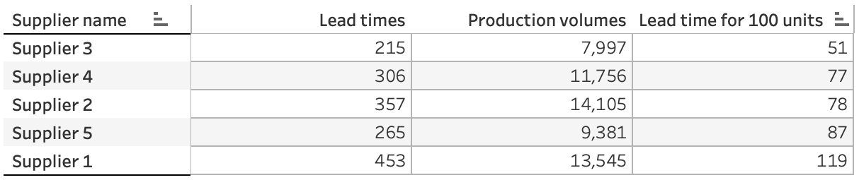
Conclusions
Task - 3
3.1. Analysis Questions: contd/-
d) Which suppliers have the most efficient manufacturing processes based on Manufacturing lead time and Production volumes ?
Answer:
In the manufacturing efficiency chart showing the Supplier-wise Lead times line and Supplier-wise Production volume line which we created using using Dual Axis chart, we can look for the apparent gap between the two lines, however, a better way to find out the supplier having the most efficient manufacturing process is to created a calculated filed for “lead time for 100 units’ and find out the supplier with the lowest value. This we can do using the text table which depicts as below :
We find that in case of supplier 3 the lead time for 100 units is the lowest at 51, so we can conclude that Supplier 3 has the most efficient manufacturing process.
e) What demographic group contributes the most to sales ?
Answer:
We have created a Tree map of Revenue by Demographics showing the revenue under different demographic categories as “Unknown” ₹ 173090, “Female” ₹ 161514, “Male” ₹ 126634, and “Non-binary” ₹ 116366, in the decreasing order. Therefore, the group ‘Unknown’ contributes the most to sales.

Slide 21
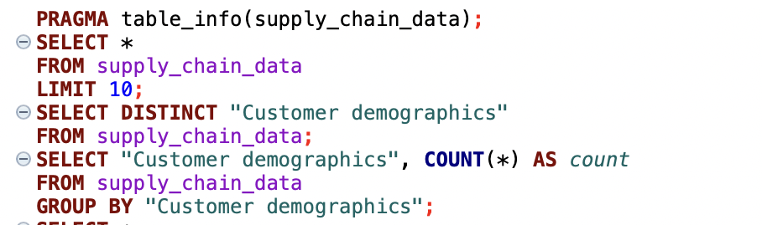
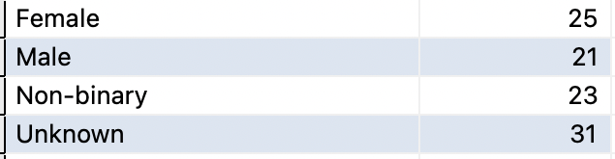
Appendix - 1
In Data Wrangling Step, using SQLite in DBeaver the following queries were run and the sample output is as under :
The Fields were also examined, the fields with their details and the steps taken post analysis are :
Field Name Sample Data Type ‘0’ / null / blank
'Product Type', haircare VARCHAR(50) NIL
‘SKU', SKU0 VARCHAR(50) NIL
'Price', 69.80800554211577 REAL NIL
'Availability', 55 INTEGER NIL

Slide 22
Appendix - 1
The Fields were also examined, the fields with their details and the steps taken post analysis are :
contd/-
Field Name Sample Data Type ‘0’ / null / blank
'Number of products sold', 803 INTEGER NIL
'Revenue generated', 8661.996792392383 REAL NIL
'Customer demographics', Non-binary / Male / VARCHAR(50) NIL
Female / Unknown
'Stock levels', 58 INTEGER NIL
'Lead times', 7 INTEGER NIL
'Order quantities', 96 INTEGER NIL
'Shipping times', 4 INTEGER NIL
'Shipping carriers', Carrier B VARCHAR(50) NIL
'Shipping costs', 2.956572139430807 REAL NIL
'Supplier name', Supplier 3 VARCHAR(50) NIL
'Location', Mumbai VARCHAR(50) NIL
'Lead time', 23 INTEGER NIL
'Production volumes', 215 INTEGER NIL
'Manufacturing lead time', 29 INTEGER NIL

Slide 23
Appendix - 1
The Fields were also examined, the fields with their details and the steps taken post analysis are : contd/-
Field Name Sample Data Type ‘0’ / null / blan
'Manufacturing costs', 46.27987924050832 REAL NIL
'Inspection results', Pending / Fail VARCHAR(50) NIL
'Defect rates', 0.22641036084992516 REAL NIL
'Transportation modes', Road / Air / Rail / Sea VARCHAR(50) NIL
'Routes', Route B VARCHAR(50) NIL
'Costs'. 187.75207545920392 REAL NIL
On analysis of the data we find that the numbers of different values in ‘Customer demographics’ field as Female = 25, Male = 21, Non-binary = 23, Unknown = 31 i.e. Unknown and Non-binary being 23% and 31% respectively. Given that more than 50% of the data is either "Non-binary" or "Unknown," we should not discard them. The choice between merging them into a broader category like "Other/Unspecified" or redistributing them proportionally to "Male" and "Female" depends on our analysis goals:

Slide 24
Appendix - 1
The Fields were also examined, the fields with their details and the steps taken post analysis are : contd/-
If simplicity and clarity are important, merging into "Other/Unspecified" might be a good approach.
If we want to work with the data in its most detailed form, we can keep them as separate categories and report the findings accordingly.
As we feel that removing or replacing these values could bias the analysis, we have retained them and have handled the visualization in Tableau:
In Tableau, we have created a separate category for "Non-binary" and "Unknown" but have highlighted that these may represent unknown or alternative gender identities.
This could give us a more inclusive and informative analysis.
Thus, after examining the dataset (csv file) using SQLite we have concluded that no such data wrangling is, required and the csv file can be uploaded into Tableau for preparation of Charts and making the story.

Slide 25
THANK YOU

