Slide 1
FlashStash
George Calvert

Slide 2
Overview
Application for users to create, share, like, and save Study Sets
Easy non physical way of studying for certain tests and classes
Allows user to share for group studies or even to help other classmates

Slide 3
Demo

Slide 4
ER Diagram Walkthrough

Slide 5
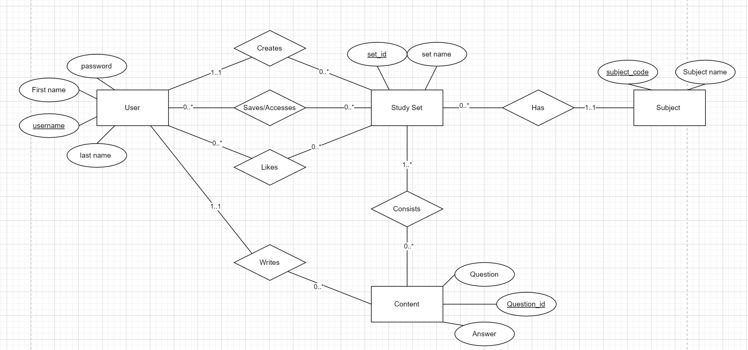

Slide 6
Tables/Schema Walkthrough

Slide 7
Query Walkthrough
Filtering Study Set Queries
Top Ranking Users
Most Active Users

Slide 8
Testing
Integration Testing
User testing

Slide 9
Challenges
Filtering Study Sets when browsing
Only having one frame open the entire time
Frame/panel layouts
Creating Study Sets
Minor issue when trying to study an empty set and not closing pop-up

Slide 10
Future of FlashStash
Improve overall looks
Allow users to search for certain Study Set names or Usernames
Improve UI for creating sets (a little confusing on which button to click)
Improve performance
Make code more modular

