Slide 1


Slide 2
Class outline
Android Studio layout
UI Tools
Recycler Views
Main Activity
Adapter class
Adding and Removing
Persistence
Edit Items

Slide 3
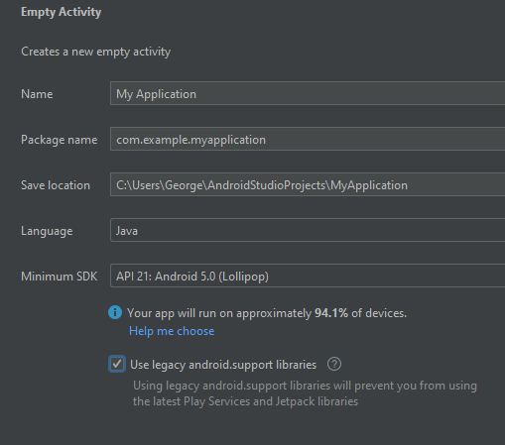
Configure the application
Open New project
Select empty Activity
Configure the Empty Activity

Slide 4
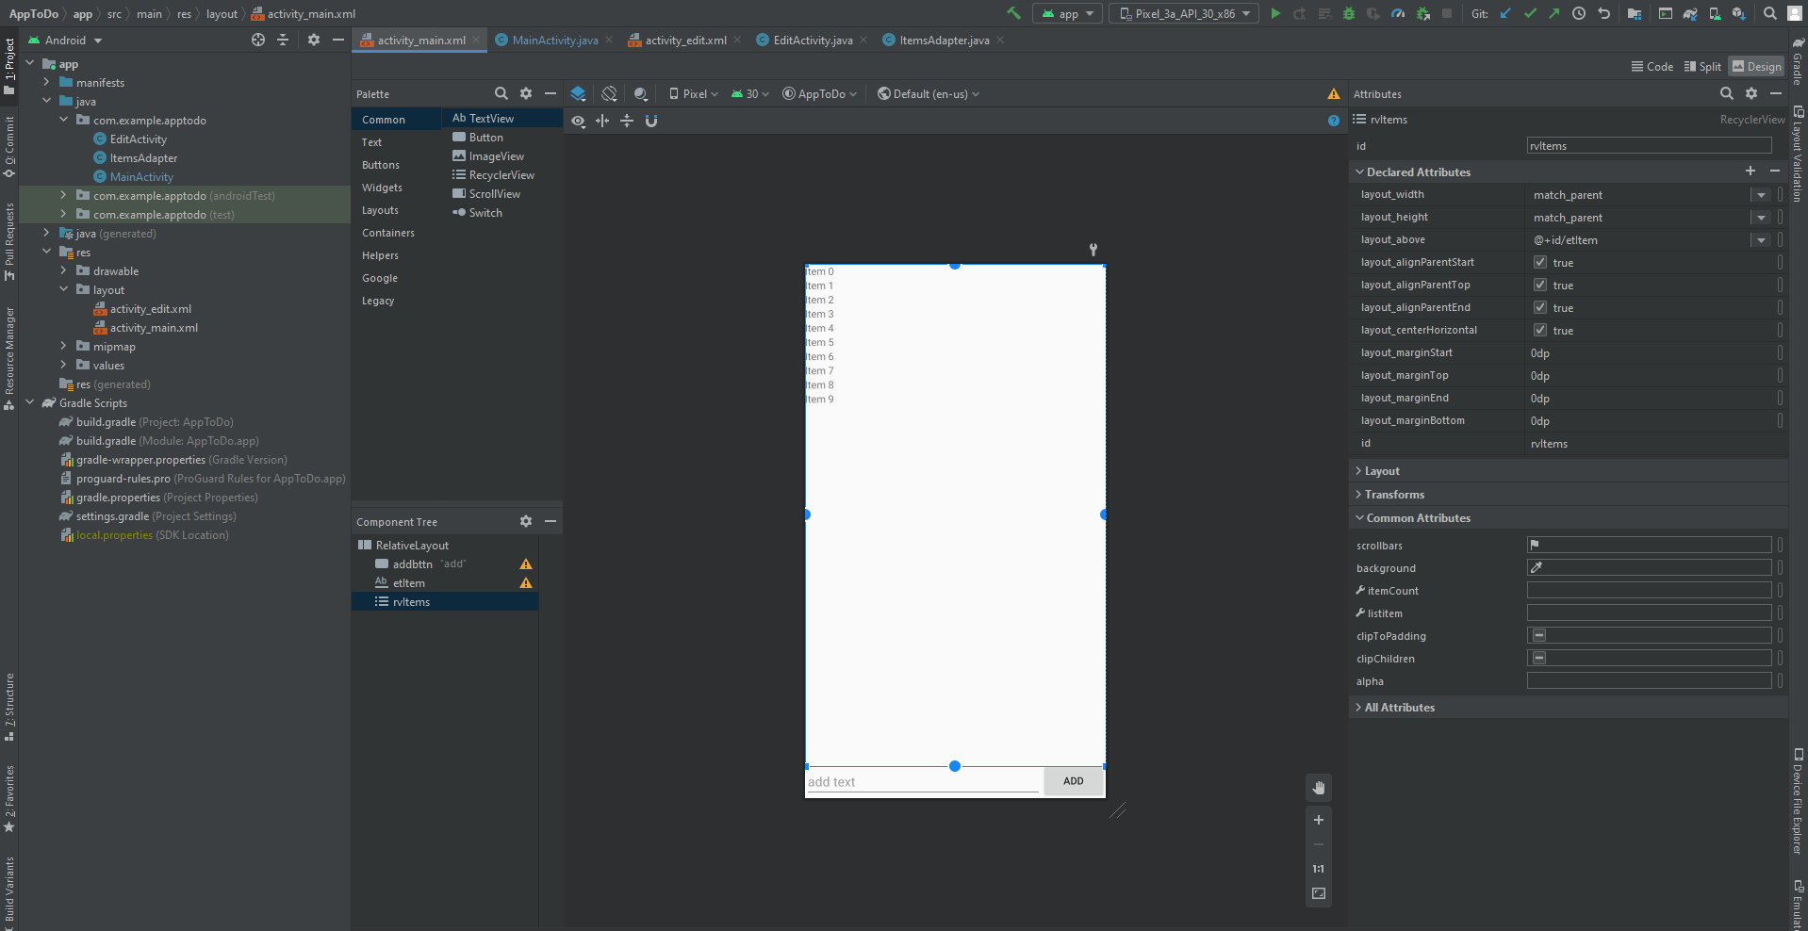

Slide 5
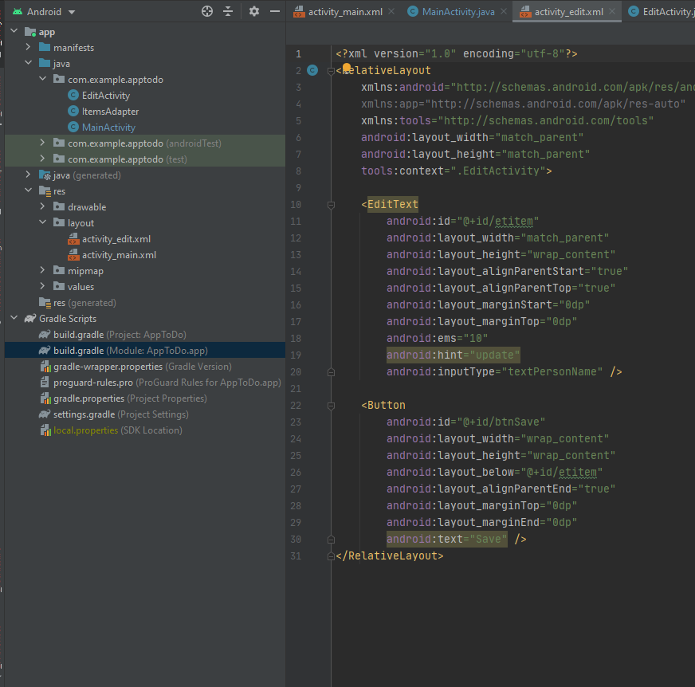
Design Code
Make it easer to trouble shoot
Faster to locate information
Faster to make edits

Slide 6
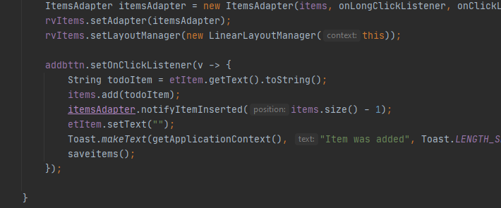
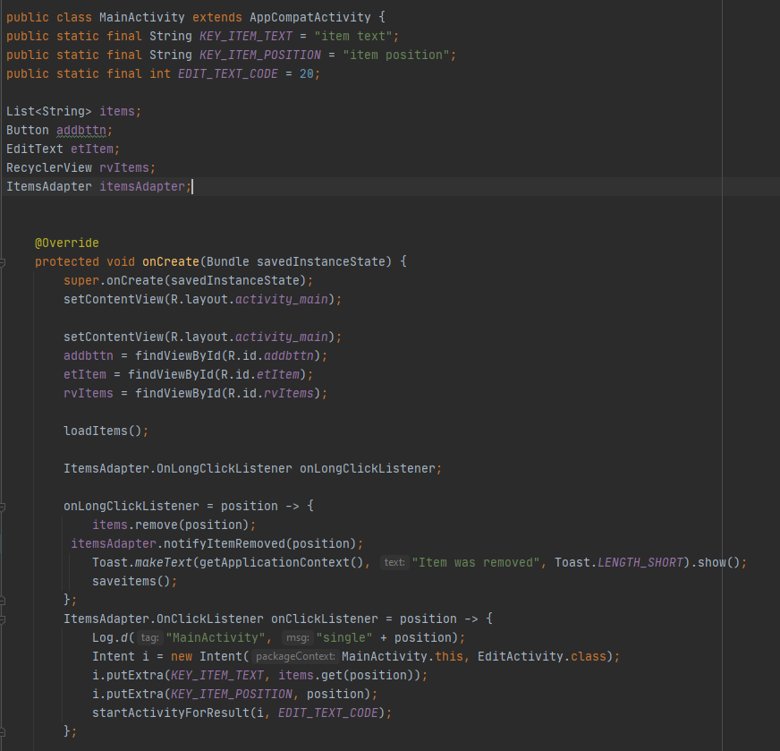
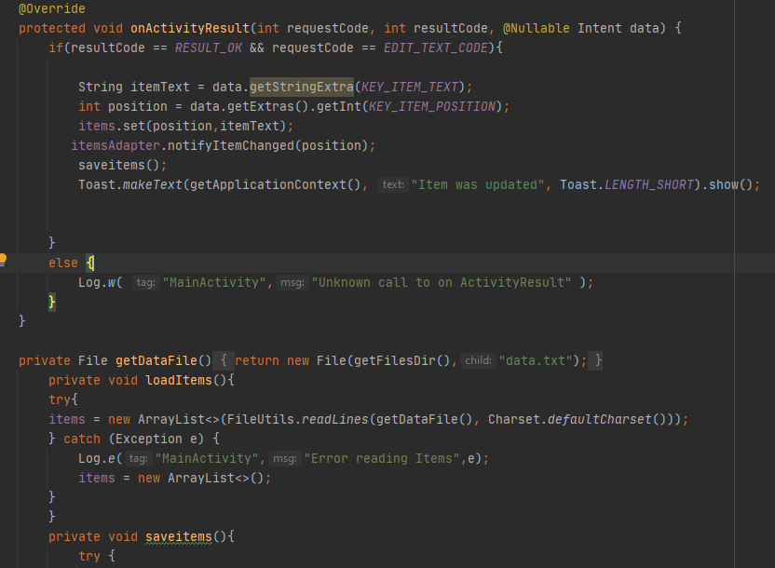
Main Activity code

Slide 7
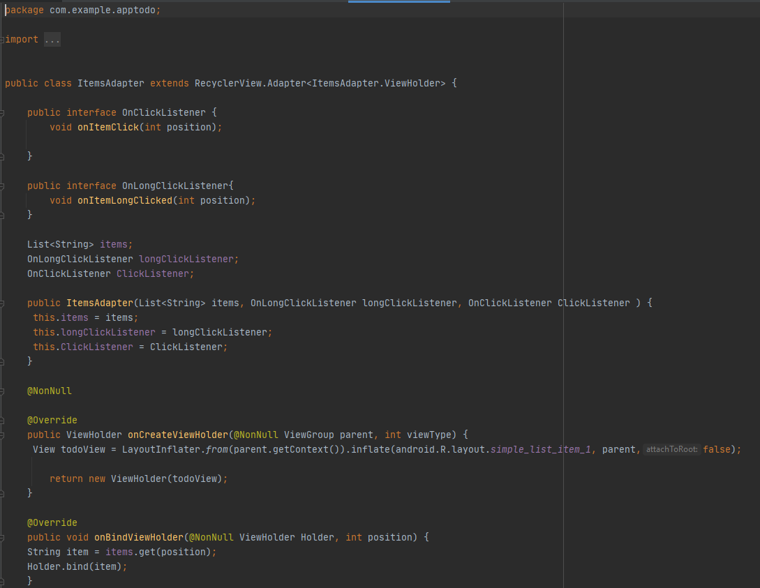
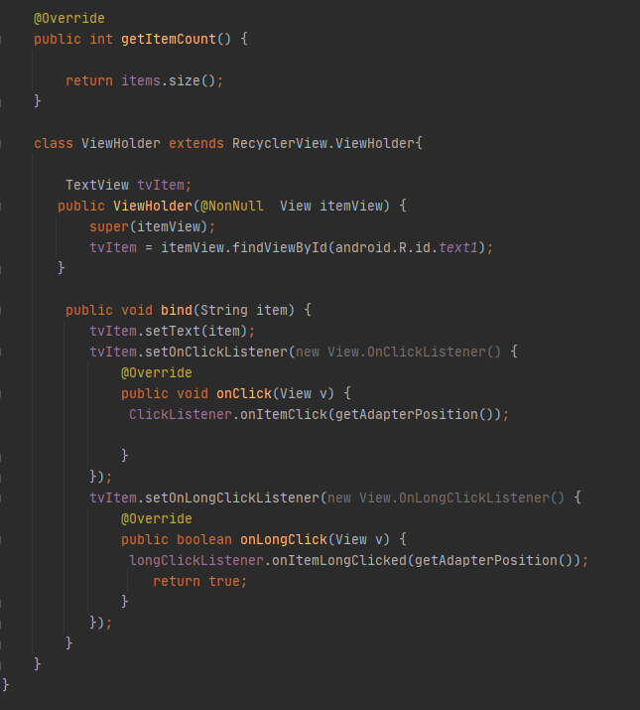
Adapter class
listeners of the events
View holder
bind

Slide 8
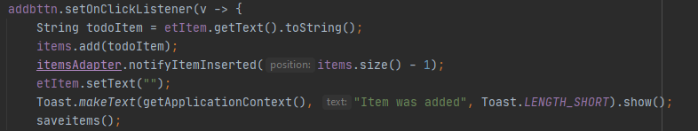
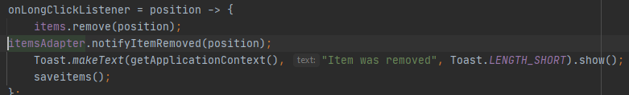
Adding and Removing

Slide 9
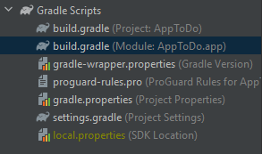
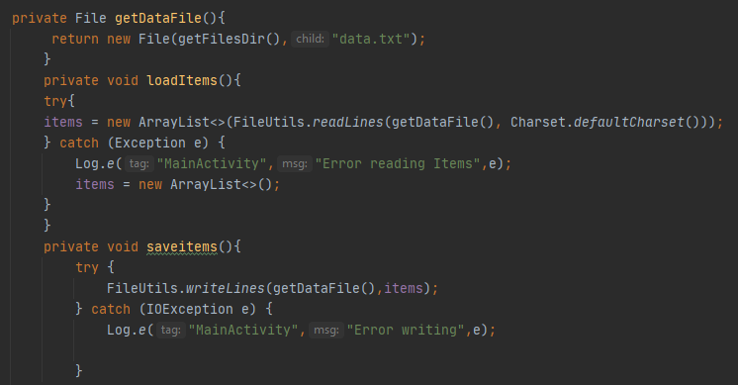
Persistence
A way for the app to keep functioning even after disruptions

Slide 10
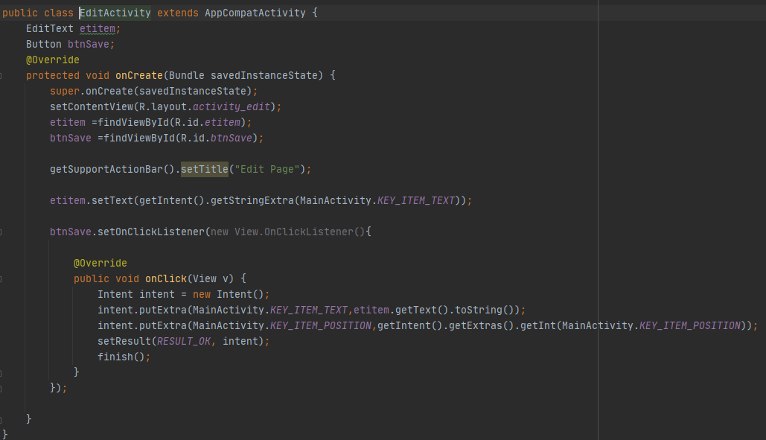
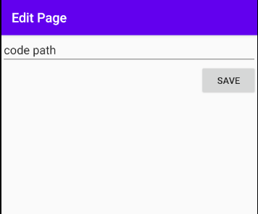
Edit Items

