Slide 1


Tech ABC Corp - HR Database
[George Christodoulou 06/02/25]

Slide 2
Business Scenario
Business requirement
Tech ABC Corp saw explosive growth with a sudden appearance onto the gaming scene with their new AI-powered video game console. As a result, they have gone from a small 10 person operation to 200 employees and 5 locations in under a year. HR is having trouble keeping up with the growth, since they are still maintaining employee information in a spreadsheet. While that worked for ten employees, it has becoming increasingly cumbersome to manage as the company expands.
As such, the HR department has tasked you, as the new data architect, to design and build a database capable of managing their employee information.
Dataset
The HR dataset you will be working with is an Excel workbook which consists of 206 records, with eleven columns. The data is in human readable format, and has not been normalized at all. The data lists the names of employees at Tech ABC Corp as well as information such as job title, department, manager's name, hire date, start date, end date, work location, and salary.
IT Department Best Practices
The IT Department has certain Best Practices policies for databases you should follow, as detailed in the Best Practices document.

Slide 3
Step 1
Data Architecture Foundations

Slide 4
Step 1: Data Architecture Foundations
Hi,
Welcome to Tech ABC Corp. We are excited to have some new talent onboard. As you may already know, Tech ABC Corp has recently experienced a lot of growth. Our AI powered video game console WOPR has been hugely successful and as a result, our company has grown from 10 employees to 200 in only 6 months (and we are projecting a 20% growth a year for the next 5 years). We have also grown from our Dallas, Texas office, to 4 other locations nationwide: New York City, NY, San Francisco, CA, Minneapolis, MN, and Nashville, TN.
While this growth is great, it is really starting to put a strain on our record keeping in HR. We currently maintain all employee information on a shared spreadsheet. When HR consisted of only myself, managing everyone on an Excel spreadsheet was simple, but now that it is a shared document I am having serious reservations about data integrity and data security. If the wrong person got their hands on the HR file, they would see the salaries of every employee in the company, all the way up to the president.
After speaking with Jacob Lauber, the manager of IT, he suggested I put in a request to have my HR Excel file converted into a database. He suggested I reach out to you as I am told you have experience in designing and building databases. When you are building this, please keep in mind that I want any employee with a domain login to be have read only access the database. I just don't want them having access to salary information. That needs to be restricted to HR and management level employees only. Management and HR employees should also be the only ones with write access. By our current estimates, 90% of users will be read only.
I also want to make sure you know that am looking to turn my spreadsheet into a live database, one I can input and edit information into. I am not really concerned with reporting capabilities at the moment. Since we are working with employee data we are required by federal regulations to maintain this data for at least 7 years; additionally, since this is considered business critical data, we need to make sure it gets backed up properly.
As a final consideration. We would like to be able to connect with the payroll department's system in the future. They maintain employee attendance and paid time off information. It would be nice if the two systems could interface in the future
I am looking forward to working with you and seeing what kind of database you design for us.
Thanks,
Sarah Collins
Head of HR

Slide 5
Data Architect Business Requirement
Purpose of the new database:
The purpose of the new DB is to replace the shared Excel file which contains employee info. The new DB is going to be secure and scalable.
Describe current data management solution:
The HR head stores and maintains employee information into a shared Excel file. This is sufficient if a team is small but not recommended for a fast-growing organization.
Describe current data available:
In the Excel sheet, there are several information regarding the employees of the company. In specific this file contains the employee id, the full name, email, hiring date, job title, salary, department, reporting manager, starting date, ending date, site location, site address, city, state and employee’s education level
Additional data requests:
There is a request for future integration with the payroll system which will include employee’s attendance and POT
Who will own/manage data
Only the HR department will have data ownership and management.

Slide 6
Data Architect Business Requirement
Who will have access to database
There will be two type of users: Read-only access users to all info besides salary (applies to all employees) and read/write access to all fields for HR and Management users.
Estimated size of database
Currently there are 200 employee records, meaning 200 rows. Each record may have 15-30 fields (columns)
Estimated annual growth
It is pointed out that there will be 20% growth per year. Therefore: 1st Year: 200 employees * 1.20 = 240 2nd Year: 240*1.20 = 288 3rd Year: 288*1.20 = 346 4th Year: 346*1.20 = 416 5th Year: 416*1.20 = 500 So it is expected to have aprox. 500 employees in 5 years.
Is any of the data sensitive/restricted
The Salary information field should be restricted only to HR and Management user

Slide 7
Data Architect Technical Requirement
Justification for the new database
The first reason is data security: To prevent unauthorized access to sensitive data such as salaries.
The second reason is scalability: Employee base is expected to grow, therefore the excel approach is unsustainable.
Database objects
The following objects were created: Manager, JobTitle, Employee, EmployeeJobHistory, Department, Location and EducationLevel. I had to alter the Employee table to store the current reporting manager directly on the employee record, while still preserving the historical manager info in the EmployeeJobHistory table.
Data ingestion
The most appropriate data ingestion method is ETL. An automated ETL process will ensure data consistency, integrity and compliance with the company best practices. By using ETL, we can support data transformation and validation.

Slide 8
Data Architect Technical Requirement
Data governance (Ownership and User access)
Ownership: HR department is the owner and responsible for maintaining the data.
User Access: 1) HR department which will have full access (read/write and sensitive data). 2) Employees: Read-only access without the salary data.
Scalability
In order to ensure availability and backup, replication is highly recommended. Sharding may be considered later on, if there are going to be issues with data volume or query performance.
Flexibility
I used normalized schema design (3NF) for each table implemented.
Storage & retention
Storage (disk or in-memory): Since the HR DB stores employee records with typical CRUD operation, we will require spinning disk storage type. We don’t need in-memory, since the process doesn’t involve heavy computation in terms of complex analytics or ML.
Retention: 7 Years

Slide 9
Data Architect Technical Requirement
Backup
The appropriate backup classification is “Critical”. The data is sensitive and includes regulated employee info which according to Sarah is considered business-critical. Retention is required for at least 7 years. Therefore, loss or corruption of this data might lead to legal, compliance and operational risks.

Slide 10
Step 2
Relational Database Design

Slide 11
Step 2: Relational Database Design
This step is where you will go through the process of designing a new database for Tech ABC Corp's HR department. Using the dataset provided, along with the requirements gathered in step one, you are going to develop a relational database set to the 3NF.
Using Lucidchart, you will create 3 entity relationship diagrams (ERDs) to show how you developed the final design for your data.
You will submit a screenshot for each of the 3 ERDs you create. You will find detailed instructions for developing each of the ERDs over the next several pages.

Slide 12
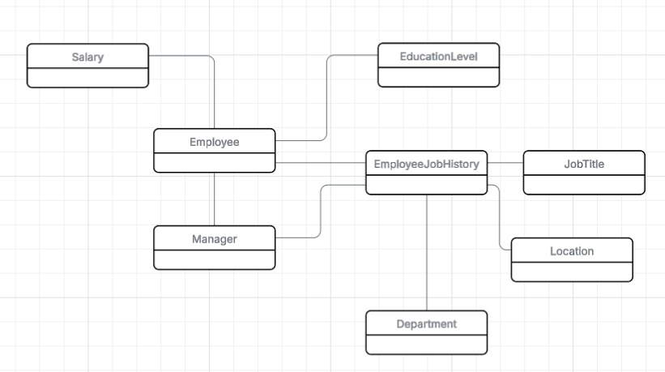
ERD
Conceptual
This is the most general level of data modeling. At the conceptual level, you should be thinking about creating entities that represent business objects for the database. Think broadly here. Attributes (or column names) are not required at this point, but relationship lines are required (although Crow's foot notation is not needed at this level). Create at least three entities for this model; thinking about the 3NF will aid you in deciding the type of entities to create.
Use Lucidchart’s built-in template for DBMS ER Diagram UML.
** Replace example screenshot below with your response

Slide 13
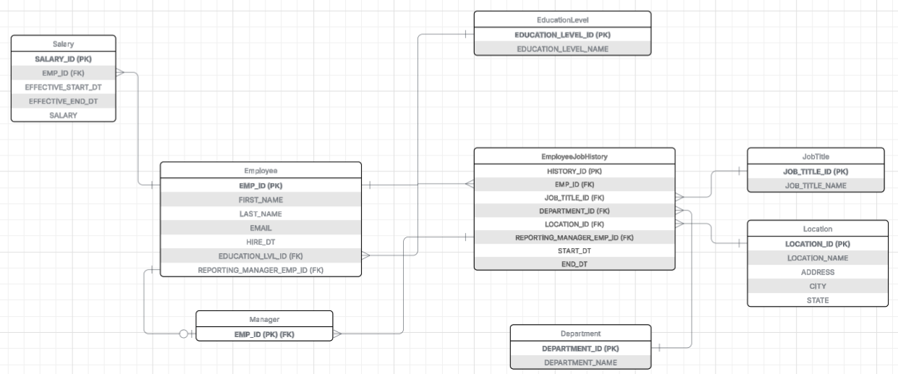
ERD
Logical
The logical model is the next level of refinement from the conceptual ERD. At this point, you should have normalized the data to the 3NF. Attributes should also be listed now in the ERD. You can still use human-friendly entity and attribute names in the logical model, and while relationship lines are required, Crow's foot notation is still not needed at this point.
Use Lucidchart’s built-in template for DBMS ER Diagram UML.
** Replace example screenshot below with your response

Slide 14
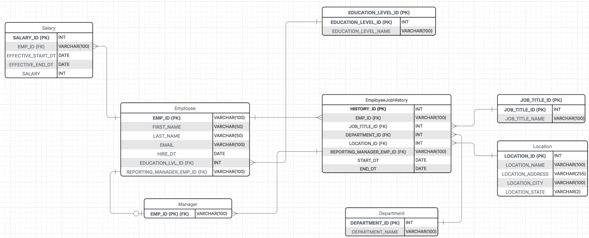
ERD
Physical
The physical model is what will be built in the database. Each entity should represent a database table, complete with column names and data types. Primary keys and foreign keys should also be represented here. Primary keys should be in bold type with the (PK) designation following the field name. Foreign keys should be in normal type face, but have the designation (FK) after the column name. Finally, in the physical model, Crow's foot notation is important.
** Replace example screenshot below with your response

Slide 15
Step 3
Create A Physical Database

Slide 16
Step 3: Create A Physical Database
In this step, you will be turning your database model into a physical database.
You will:
Create the database using SQL DDL commands
Load the data into your database, utilizing flat file ETL
Answer a series of questions using CRUD SQL commands to demonstrate your database was created and populated correctly
Submission
For this step, you will need to submit SQL files containing all DDL SQL scripts used to create the database.
You will also have to submit screenshots showing CRUD commands, along with results for each of the questions found in the starter template.
Hints
Your DDL script will be graded by running the code you submit. Please ensure your SQL code runs properly!
Foreign keys cannot be created on tables that do not exist yet, so it may be easier to create all tables in the database, then to go back and run modify statements on the tables to create foreign key constraints.
After running CRUD commands like update, insert, or delete, run a SELECT* command on the affected table, so the reviewer can see the results of the command.

Slide 17
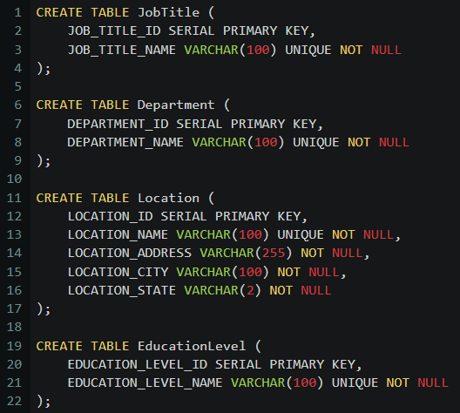
DDL-Part 1
Create a DDL SQL script capable of building the database you designed in Step 2
Hints
The DDL script will be graded by running the code you submit. Please ensure your SQL code runs properly.
Foreign keys cannot be created on tables that do not exist yet, so it may be easier to create all tables in the database, then to go back and run modify statements on the tables to create foreign key constraints.
Remember to submit the related SQL file as well, not just a screenshot (replace the below screenshot).

Slide 18
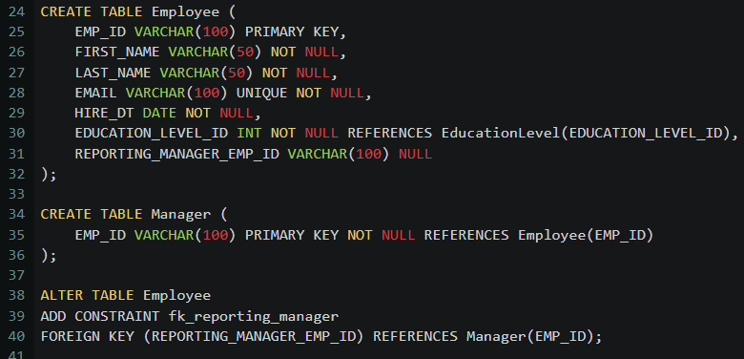
DDL-Part2
Create a DDL SQL script capable of building the database you designed in Step 2
Hints
The DDL script will be graded by running the code you submit. Please ensure your SQL code runs properly.
Foreign keys cannot be created on tables that do not exist yet, so it may be easier to create all tables in the database, then to go back and run modify statements on the tables to create foreign key constraints.
Remember to submit the related SQL file as well, not just a screenshot (replace the below screenshot).

Slide 19
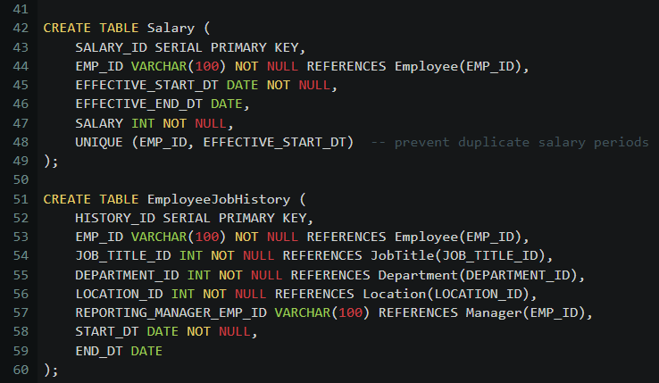
DDL-Part3
Create a DDL SQL script capable of building the database you designed in Step 2
Hints
The DDL script will be graded by running the code you submit. Please ensure your SQL code runs properly.
Foreign keys cannot be created on tables that do not exist yet, so it may be easier to create all tables in the database, then to go back and run modify statements on the tables to create foreign key constraints.
Remember to submit the related SQL file as well, not just a screenshot (replace the below screenshot).

Slide 20
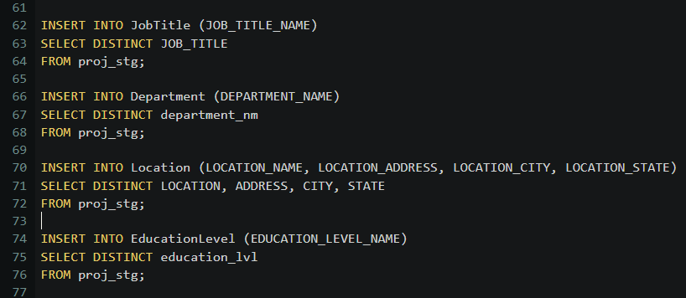
DDL-Part4
Create a DDL SQL script capable of building the database you designed in Step 2
Hints
The DDL script will be graded by running the code you submit. Please ensure your SQL code runs properly.
Foreign keys cannot be created on tables that do not exist yet, so it may be easier to create all tables in the database, then to go back and run modify statements on the tables to create foreign key constraints.
Remember to submit the related SQL file as well, not just a screenshot (replace the below screenshot).

Slide 21
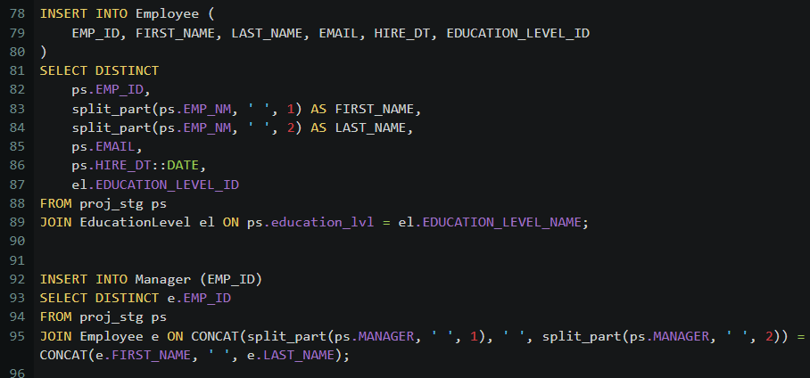
DDL-Part5
Create a DDL SQL script capable of building the database you designed in Step 2
Hints
The DDL script will be graded by running the code you submit. Please ensure your SQL code runs properly.
Foreign keys cannot be created on tables that do not exist yet, so it may be easier to create all tables in the database, then to go back and run modify statements on the tables to create foreign key constraints.
Remember to submit the related SQL file as well, not just a screenshot (replace the below screenshot).

Slide 22
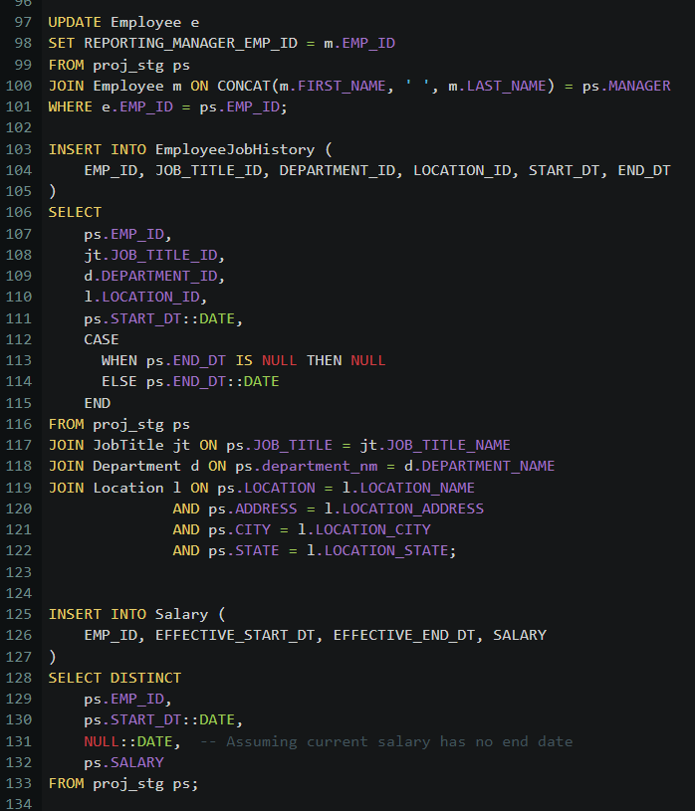
DDL-Part6
Create a DDL SQL script capable of building the database you designed in Step 2
Hints
The DDL script will be graded by running the code you submit. Please ensure your SQL code runs properly.
Foreign keys cannot be created on tables that do not exist yet, so it may be easier to create all tables in the database, then to go back and run modify statements on the tables to create foreign key constraints.
Remember to submit the related SQL file as well, not just a screenshot (replace the below screenshot).

Slide 23
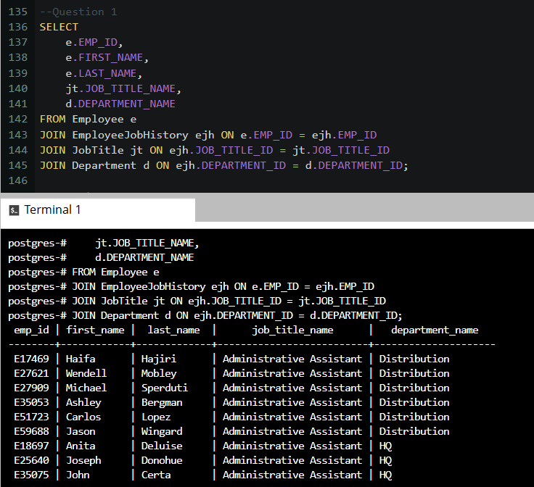
CRUD
Question 1: Return a list of employees with Job Titles and Department Names
** Replace example screenshot below with your response, and include the query in a SQL file

Slide 24
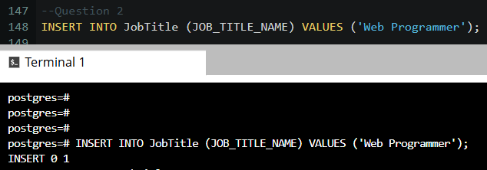
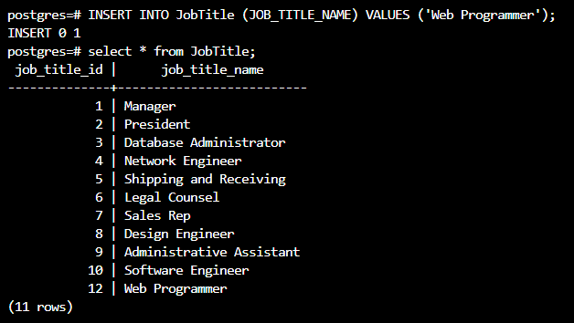
CRUD
Question 2: Insert Web Programmer as a new job title
** Replace example screenshot below with your response, and include the query in a SQL file

Slide 25
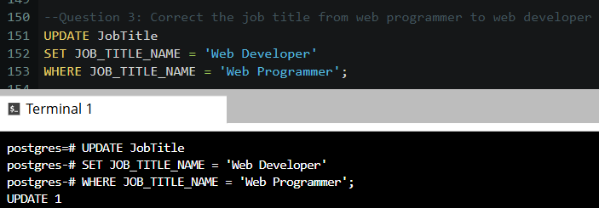
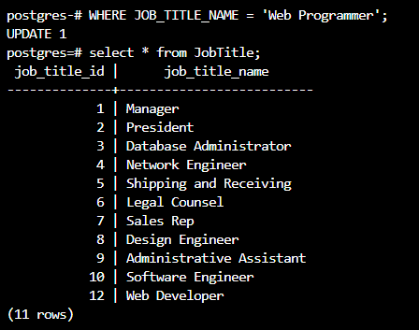
CRUD
Question 3: Correct the job title from web programmer to web developer
** Replace example screenshot below with your response, and include the query in a SQL file

Slide 26
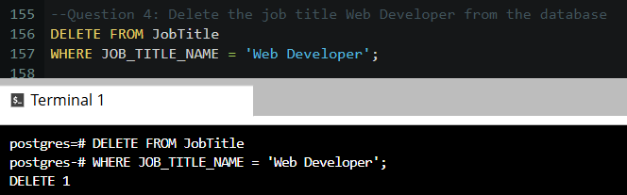
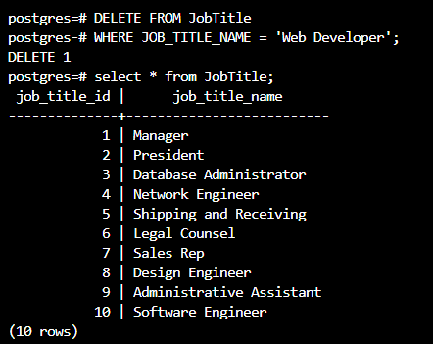
CRUD
Question 4: Delete the job title Web Developer from the database
** Replace example screenshot below with your response, and include the query in a SQL file

Slide 27
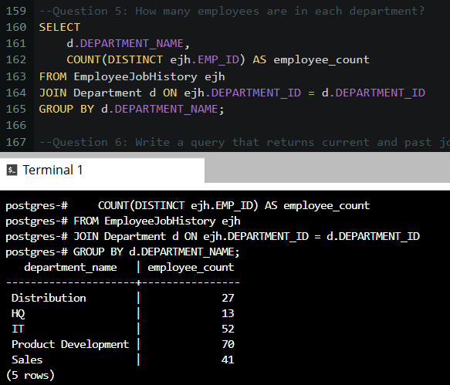
CRUD
Question 5: How many employees are in each department?
** Replace example screenshot below with your response, and include the query in a SQL file

Slide 28
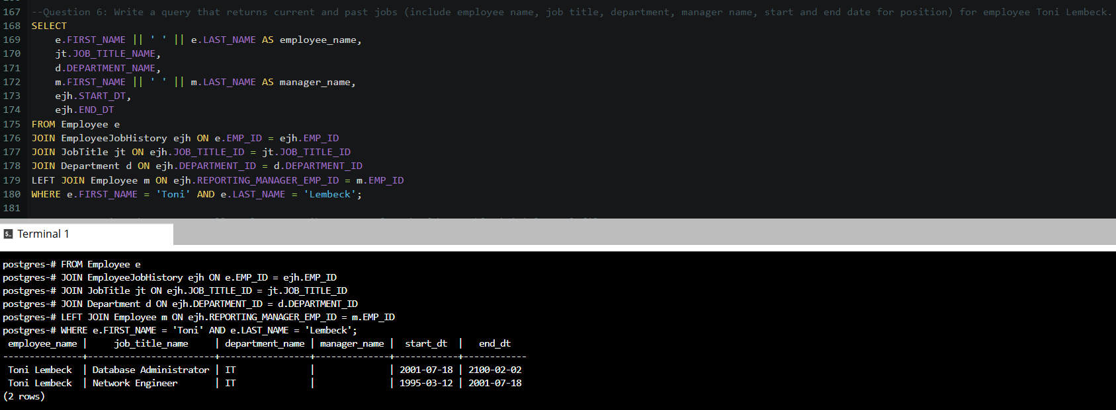
CRUD
Question 6: Write a query that returns current and past jobs (include employee name, job title, department, manager name, start and end date for position) for employee Toni Lembeck.
** Replace example screenshot below with your response, and include the query in a SQL file

Slide 29
CRUD
Question 7: Describe how you would apply table security to restrict access to employee salaries using an SQL server.
** answer in a short paragraph, how you would apply table security to restrict access to employee salaries
We can use views and role-based access control. For example we can create a role Tier1 that has restricted access to salary. We can do that by creating a view of the table that excludes the salary. Then the Tier1 role is granted access to the view only.

Slide 30
Step 4
Above and Beyond (optional)

Slide 31
Step 4: Above and Beyond
This last step is called Above and Beyond. In this step, I have proposed 3 challenges for you to complete, which are above and beyond the scope of the project. This is a chance to flex your coding muscles and show everyone how good you really are.
These challenge steps will bring your project even more in line with a real-world project, as these are the kind of “finishing touches” that will make your database more usable. Imagine building a car without air conditioning or turn signals. Sure, it will work, but who would want to drive it.
I encourage you to take on these challenges in this course and any future courses you take. I designed these challenges to be a challenge to your current abilities, but I ensured they are not an unattainable challenge. Remember, these challenges are completely optional - you can pass the project by doing none of them, or just some of them, but I encourage you to at least attempt them!

Slide 32
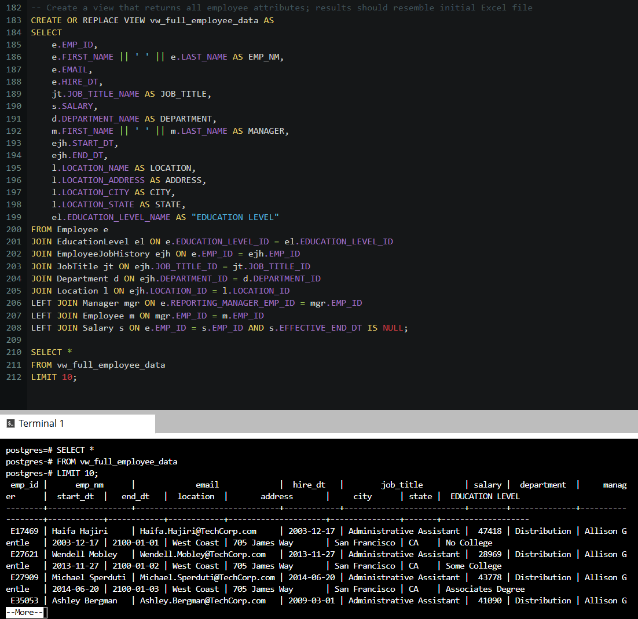
Standout Suggestion 1
Create a view that returns all employee attributes; results should resemble initial Excel file
** return a screenshot of the view create code, along with the results of a select all on the view

Slide 33
Standout Suggestion 2
Create a stored procedure with parameters that returns current and past jobs (include employee name, job title, department, manager name, start and end date for position) when given an employee name.
** submit screenshot of stored procedure creation code, along with a screenshot of the stored procedure executed using Toni Lembeck as the parameter value

Slide 34
Standout Suggestion 3
Implement user security on the restricted salary attribute.
Create a non-management user named NoMgr. Show the code of how your would grant access to the database, but revoke access to the salary data.
Submit screenshot of code

Slide 35
Appendix

Slide 36
Additional Info
You can include supporting or additional information that supports your previous slides, but isn’t necessary for every person to see that looks at your slides.

