Slide 1
Code Challenge
George Clarke

Slide 2
Brief
Extract data from a relational database into a pub/sub system.
Aggregate the data within the pub/sub system.
Consume the data into a NoSQL database.

Slide 3
Project tools
This project is dependent on:
Kafka - Apache Kafka is an open-source stream-processing software platform developed by the Apache Software Foundation, written in Scala and Java. The project aims to provide a unified, high-throughput, low-latency platform for handling real-time data feeds
Docker - Docker is a tool designed to make it easier to create, deploy, and run applications by using containers.
Mysql - An RDBMS database and was required in the project brief.
DynamoDB - is a fully managed proprietary NoSQL database service that supports key-value and document data structures and is offered by Amazon

Slide 4
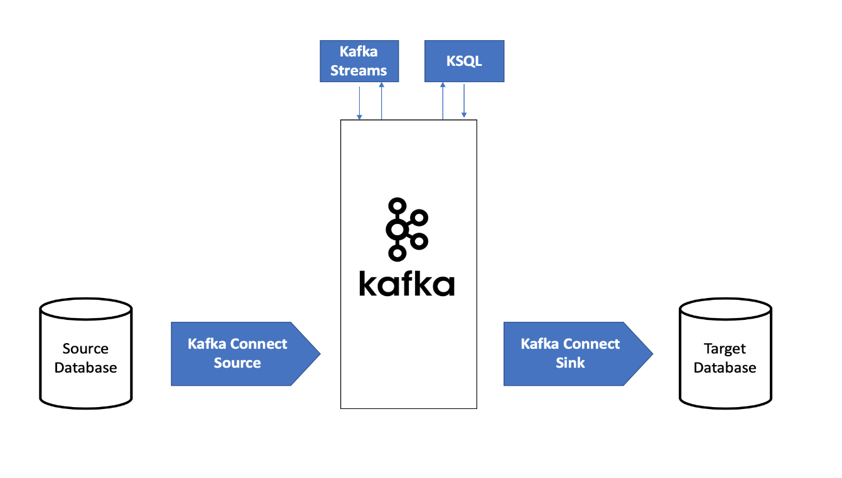
Architecture

Slide 5
Architecture
Consists of
MySQL Database with python writing rows from the dataset to the database.
Kafka Source Connector – To transfer data from the database to Kafka.
Kafka is used to persists data and make the streaming data available to the consumer.
Kafka streams is used for lightweight transformations.
Kafka Sink Connector - To move data from Kafka into the consumer database.
NoSql Database as the target area the aggregated data should land.

Slide 6
Discussion
Usually the best time to use when calculating metrics is the event time, this is usually set by the producer. This gives you a near-real simulation of when the events occurred.
Query time is set at the end by processors within Kafka. Although Kafka is a real time streaming platform, there are still some lags in processing which can affect time based metrics.

Slide 7
Challenges and choices
DynamoDB was the preferred over other NoSQL Engine, but DynamoDB has not GUI when your running locally in a container. This means the platform where you are running the container has to have awscli installed.
Choose to use KSQL, to build streams because of its friendly SQL like interface.
I have pulled the docker container for an OS independent reliable deployment and all shell scripts are minimal to make the project transferrable to other OSs.

Slide 8
Conclusion

