Slide 1
Mid-Project Review

Slide 2
Agenda
  Part 1 Assessment 2
  R&D project work over the summer break

Slide 3
Mid-term review (10%)
2nd Assessment for Part 1
Two things-
Write a status report based on the following:
  Work done (identity) from week 7 to week 12, including during the mid-semester break
    Evidence of work done (artefacts & documents) must be in the team portfolio
    Evidence for individual contribution (hours spent) must be in the worklog book
  Improvement done on the proposal based on the feedback. (proposal baseline- ready to be executed)
Do a team presentation on the status report (one slide only) and show/tell portfolio (and individual worklog book)

Slide 4
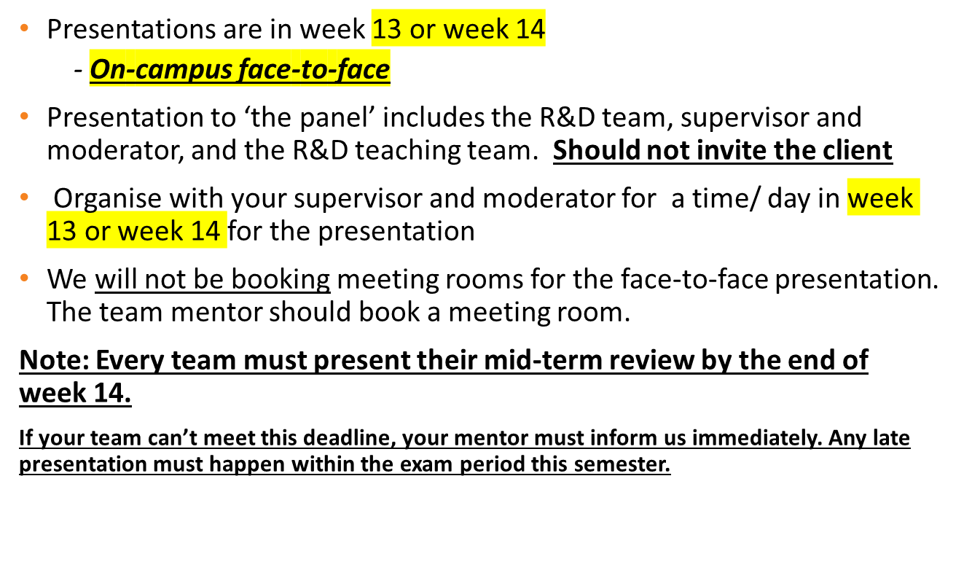
Mid-term review presentation

Slide 5
Mid-term review presentation
15 minutes to present and show/tell the team portfolio. Presentation material is limited to 1 slide only (5 minutes only)-
  content based on the status report.
  rest of the time- show/tell your portfolio
20 to 25 minutes for Q & A.
The assessment panel will then confer for 10 minutes. You can wait for a verbal outcome.

Slide 6
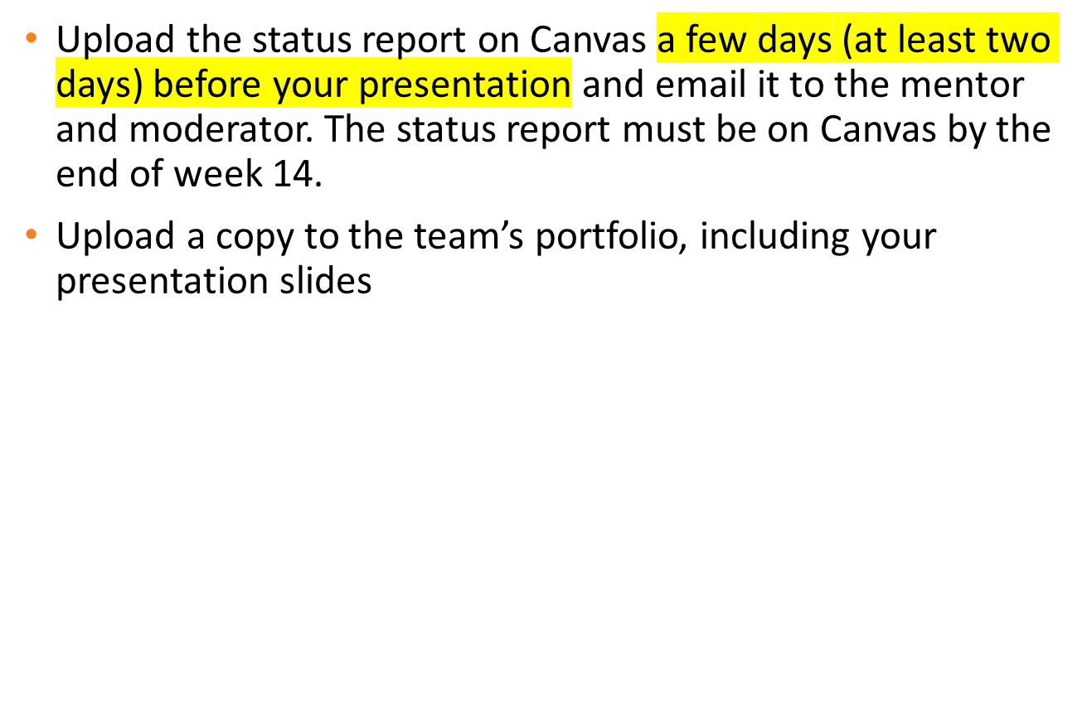
Status report

Slide 7
Why status report in IT Projects?
A status report summarizes a project's progress against the project plans (proposal baseline).
The goal is to keep all stakeholders informed of the progress (achievements), identify issues and risks, including strategies, and show that the project will be delivered within the allocated time frame
Status report- a vital deliverable for project stakeholders for decision-making
  Portfolio Management (Sponsor- finance/provide funding)
  Client (product idea)
  Product management
  Program management
  Project management

Slide 8
Status report- R&D paper requirement
Provides information on the team’s progress towards the goal to:
  deliver the project objective (product or report)
  complete paper assessments
  apply knowledge and learn new skills (technical & non-technical )
Must provide a general update, all at a glance.
  It is a summary- no more than 2000 words or 5 pages (including the cover page) in total
A professionally presented report that honestly provides the current project status
Confidentiality: You can make the report confidential to your team, academic mentor and BCIS Project team if there are matters that you do not wish to share with your client.

Slide 9
Status Report- structure
Download the mid-term assessment guideline from Canvas, which provides the template.
Title page with the team name, date, version, team and supervisor names
An executive summary
A brief project description
An overview of project objective, scope, approach, major milestones, and product and project-related deliverables- these will be in your proposal
A response to how the proposal feedback/recommendations have been addressed (refer to slide 11)
New variations from the proposal baseline with a rationale for them (any recent changes done to the proposal or a plan(s))
Summary of current project status- work completed and work yet to be done, which should have been done by now & why not done; risks and issues that impacted your plans/milestones and project work (refer to slide 11)

Slide 10
Structure status report
A summary of individual member contributions and hours done, including learning achieved so far in the R&D Project (refer to slide 11)
Recommendations for improving the project team’s performance based on project risks and team issues, including what would be achieved at the end of part 2.
A new schedule (updated) based on work to be done (must show all the remaining work to be achieved in Part 2)

Slide 11
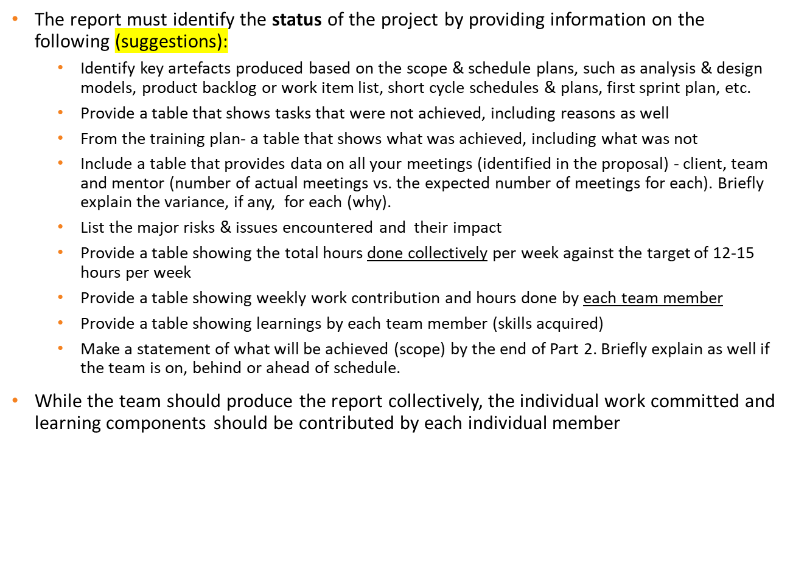
Mid-term review

Slide 12
What do you need to bring?
Worklog book- captures evidence of your contribution up to week 12
A digital project portfolio of your project work to date.
  You should have a clear and well-defined (a) index and (b) folder structure matching the marking criteria (use hyperlinks)
  From now onwards, your folder structure should match the final portfolio assessment marking criteria
Consider what your assessors will be looking for:
Evidence of your:
  Research and upskilling
  Planning and Control
  Communication and Teamwork
  Development and Quality Assurance
  Note: Detailed minutes are very important

Slide 13
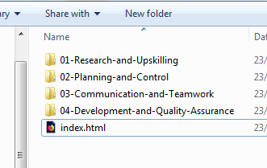
Suggested structure

Slide 14
Suggested structure
Research and Upskilling
  Evidence of upskilling. Technology and tool selection research documents. Architecture, platform reports, usability reports, investigations, and feasibility assessments.
Project Planning and Control
  Evidence of sound and effective planning and control processes, including rationale for project decisions. Versions of your proposals, reporting, and scheduling
Teamwork and Communication
  Evidence of sound and effective communication and collaboration with team members, supervisor, client, stakeholders.
Development Activities and Work Products
  Quality and completeness of all development activities and outputs. Quality and completeness of final product/s

Slide 15
Worklog books
Up-to-date worklog book for Part 1
Mentors/moderators can check/validate information provided in the status report reflects hours and contributions captured in the worklog book

Slide 16
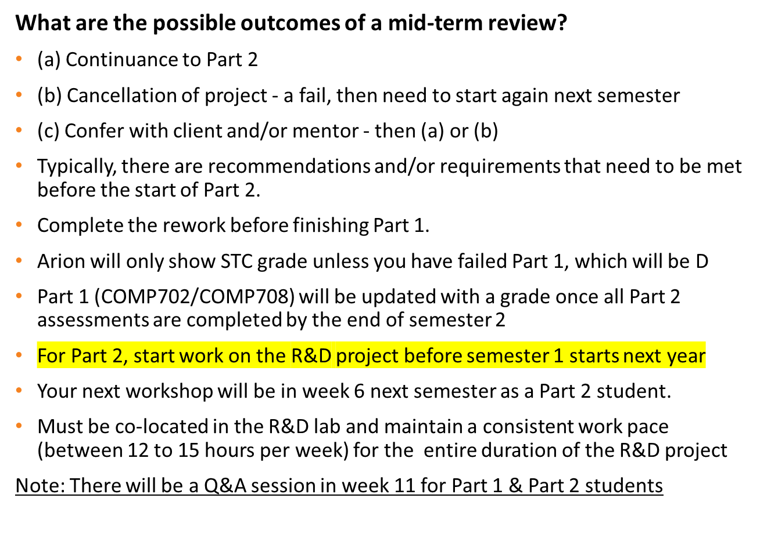
Review outcomes
Notes:
Continuance:
Your project will be permitted to continue with or without recommendations or conditions
This is the normal and hoped for situation
Cancellation
This is clearly undesirable, but may be the best solution if the project shows a general failure to make headway, or circumstances surrounding the project warrant its cancellation.
In this event team members may be reassigned to other projects, with the option of extending the duration of their studies, or may be required to accelerate their contribution to complete within the timeline of the other project team. These decisions will be made by the BCIS Project Team in consultation with your supervisor.
However there can be no guaranteed outcome for students in this situation, and each case will need to be individually negotiated
Confer with Client
In this situation there may be some problem with the client relationship, availability, expectation from the team, etc. which the team will need to resolve with the client. Your supervisor should help lead these discussions.

Slide 17
Break between two Semesters
  Your team can ensure R&D project success and achieve better overall team/individual grades if work can be done over the break before starting Part 2
  Between the end of Part 1 and the start of Part 2, there are almost 12 weeks available to work on your R&D project. Your team will be able to accomplish Part 2 tasks before the deadline and have more than sufficient time to complete your team poster and portfolio. Individually, you will have sufficient time to write your reflective report.
    Identify the team’s motivation to work over the summer break
    Come up with a workable strategy (schedule).

Slide 18
Questions about the process?
What concerns do you have about your review interview/status report/portfolio?
What else do you need to know?
Email us if you need any help/clarification.

