Slide 1
Do Gene Expression Profiles Differ Based on Time-Course RNA-seq Data Between Drug-Sensitive and –Resistant Glioma Cell Lines
Data: 04/14/2019
Presenter: Zhuoyang Chen

Slide 2
Background
Quality Control
Analysis
Conclusion

Slide 3
Background
Glioma cell lines treated with drug dbcAMP (differentiation therapy)
Through experiments, DBTRG is sensitive to the drug and LN18 is resistant, cell line U87 is used as test data
RNA-seq samples were collected at time 0h, 6h, 12h, 24h and 48h after treatment for all 3 cell lines
differentiate
drug-sensitive
dbcAMP
undifferentiate
drug-resistant
Zhang J, Zhu W, Wang Q, Gu J, Huang LF, Sun X (2019) Differential regulatory networkbased quantification and prioritization of key genes underlying cancer drug resistance based on timecourse RNA-seq data. PLoS Comput Biol 15(11): e1007435. https://doi.org/10.1371/journal. pcbi.1007435

Slide 4
Question
How to capture difference on expressions of drug-sensitive and drug-resistant across time
How to measure the robustness of resistant cells

Slide 5
Background
Quality Control
Analysis
Conclusion

Slide 6
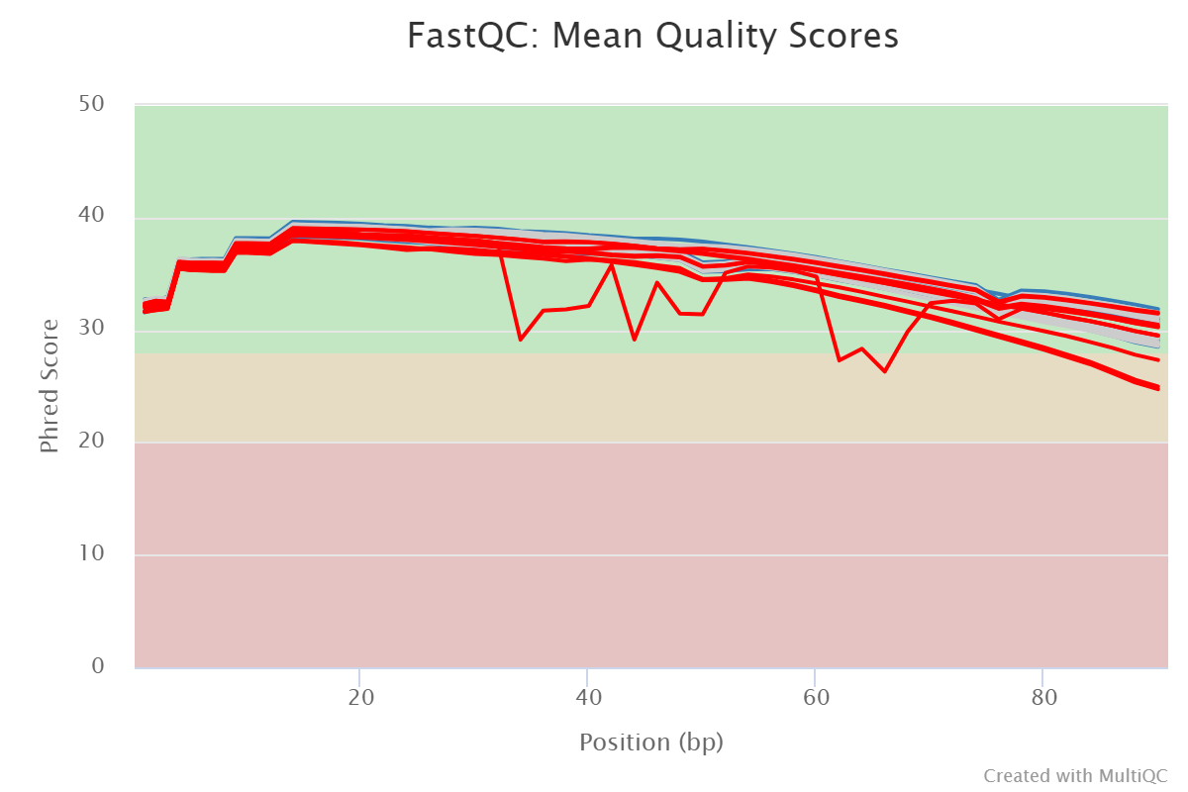
Quality Control On Raw Data
Sensitive
Resistant
overall quality: High
Anomaly: resistant_48_R1

Slide 7
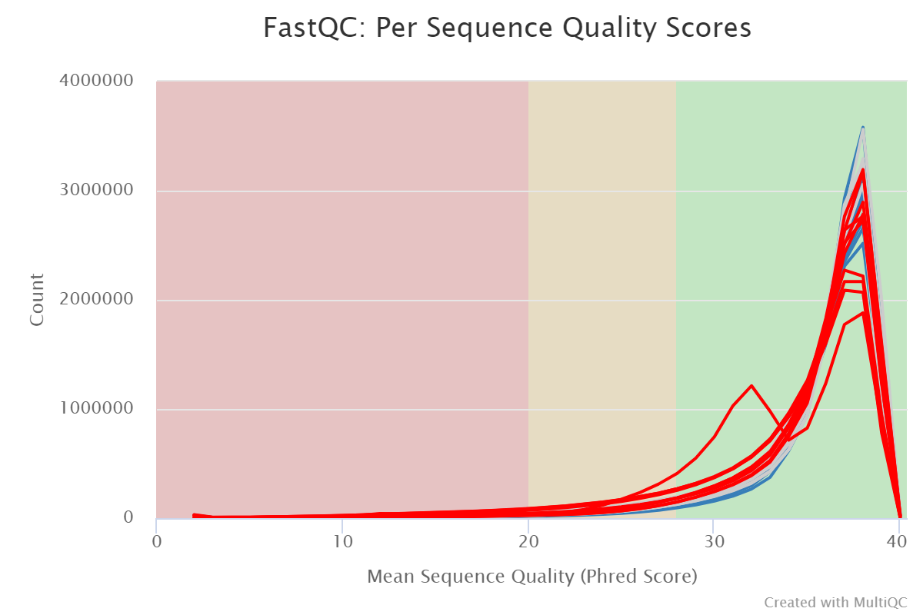
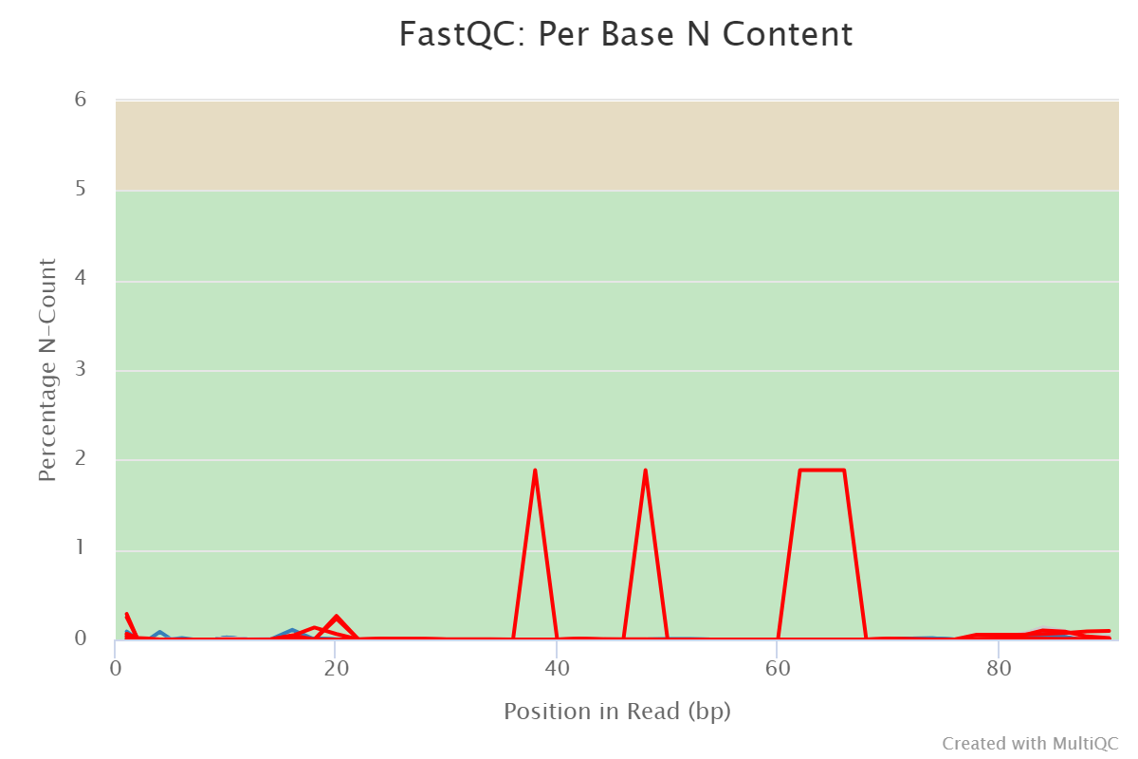
Quality Control
Sensitive
Resistant
Phred 33
low quality caused by N content
Illumina assigns N with Phred score 33

Slide 8
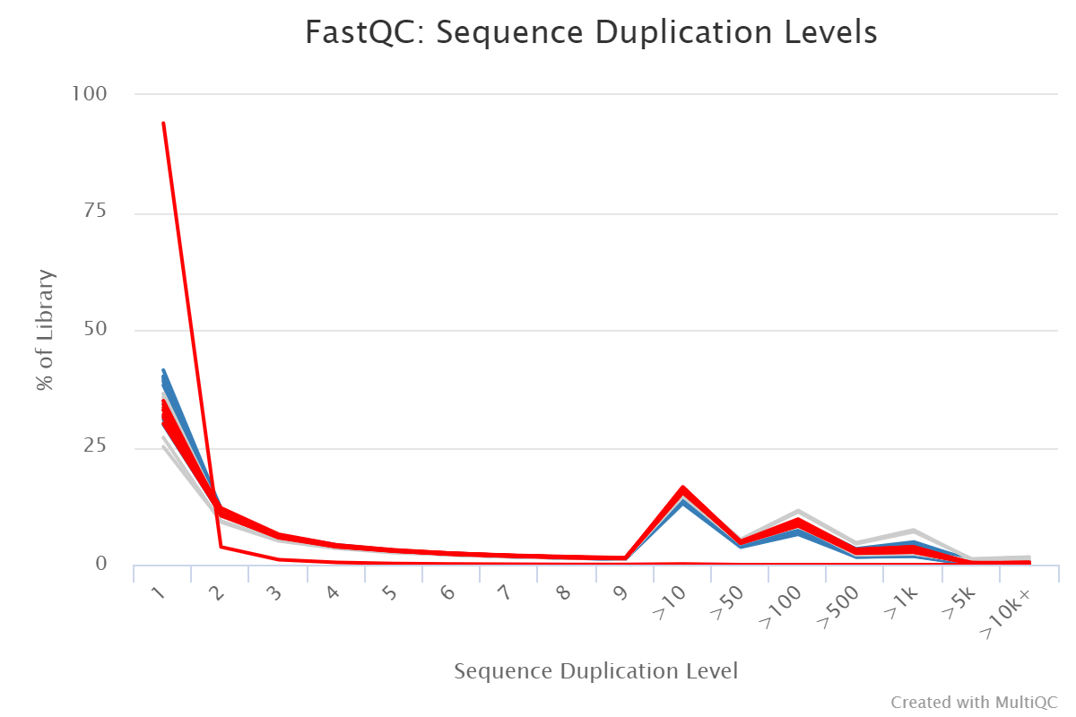
Quality Control
Sensitive
resistant_48_R1
Resistant
High duplicates are expected
Anomaly resistant_48_R1
low duplicates are caused by N content

Slide 9
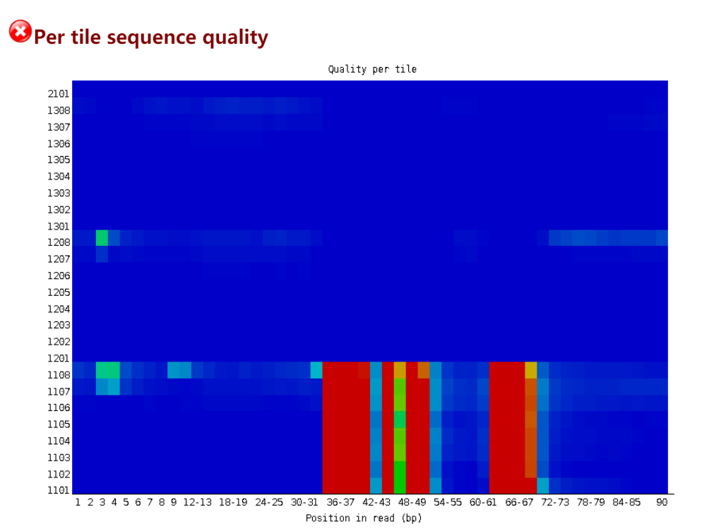
Inspect resistant_48_R1
Block of cells are abnormal
Indicates something going wrong with the glass slide or sequencer

Slide 10
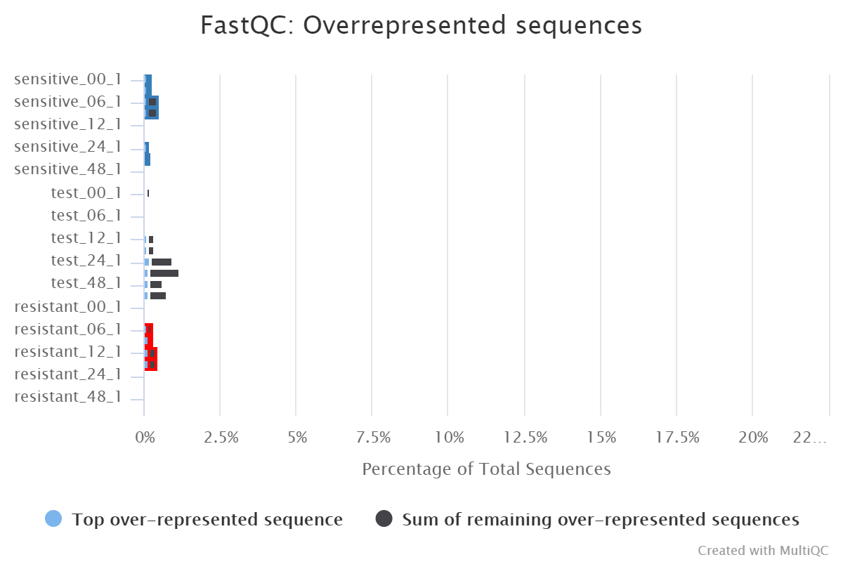
Quality Control
Sensitive
Resistant
Overrepresented sequences only take up
a small portion

Slide 11
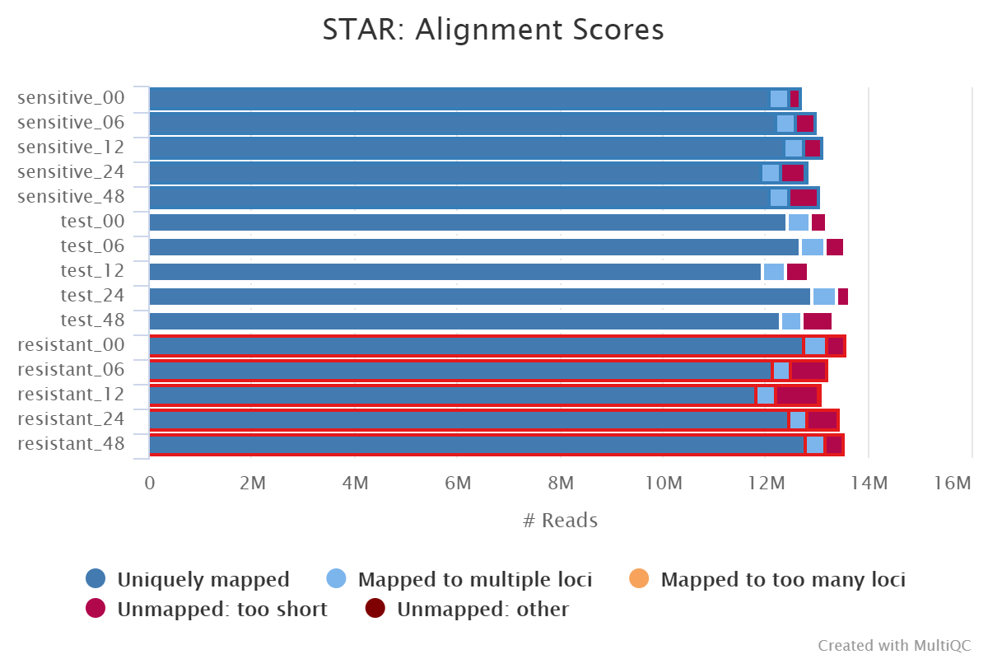
Quality Control On Alignments
Sensitive
Resistant
High mapping ratio
Sequencing depth 13M
even for the problematic sample
the minimum overlap for mapping is 3
bases in STAR

Slide 12
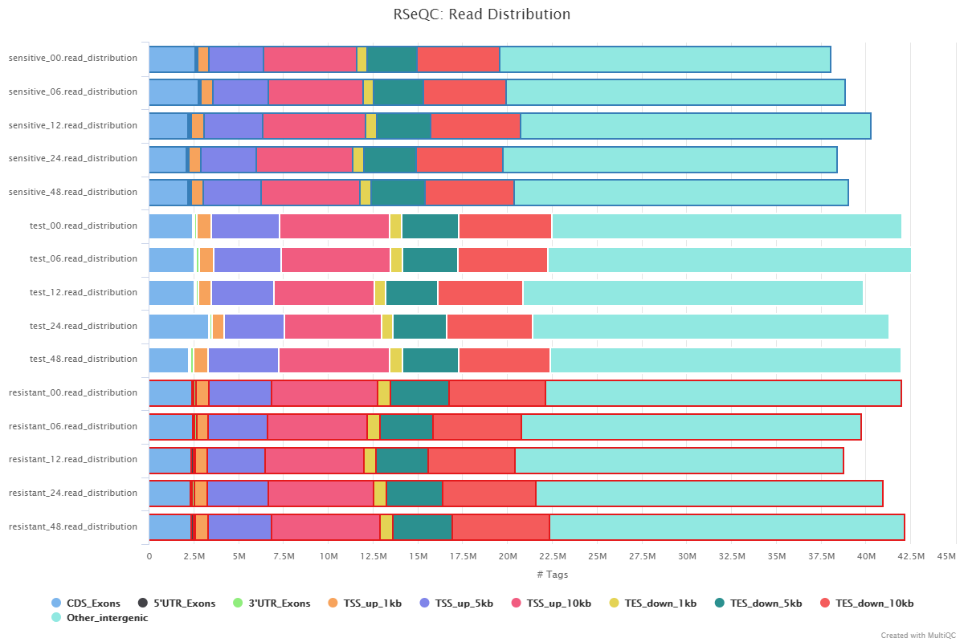
Quality Control
Sensitive
Resistant
Only small portion of reads are mapped to CDS, number around 2.5M each sample

Slide 13
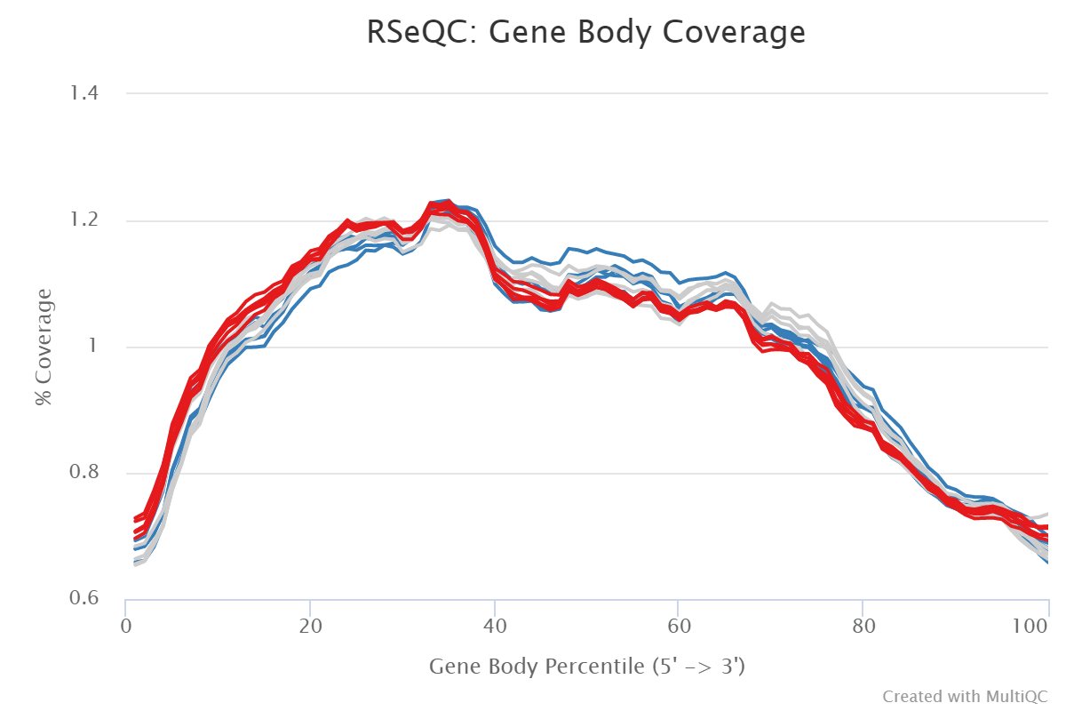
Quality Control
Sensitive
Resistant
No distinct bias observed

Slide 14
Background
Quality Control
Analysis
Conclusion

Slide 15
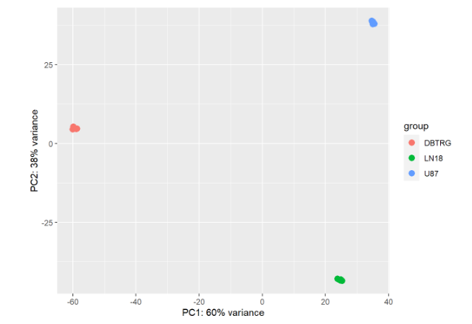
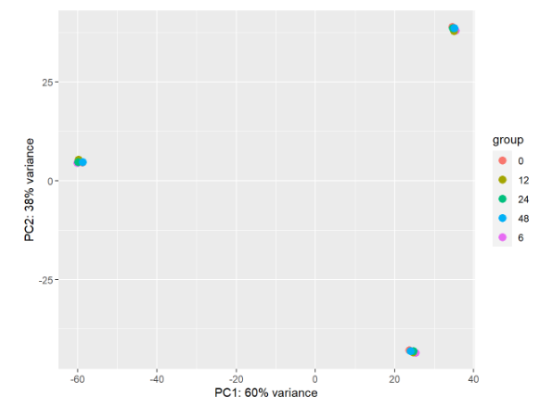
Analysis - PCA
An overall PCA cannot distinguish time-course difference between cell lines

Slide 16
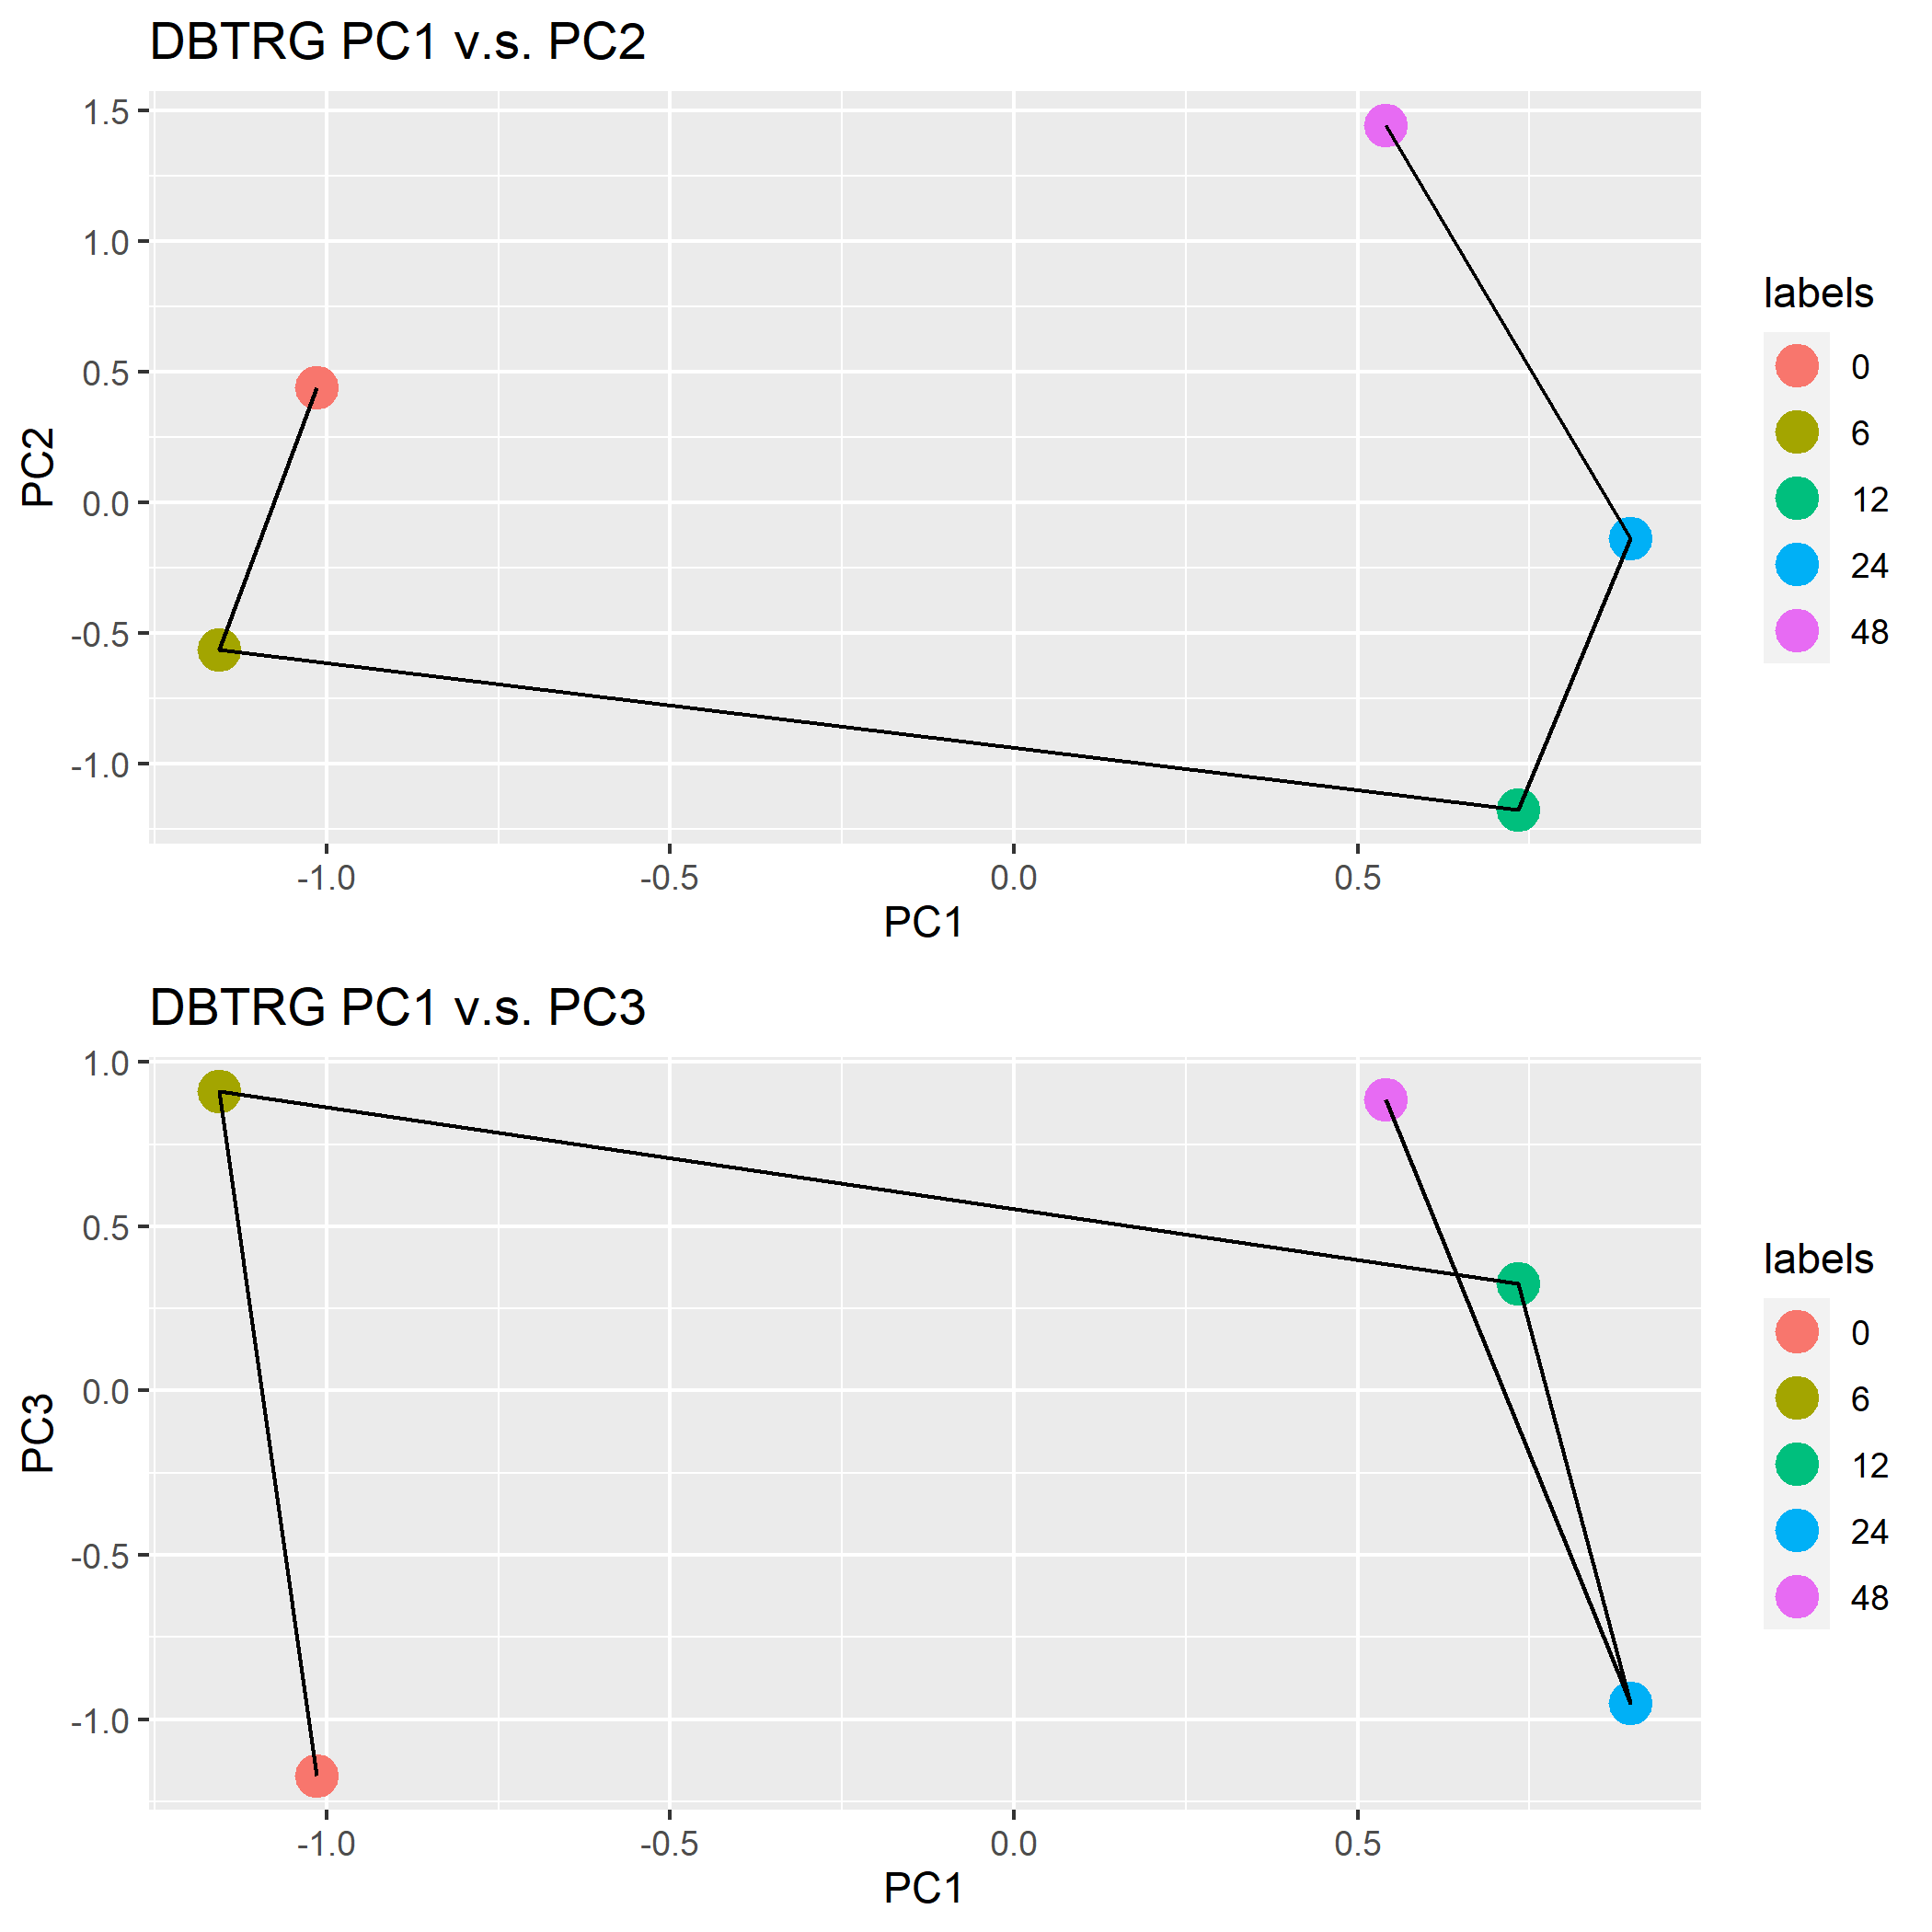
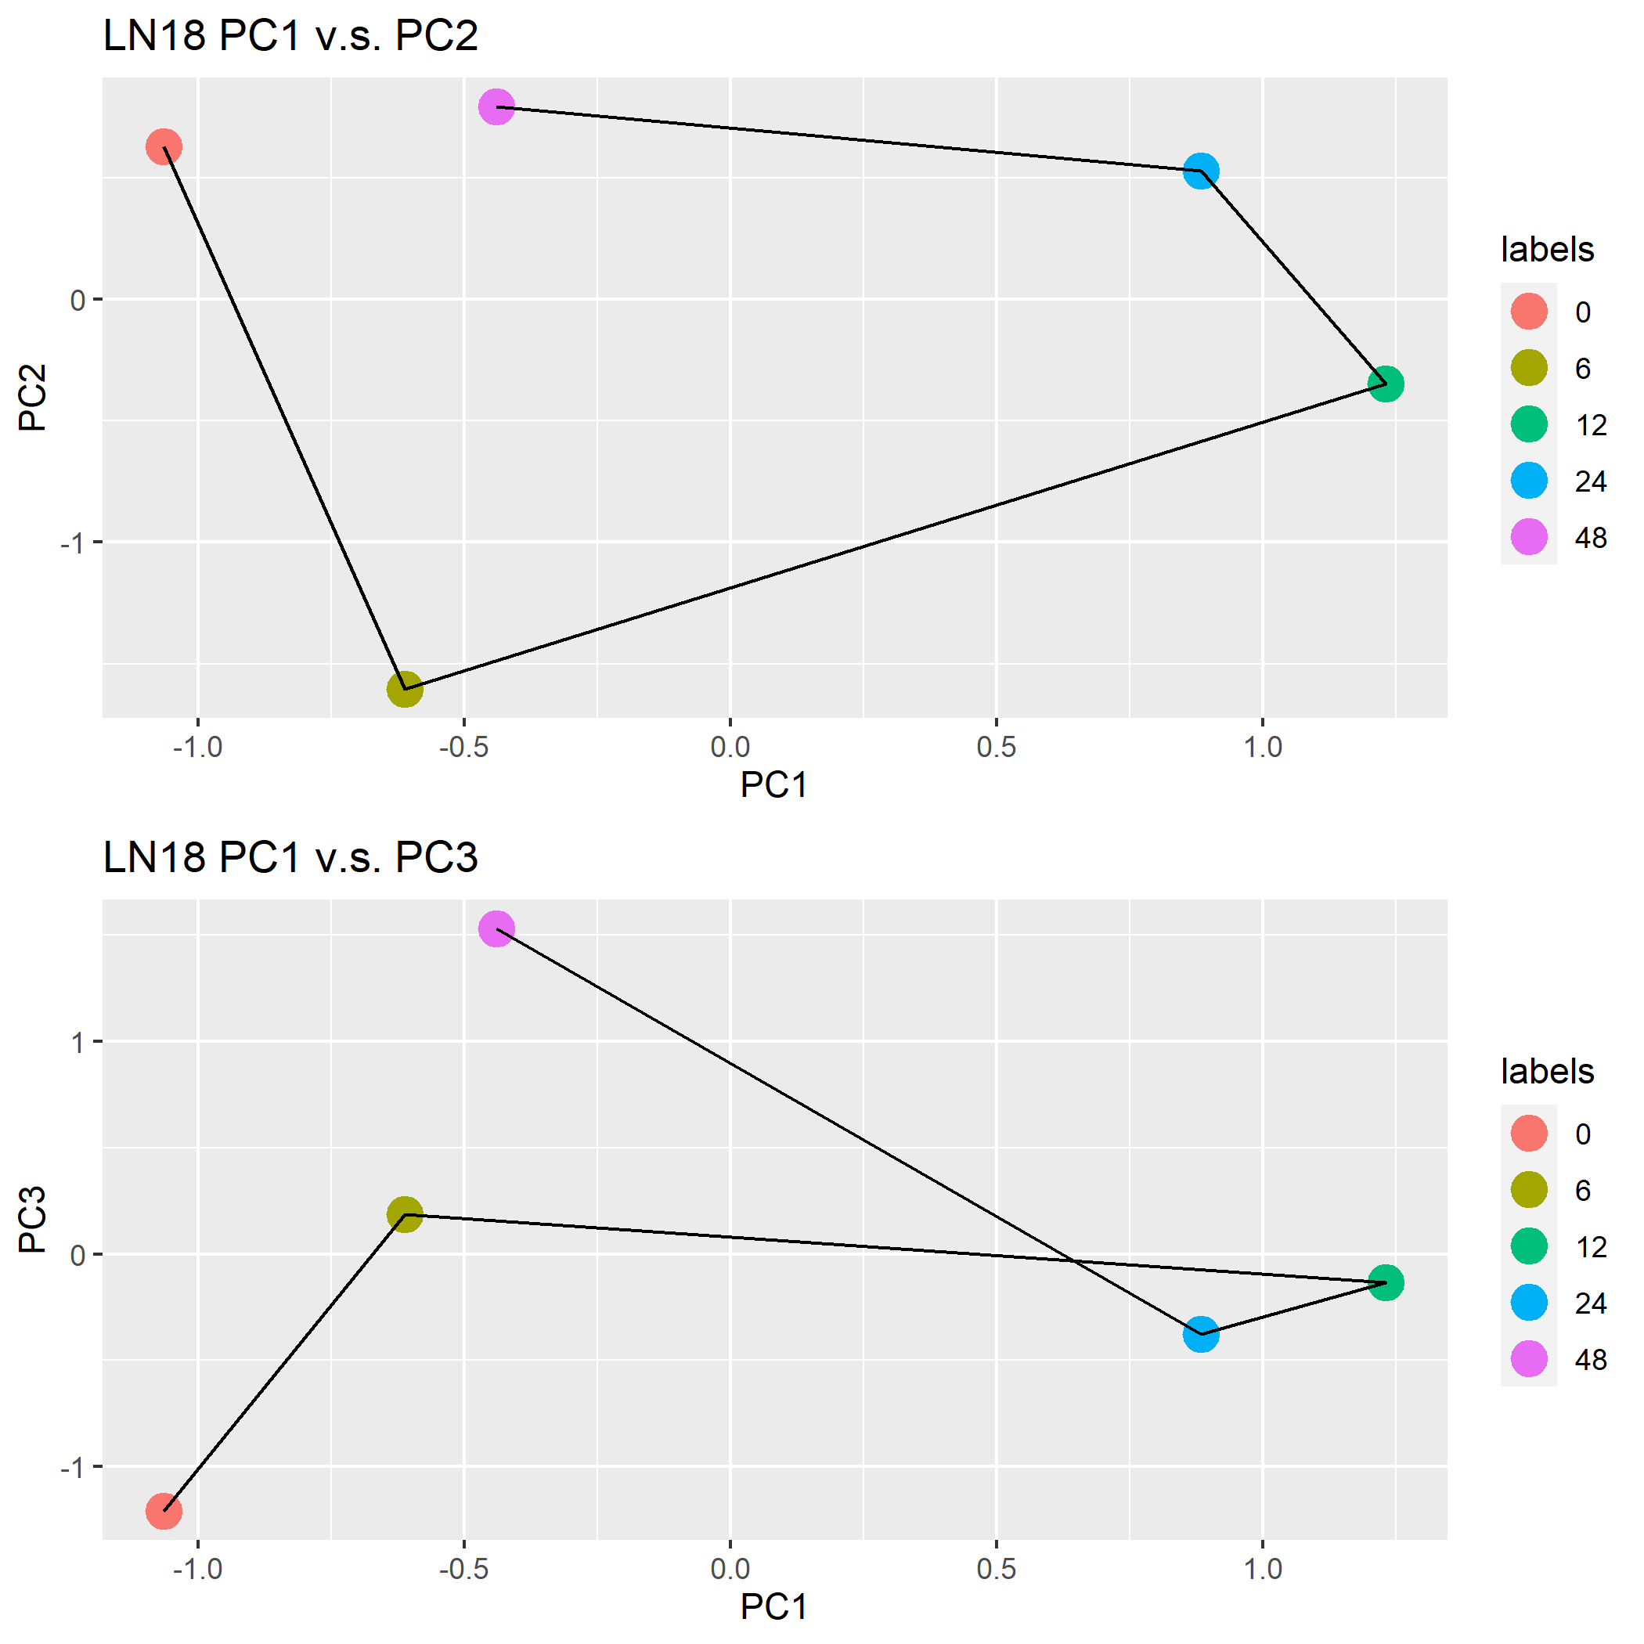
Analysis - PCA
Sensitive
Resistant
Resistant cell has a tendency of going back to the original state (position)

Slide 17
Analysis - TCG
Select TCGs (temporally changing genes)
Two conditions (threshold set empirically):
Max counts across time larger than 10
fold change within a gene larger than 5
max > 10
Counts
fold change > 5
Time

Slide 18
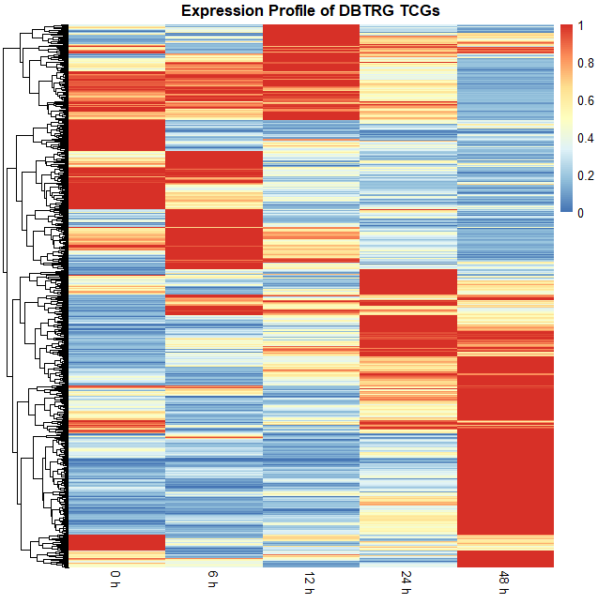
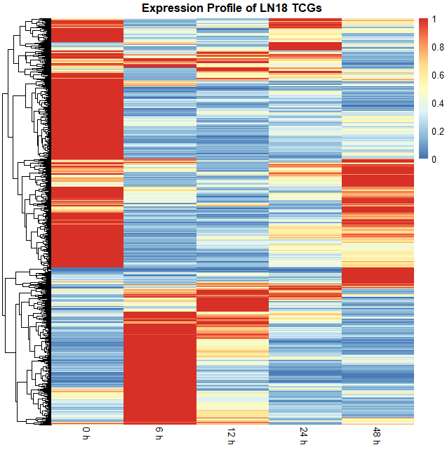
Analysis - heatmap
Sensitive
Resistant
values scaled:
divided by the max
expression level
~ 1100 TCGs
~ 1300 TCGs
Different expression profiles across time

Slide 19
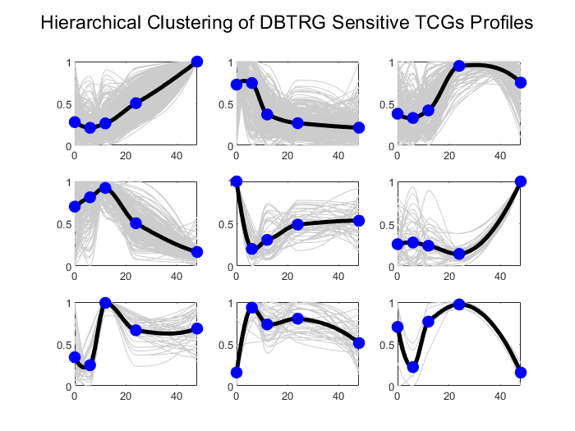
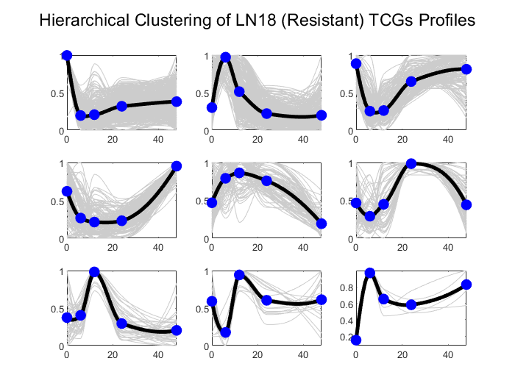
Analysis - hier clustering
( )
Expression profiles show that expression of resistant cells approach closer to the baseline expression after treatment, although oscillation can be observed in both cells

Slide 20
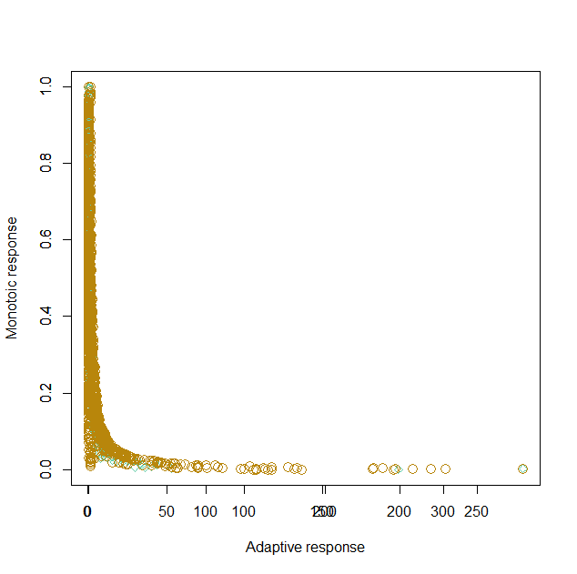
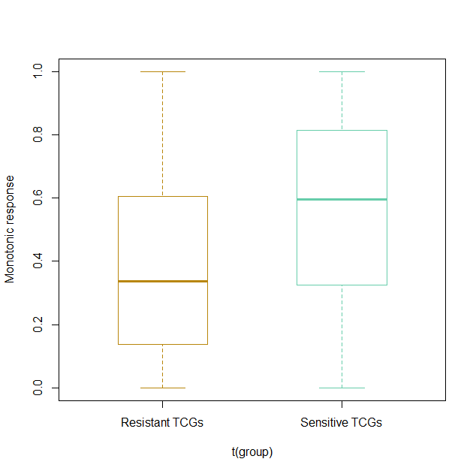
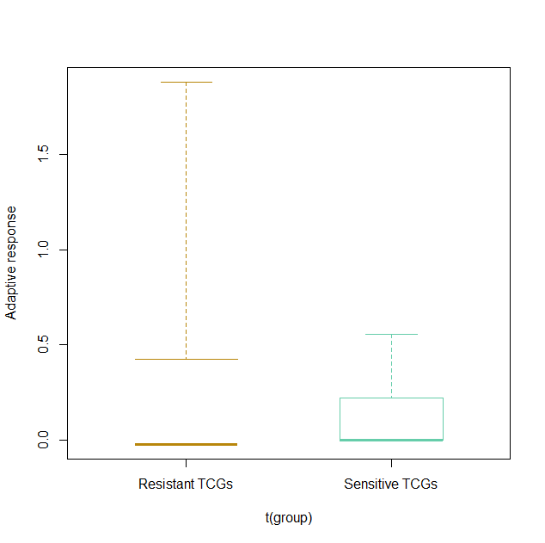
Analysis - Monotonicity v.s. Adaptive scores
Mono: end point / max point
Adaptive: max change / (end – start)
Sensitive
Resistant
No significant difference on Adaptive score by Wilcox test
Hard to captured the higher adaptive scores of resistant cells

Slide 21
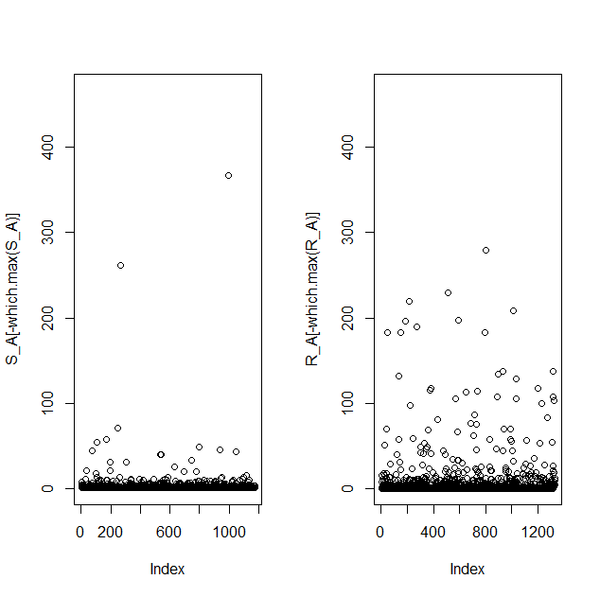
Analysis - Monotonicity v.s. Adaptive scores
Sensitive Adaptive Scores
Resistant Adaptive Scores
Sensitive
Resistant
Difference can be observed between two cells on adaptive scores

Slide 22
Background
Quality Control
Analysis
Conclusion

Slide 23
Conclusion
Gene expression profiles are different between drug-sensitive and -resistant cells
Differences cannot be captured by PCA on overall genes expression, but different patterns can be shown by PCA across genes within different cell lines
To avoid obscuration by other genes, select TCGs, which could be potentially responsible for drug resistance
Heatmap and clustered gene expression curves shows different expression profiles
Difference on monotonicity and adaptive scores measurement

Slide 24
THANK YOU
Q & A

Slide 25
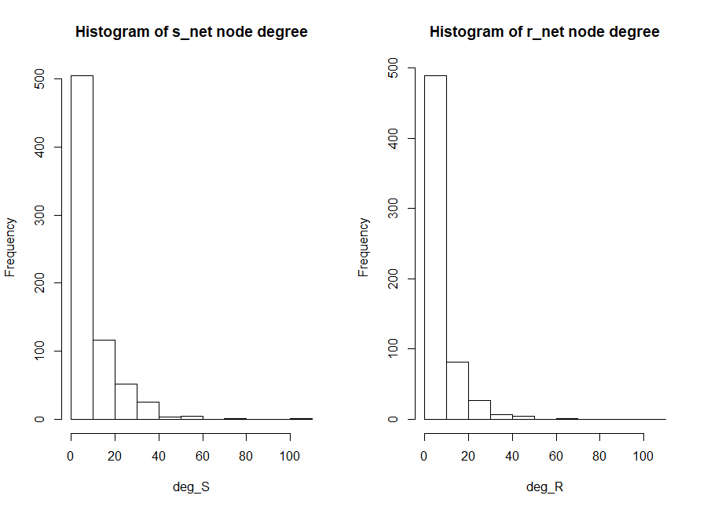
After Building the network, node degrees are measured
Higher degree is expected in resistant network
but not shown in the figure

Slide 26
Raw Data Quality Control Summary
High overall sequencing quality
Reasonable duplication level
Low overrepresented reads portion
No adapters detected (figures not shown)
Sample resistant_48_R1 has unrecognized based due to sequencer problems
Whether this problem would badly influence alignment should be carefully checked !

Slide 27
Alignment Quality Control Summary
High mapping rate
No obvious 5’ and 3’ bias observed
Based on the alignment results, sample resistant_48_R1 could be retained for further analysis
Low CDS mapping reads
Total reads around 2.5M for each sample would be enough for feature counting, thanks to
a high sequencing depth

