Slide 1
BCSE203E
Web Programming
ExpenseTracker
A Personal Finance Management Dashboard
24BCE2753 George Christian Mathew
April 2026

Slide 2
Table of Contents
1
Introduction
2
Idea of the Project
3
Tech Stack
4
Workflow
5
Outputs
6
Conclusions

Slide 3
Introduction
ExpenseTracker is a full-featured Personal Finance Management Dashboard built as a web application using vanilla HTML, CSS, and JavaScript.
The application enables users to:
• Track both income and expenses with categorized transactions
• Set and monitor monthly budgets per category with visual progress bars
• Visualize spending patterns through interactive charts (Chart.js)
• Get AI-powered Smart Insights about their financial habits
• Toggle between Dark and Light themes for comfortable usage
• Export transaction data to CSV for external analysis
The project demonstrates advanced frontend concepts including state management, data persistence via localStorage, dynamic DOM manipulation, responsive design, and user authentication.

Slide 4
Idea of the Project
Problem Statement:
Managing personal finances is a challenge for students and young professionals. Most available tools are either overly complex or require paid subscriptions.
Solution:
ExpenseTracker provides a simple yet powerful browser-based finance tracker that runs entirely in the browser with no backend required.
Key Goals:
✦ Make expense tracking effortless with a clean, modern UI
✦ Provide visual analytics to help users understand spending patterns
✦ Support income tracking and savings calculation
✦ Allow budget setting with real-time overspend warnings
✦ Generate automatic Smart Insights for data-driven decisions
✦ Ensure data persistence across browser sessions using localStorage
✦ Support multi-user authentication with separate data per user

Slide 5
Tech Stack
HTML5
Semantic structure, forms, modals, multi-page navigation
CSS3
CSS Variables, Flexbox, Grid, animations, responsive design, dark/light themes
JavaScript (ES6+)
DOM manipulation, event handling, localStorage, data processing, Chart.js integration
Chart.js
Doughnut charts for category breakdown, bar charts for monthly trends
Google Fonts (Inter)
Modern, professional typography
localStorage API
Client-side data persistence for expenses, budgets, user auth, and theme preferences

Slide 6
Workflow
1
User Authentication
User signs up or logs in → credentials stored in localStorage
2
Dashboard Overview
View Balance, Income, Expenses summary → Smart Insights auto-generated
3
Add Transactions
Toggle Income/Expense → fill form → data saved to localStorage → UI updates
4
Filter & Manage
Filter by type, category, date period → Sort → Edit/Delete → Export CSV
5
Budget Tracking
Set monthly limits per category → progress bars show usage → alerts on overspend
6
Analytics
Category pie chart + Monthly trend bar chart → breakdown with percentages

Slide 7
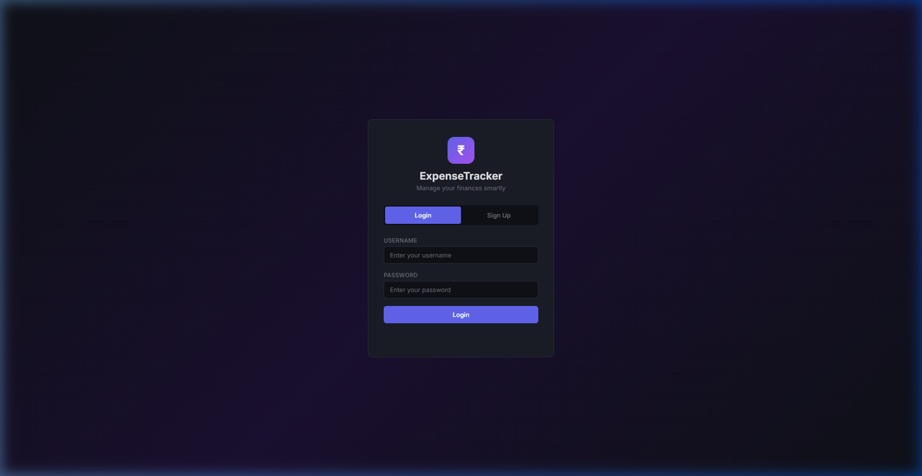
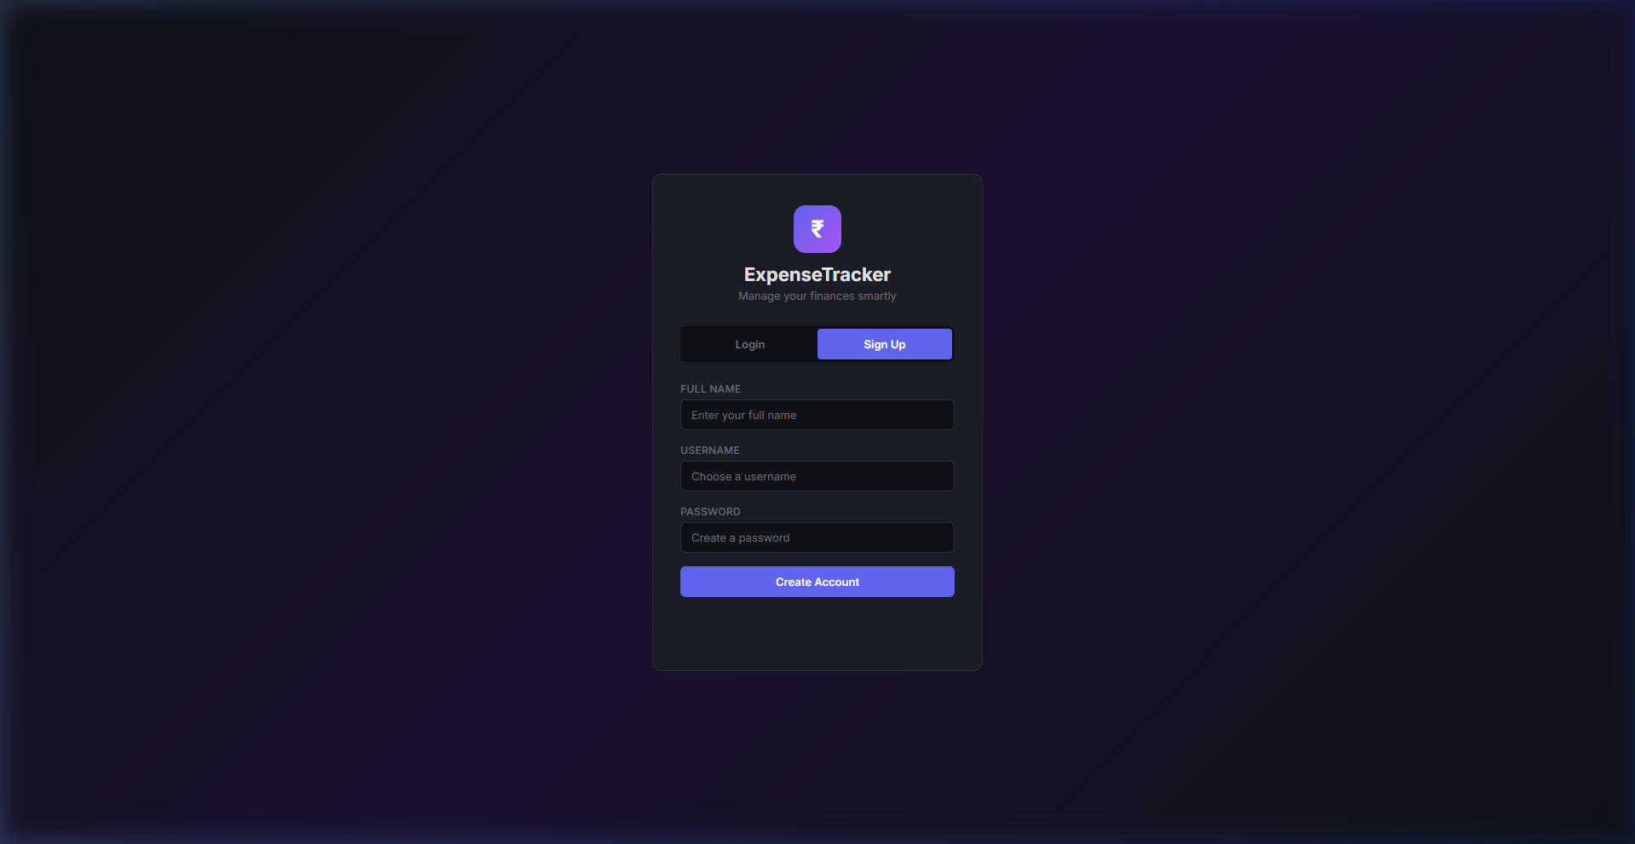
Output — Login & Signup
Login Page
Signup Page

Slide 8
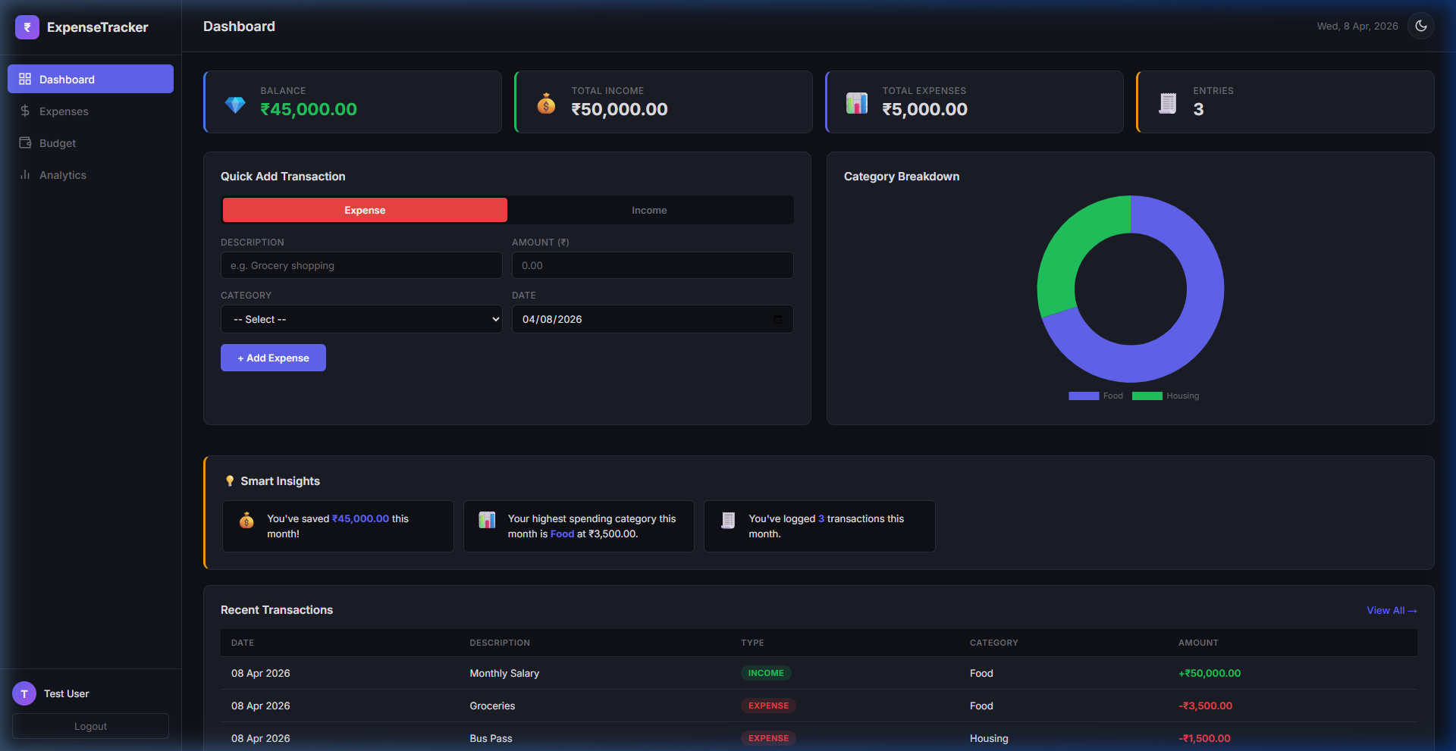
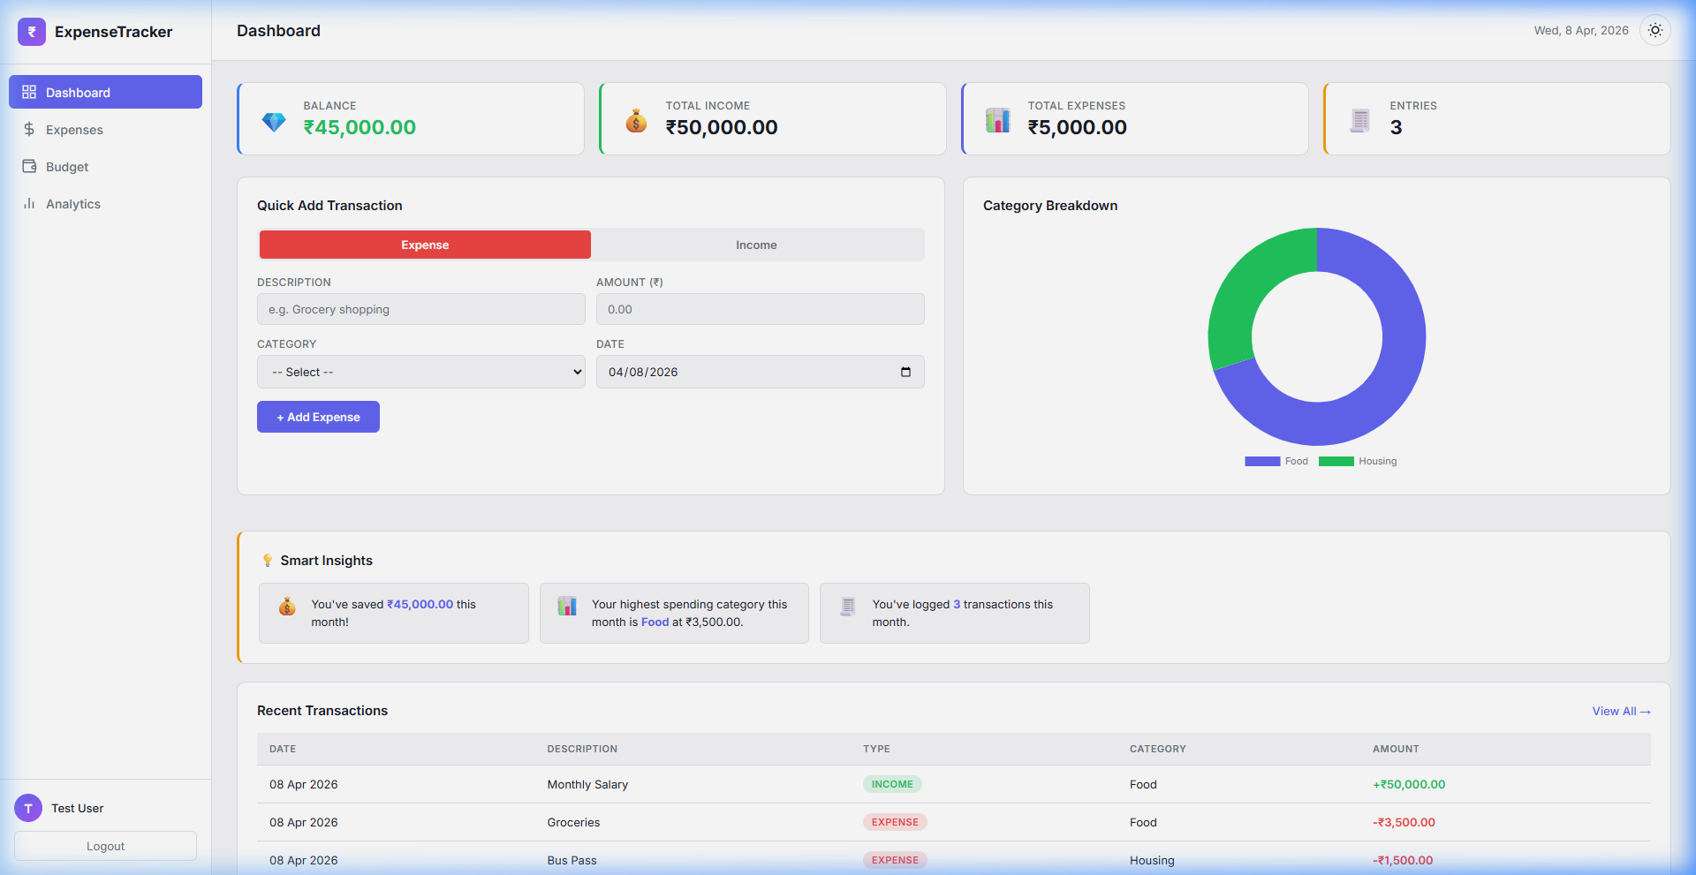
Output — Dashboard
Dark Mode
Light Mode

Slide 9
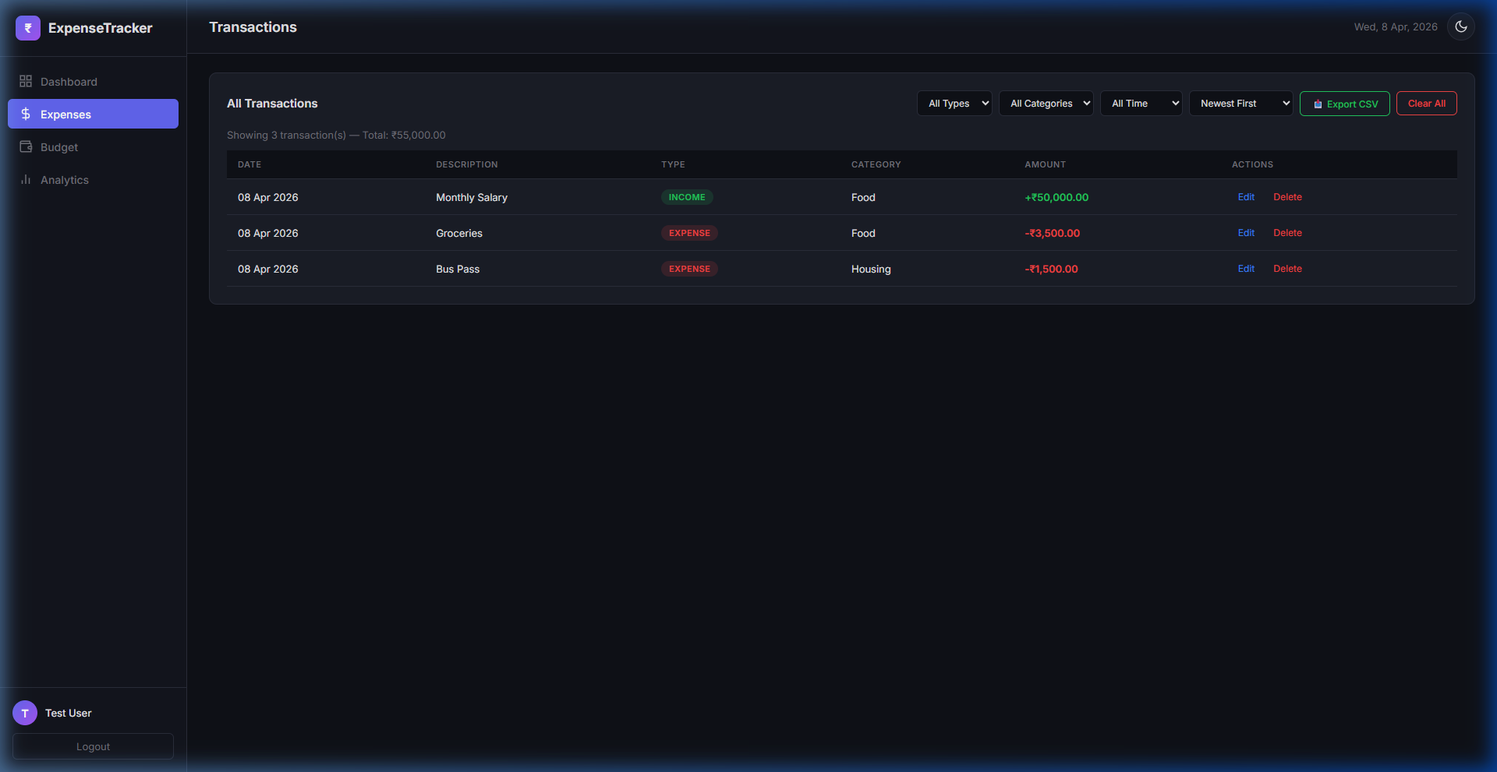
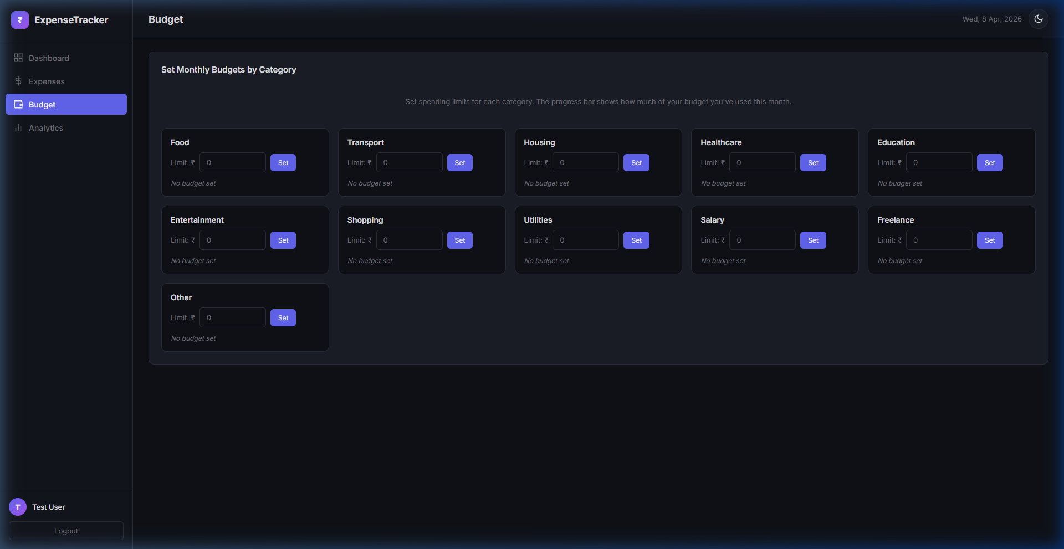
Output — Transactions & Budget
Transactions Page
Budget Page

Slide 10
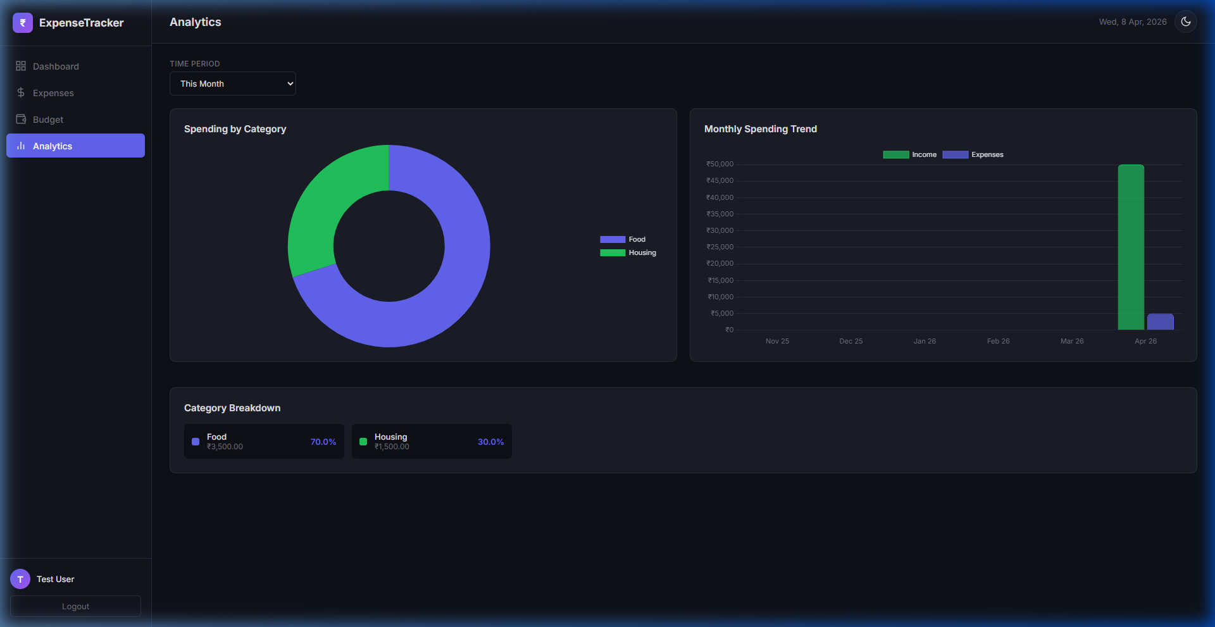
Output — Analytics
Analytics Dashboard

Slide 11
Conclusions
Successfully built a complete Personal Finance Management Dashboard using only HTML, CSS, and JavaScript — no frameworks or backend required.
Key achievements include:
✦ Full CRUD operations on transactions (Create, Read, Update, Delete)
✦ Income + Expense tracking with automatic Balance calculation
✦ Category-based budget management with visual progress indicators
✦ Interactive data visualization using Chart.js (Pie + Bar charts)
✦ Smart Insights engine providing automated financial analysis
✦ Dark/Light theme toggle with persistent user preference
✦ CSV Export functionality for data portability
✦ Multi-user authentication with separate data isolation
✦ Responsive design working across desktop and mobile devices
The project demonstrates strong fundamentals in DOM manipulation, state management, event-driven programming, CSS theming, and client-side data persistence.

Slide 12
Thank You!
github.com/georgedotdev/Expense-Tracker

