Slide 1
Sales and Marketing
Prepared by : George Adel

Slide 2
Dataset Shape
Rows: 15,000
Columns: 30
https://www.kaggle.com/datasets/bhaskerpaul/sales-and-marketing-dataset?utm_source=chatgpt.com

Slide 3
Business Problem
Customer churn
The goal of this dataset is to help answer questions like:
Why do customers churn?
Which customers are most likely to churn?
Which acquisition channels bring the highest lifetime value?
How does customer satisfaction impact revenue?
Which marketing strategies reduce churn?

Slide 4
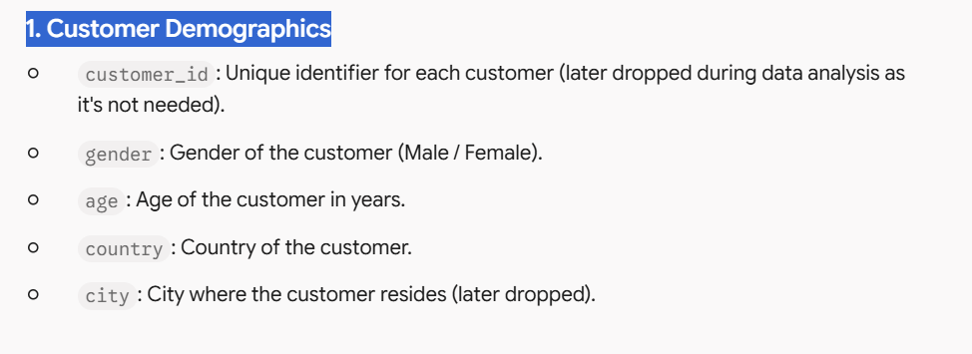
Columns
1. Customer Demographics

Slide 5
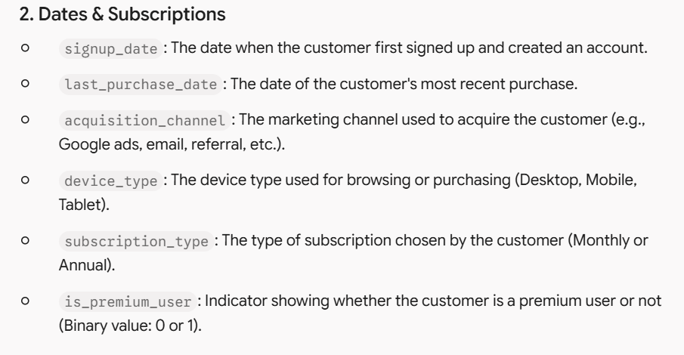

Slide 6
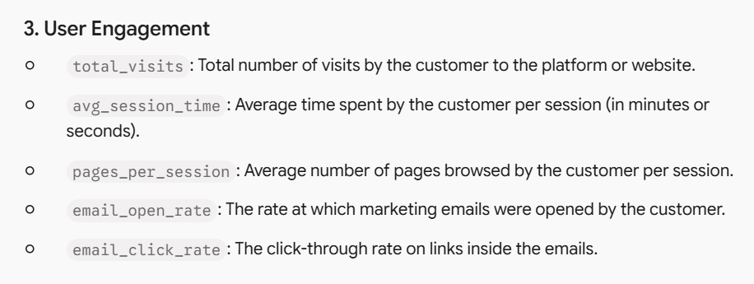

Slide 7
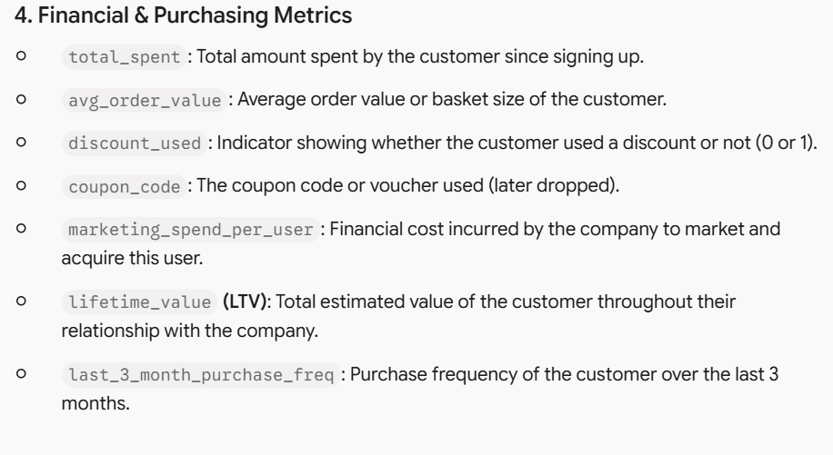

Slide 8
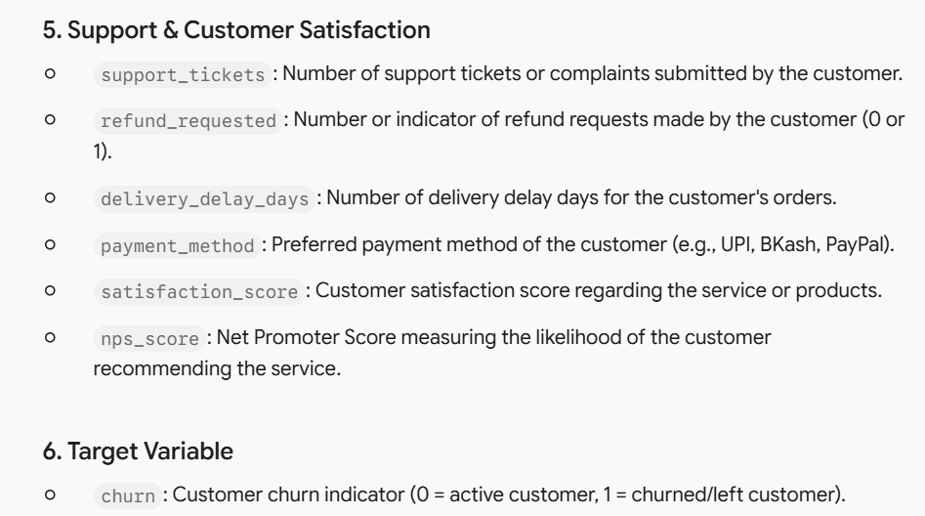

Slide 9
Librairies
1- Numpy
2- Pandas
3- Plotly
4- Streamlit

Slide 10
Missing Values (NAs)
1- Use the average for the numerical columns (Age/ Total spent)
2- Use the mode for the ordinal and categorial values (Gender/Satisfaction Score)

Slide 11
Outliers
1- Gender (Replace « Others » by the mode)
2- Age (remove the unlogic ages less than 18 rows)
3- Total spent (Expand the quantile percentage 0.99)

Slide 12
Removed columns
1- Customer ID (Doesn’t impact the study)
2- Coupon Code (41% missing value and very low impact on study)
3- City inconsistent with country

Slide 13
Data Modification And Feature Engineering
1- Transforming the « SignUp_Date » and « Last Purchase Date » from object to Date time
2- Modify the dates by making the SignUp Date less than or equal to last purchase date
3- Extract new column (Customer tenure days) by making last purchase date (-) SignUp Date

Slide 14
EDA Analysis
https://salesmarketingcleaned-n2zaorxamdusvyqseygfnl.streamlit.app/

Slide 15
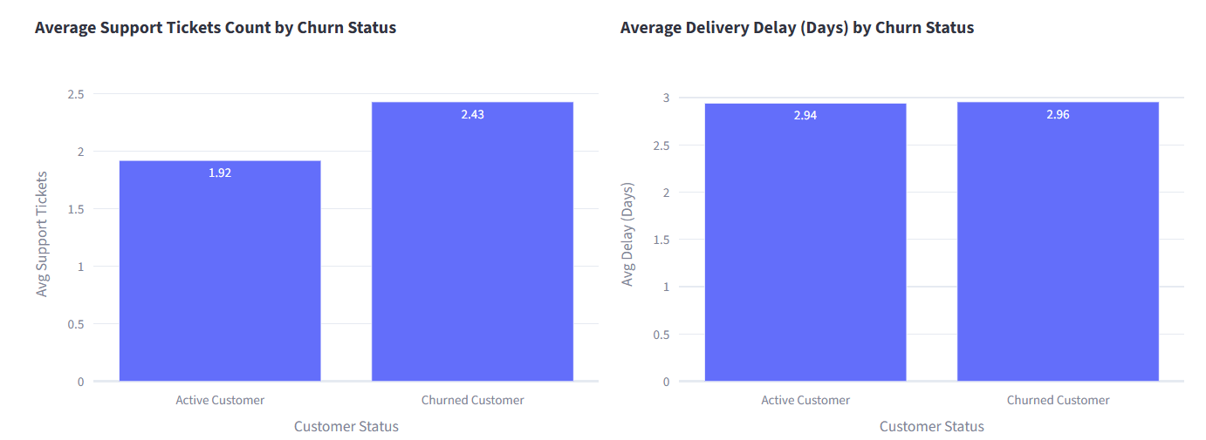
Why do customers churn?
Answer: Customers typically leave due to frequent support issues, recurrent delivery delays, or pending refund requests reflecting dissatisfaction.

Slide 16
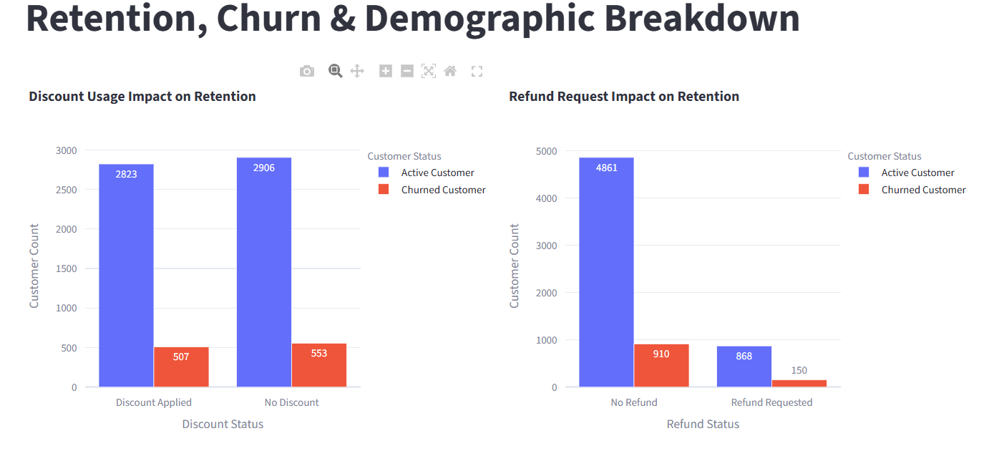
Which customers are most likely to churn?
Answer: Customers on monthly plans (due to lack of long-term commitment), those with low satisfaction scores, or those who experienced recurring delays and order issues.

Slide 17
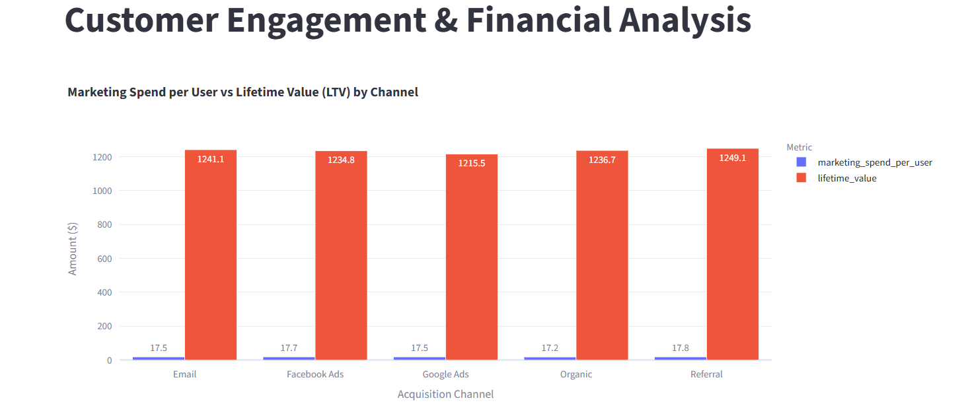
Which acquisition channels bring the highest lifetime value?
Answer: You can find the answer directly from the chart comparing marketing spend per user and lifetime value (LTV) across marketing channels (such as Google Ads, Facebook, Email, Referral) to identify the most profitable long-term channel.

Slide 18
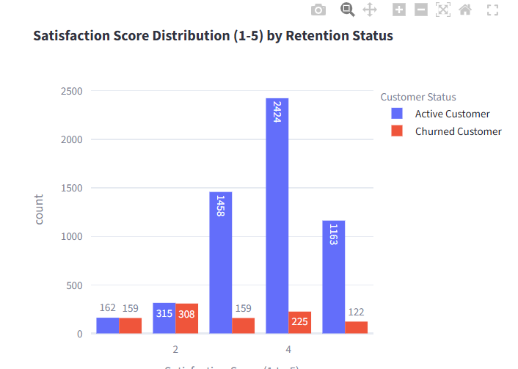
How does customer satisfaction impact revenue?
Answer: Customer satisfaction directly impacts revenue by driving long-term customer value and retention.

Slide 19
Which marketing strategies reduce churn?
Answer: Strategies focused on improving user experience, offering effective and well-planned discounts (Discount Usage Impact on Retention), and encouraging transitions from monthly to annual plans to ensure customer loyalty and continuity.

Slide 20
With pleasure
Thank You

