Slide 1
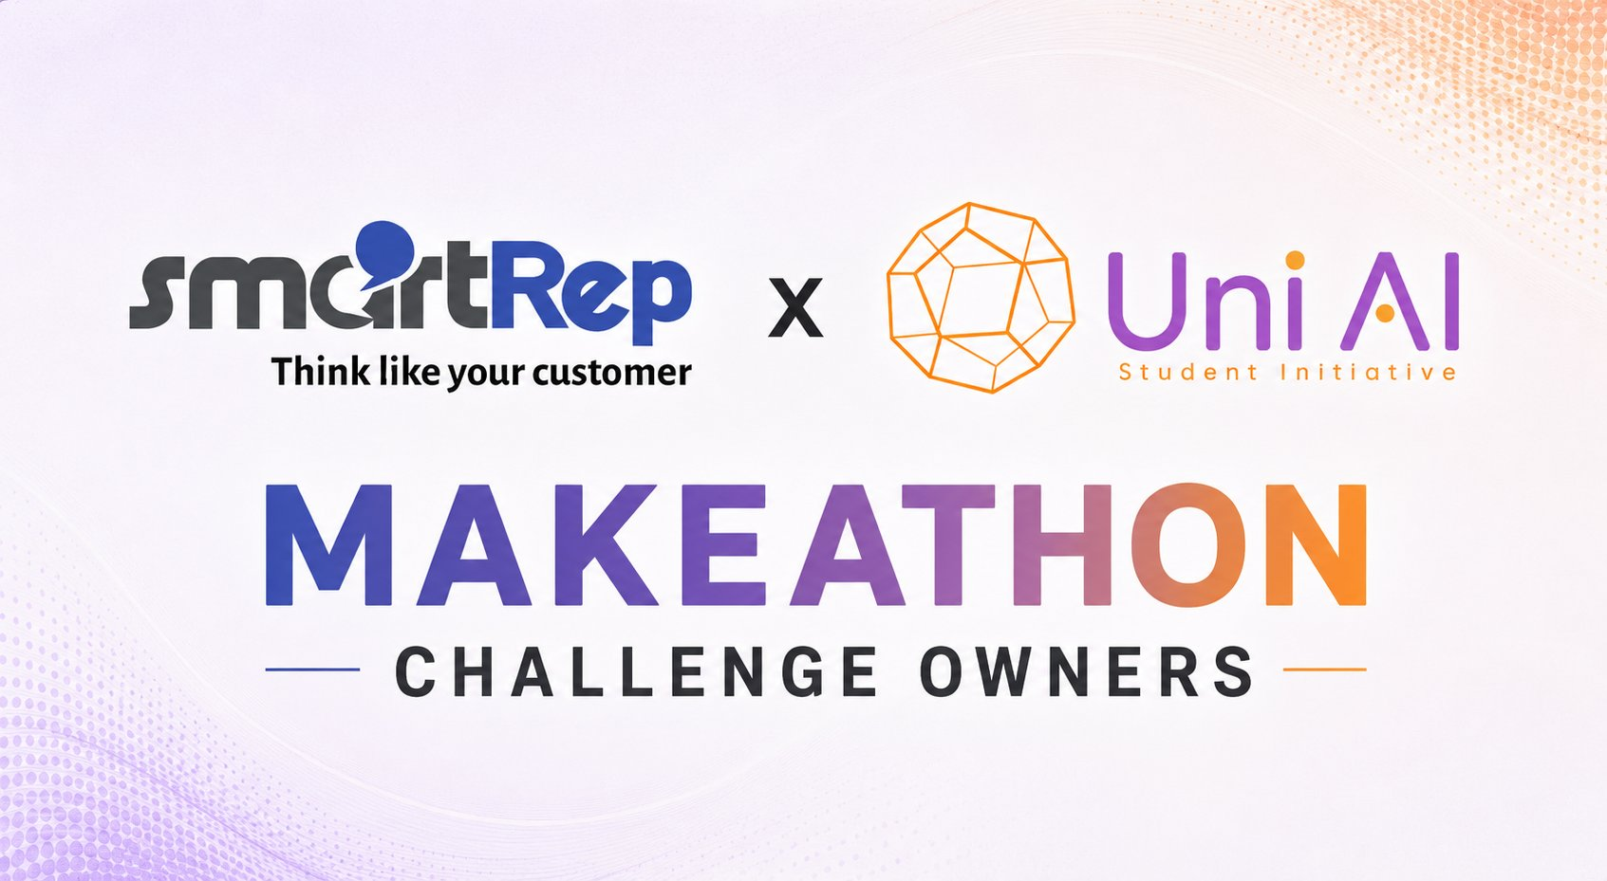

Slide 2
The Challenge
Build a system that turns natural-language questions into dashboard components
"Show me a pie chart of Greek vs English users."
"How is the bot doing this week?"
→ Working pie chart. Instantly.
→ Multi-metric overview. No SQL required.
Works for any question a real ops or product person might ask:
Distributions
Trends
Rankings
Anomaly hunts
Open-ended checks
In English or Greek

Slide 3
What You're Given
conversations.duckdb
conversations.jsonl
data/schema.md
90-day synthetic dataset — ~10,000 banking voicebot conversations. Flat SQL-ready views, pre-built for every team.
The same dataset as raw nested JSON. Great for exploratory processing or custom parsing pipelines.
The column dictionary. The single most important reference document for understanding the data.
data/metrics_dictionary.md
starter/
Canonical definitions for containment rate, CSAT, AHT, and all other KPIs. All teams compute the same metrics.
A small worked example you can crib from or ignore entirely. Optional but useful for a fast start.
⚠️ Every team works from the exact same pre-built dataset. Do not regenerate or modify it.

Slide 4
EXAMPLE
From Query to Dashboard
User Query
Dashboard Output
“Show me containment rate
by intent type this week”
Containment Rate by Intent — Last 7 Days
→
NR2Dashboard → interprets query → generates SQL → renders chart
Purple = above 85% threshold • Orange = needs attention • Threshold: 85%

Slide 5
What You Build
Anything that takes a natural-language question and produces dashboard components. The form is entirely up to you.
CLI Tool
Jupyter Notebook
Streamlit App
FastAPI + React
Desktop App
Python Script
A live UI is strongly recommended — something that lets a judge type a query and see results in real time wins.

Slide 6
Possible Architectures
Tool-Calling
Spec Generation
LLM chooses from create_pie_chart, create_bar_chart, etc.
LLM emits Vega-Lite or a similar declarative spec.
✓ Reliable · Easy to validate · Easy to extend
✓ Flexible · Type-safe · Renders cleanly
SQL + Chart Inference
Code Generation
LLM emits SQL against DuckDB plus a chart type.
LLM emits React/Recharts code, sandbox-rendered.
✓ Pairs naturally with the dataset
✓ Maximum flexibility · Biggest blast radius
Pick the one your team can ship.

Slide 7
The Dataset
90
~10K
2
days
convos
langs
Synthetic voicebot data
Banking conversations
Greek & English
Key features:
Nested JSON + flat DuckDB views — pick your preferred access pattern
Metrics: Containment Rate, CSAT, AHT (Average Handle Time) & more
Rich enough for distributions, trends, anomaly detection, and rankings
Pre-built for the event — consistent data for every competing team

Slide 8
Rules & Constraints
ALLOWED
NOT ALLOWED
✓ Use the dataset as-is — no regeneration, no outside data
✗ Hard-coded lookup tables ("if query contains X → return Y")
✓ Respect metric definitions from metrics_dictionary.md
✗ Modifying or regenerating the dataset
✓ All code under a permissive license (MIT / Apache / BSD)
✗ Bringing in external data sources
✓ Pretrained & API-served LLMs are allowed
✓ Pre-trained NL-to-SQL adapters are allowed
Quick Start
git clone https://github.com/SmartRepOrg/makeathon-NR2Dashboard && cd makeathon-NR2Dashboard

Slide 9
Good Luck.
Build something you'd actually want to use Monday morning.
Think
Build
Ship
github.com/SmartRepOrg/makeathon-NR2Dashboard

