Slide 1
Documenting Software

Slide 2
Things to consider when writing documentation
Consider your audience – is the documentation intended for programmers to read, or is it for users of your software?
What format suits your documentation best, and how to make it accessible to whoever needs to read it?
It’s likely that you’ll need multiple types of documentation for a project. Don’t try to write all your documentation in one place if it makes more sense to split it up.

Slide 3
Documentation for software users
Even the best designed software may not always be easy to learn how to use. It is a good idea to include documentation when you distribute software to teach the user how to use it.
User documentation can sometimes be difficult to write, as you already know how your software works so it can be hard to imagine how the user will approach using the software.
The best format for user documentation will depend on the type and distribution method of the software.
Software that is distributed via physical discs often come with a user manual booklet. Software distributed digitally may include the manual as a downloadable PDF, or smaller programs may just include a readme file. Open source software may host its documentation on GitHub.
Sometimes it is easier to show how to use software, rather than explain it. Consider including pictures, or even videos if you have your user documentation in digital form.
Games often have a manual explaining how to play the game, but also usually have a tutorial that the player can play to be given a guided walkthrough of some easy gameplay.

Slide 4
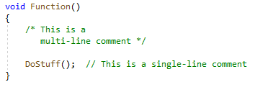
Comments
Comments are the simplest form of documentation for code. Comments are written inside of the code file, but are ignored when running the program.
They can be used to explain how code works when it may not be obvious, or to include information that will be useful for other programmers who read or edit your code.
Different languages have different ways of writing comments. In C# you can start a comment with a double forward-slash (//). Everything after this on the same line will be part of the comment.
You can also have comments that span multiple lines by starting the comment with /* and ending with */.

Slide 5
Self-documenting code
Self-documenting code is code that is purposefully written to be easy to understand.
Because it is easy to understand, it doesn’t need separate documentation to explain what it does, the code itself is enough to document what it does and how it works.
Read this article for some suggestions on ways to make code more self-documenting: https://multi-programming.com/blog/self-documenting-code
Usually it is not possible to avoid writing documentation completely, but code that is written to be self-documenting can reduce the amount of documentation that needs to be written.
It also makes it easier for programmers to collaborate, because they will spend less time trying to understand each-other’s code.

Slide 6
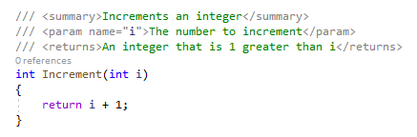
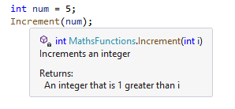
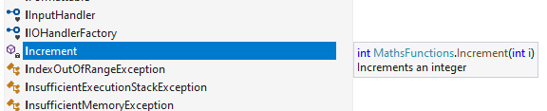
C# - Documentation Comments
Documentation comments (which serve a different purpose to normal comments) are a C# feature that allows you to write detailed descriptions of functions and Visual Studio will show the documentation when hovering over the function call and in the list of suggested functions.
Documentation comments are written in XML. If you are unfamiliar with XML, there is a guide here: https://www.w3schools.com/xml/.
To start a documentation comment you need to use a triple forward-slash (///). The comment uses XML tags to describe parts of the function, such as the summary tag which lets you provide a brief description, the param tag which lets you describe one of the function’s parameters, and the returns tag which lets you specify what will be returned.
The list of tags can be found here: https://docs.microsoft.com/en-us/dotnet/csharp/language-reference/language-specification/documentation-comments.

Slide 7
Doxygen
Doxygen is a tool that converts the C# documentation comments (and similar comments for other languages) into HTML web pages.
This is useful when you are writing code libraries that other people will use.
It generates a webpage for every class in your library and each function is documented. It has search and navigation features to find what you are looking for and because it is web-based it can use hyperlinks.
You can find Doxygen here: https://doxygen.nl/index.html

Slide 8
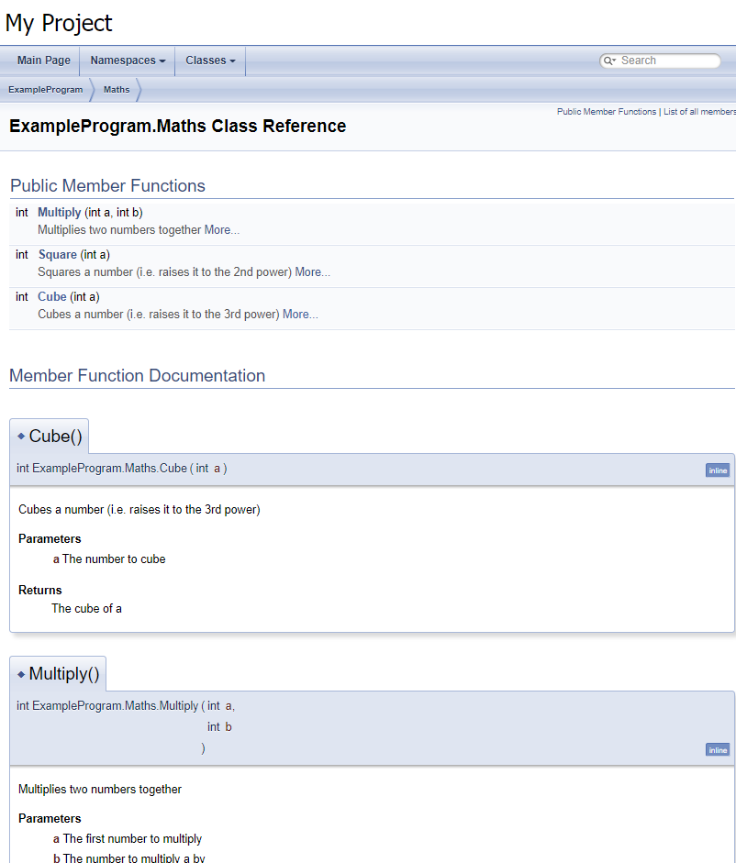
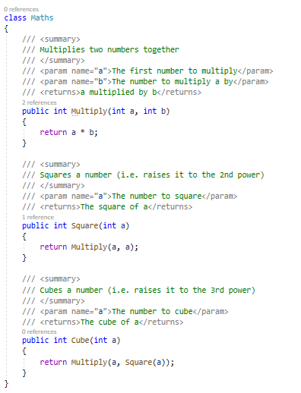
C# code
Doxygen generated webpage

Slide 9
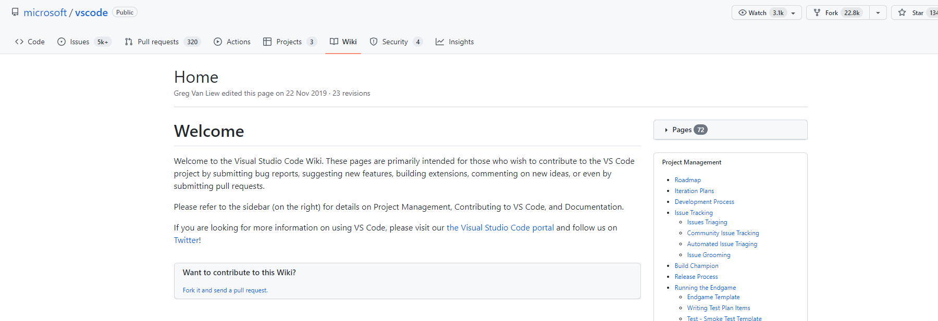
GitHub Wiki
GitHub allows you to create a Wiki for your repository where you can create pages of documentation for your project. This could be documentation for users if GitHub is where users can download your software from, or could be information for programmers, designers, testers, or production information.
Wiki pages are generally unsuitable for documenting specific parts of code, but can be used to explain a more general overview of how features work in code.

Slide 10
Links for reading:
https://www.w3schools.com/cs/cs_comments.php
https://multi-programming.com/blog/self-documenting-code
https://www.w3schools.com/xml/
https://docs.microsoft.com/en-us/dotnet/csharp/language-reference/language-specification/documentation-comments

